Slide 1
Starter
Find the medians of these sets of data:
= 5
= 15
= 95
= 65
1, 6, 5, 3, 8, 5, 4
11, 15, 17, 12, 19
99, 95, 96, 95, 95
72, 78, 54, 54, 64, 66

Slide 2
For the following video clips, you will need to fill in the gaps and answer the questions.
May sure you answer in full sentences.

Slide 3
Please play video 1

Slide 4
Video 1 - Answers
The skateboarder Rick wants to come in the top quarter of competitors. We can use a cumulative frequency graph to look at the scores. There were fifty-six competitors in the whole competition. To complete a cumulative frequency table you need to work out a running total by adding up the numbers in each row. You should always check that the total matches the total number of people in the question. We always plot the cumulative frequency on the vertical axis and the data we are looking at on the horizontal axis. Then plot each point on the end point of each interval with the corresponding cumulative frequency. Lastly join the points up with a smooth curve.

Slide 5
The table below shows the number of minutes 80 students were late for their maths lessons in the autumn term.
Draw a cumulative frequency diagram of the data.
Use it to find the median, lower quartile, upper quartile and interquartile range.
Draw a box plot assuming a minimum time of 0 minutes and a maximum of 25 minutes.
Time ($t$ mins) | Number of Students | Cumulative Frequency
$$0<t≤5$$ | 10
$$5<t≤10$$ | 16
$$10<t≤15$$ | 30
$$15<t≤20$$ | 22
$$20<t≤25$$ | 2
10
26
56
78
80

Slide 6
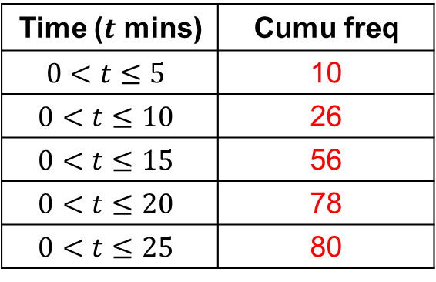
80
$$×$$
$$×$$
Cumulative frequency
60
$$×$$
40
$$×$$
20
$$×$$
0
0
5
10
15
20
$t$ mins
25

Slide 7
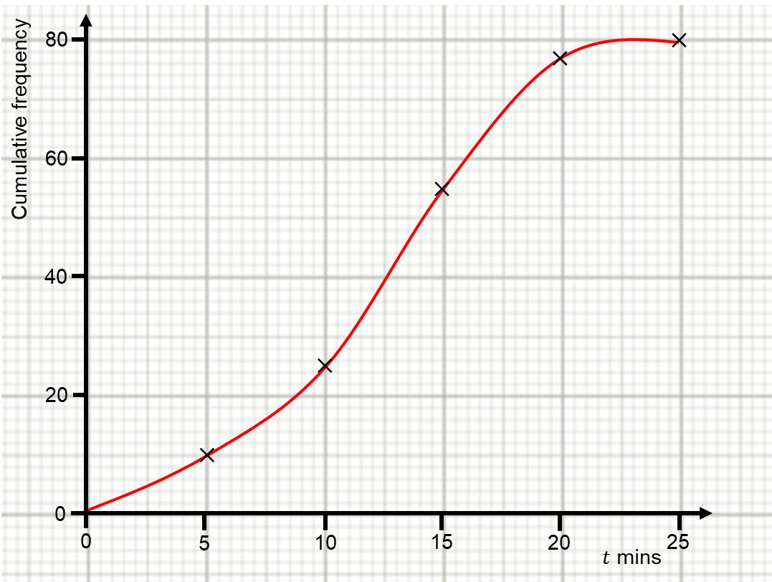
The table below shows the number of minutes 80 students were late for their maths lessons in the autumn term.
Draw a cumulative frequency diagram of the data.
Use it to find the median, lower quartile, upper quartile and interquartile range.
Draw a box plot assuming a minimum time of 0 minutes and a maximum of 25 minutes.

Slide 8
Please play video 2

Slide 9
Video 2 – Answers
Median, lower quartile and upper quartile.
Halfway up the cumulative frequency, across to the graph, then down to the horizontal axis.
No, we can estimate and just use $\frac{n}{2}$ because we’re dealing with large data sets.
Median is $\frac{1}{2}$, LQ is $\frac{1}{4}$ and UQ is $\frac{3}{4}$.
Because he wants to be in the top quarter of competitors.

Slide 10
The table below shows the number of minutes 80 students were late for their maths lessons in the autumn term.
Draw a cumulative frequency diagram of the data.
Use it to find the median, lower quartile, upper quartile and interquartile range.
Draw a box plot assuming a minimum time of 0 minutes and a maximum of 25 minutes.

Slide 11
80
$$×$$
$$×$$
Cumulative frequency
60
Median → 12.5 minutes
Lower quartile → 9 minutes
Upper quartile → 16 minutes
Interquartile range → 16 – 9 = 7 minutes
$$×$$
40
$$×$$
20
$$×$$
0
0
5
10
15
20
$t$ mins
25

Slide 12
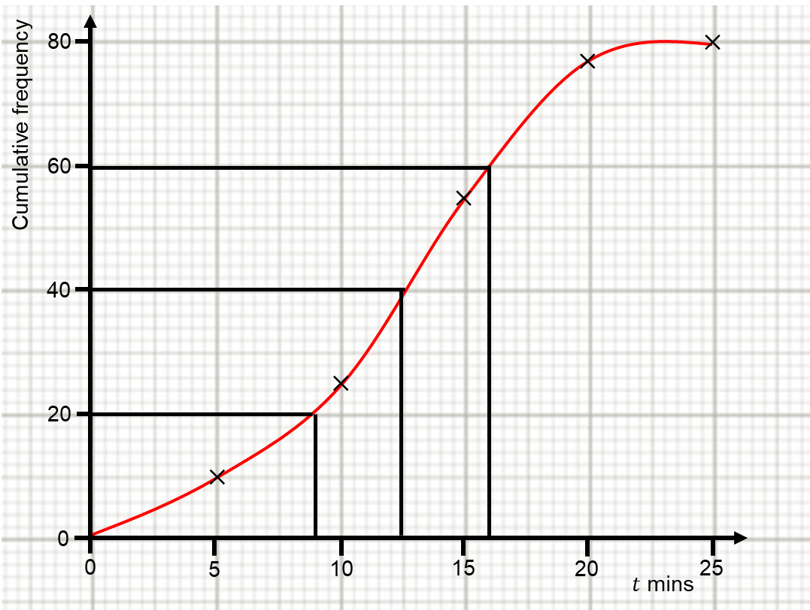
The table below shows the number of minutes 80 students were late for their maths lessons in the autumn term.
Draw a cumulative frequency diagram of the data.
Use it to find the median, lower quartile, upper quartile and interquartile range.
Draw a box plot assuming a minimum time of 0 minutes and a maximum of 25 minutes.
Median → 12.5 minutes
Lower quartile → 9 minutes
Upper quartile → 16 minutes
Interquartile range → 7 minutes

Slide 13
Please play video 3

Slide 14
Video 3 – Answers
50 years.
320
Median, lower quartile and upper quartile.
Minimum and maximum.
Median and interquartile range
Minimum
Maximum
Median
Lower quartile
Upper quartile

Slide 15
The table below shows the number of minutes 80 students were late for their maths lessons in the autumn term.
Draw a cumulative frequency diagram of the data.
Use it to find the median, lower quartile, upper quartile and interquartile range.
Draw a box plot assuming a minimum time of 0 minutes and a maximum of 25 minutes.
Median → 12.5 minutes
Lower quartile → 9 minutes
Upper quartile → 16 minutes
Interquartile range → 7 minutes

Slide 16
Minimum → 0 minutes
Maximum → 25 minutes
Median → 12.5 minutes
Lower quartile → 9 minutes
Upper quartile → 16 minutes
Interquartile range → 7 minutes
0
5
10
15
20
$t$ mins
25

Slide 17
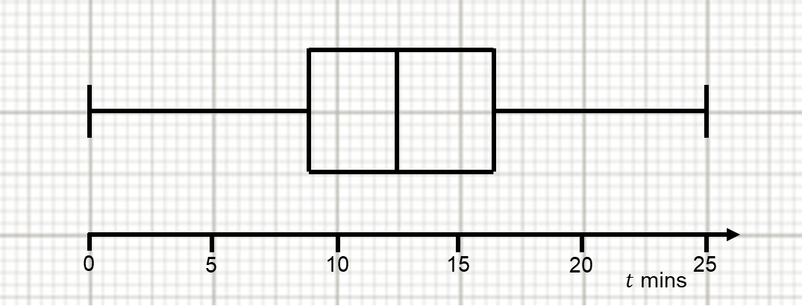
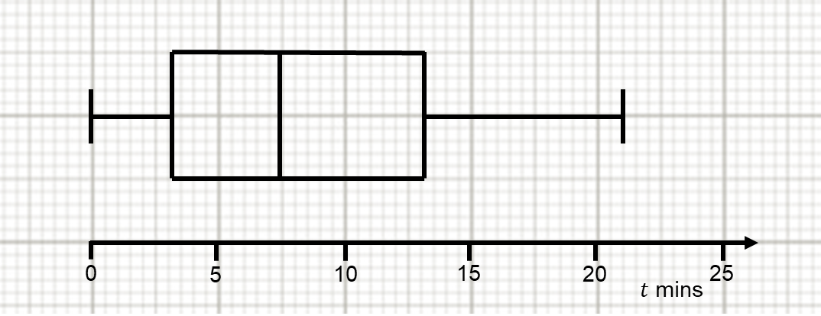
What are the similarities?
What are the differences?
Can you make contextual comparisons?
Autumn term
Spring term

