Slide 1
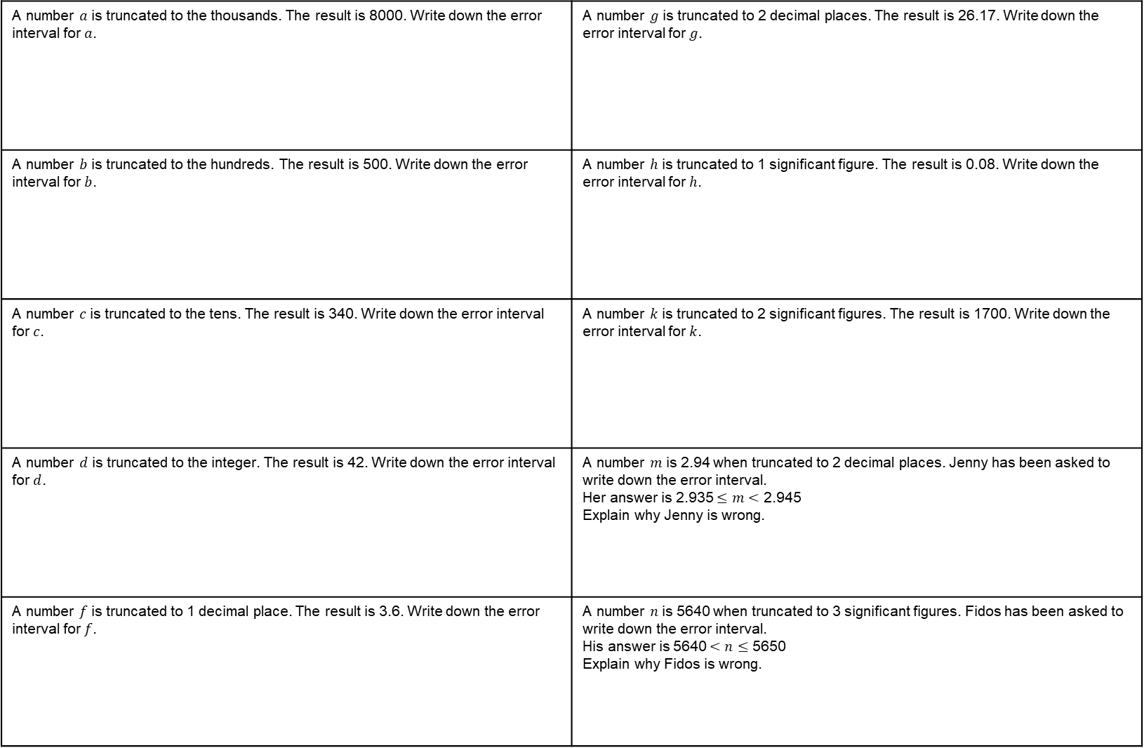
Truncation and Error Intervals GREEN
A number $a$ is truncated to the thousands. The result is 8000. Write down the error interval for $a$. | A number $g$ is truncated to 2 decimal places. The result is 26.17. Write down the error interval for $g$.
A number $b$ is truncated to the hundreds. The result is 500. Write down the error interval for $b$. | A number $h$ is truncated to 1 significant figure. The result is 0.08. Write down the error interval for $h$.
A number $c$ is truncated to the tens. The result is 340. Write down the error interval for $c$. | A number $k$ is truncated to 2 significant figures. The result is 1700. Write down the error interval for $k$.
A number $d$ is truncated to the integer. The result is 42. Write down the error interval for $d$. | A number $m$ is 2.94 when truncated to 2 decimal places. Jenny has been asked to write down the error interval. Her answer is 2.935 $≤m<$ 2.945 Explain why Jenny is wrong.
A number $f$ is truncated to 1 decimal place. The result is 3.6. Write down the error interval for $f$. | A number $n$ is 5640 when truncated to 3 significant figures. Fidos has been asked to write down the error interval. His answer is 5640 $<n≤$ 5650 Explain why Fidos is wrong.

Slide 2
Truncation and Error Intervals AMBER
A number $a$ is truncated to the thousands. The result is 8000. Write down the error interval for $a$. | A number $g$ is truncated to 2 decimal places. The result is 26.17. Write down the error interval for $g$.
A number $b$ is truncated to the hundreds. The result is 500. Write down the error interval for $b$. | A number $h$ is truncated to 1 significant figure. The result is 0.08. Write down the error interval for $h$.
A number $c$ is truncated to the tens. The result is 340. Write down the error interval for $c$. | A number $k$ is truncated to 2 significant figures. The result is 1700. Write down the error interval for $k$.
A number $d$ is truncated to the integer. The result is 42. Write down the error interval for $d$. | A number $m$ is 2.94 when truncated to 2 decimal places. Jenny has been asked to write down the error interval. Her answer is 2.935 $≤m<$ 2.945 Explain why Jenny is wrong.
A number $f$ is truncated to 1 decimal place. The result is 3.6. Write down the error interval for $f$. | A number $n$ is 5640 when truncated to 3 significant figures. Fidos has been asked to write down the error interval. His answer is 5640 $<n≤$ 5650 Explain why Fidos is wrong.
__________ $≤a<$ __________
__________ $≤b<$ __________
__________ $≤c<$ __________
__________ $≤d<$ __________

Slide 3
Truncation and Error Intervals RED
A number $a$ is truncated to the thousands. The result is 8000. Write down the error interval for $a$. | A number $g$ is truncated to 2 decimal places. The result is 26.17. Write down the error interval for $g$.
A number $b$ is truncated to the hundreds. The result is 500. Write down the error interval for $b$. | A number $h$ is truncated to 1 significant figure. The result is 0.08. Write down the error interval for $h$.
A number $c$ is truncated to the tens. The result is 340. Write down the error interval for $c$. | A number $k$ is truncated to 2 significant figures. The result is 1700. Write down the error interval for $k$.
A number $d$ is truncated to the integer. The result is 42. Write down the error interval for $d$. | A number $m$ is 2.94 when truncated to 2 decimal places. Jenny has been asked to write down the error interval. Her answer is 2.935 $≤m<$ 2.945 Explain why Jenny is wrong.
A number $f$ is truncated to 1 decimal place. The result is 3.6. Write down the error interval for $f$. | A number $n$ is 5640 when truncated to 3 significant figures. Fidos has been asked to write down the error interval. His answer is 5640 $<n≤$ 5650 Explain why Fidos is wrong.
7000
8000
9000
__________ $≤a<$ __________
__________ $≤g<$ __________
500
600
700
__________ $≤b<$ __________
__________ $≤h<$ __________
__________ $≤c<$ __________
__________ $≤k<$ __________
__________ $≤d<$ __________
__________ $≤f<$ __________

