Slide 1
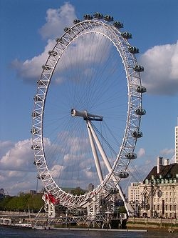

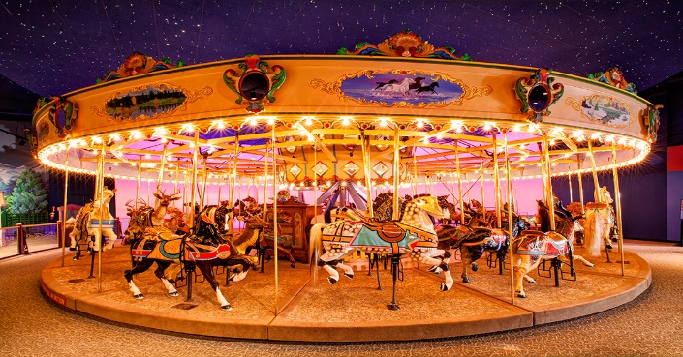
Starter
What do all of these things have in common?

Slide 2
The order of rotational symmetry of a shape is determined by how many times the shape fits onto itself during a 360° turn.

Slide 3
The order of rotational symmetry of a shape is determined by how many times the shape fits onto itself during a 360° turn.
3
2
1
ORDER 3

Slide 4
The order of rotational symmetry of a shape is determined by how many times the shape fits onto itself during a 360° turn.
3
2
1
ORDER 3
Every shape has an order of rotational symmetry, even if it is order 1.

Slide 5
The order of rotational symmetry of a shape is determined by how many times the shape fits onto itself during a 360° turn.
3
2
1
1
ORDER 3
Every shape has an order of rotational symmetry, even if it is order 1.
ORDER 1

Slide 6
State the order of rotational symmetry for each shape below:
Order 6
Order 2
Order 3
Order 2
Order 1
Order 3
Order 2
Order 5
Order 4
Order 1
Order 6
Order 8

Slide 7
Rotation is a type of transformation.
A rotation turns an object. The size and shape stay exactly the same but the orientation changes.
We describe rotations with an angle, a direction and a centre.

Slide 8
Direction - There are two directions when we rotate;
CLOCKWISE &
ANTICLOCKWISE

Slide 9
¼ turn (90°)
½ turn (180°)
¾ turn (270°)
Full turn (360°)
360º
Direction - There are two directions when we rotate;
270º
90º
CLOCKWISE &
ANTICLOCKWISE
180º

Slide 10
Rotate this triangle by
¼ turn
anticlockwise
around A
Use tracing paper to help you!
A

Slide 11

Rotate this triangle by
¼ turn
anticlockwise
around A
Draw over the shape.
A

Slide 12
Rotate this triangle by
¼ turn
anticlockwise
around A
Draw over the shape.
A

Slide 13
Rotate this triangle by
¼ turn
anticlockwise
around A
Draw over the shape.
A

Slide 14
Rotate this triangle by
¼ turn
anticlockwise
around A
Use the pencil as a pivot then turn the tracing paper.
A

Slide 15
Rotate this triangle by
¼ turn
anticlockwise
around A
Draw in the new shape and remove the tracing paper.
A

Slide 16
Rotate this rectangle by
½ turn
around B
Use tracing paper to help you!
B

Slide 17
Rotate this rectangle by
½ turn
around B
Draw over the shape.
B

Slide 18
Rotate this rectangle by
½ turn
around B
Draw over the shape.
B

Slide 19
Rotate this rectangle by
½ turn
around B
Draw over the shape.
B

Slide 20
Rotate this rectangle by
½ turn
around B
Draw over the shape.
B

Slide 21
Rotate this rectangle by
½ turn
around B
Use the pencil as a pivot then turn the tracing paper.
B

Slide 22
Rotate this rectangle by
½ turn
around B
Draw in the new shape and remove the tracing paper.
B

Slide 24
Answers

