Slide 1
Starter
Calculate the areas of the following shapes:
3cm
4cm
5cm
4cm
3cm
5cm
6cm

Slide 2
Answers
3cm
15 cm²
4cm
16 cm²
5cm
4cm
3cm
5cm
15 cm²
28.26 cm²
6cm

Slide 3
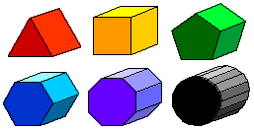
A prism is a 3D shape with two identical 2D shapes facing each other.
These identical shapes are called the cross-section.
The bases can be a triangle, square, rectangle or any other polygon.

Slide 4
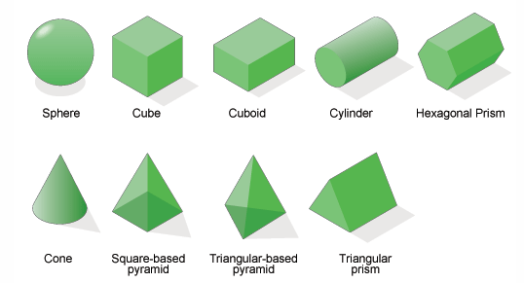
Think – Pair – Share
Identify the prisms

Slide 5
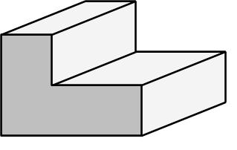
Volume of prism:
area of cross-section $×$ perpendicular length
perpendicular length
cross-section

Slide 6
Volume of prism:
area of cross-section $×$ perpendicular length
Example
Find the volume of this prism:
25 $×$ 7
$=$ 175
cm³
25 cm²
7 cm

Slide 7
Volume of prism:
area of cross-section $×$ perpendicular length
Example
Find the volume of this prism:
Area of cross-section $=$ $\frac{1}{2}$ $×$ 6 $×$ 3
$=$ 9
3 cm
cm²
Volume $=$ 9 $×$ 10
$=$ 90
cm³
10 cm
6 cm

Slide 8
Checkpoint
100mm³
72cm³
2
90cm³
120m³
5cm
5m
250cm³
6m

Slide 9
Task
Thoughts and crosses…
Calculate the volumes of 4 of the prisms, either vertically, horizontally or diagonally.

Slide 10
Answers
a) 42 cm³ b) 54 cm³ c) 180 cm³ d) 6 cm³
a) 45 cm³ b) 112 cm³ c) 24 cm³ d) 35 cm³
a) 45 cm³ b) 360 cm³ c) 100 cm³ d) 48 cm³
a) 380 cm³ b) 432 cm³ c) 1332 cm³ d) 261 cm³

Slide 11
The surface area of a shape is the total area of all of its faces.
To calculate the total surface area, work out the areas of every face and add them together.

Slide 12
Example
Calculate the surface area of the triangular prism.
Front: $\frac{1}{2}×3×4=6$ cm²
Back: $\frac{1}{2}×3×4=6$ cm²
Left: $3×6= 18$ cm²
Slant: $6×5= 30$ cm²
Bottom: $4×6= 24$ cm²
Total: $84$ cm²
$5$ cm
$3$ cm
$$+$$
$6$ cm
$4$ cm

Slide 14
Answers
36 cm² 240 cm²
352 cm² 372 cm²

