Slide 1
Coordinates Picture
For each instruction, join up the coordinates.
Do not join one instruction to the next.
(1, 3) → (0, 3) → (0, 5) → (2, 7) → (6, 7) → (7, 6) → (10, 5) → (10, 3) → (8, 3)
(6, 2) → (6, 4) → (8, 4) → (8, 2) → (6, 2)
(1, 2) → (1, 4) → (3, 4) → (3, 2) → (1, 2)
(3, 3) → (6, 3)
(2, 5) → (3, 6) → (6, 6) → (7, 5) → (2, 5)

Slide 2
Example
Draw the graph of $y=x+3$ for values of $x$ from $−3$ to $3$.
Complete a table of values.
Plot the points on a coordinate grid.
Draw a straight line through the points.
Label the line.
$$x$$
$$y=x+3$$

Slide 3
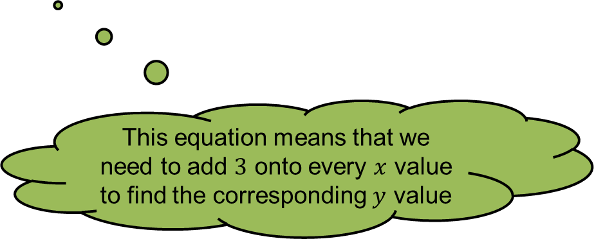
Example
Draw the graph of $y=x+3$ for values of $x$ from $−3$ to $3$.
Complete a table of values.
Plot the points on a coordinate grid.
Draw a straight line through the points.
Label the line.
$$x$$ | $$−3$$ | $$−2$$ | $$−1$$ | $$0$$ | $$1$$ | $$2$$ | $$3$$
$$y=x+3$$
$$0$$
$$1$$
$$2$$
$$3$$
$$4$$
$$5$$
$$6$$
This equation means that we need to add $3$ onto every $x$ value to find the corresponding $y$ value

Slide 4
Example
Draw the graph of $y=x+3$ for values of $x$ from $−3$ to $3$.
Complete a table of values.
Plot the points on a coordinate grid.
Draw a straight line through the points.
Label the line.
$$x$$ | $$−3$$ | $$−2$$ | $$−1$$ | $$0$$ | $$1$$ | $$2$$ | $$3$$
$$y=x+3$$ | $$0$$ | $$1$$ | $$2$$ | $$3$$ | $$4$$ | $$5$$ | $$6$$
$$(−3, 0)$$
$$(−2, 1)$$
$$(−1, 2)$$
$$(0, 3)$$
$$(1, 4)$$
$$(2, 5)$$
$$(3, 6)$$

Slide 5
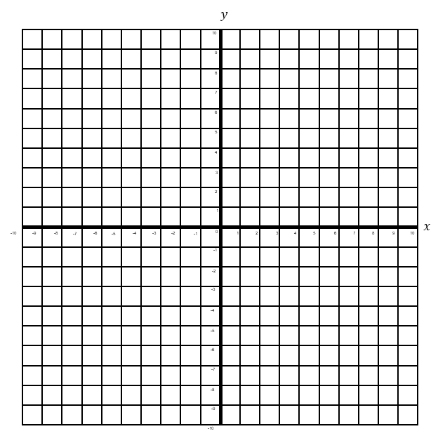
Example
Draw the graph of $y=x+3$ for values of $x$ from $−3$ to $3$.
Complete a table of values.
Plot the points on a coordinate grid.
Draw a straight line through the points.
Label the line.
$$(−3, 0)$$
$$(−2, 1)$$
$$(−1, 2)$$
$$(0, 3)$$
$$(1, 4)$$
$$(2, 5)$$
$$(3, 6)$$
$$y=x+3$$
Why bother with this last step?

Slide 6
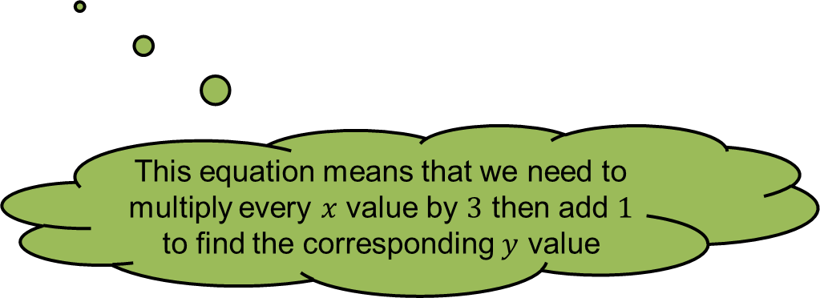
Example
Draw the graph of $y=3x+1$ for values of $x$ from $−3$ to $3$.
Complete a table of values.
Plot the points on a coordinate grid.
Draw a straight line through the points.
Label the line.
$$x$$ | $$−3$$ | $$−2$$ | $$−1$$ | $$0$$ | $$1$$ | $$2$$ | $$3$$
$$y=3x+1$$
$$−8$$
$$−5$$
$$−2$$
$$1$$
$$4$$
$$7$$
$$10$$
$$(−3, −8)$$
$$(−2, −5)$$
$$(−1, −2)$$
$$(0, 1)$$
$$(1, 4)$$
$$(2, 7)$$
$$(3, 10)$$
This equation means that we need to multiply every $x$ value by $3$ then add $1$ to find the corresponding $y$ value

Slide 7
Example
Draw the graph of $y=3x+1$ for values of $x$ from $−3$ to $3$.
Complete a table of values.
Plot the points on a coordinate grid.
Draw a straight line through the points.
Label the line.
$$(−3, −8)$$
$$(−2, −5)$$
$$(−1, −2)$$
$$(0, 1)$$
$$(1, 4)$$
$$(2, 7)$$
$$(3, 10)$$
$$y=3x+1$$
Why bother with this last step?

Slide 8
Finished? Sketch these in your book on your own axes!
5) $y=2x−4$
6) $y=3x+2$
7) $y=½x$

Slide 9
Pair Activity
Match the equations on the dominoes to the coordinates that are on the line!
Hint: Draw a table of values for each question.
Extension: Can you sketch any of them?

