Slide 1
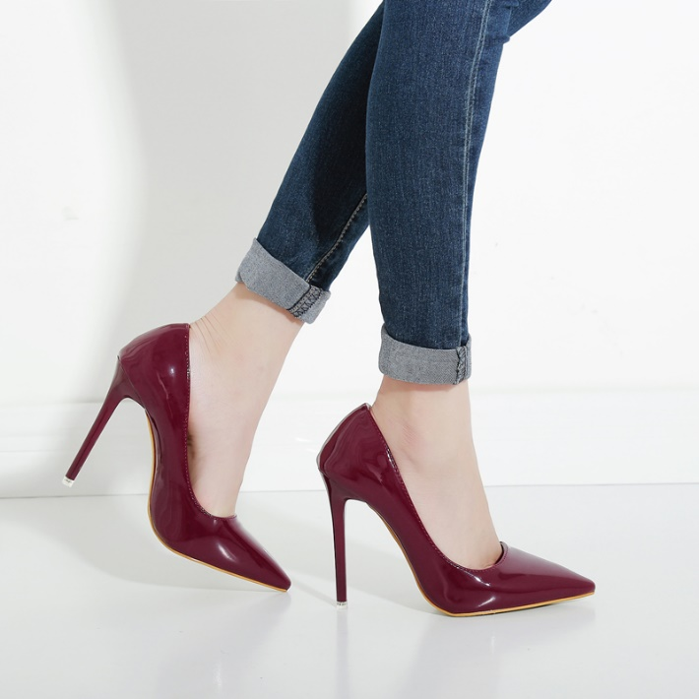
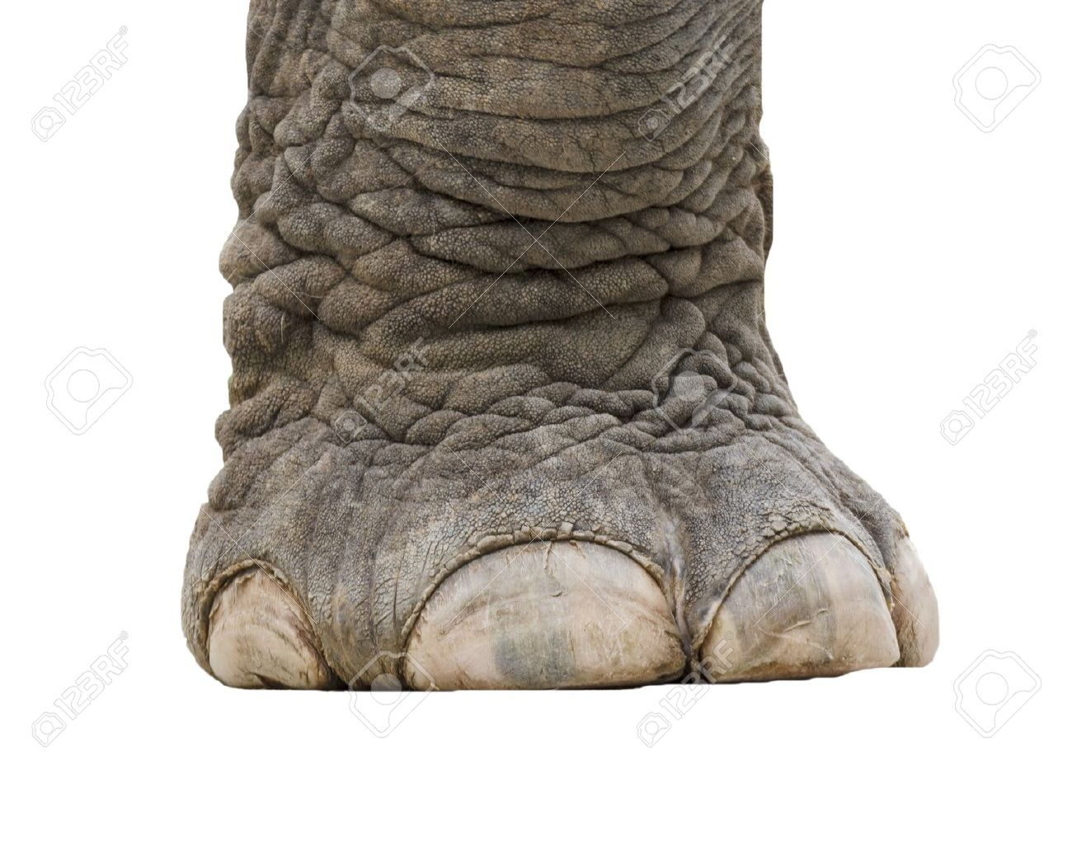
Would you rather…
A woman wearing a stiletto heel trod on your foot
Or…
An elephant trod on your foot?

Slide 2
What is compound measure?
Write down as many units of measure as you can.
Which do you think are compound ?
What is compound measure?

Slide 3
Commonly used compound measures include:
Pressure is a measure of how much force is applied over a unit of area
Gets bigger if force gets bigger
Gets bigger if force is more concentrated
Gets smaller if force is more spread out
Density | $$\frac{\text{mass}}{\text{volume}}$$ | Measured in g/cm³ or kg/L
Speed | $$\frac{\text{distance}}{\text{time}}$$ | Measured in m/s, km/h or mph
Pressure | $$\frac{\text{force}}{\text{surface} \text{area}}$$ | Measured in N/m² or N/cm²
Fuel consumption | $$\frac{\text{distance}}{\text{volume}}$$ | Measured in km/L or mpg

Slide 4
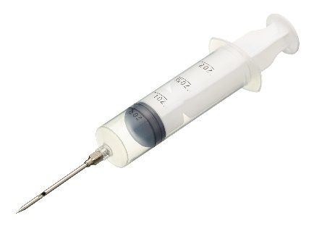
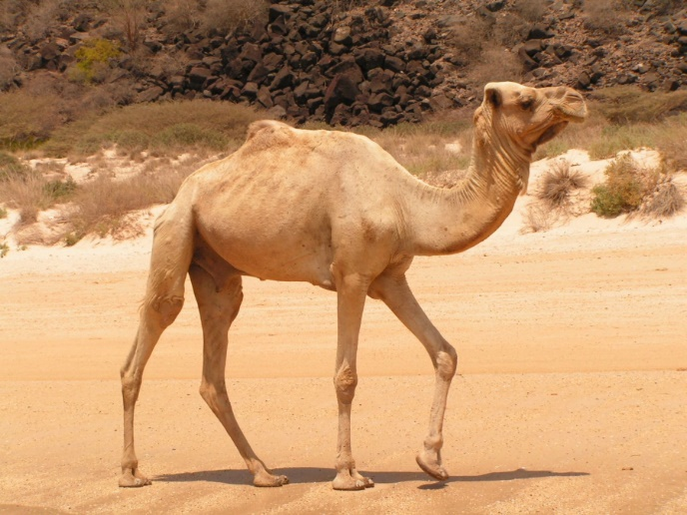
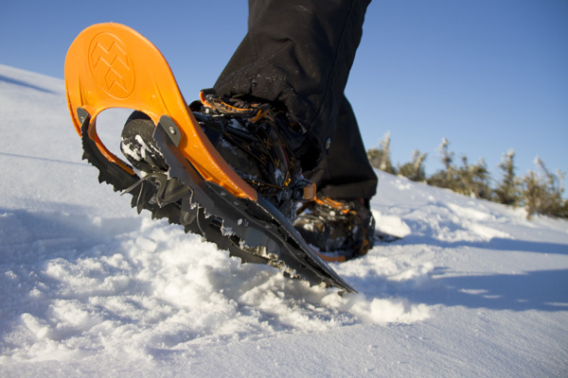
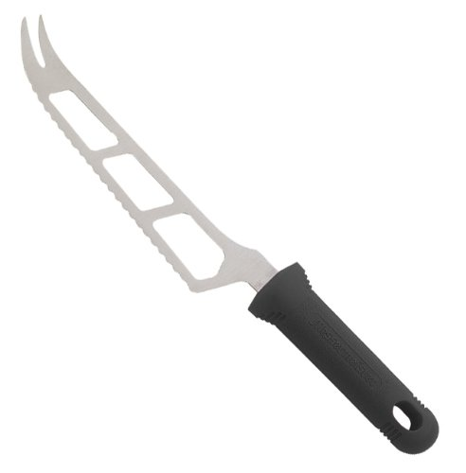
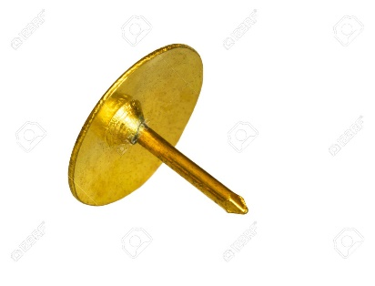

Slide 5
Example
A car of weight 6 400 N has four wheels. Each wheel has an area of 80 cm² touching the road. Find the pressure the car puts on the ground.
Pressure = $\frac{\text{force}}{\text{surface} \text{area}}$
Pressure = $\frac{\text{force}}{\text{surface} \text{area}}$
= $\frac{\text{6400}}{\text{4}\text{×}\text{80}}$
= 20
N/cm²

Slide 6
Emily weighs 500 N and is wearing stiletto heels which combined have an area of 0.0001 m². What pressure does she exert?
Nelly the elephant weighs 50 000 N. Her 4 feet are on the ground and cover a total area of 0.8 m². What is the pressure under her feet?
Who would sink further into the ground – Emily or Nelly? Can you justify your answer?
Pressure = 500 ÷ 0.0001 = 5 000 000 N/m²
Pressure = 50 000 ÷ 0.8 = 62 500 N/m²
Emily – more pressure!

Slide 8
Answers
Draw and describe an object that is designed to decrease pressure:
Elephant’s foot
Snow shoes
Large tyres
Draw and describe an object that is designed to increase pressure:
Sharp point – needle/pin
Sharp edge - knife
1. 2500 N/cm²
2. 1.5 N/cm²
3. 12.5 N/cm²
4. 5 N/cm²
5. 2 N
6. 0.005 cm² or 0.5 mm²

Slide 9
Snow shoes work by decreasing the surface area over which the weight is applied.
False
Not sure
True

Slide 10
Snow shoes work by increasing the surface area over which the weight is applied.
False
Not sure
True

Slide 11
Snow shoes work by decreasing the force applied to the ground.
False
Not sure
True

Slide 12
Snow shoes work by spreading out the pressure applied to the ground.
False
Not sure
True

Slide 13
The total force is the weight of the person wearing the show shoes.
False
Not sure
True

Slide 14
Snow shoes work by decreasing the pressure applied to the ground.
False
Not sure
True

Slide 15
Pressure is the force multiplied by the area.
False
Not sure
True

Slide 16
The total force is the pressure times the area of the base of the shoes.
False
Not sure
True

Slide 17
Snow shoes work by spreading out the force applied to the ground.
False
Not sure
True

Slide 18
The total force is the pressure divided by the area of the base of the shoes.
False
Not sure
True

Slide 19
The total pressure is the weight of the person wearing the snow shoes.
False
Not sure
True

Slide 20
The force applied by the person to the snow is still the same if he wears normal shoes, or even heels.
False
Not sure
True

Slide 21
Pressure is the force divided by the area.
False
Not sure
True

Slide 22
The pressure applied by the person to the snow is still the same if he wears normal shoes, or even heels.
False
Not sure
True

