Slide 1
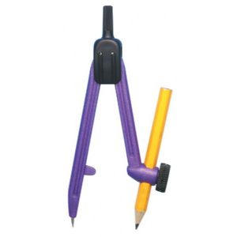
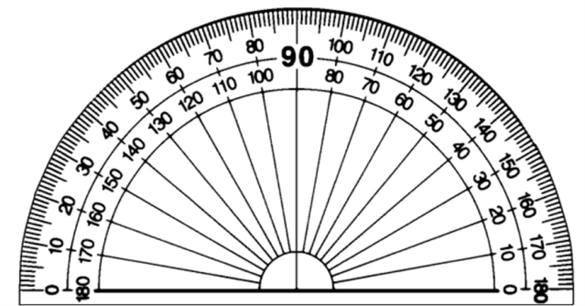
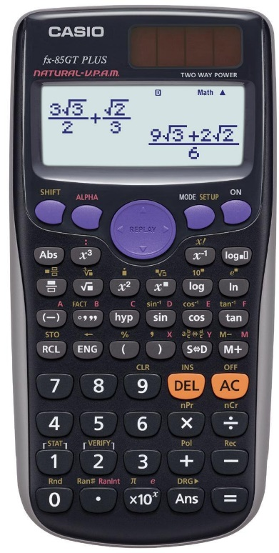
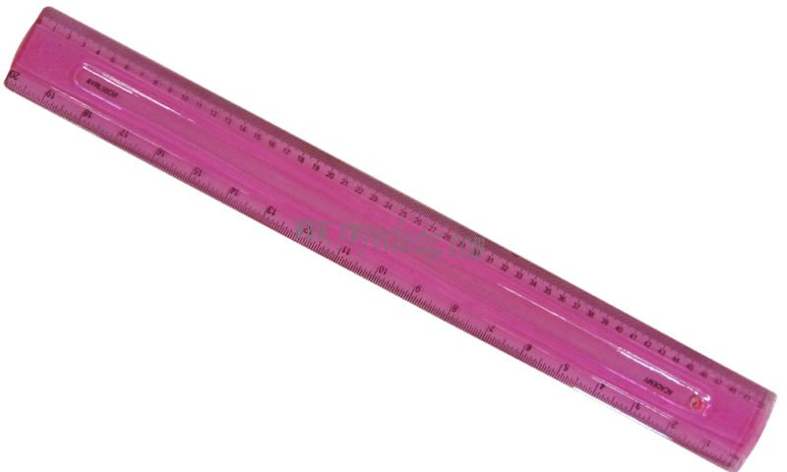
Autumn Term
Spring Term
Summer Term
Notes:
To use:
Click the term.
On the next slide, select the week of the term and the lesson of the week.
Give students 5 to 10 minutes on the questions.
Go through the solutions as a class – answers are not included as there is no point in using this resource if you do not go though full solutions.
No printing required!

Slide 2
Autumn Term
Week 1 | Lesson 1 | Lesson 2 | Lesson 3 | Lesson 4
Week 2 | Lesson 1 | Lesson 2 | Lesson 3 | Lesson 4
Week 3 | Lesson 1 | Lesson 2 | Lesson 3 | Lesson 4
Week 4 | Lesson 1 | Lesson 2 | Lesson 3 | Lesson 4
Week 5 | Lesson 1 | Lesson 2 | Lesson 3 | Lesson 4
Week 6 | Lesson 1 | Lesson 2 | Lesson 3 | Lesson 4
Week 7 | Lesson 1 | Lesson 2 | Lesson 3 | Lesson 4
Week 8 | Lesson 1 | Lesson 2 | Lesson 3 | Lesson 4
Week 9 | Lesson 1 | Lesson 2 | Lesson 3 | Lesson 4
Week 10 | Lesson 1 | Lesson 2 | Lesson 3 | Lesson 4
Week 11 | Lesson 1 | Lesson 2 | Lesson 3 | Lesson 4
Week 12 | Lesson 1 | Lesson 2 | Lesson 3 | Lesson 4
Week 13 | Lesson 1 | Lesson 2 | Lesson 3 | Lesson 4
Week 14 | Lesson 1 | Lesson 2 | Lesson 3 | Lesson 4

Slide 3
Spring Term
Week 1 | Lesson 1 | Lesson 2 | Lesson 3 | Lesson 4
Week 2 | Lesson 1 | Lesson 2 | Lesson 3 | Lesson 4
Week 3 | Lesson 1 | Lesson 2 | Lesson 3 | Lesson 4
Week 4 | Lesson 1 | Lesson 2 | Lesson 3 | Lesson 4
Week 5 | Lesson 1 | Lesson 2 | Lesson 3 | Lesson 4
Week 6 | Lesson 1 | Lesson 2 | Lesson 3 | Lesson 4
Week 7 | Lesson 1 | Lesson 2 | Lesson 3 | Lesson 4
Week 8 | Lesson 1 | Lesson 2 | Lesson 3 | Lesson 4
Week 9 | Lesson 1 | Lesson 2 | Lesson 3 | Lesson 4
Week 10 | Lesson 1 | Lesson 2 | Lesson 3 | Lesson 4
Week 11 | Lesson 1 | Lesson 2 | Lesson 3 | Lesson 4
Week 12 | Lesson 1 | Lesson 2 | Lesson 3 | Lesson 4
Week 13 | Lesson 1 | Lesson 2 | Lesson 3 | Lesson 4
Week 14 | Lesson 1 | Lesson 2 | Lesson 3 | Lesson 4

Slide 4
Summer Term
Week 1 | Lesson 1 | Lesson 2 | Lesson 3 | Lesson 4
Week 2 | Lesson 1 | Lesson 2 | Lesson 3 | Lesson 4
Week 3 | Lesson 1 | Lesson 2 | Lesson 3 | Lesson 4
Week 4 | Lesson 1 | Lesson 2 | Lesson 3 | Lesson 4
Week 5 | Lesson 1 | Lesson 2 | Lesson 3 | Lesson 4
Week 6 | Lesson 1 | Lesson 2 | Lesson 3 | Lesson 4
Week 7 | Lesson 1 | Lesson 2 | Lesson 3 | Lesson 4
Week 8 | Lesson 1 | Lesson 2 | Lesson 3 | Lesson 4
Week 9 | Lesson 1 | Lesson 2 | Lesson 3 | Lesson 4
Week 10 | Lesson 1 | Lesson 2 | Lesson 3 | Lesson 4
Week 11 | Lesson 1 | Lesson 2 | Lesson 3 | Lesson 4
Week 12 | Lesson 1 | Lesson 2 | Lesson 3 | Lesson 4
Week 13 | Lesson 1 | Lesson 2 | Lesson 3 | Lesson 4
Week 14 | Lesson 1 | Lesson 2 | Lesson 3 | Lesson 4

Slide 5
Calculate the highest common factor of 36 and 24.
Calculate the size of the missing angle $x$.
Divide £72 in the ratio 4 : 5.
Solve $3n+4=19$
$$x°$$
$$120°$$

Slide 6
Complete the table of values to sketch the graph of $y=2x−1$.
Describe fully the single transformation which maps the blue shape onto the red shape.
$$x$$ | -2 | -1 | 0 | 1 | 2
$$y$$
Order the following fractions from smallest to largest:
$\frac{1}{3}$ $\frac{1}{4}$ $\frac{2}{5}$ $\frac{3}{7}$

Slide 7
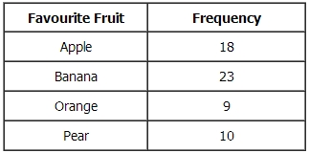
Simplify $x^{3}×x^{5}$.
Find the n^{th} term of the sequence: 3 7 11 15…
Mike asked 60 students to name their favourite fruit. Here are his results. Draw an accurate pie chart for his results.

Slide 8
Calculate the size of the missing angle x. You must give a reason for your answer.
Expand $x(x+2)$
Solve $3(x+4)=27$
The probability that a biased dice will land on a five is 0.3. Megan is going to roll the dice 400 times. Work out an estimate for the number of times the dice will land on a five.
$$x°$$
$$40°$$

Slide 9
Calculate $10−2×5$
Work out the value of $3x+y$ when $x=2$ and $y=5$.
Calculate the area of the triangle.
3 cm
5 cm

Slide 10
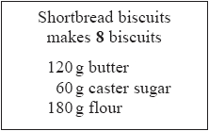
Work out $\sqrt{44.89}$. You must give your answer as a decimal.
How much of each of the ingredients does John need to make 16 biscuits?
Solve $7n+3=3n+27$

Slide 11
Hayley is buying bottles of juice for a children's party. She uses this rule to work out the number of bottles of juice she needs.
There will be 24 children at the party. Work out the number of bottles of juice Hayley needs.
Calculate the volume of the cube.
Calculate $\frac{2}{5}+\frac{1}{4}$
4 cm

Slide 12
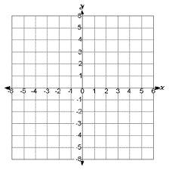
Calculate the gradient of the graph.
Write 0.7 as a fraction.
Calculate 40% of £36.
Adam cycled 24 km in 2 hours. Work out his average speed.

Slide 13
Calculate $\frac{1}{3}$ of £39.
Convert 10 cm to metres.
Show the inequality $x>3$ on a number line.

Slide 14
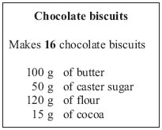
Calculate the highest common factor of 10 and 15.
Expand $2\left(3−x\right)$
Work out how much of each ingredient Dave needs to make 48 biscuits.

Slide 15
Find the n^{th} term of the sequence: 4 6 8 10…
Solve $2x=15$
Joshua rolls an ordinary dice once. Write down the probability that he gets a 6.

Slide 16
Complete the table of values and sketch the graph of $x+y=6$
Order the following from smallest to largest:
45% 0.3 $\frac{1}{3}$ $\frac{2}{5}$
Write down the mode of the following list of numbers:
8 7 5 6 7 3
$$x$$ | -2 | -1 | 0 | 1 | 2
$$y$$

Slide 17
What is the reciprocal of 5?
Calculate the value of $x$.
Work out $\frac{1}{{2.5}^{3}}$. You must give your answer as a decimal.
A pack of 9 toilet rolls costs £4.23. A pack of 4 toilet rolls costs £1.96. Which pack gives the better value for money?
$$136°$$
$$x°$$

Slide 18
Calculate $2×3^{2}$
Solve $5(5x+1)=105$
Hayley is buying bottles of juice for a children's party. She uses this rule to work out the number of bottles of juice she needs.
Hayley needs 13 bottles of juice. Work out the number of children at the party.

Slide 19
There are only silver cars, blue cars and red cars in the car park at Allerton School. The pie charts show information about the numbers of these cars. What fraction of the cars in the car park at Allerton School are blue? Give your fraction in its simplest form.
Describe fully the single transformation which maps the blue shape onto the red shape.
Stuart drives 180 km in 2 hours 15 minutes. Work out Stuart’s average speed.

Slide 20
Calculate the size of the missing angle $x$. You must give a reason for your answer.
Solve $\frac{10+2x}{3}=4$
Calculate the surface area of the cube.
$$x°$$
$$36°$$
4 cm

Slide 21
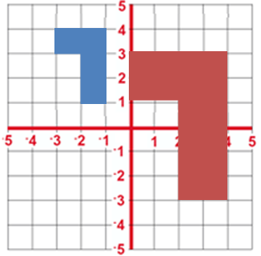
Describe fully the single transformation which maps the blue shape onto the red shape.
Calculate the lowest common multiple of 12 and 15.
Divide £32 in the ratio 3 : 8.
Calculate the area of the parallelogram.
4 cm
5 cm

Slide 22
Complete the table of values and sketch the graph of $y=3x+2$.
Order the following fractions from smallest to largest:
$\frac{2}{3}$ $\frac{3}{4}$ $\frac{4}{5}$ $\frac{1}{2}$
Calculate 0.5 x 0.7
$$x$$ | -2 | -1 | 0 | 1 | 2
$$y$$

Slide 23
Simplify ${(a^{5})}^{3}$.
Jack sows 300 wildflower seeds. The probability of a seed flowering is 0.7. Work out an estimate for the number of these seeds that will flower.
Write $\frac{3}{5}$ as a decimal.

Slide 24
Find the n^{th} term of the sequence: 6 11 16 21…
Calculate the area of the shape.
Calculate 42% of £80.
3 cm
4 cm
6 cm
3 cm

Slide 25
Work out the value of $a^{2}$ when $a=6$.
Solve $5+4n=13$
Calculate the area of the trapezium.
£3.45 + £4.86
4 cm
3 cm
6 cm

Slide 26
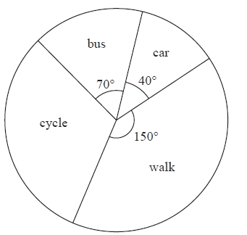
The pie chart shows information about how the students in Year 11 get to school. Mr Morley says, "Less than 10% of students in Year 11 get to school by car". Is Mr Morley correct? You must explain your answer.
Expand $3\left(a+b\right)$
Joshua rolls an ordinary dice once. Write down the probability that he gets an odd number.
Solve $4x+3=19$

Slide 27
Calculate the size of the missing angle $x$.
Calculate $18÷(4+5)$
Write down the inequality shown on the number line.
$$x°$$
$$100°$$

Slide 28
Calculate the lowest common multiple of 10 and 15.
Solve $10(7x–5)=300$
Calculate $\frac{2}{5}$ of 35 kg.

Slide 29
This rule can be used to work out the time, in seconds, it takes to download music tracks.
Work out the time, in seconds, it takes to download 9 music tracks.
Convert 800 g to kilograms.
Write down the mode of the following list of numbers:
6 9 10 9 11 9 9

Slide 30
Describe fully the single transformation which maps the blue shape onto the red shape.
Solve $25=4n−3$
Order the following from smallest to largest:
$\frac{7}{8}$ 0.8 85% $\frac{5}{6}$
£2.19 - £1.63

Slide 31
Calculate the size of the missing angle $x$. You must give a reason for your answer.
Joe travelled 60 miles in 1 hour 30 minutes. Work out Joe’s average speed. Give your answer in miles per hour.
Write down the median of the following list of numbers:
8 7 5 6 7 3
$$29°$$
$$x°$$

Slide 32
Calculate the gradient of the graph.
Use your calculator to work out the value of $\sqrt[3]{42.875}$.
Potatoes cost £9 for a 12.5 kg bag at a farm shop. The same type of potatoes cost £1.83 for a 2.5 kg bag at a supermarket. Where are the potatoes the better value, at the farm shop or at the supermarket?
6 ÷ 0.5

Slide 33
Joshua rolls an ordinary dice once. Write down the probability that he gets a number less than 3.
Calculate the volume of the cube.
Order the following fractions from smallest to largest:
$\frac{1}{2}$ $\frac{2}{3}$ $\frac{3}{7}$ $\frac{3}{4}$
6 cm

Slide 34
Complete the table of values and sketch the graph of $x+y=8$
Write 56% as a decimal.
Calculate $\frac{4}{5}×\frac{15}{17}$
$$x$$ | -2 | -1 | 0 | 1 | 2
$$y$$

Slide 35
How much of each ingredient does Cassie need to make 12 biscuits?
Solve $2m−44=76−8m$
Increase £30 by 26%.

Slide 36
Simplify $\frac{a^{7}}{a^{3}}$.
Calculate the size of the missing angle $x$.
Work out the value of $5x^{2}$ when $x=4$
£15.54 - £9.62
$$71°$$
$$x°$$

Slide 37
Calculate the highest common factor of 54 and 36.
Describe fully the single transformation which maps the blue shape onto the red shape.
Four teams, City, Rovers, Town and United play a competition to win a cup. Only one team can win the cup. The table below shows the probabilities of City or Rovers or Town winning the cup.
Work out the value of $x$.
Write down the range of the following list of numbers:
6 9 10 9 11 9 9

Slide 38
Find the n^{th} term of the sequence: 7 10 13 16…
Jane and Sumeet share £55 in the ratio 6 : 5. How much does Jane receive?
Solve $4(5c+15)=20$
What is the sum of the angles in a triangle?

Slide 39
This rule can be used to work out the time, in seconds, it takes to download music tracks.
How many music tracks can be downloaded in 360 seconds?
Calculate $\frac{3}{7}$ of £63.
Show the inequality $−1≤x<4$ on a number line.

Slide 40
What is the reciprocal of ½?
Divide £200 in the ratio 13 : 7.
Solve $3=\frac{9x−15}{4}$
Calculate the perimeter of the shape.
3 cm
4 cm
6 cm
3 cm

Slide 41
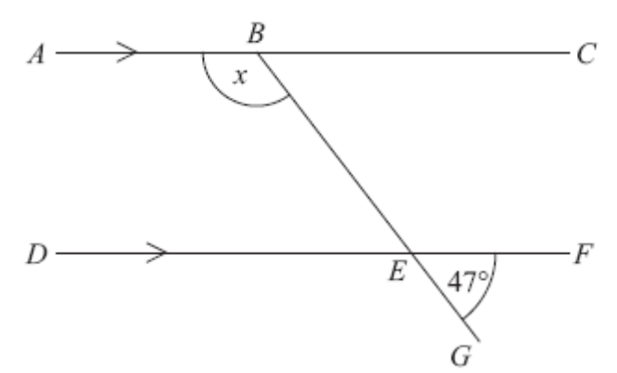
Work out the size of the angle marked $x$. Give reasons for your answer.
Use your calculator to work out $\frac{3.4×5.2}{2.6−0.39}$.
Expand and simplify $2\left(x+1\right)+4x$
Work out how much of each ingredient Wendy needs to make 24 biscuits.

Slide 42
Simplify ${({2x}^{2})}^{3}$.
Calculate $16÷2^{2}$
Convert 5 m to centimetres.

Slide 43
The table gives information about the results of the matches a football team played. Draw an accurate pie chart to show this information.
Order the following from smallest to largest:
0.52 $\frac{1}{2}$ 48% $\frac{3}{5}$
Write down the mean of the following list of numbers:
8 7 5 6 7 3

Slide 44
Radox Handwash cost is on offer at Boots and Superdrug.
Boots 500ml bottles on offer at 3 for 2
Superdrug 300ml bottles on offer at buy one get one free
Where is the handwash better value, at Boots or Superdrug?
Calculate the surface area of the cube.
The distance from Liverpool to Prague is 1200 km. A flight from Liverpool to Prague lasts 4 hours. Work out the average speed of the aeroplane.
6 cm

Slide 45
Solve $4+5n=2n+22$
Calculate the area of the triangle.
Calculate $\frac{2}{3}÷\frac{5}{6}$
4 cm
7 cm

Slide 46
Describe fully the single transformation which maps the blue shape onto the red shape.
Work out the value of $3a−2b$ when $a=4$ and $b=−2$
Write 0.6 as a fraction in its simplest form.

Slide 47
Find the n^{th} term of the sequence: 7 3 -1 -5…
Joshua rolls an ordinary dice once. Write down the probability that he gets an 8.
Mia spins a spinner. The spinner can land on red or green or blue or pink. The table shows each of the probabilities that the spinner will land on red or green or blue.
Work out the probability that the spinner will land on pink
£12.51 - £8.34

Slide 48
Complete the table of values and sketch the graph of $y=6−2x$.
Solve $2(2d+3)=34$
Calculate the area of the parallelogram.
What is the sum of the angles inside a quadrilateral?
$$x$$ | -2 | -1 | 0 | 1 | 2
$$y$$
6 cm
8 cm

Slide 49
There are only silver cars, blue cars and red cars in the car park at Bragdon School. The pie chart shows information about the numbers of these cars. There are 12 red cars in the car park at Bragdon School. How many silver cars are there in this car park?
Order the following fractions from largest to smallest:
$\frac{7}{8}$ $\frac{3}{4}$ $\frac{5}{8}$ $\frac{2}{3}$
Decrease £60 by 52%

Slide 50
Use your calculator to work out $\sqrt{84.64}+{3.2}^{3}$.
Solve $\frac{x}{5}=12$
Kimona is going to cook some meat. She uses this rule to work out the cooking time in minutes.
Kimona wants to finish cooking the meat at 1 pm. The weight of the meat is 1.5 kg. Work out the latest time Kimona can start to cook the meat.
£2.65 + £7.59

Slide 51
Calculate the size of the missing angle $x$. You must give a reason for your answer.
Calculate $\frac{4}{9}$ of 36 ml.
Write down the inequality shown on the number line below.
$$x°$$
$$116°$$

Slide 52
Calculate $(7+5)÷(5−2)$
Carol and Bob share £20 in the ratio 2 : 3. How much does Carol receive?
Calculate the area of the trapezium.
6 cm
5 cm
9 cm

Slide 53
Describe fully the single transformation which maps the blue shape onto the red shape.
How much of each ingredient does Perveen need to make 20 biscuits?
Convert 0.8 L to millilitres.

Slide 54
Calculate the gradient of the graph.
Order the following from smallest to largest:
0.3 27% $\frac{1}{3}$ 33%
Write down the range of the following list of numbers:
8 7 5 6 7 3

Slide 55
Calculate the lowest common multiple of 12 and 18.
Calculate the size of the missing angle $x$.
Solve $5x=60$
8 ÷ 0.5
$$115°$$
$$x°$$
$$100°$$

Slide 56
Calculate the lowest common multiple of 9 and 12.
Expand and simplify $3\left(m+2\right)−4(m−1)$
Mia drove a distance of 343 km. She took 3 hours 30 minutes. Work out her average speed. Give your answer in km/h.

Slide 57
Find the n^{th} term of the sequence: 8 5 2 -1…
Work out the value of $4m^{2}−2m$ when $m=−3$
Calculate the area of the shape.
2 cm
5 cm
7 cm
3 cm

Slide 58
Complete the table of values and sketch the graph of $y=2x+4$
Solve $4(x+2)=40$
Calculate the volume of the cuboid.
$$x$$ | -2 | -1 | 0 | 1 | 2
$$y$$
4 cm
3 cm
6 cm

Slide 59
Calculate the size of the missing angle x. You must give a reason for your answer.
Mary and Clive share some money in the ratio 2 : 5. Clive receives £35. How much money was there to begin with?
Calculate $\frac{7}{8}−\frac{2}{5}$
$$x°$$
$$119°$$

Slide 60
Simplify $\frac{6a^{3}b^{4}}{2ab^{3}}$.
Solve $3p−2=16$
Emily has a bag of 20 fruit flavour sweets. 7 of the sweets are strawberry flavour, 11 are lime flavour and 2 are lemon flavour. Emily takes at random a sweet from the bag. Write down the probability that Emily takes a strawberry flavour sweet,
What is the sum of angles around a point?

Slide 61
Simplify $\frac{{4x}^{2}×{3x}^{5}}{2x^{4}}$.
Tracy uses this rule to work out the cost, in pounds, of printing invitations.
Work out the cost of printing 20 invitations.
Solve $15=2x+1$

Slide 62
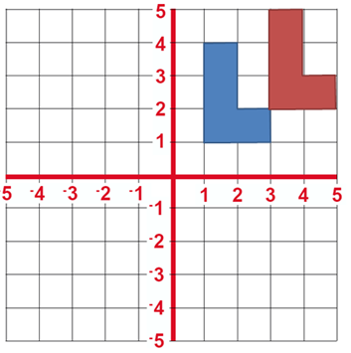
What is the reciprocal of $\frac{2}{3}$?
Describe fully the single transformation which maps the blue shape onto the red shape.
Carrots cost £1 for a 1.2 kg bag at Tesco. The same type of carrots cost 77 pence for a 700 g bag at ASDA. Where are the Carrots better value?
What is the sum of the angles on a straight line?

Slide 63
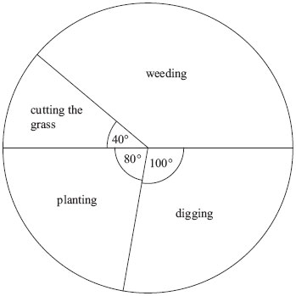
The pie chart shows some information about the time Gill spent working in her garden one month. What fraction of the time did Gill spend cutting the grass?
Order the following fractions from smallest to largest:
$\frac{2}{3}$ $\frac{5}{6}$ $\frac{3}{4}$ $\frac{1}{2}$
Write 0.4 as a percentage.

Slide 64
Work out the value of $\sqrt{14.44}×{(7.3−2.45)}^{2}$. Write down all the figures on your calculator display.
Work out how much of each ingredient Miles needs to make 20 chocolate biscuits.
Increase £25 by 64%

Slide 65
Calculate $(2+7)×2^{3}$
Solve $5n−5=n+10$
A box contains bricks which are orange or blue or brown or yellow. Duncan is going to choose one brick at random from the box. The table shows each of the probabilities that Duncan will choose an orange brick or a brown brick or a yellow brick.
Work out the probability that Duncan will choose a blue brick.
3 ÷ 0.5

Slide 66
Calculate the size of the missing angle $x$. You must give a reason for your answer.
Calculate $\frac{4}{5}$ of £85.
Show the inequality $x>7$ on a number line.
$$x°$$
$$121°$$

Slide 67
Describe fully the single transformation which maps the blue shape onto the red shape.
Order the following from smallest to largest:
65% $\frac{2}{3}$ 0.66 0.606
Convert 6 mm to centimetres.

Slide 68
Calculate the size of the missing angle $x$.
Solve $3(9–2b)=3$
Write down the median of the following list of numbers:
6 9 10 9 11 9 9
$$121°$$
$$x°$$

Slide 69
Expand $2a(3b−4a)$
Martin uses this rule to work out the cost, in pounds, of printing invitations.
The cost is £47.75. Work out how many invitations Martin had printed.
The distance from London to New York is 3456 miles. A plane takes 8 hours to fly from London to New York. Work out the average speed of the plane.

Slide 70
Work out the value of $6x−7y$ when $x=−2$ and $y=4$
Solve $\frac{2x+10}{3}=7$
Calculate the surface area of the cuboid.
4 cm
3 cm
6 cm

Slide 71
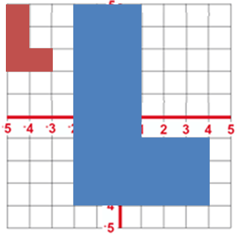
Describe fully the single transformation which maps the blue shape onto the red shape.
Write 0.8 as a fraction in its simplest form.
Calculate 0.7 x 0.9

Slide 72
Complete the table of values and sketch the graph of $y=\frac{1}{2}x+2$
Order the following fractions from smallest to largest:
$\frac{1}{2}$ $\frac{2}{5}$ $\frac{1}{3}$ $\frac{2}{7}$
Decrease £70 by 13%.
$$x$$ | -2 | -1 | 0 | 1 | 2
$$y$$

Slide 73
Find the n^{th} term of the sequence: 4 -2 -8 -14…
Calculate $6^{2}÷(1+3)×3$
Calculate the perimeter of the shape.
5 ÷ 0.2
2 cm
5 cm
7 cm
3 cm

Slide 74
Calculate the size of the missing angle $x$.
Emily has a bag of 20 fruit flavour sweets. 7 of the sweets are strawberry flavour, 11 are lime flavour and 2 are lemon flavour. Emily takes at random a sweet from the bag. Write down the probability that Emily does not take a lime flavour sweet.
Write down the inequality shown on the number line.
$$111°$$
$$x°$$
$$96°$$

Slide 75
Calculate the gradient of the graph.
Amy, Sarah and Yasmin share some sweets in the ratio 4 : 2 : 5. Yasmin receives 12 more sweets than Sarah, How many sweets does Amy get?
Solve $2=t−8$
£5.64 + £4.93

Slide 76
Work out the value of ${3.2}^{2}+\sqrt{7.5}$. Write down all the figures on your calculator display.
Calculate the area of the trapezium.
Calculate $\frac{7}{9}$ of 81 g.
6.5 m
5 m
9.3 m

Slide 77
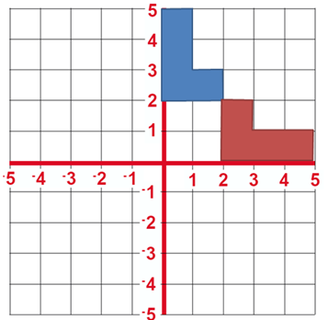
Describe fully the single transformation which maps the blue shape onto the red shape.
Order the following from smallest to largest:
$\frac{4}{5}$ 0.85 78% $\frac{7}{8}$
Convert 500 cm² to metres².

Slide 78
The table gives some information about the birds Paula sees in her garden one day. Draw an accurate pie chart to show this information.
Calculate the highest common factor 72 and 64.
Solve $5(6y–2)=20$
Calculate the area of the triangle.
Bird | Frequency
Magpie | 15
Thrush | 10
Starling | 20
Sparrow | 27
4 cm
6 cm

Slide 79
Find the n^{th} term of the sequence:
-3 -1 1 3…
Tariq is going to make some shortbread biscuits. He has the following ingredients:
330 g butter
200 g caster sugar
450 g flour
Work out the greatest number of shortbread biscuits that Tariq can make with his ingredients.
Write down the mean of the following list of numbers:
6 9 10 9 11 9 9

Slide 80
Simplify $\frac{a^{3}×a^{4}}{a^{9}}$.
A cuboid has a volume of 72 cm², a height of 3 cm and a depth of 4 cm. What is its width?
A car travels for 3 hours. Its average speed is 75 km/h. Work out the total distance the car travels.

Slide 81
Calculate the highest common factor of 32 and 24.
Complete the table of values and sketch the graph of $y=3x−2$.
Expand $2x^{2}(3x−4y)$
Solve $4+5n=34$
$$x$$ | -2 | -1 | 0 | 1 | 2
$$y$$

Slide 82
Simplify $\frac{m^{3}×m^{4}}{m^{5}}$.
You can use this rule to work out the total hire charge, in pounds (£), for hiring a satellite phone.
Ismail wants to hire a satellite phone for 4 weeks. Work out the total hire charge.
Calculate $3\frac{1}{2}−1\frac{3}{5}$

Slide 83
A bag contains some balls which are red or blue or green or black. Yvonne is going to take one ball at random from the bag. The table shows each of the probabilities that Yvonne will take a red ball or a blue ball or a black ball.
Work out the probability that Yvonne will take a green ball
Order the following fractions from smallest to largest:
$\frac{2}{3}$ $\frac{3}{4}$ $\frac{4}{5}$ $\frac{5}{7}$
Write 30% as a fraction in its simplest form.

Slide 84
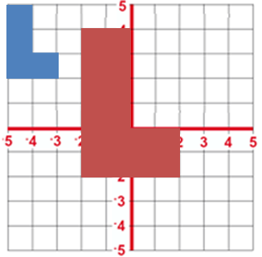
Describe fully the single transformation which maps the blue shape onto the red shape.
Work out the value of $a−bc$ when $a=−2$, $b=3$ and $c=−4$
Increase £65 by 45%

Slide 85
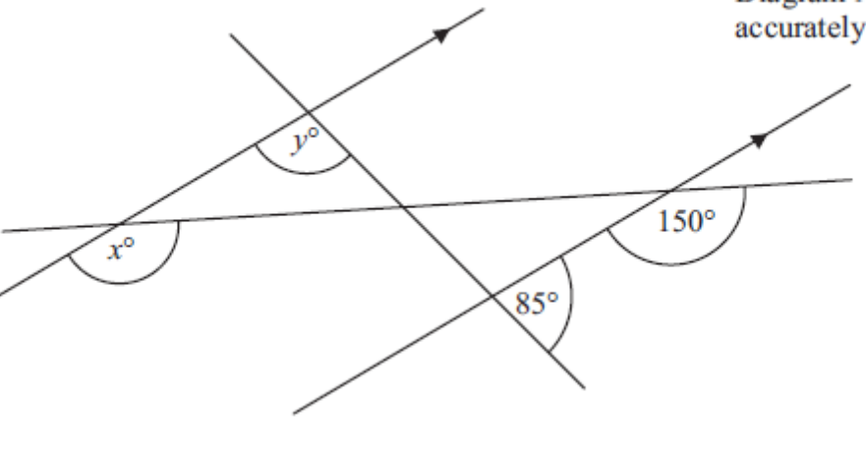
Calculate the values of $x$ and $y$, giving reasons for your answers.
Calculate $(5−2)÷(2×3)$
Solve $7x+2=10−x$
4 ÷ 0.2

Slide 86
What is the reciprocal of $\frac{6}{7}$ ?
Sabrina has
250 g of butter
300 g of caster sugar
600 g of flour
60 g of cocoa
Work out the greatest number of chocolate biscuits Sabrina can make.
Show the inequality $0<x≤3$ on a number line.

Slide 87
There are only silver cars, blue cars and red cars in the car parks at Allerton School and at Bragdon School. The pie charts show information about the numbers of these cars. In which car park are there more silver cars? Explain your answer.
Emily has a bag of 20 fruit flavour sweets. 7 of the sweets are strawberry flavour, 11 are lime flavour and 2 are lemon flavour. Emily takes at random a sweet from the bag. Write down the probability that Emily takes an orange flavour sweet.
Calculate $\frac{6}{7}$ of £91.

Slide 88
Calculate the size of the missing angle $x$.
Luna, Hettie and Poppy share some dog treats in the ratio 2 : 3 : 4. Poppy gets 20 treats. How many does Luna get?
Convert 1 m³ to centimetres³.
$$140°$$
$$x°$$

