Slide 1
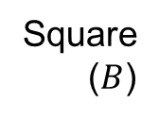
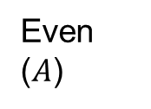
Starter
Sort the numbers 1 – 10 into this Venn diagram.
Then write down the numbers in $A∪B′$.
7
Even
($A$)
Square
($B$)
2
1
8
4
6
9
10
3
5
Notes:
Print starter task to save drawing time.

Slide 2
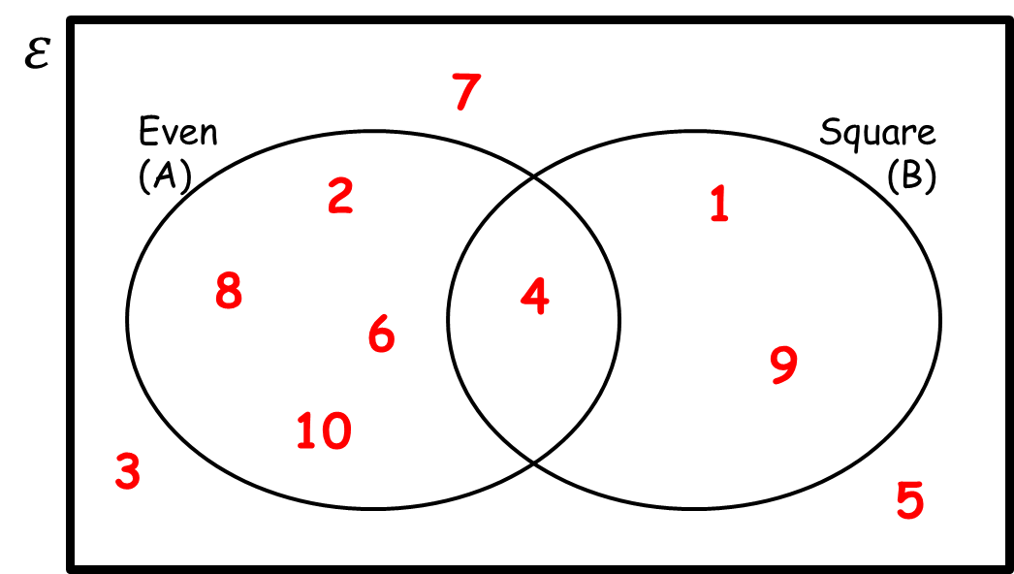
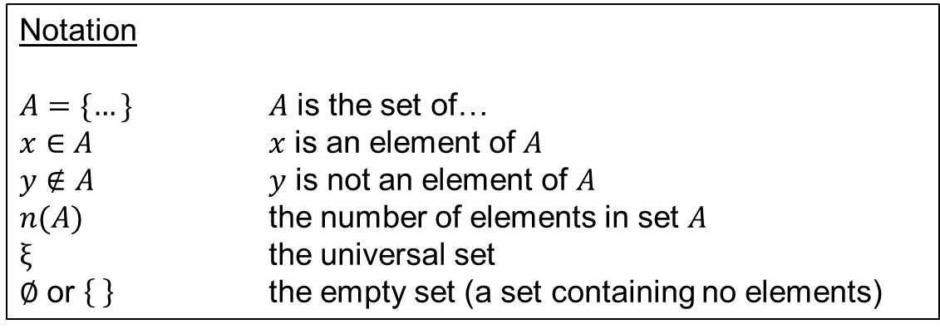
Sets come with strange notation, but a set is just a word for a collection of things.
Each thing in a set is called an element or member.
Capital letters represent a set, and lower case letters represent elements.
Notation
$A=\{…\}$ $A$ is the set of…
$x∈A$ $x$ is an element of $A$
$y∉A$ $y$ is not an element of $A$
$n(A)$ the number of elements in set $A$
$ξ$ the universal set
$∅$ or the empty set (a set containing no elements)

Slide 3
We can describe sets using numbers and symbols.
If a set is described using numbers and symbols, work out what the description means in words before you start working with the set.
$\left\{x:x<0\right\}$ describes the set of negative numbers.
$\left\{\left(x,y\right):y=2x+2\right\}$ describes the set of coordinates that lie on the line $y=2x+2$.
The colon means ‘such that’

Slide 4
Examples
List the members of $A=\{x:x<15\}$ if $ξ=\{x:x is a square number\}$
$A$ is the set of numbers $x$, such that $x$ is less than $15$
Elements of $A$ must be in the universal set
So $A=\{square numbers less than 15\}$
$A=\{1,4,9\}$
List the members of $A=\{x:x<15\}$ if $ξ=\{x:x is a prime number\}$
$A=\{prime numbers less than 15\}$
$A=\{2,3,5,7,11,13\}$
List the members of $A=\{x:x<15\}$ if $ξ=\{x:x>15\}$
$A=\{numbers that are both greater than 15 and less than 15\}$
No elements of $ξ$ fit the definition of an element of $A$, so $A$ is empty.
$A=∅$
Task – complete the set notation worksheet.

Slide 5
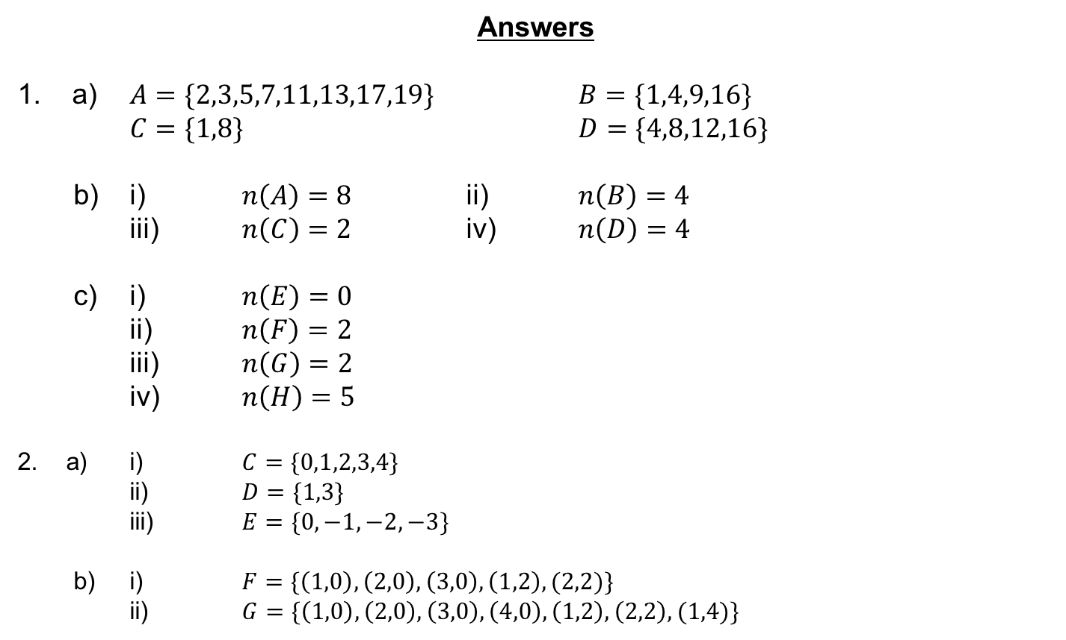
Answers
1. a) $A=\{2,3,5,7,11,13,17,19\}$ $B=\{1,4,9,16\}$
$C=\{1,8\}$ $D=\{4,8,12,16\}$
b) i) $n\left(A\right)=8$ ii) $n\left(B\right)=4$
iii) $n\left(C\right)=2$ iv) $n\left(D\right)=4$
c) i) $n\left(E\right)=0$
ii) $n\left(F\right)=2$
iii) $n\left(G\right)=2$
iv) $n\left(H\right)=5$
2. a) i) $C=\{0,1,2,3,4\}$
ii) $D=\{1,3\}$
iii) $E=\{0,−1,−2,−3\}$
b) i) $F=\{\left(1,0\right),\left(2,0\right),\left(3,0\right),\left(1,2\right),(2,2)\}$
ii) $G=\{\left(1,0\right),\left(2,0\right),\left(3,0\right),\left(4,0\right),\left(1,2\right),\left(2,2\right),(1,4)\}$

Slide 6
$$A$$
$$B$$
The intersection is where two sets overlap.
$A∩B$
This means $A$ and $B$.
AND rule
$$A$$
$$B$$
If you put two sets together, you get the union.
$A∪B$
This means $A$ or $B$.
OR rule
$$A$$
$$B$$
The complement of A is the region that is not A.
$A′$
This means not $A$.
Notes:
Print this slide for students to stick in books for reference (or ask them to copy).

Slide 7
Task
Use your pieces of tracing paper to correctly shade the Venn diagrams.
Don’t forget to keep looking at that exam question too ☺

Slide 8
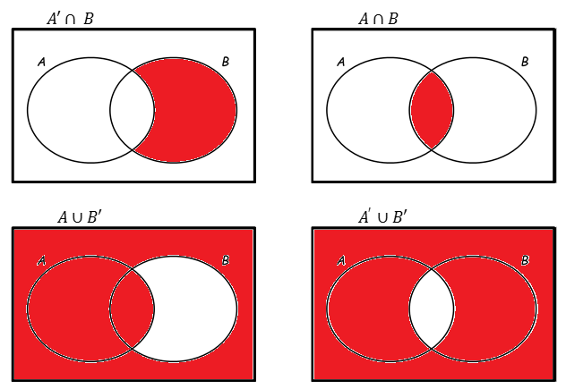
Answers

Slide 9
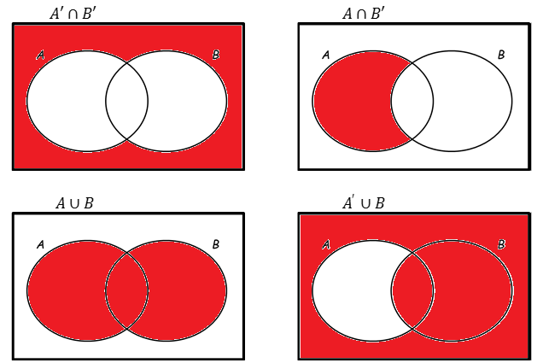
Answers

Slide 11
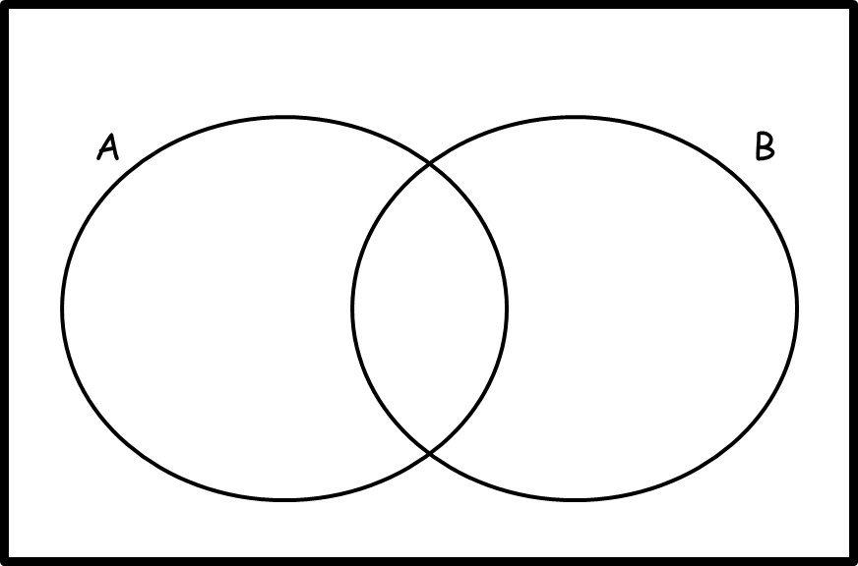
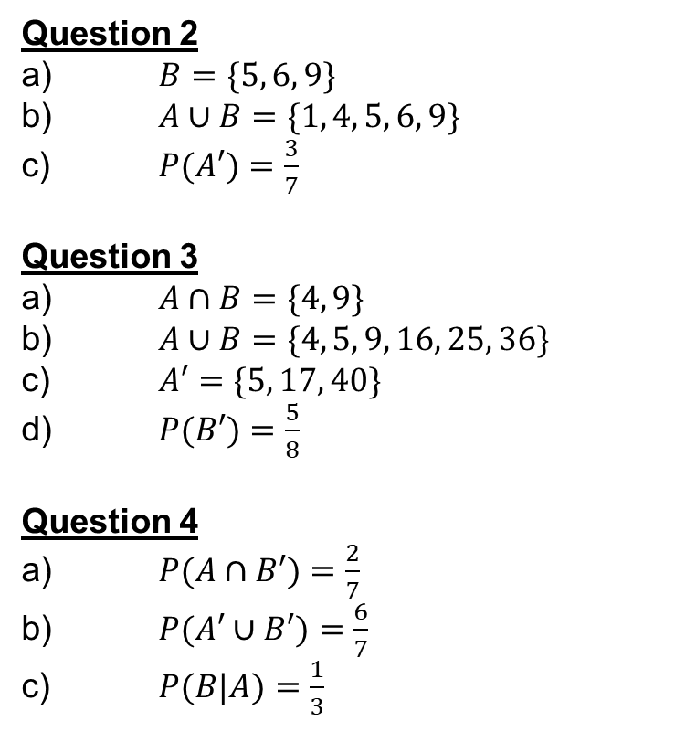

Answers
Question 1
a)
b) $P(A∩B)=\frac{1}{15}$
Question 2
a) $B=\{5, 6, 9\}$
b) $A∪B=\{1, 4, 5, 6, 9\}$
c) $P(A′)=\frac{3}{7}$
Question 3
a) $A∩B=\{4, 9\}$
b) $A∪B=\{4, 5, 9, 16, 25, 36\}$
c) $A′=\{5, 17, 40\}$
d) $P(B′)=\frac{5}{8}$
Question 4
a) $P(A∩B′)=\frac{2}{7}$
b) $P(A′∪B′)=\frac{6}{7}$
c) $P(B|A)=\frac{1}{3}$
4
8
11
14
3
6
5
9
15
10
12
1
2
7
13

Slide 12

Starter
Sort the numbers 1 – 10 into this Venn diagram.
Then write down the numbers in $A∪B′$.
7
Even
($A$)
Square
($B$)
2
1
$$A∪B′=$$
$$\{2, 4, 6, 8, 10, 3, 5, 7\}$$
8
4
6
9
10
3
5
Notes:
Print starter task to save drawing time.

