Slide 1
Next Term Bingo Use any 9 of these numbers NO REPEATS
13 0.25 -8 39
36 16 1.7 30
-5 12.5 48 26
62 31 15 49

Slide 2
4, 7, 10, 13, ?

Slide 3
25, 31, 37, 43, ?

Slide 4
1, 4, 9, 16, 25, ?

Slide 5
7, 15, 23, 31, ?

Slide 6
200, 100, 50, 25, ?

Slide 7
1, 3, 6, 10, ?

Slide 8
4, 1, -2, -5, ?

Slide 9
64, 16, 4, 1, ?

Slide 10
3, 6, 12, 24, ?

Slide 11
10, 14, 18, 22, ?

Slide 12
0.5, 0.8, 1.1, 1.4, ?

Slide 13
18, 29, 40, 51, ?

Slide 14
7, 10, 15, 22, ?

Slide 15
42, 39, 36, 33, ?

Slide 16
19, 13, 7, 1, ?

Slide 17
1, 1, 2, 3, 5, 8, ?

Slide 18
A sequence is a set of terms, in a definite order, where the terms are obtained by some rule.
A finite sequence ends after a certain number of terms.
An infinite sequence is one that continues indefinitely.
A sequence that increases by a constant amount is known as an arithmetic sequence.

Slide 19
A sequence is an ordered list of numbers and series is the sum of a list of numbers.
Example of a sequence:
$2, 4, 6, 8, 10 …$
Now if we add them up:
$2+4+8+10+ …$ this is a series.

Slide 20

Example
$2n−1$
1st term → $2×1−1=1$
2nd term → $2×2−1=3$
3rd term → $2×3−1=5$
n^{th} term → $2×n−1=2n−1$
$$2×0−1=−1$$
$$−2$$
$$+2$$
$$+2$$

Slide 21
$1$ $2$ $3$ … $n−1$ $n$
$a$
$a+d$
$a+2d$
$a+(n−2)d$
$a+(n−1)d$
$$+d$$
$$+d$$
$$+d$$
$$+d$$
$$+d$$
$a$ is the first term
$d$ is the difference
We can use this formula to find the $n^{th}$ term of an arithmetic sequence

Slide 22
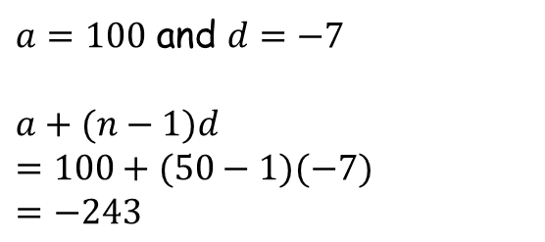
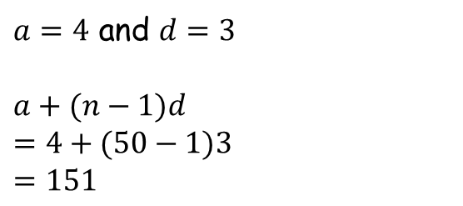
Example
Find the 50th term of the following sequences:
a) 4, 7, 10, 13… b) 100, 93, 86, 79…
$a=4$ and $d=3$
$a+(n−1)d$
$=4+(50−1)3$
$=151$
$a=100$ and $d=−7$
$a+(n−1)d$
$=100+(50−1)(−7)$
$=−243$

Slide 23
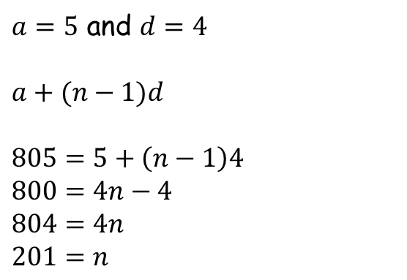
Example
For the following series, calculate the number of terms.
$$5 + 9 + 13 + 17 + 21 + … + 805$$
$a=5$ and $d=4$
$a+(n−1)d$
$805=5+\left(n−1\right)4$
$800=4n−4$
$804=4n$
$201=n$

Slide 24
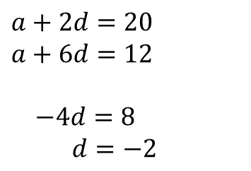
Example
Given that the 3rd term of an arithmetic sequence is 20 and the 7th is 12, work out the first term.
$n=3$
$a+\left(3−1\right)d=20$
$a+2d=20$
$n=7$
$a+\left(7−1\right)d=12$
$a+6d=12$
$a+2d=20$
$a+6d=12$
$−4d=8$
$d=−2$
$a=24$

Slide 25

Pause for thought…
When Karl Friedrich Gauss was in school
his teacher asked the class to add up the numbers from 1 to 100. Gauss did it in about 30 seconds. How did he do it?
$1+2+3+4+…+97+98+99+100$
How many 101s?
$=101+101+101+…+101$
$=50×101$
$=\frac{100}{2}×101$
$$\frac{n}{2}\left[2a+\left(n−1\right)d\right]$$
$=\frac{100}{2}×(1+100)$

Slide 26
We can use this formula to find sum of the first $n$ terms of an arithmetic series.
Where does $2a$ come from?
$$\frac{n}{2}\left[2a+\left(n−1\right)d\right]$$

Slide 27
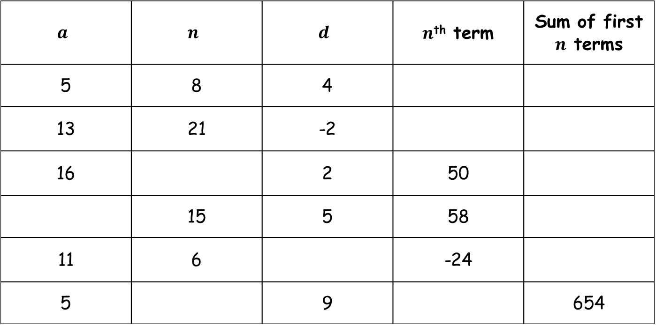
Task – copy and complete
$$a$$ | $$n$$ | $$d$$ | $n$^{th} term | Sum of first $n$ terms
5 | 8 | 4
13 | 21 | -2
16 |  | 2 | 50
 | 15 | 5 | 58
11 | 6 |  | -24
5 |  | 9 |  | 654
Notes:
All credit to TES user nebthenoob – thank you

Slide 28
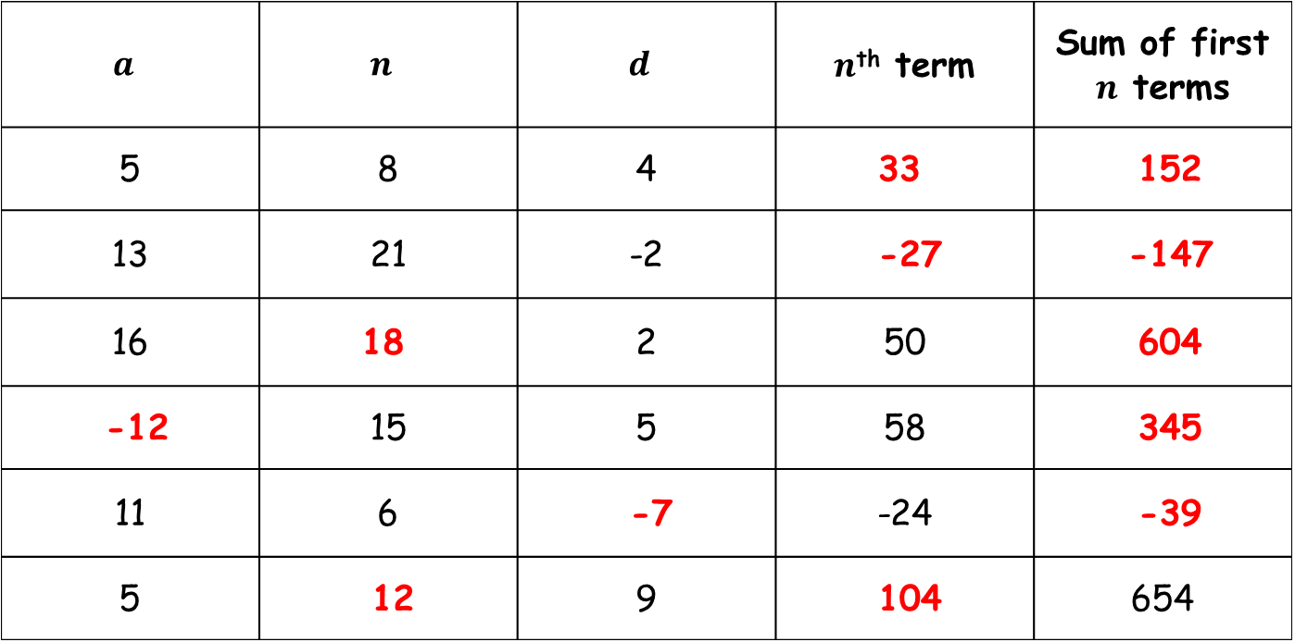
Answers
$$a$$ | $$n$$ | $$d$$ | $n$^{th} term | Sum of first $n$ terms
5 | 8 | 4 | 33 | 152
13 | 21 | -2 | -27 | -147
16 | 18 | 2 | 50 | 604
-12 | 15 | 5 | 58 | 345
11 | 6 | -7 | -24 | -39
5 | 12 | 9 | 104 | 654
Notes:
All credit to TES user nebthenoob – thank you

Slide 29
Task
Use the two formulae to answer the questions on the sheet.
Start by writing down any values of a, d or n that you know.
Some of the later questions will require you to use simultaneous equations to solve them.

Slide 30
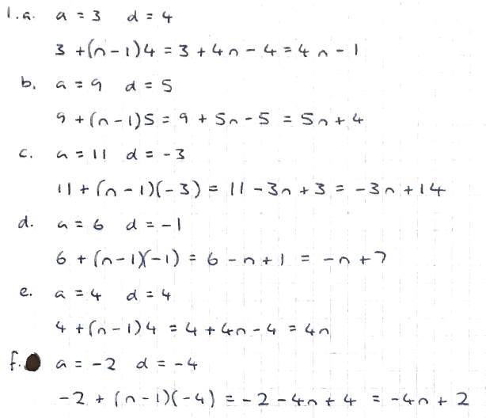
Answers

Slide 31
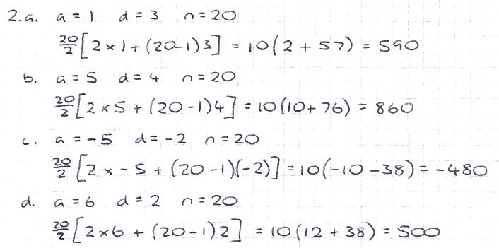
Answers

Slide 32
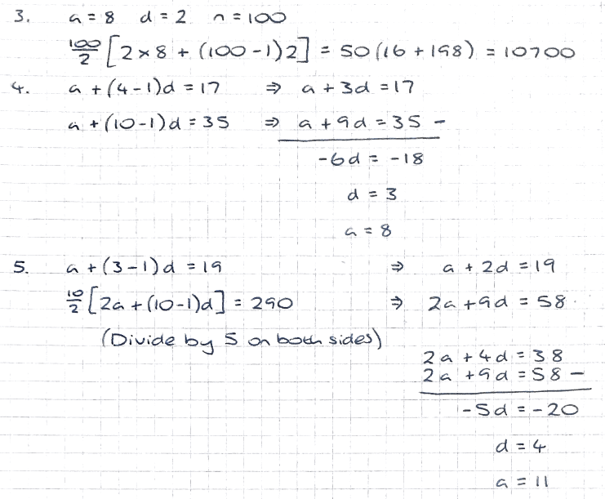
Answers

Slide 33
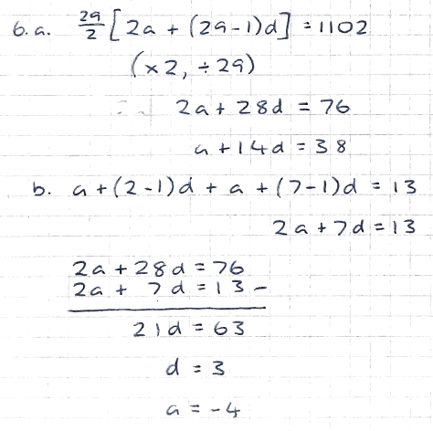
Answers

Slide 34
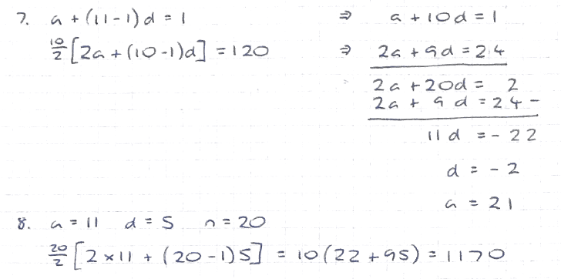
Answers

