Slide 1
Starter
Calculate the volume of the cuboid and the area of the circle. Give your answers to 3 s.f. where appropriate.
94 cm
9 m
89 cm
140 cm
1 170 000 cm³
or 1.17 m³
63.6 m²

Slide 2
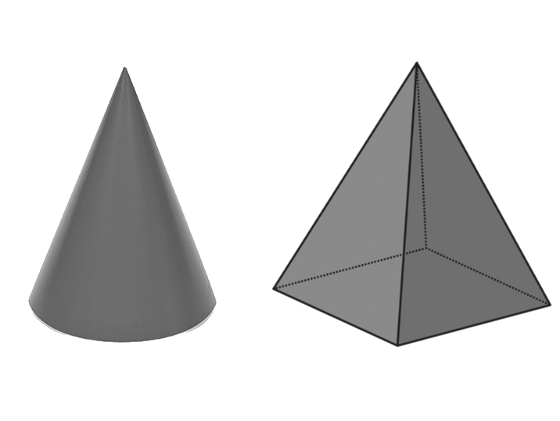
A pyramid is a polyhedron that has a base, which can be any polygon, and three or more triangular faces that meet at a point called the apex.
A cone is not technically a pyramid, but behaves like a pyramid when we calculate its volume.

Slide 3
Volume of Pyramids
Volume of pyramid = $\frac{1}{3}$ $×$ base area $×$ vertical height
Examples
Calculate the volume of the pyramids below:
12 cm
6 cm
13 cm
4 cm
20 cm
7 cm
$$\frac{1}{3}×20×13×12$$
$$\frac{1}{3}×7×4×6$$
$=1040$ cm³
$=56$ cm³

Slide 4
Volume of Cones
Volume of pyramid = $\frac{1}{3}$ $×$ base area $×$ vertical height
Examples
Calculate the volume of the cones below, giving your answers correct to 1 decimal place:
6 mm
8 cm
5 cm
11 mm
$$\frac{1}{3}×π×5.5²×6$$
$$\frac{1}{3}×π×5²×8$$
$=190.1$ mm³
$=209.4$ cm³

Slide 6
Answers
70 cm³
314.16 cm³
12 cm³
$m=$ 12.5 cm
$n=$ 1.31 cm

Slide 7
? cm
3 cm
4 cm
6
5
A
B
7
4
C
D

Slide 8
? cm
3 cm
4 cm
6
5
A
B
7
4
C
D

Slide 9
9 cm
6 cm
? cm
6.7
12
A
B
10.8
13.6
C
D

Slide 10
9 cm
6 cm
? cm
6.7
12
A
B
10.8
13.6
C
D

Slide 11
8 cm
? cm
3 cm
7.4
8.5
A
B
9.3
6.6
C
D

Slide 12
8 cm
? cm
3 cm
7.4
8.5
A
B
9.3
6.6
C
D

Slide 13
Surface Area of Cones
$$l$$
Surface area of cone $=πr²+πrl$
$$h$$
Area of base
Curved surface area (you get given this bit in exams!)
$$r$$
Example
Calculate the surface area of this cone. Give your answer to 1 d.p.
$$(π×4²)+(π×4×9)$$
$=163.4$ cm²
9 cm
4 cm

Slide 14
Surface Area of Cones
$$l$$
Surface area of cone $=πr²+πrl$
$$h$$
Area of base
Curved surface area (you get given this bit in exams!)
$$r$$
Example
Sometimes, we need to calculate $l$ first.
$$l=\sqrt{6^{2}+4^{2}}$$
$=7.211$… cm
6 cm
$$(π×4²)+(π×4×7.211…)$$
$=140.9$ cm²
4 cm

Slide 16
Answers
75.4 cm² 327.7 cm² 314.2 cm²
282.7 cm² 226.7 cm² 233.2 cm²
2224.6 cm² 10 cm

Slide 17
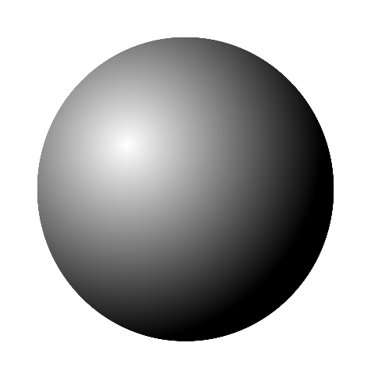
Volume of a sphere $=\frac{4}{3}πr^{3}$
$$r$$
Surface area of a sphere $=4πr²$
Example
Calculate the volume and surface area of the sphere below:
Volume $=\frac{4}{3}×π×8^{3}$
$=2144.7$ cm³
8 cm
Surface area $=4×π×8²$
$=804.2$ cm²
Notes:
17

Slide 19
Answers
1) a) V = 113.1cm³, SA = 113.1cm²
b) V = 904.8cm³, SA = 452.4cm²
c) V = 4188.8cm³, SA = 1256.6cm² d) V = 1436.8cm³, SA = 615.8cm²
e) V = 179.6cm³, SA = 153.9cm²
f) V = 47.7cm³, SA = 63.6cm²
2) a) 1963.5cm² b) 8181.2cm³
3) V = 14137.2cm³, height = 125cm

