Slide 1






Starter
Factorise and solve the following quadratic equations:
$x²+7x+12=0$
$x²+10x+16=0$
$x²−6x+8=0$
$x²−2x−35=0$
$x²+3x−40=0$
$x²−49=0$
$2x²−7x−4=0$
$3x²+11x+6=0$
$6x²−7x−3=0$
$(x+3)(x+4)=0$
$x=−3$ or $−4$
$(x+2)(x+8)=0$
$x=−2$ or $−8$
$(x−2)(x−4)=0$
$x=2$ or $4$
$(x−7)(x+5)=0$
$x=7$ or $−5$
$(x+8)(x−5)=0$
$x=−8$ or $5$
$(x−7)(x+7)=0$
$x=7$ or $−7$
$(2x+1)(x−4)=0$
$x=−½$ or $4$
$(3x+2)(x+3)=0$
$x=−2/3$ or $−3$
$(2x−3)(3x+1)=0$
$x=3/2$ or $−1/3$

Slide 2
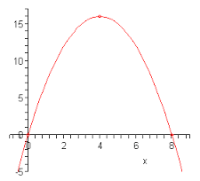
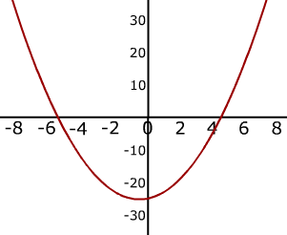
Glossary
Parabola – shape of a quadratic graph
Root – (or solution) where the graph intercepts the $x$-axis
Turning point – (or minimum/maximum) where the graph stops decreasing and starts increasing or vice-versa.

Slide 3
Sketch the graph of $y=x²−1$,
for $−3≤x≤3$, then identify the turning point and any real roots.
$$x$$ | -3 | -2 | -1 | 0 | 1 | 2 | 3
$$y$$
8
3
0
-1
0
3
8
Plot the coordinates.
Join with a smooth curve.
Turning point
(0, -1)
Roots
(-1, 0) and (1, 0)

Slide 4
Sketch the graph of $y=x²+4$,
for $−3≤x≤3$, then identify the turning point and any real roots.
$$x$$ | -3 | -2 | -1 | 0 | 1 | 2 | 3
$$y$$
13
8
5
4
5
8
13
Plot the coordinates.
Join with a smooth curve.
Turning point
(0, -1)
There are no real roots

Slide 5
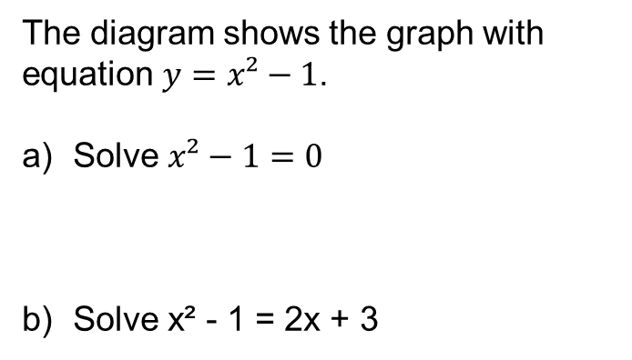
The diagram shows the graph with equation $y=x²−1$.
Solve $x²−1=0$
Solve x² - 1 = 2x + 3
Just identify the roots of the equation
$x=−1$ or $1$
Sketch the graph $y=2x+3$ and identify the points where the graphs intersect
$x=−1.2$ or $3.2$

Slide 7

Answers
1c) $x$ = 4.3 or 0.7
d) (2.5, - 3.3)
2c) $x$ = 4 or -1
d) (1.5, -6.3)
3c) $x$ = 3.6 or -0.6
d) (1.5, -4.3)
4c) $x$ = 4.2 or -0.2
d) (2, -5)

