Slide 1
Autumn Term
Spring Term
Summer Term
Notes:
To use:
Click the term.
On the next slide, select the week of the term and the lesson of the week.
Give students 5 to 10 minutes on the questions.
Go through the solutions as a class – answers are not included as there is no point in using this resource if you do not go though full solutions.
No printing required!

Slide 2
Autumn Term
Week 1 | Lesson 1 | Lesson 2 | Lesson 3 | Lesson 4
Week 2 | Lesson 1 | Lesson 2 | Lesson 3 | Lesson 4
Week 3 | Lesson 1 | Lesson 2 | Lesson 3 | Lesson 4
Week 4 | Lesson 1 | Lesson 2 | Lesson 3 | Lesson 4
Week 5 | Lesson 1 | Lesson 2 | Lesson 3 | Lesson 4
Week 6 | Lesson 1 | Lesson 2 | Lesson 3 | Lesson 4
Week 7 | Lesson 1 | Lesson 2 | Lesson 3 | Lesson 4
Week 8 | Lesson 1 | Lesson 2 | Lesson 3 | Lesson 4
Week 9 | Lesson 1 | Lesson 2 | Lesson 3 | Lesson 4
Week 10 | Lesson 1 | Lesson 2 | Lesson 3 | Lesson 4
Week 11 | Lesson 1 | Lesson 2 | Lesson 3 | Lesson 4
Week 12 | Lesson 1 | Lesson 2 | Lesson 3 | Lesson 4
Week 13 | Lesson 1 | Lesson 2 | Lesson 3 | Lesson 4
Week 14 | Lesson 1 | Lesson 2 | Lesson 3 | Lesson 4

Slide 3
Spring Term
Week 1 | Lesson 1 | Lesson 2 | Lesson 3 | Lesson 4
Week 2 | Lesson 1 | Lesson 2 | Lesson 3 | Lesson 4
Week 3 | Lesson 1 | Lesson 2 | Lesson 3 | Lesson 4
Week 4 | Lesson 1 | Lesson 2 | Lesson 3 | Lesson 4
Week 5 | Lesson 1 | Lesson 2 | Lesson 3 | Lesson 4
Week 6 | Lesson 1 | Lesson 2 | Lesson 3 | Lesson 4
Week 7 | Lesson 1 | Lesson 2 | Lesson 3 | Lesson 4
Week 8 | Lesson 1 | Lesson 2 | Lesson 3 | Lesson 4
Week 9 | Lesson 1 | Lesson 2 | Lesson 3 | Lesson 4
Week 10 | Lesson 1 | Lesson 2 | Lesson 3 | Lesson 4
Week 11 | Lesson 1 | Lesson 2 | Lesson 3 | Lesson 4
Week 12 | Lesson 1 | Lesson 2 | Lesson 3 | Lesson 4
Week 13 | Lesson 1 | Lesson 2 | Lesson 3 | Lesson 4
Week 14 | Lesson 1 | Lesson 2 | Lesson 3 | Lesson 4

Slide 4
Summer Term
Week 1 | Lesson 1 | Lesson 2 | Lesson 3 | Lesson 4
Week 2 | Lesson 1 | Lesson 2 | Lesson 3 | Lesson 4
Week 3 | Lesson 1 | Lesson 2 | Lesson 3 | Lesson 4
Week 4 | Lesson 1 | Lesson 2 | Lesson 3 | Lesson 4
Week 5 | Lesson 1 | Lesson 2 | Lesson 3 | Lesson 4
Week 6 | Lesson 1 | Lesson 2 | Lesson 3 | Lesson 4
Week 7 | Lesson 1 | Lesson 2 | Lesson 3 | Lesson 4
Week 8 | Lesson 1 | Lesson 2 | Lesson 3 | Lesson 4
Week 9 | Lesson 1 | Lesson 2 | Lesson 3 | Lesson 4
Week 10 | Lesson 1 | Lesson 2 | Lesson 3 | Lesson 4
Week 11 | Lesson 1 | Lesson 2 | Lesson 3 | Lesson 4
Week 12 | Lesson 1 | Lesson 2 | Lesson 3 | Lesson 4
Week 13 | Lesson 1 | Lesson 2 | Lesson 3 | Lesson 4
Week 14 | Lesson 1 | Lesson 2 | Lesson 3 | Lesson 4

Slide 5
Simplify $\frac{a^{4}×a^{3}}{a^{−2}}$
Solve the simultaneous equations
$3x+2y=4$
$4x+5y=17$
Calculate the area of the circle. Give your answer in terms of $π$.
8 cm

Slide 6
Write $6 500 000$ as a number in standard form.
Describe fully the single transformation which maps the blue shape onto the red shape.
Copy the Venn diagram and shade the region that represents $P(A∪B)$.
$$A$$
$$B$$

Slide 7
Draw an 8 cm line in your exercise book. Use compasses and a ruler to construct a perpendicular bisector.
Factorise $x^{2}+6x+8$.
Calculate the length of the side labelled $x$. Give your answer correct to 2 decimal places.
$x$ cm
5 cm
8 cm

Slide 8
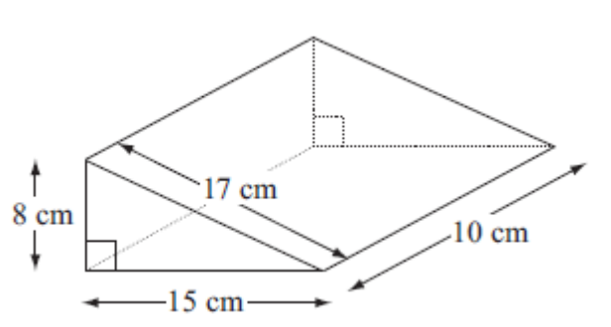
a. Sketch the graphs of $y=2x+1$ and $y=−4x−2$ on the same pair of axes.
b. Use your graphs to solve the simultaneous equations $y=2x+1$ and $y=−4x−2$.
The probability that a biased dice will land on a five is 0.3. Megan is going to roll the dice 400 times. Work out an estimate for the number of times the dice will land on a five.
Work out the volume of the triangular prism.

Slide 9
Find the equation of the line with a gradient 2 that passes through the coordinate (3, 4).
A bag of potatoes weighs 7 kg, correct to the nearest kilogram. What is the least possible weight of the bag of apples?
In a sale, normal prices are reduced by 20%. Andrew bought a saddle for his horse in the sale. The sale price of the saddle was £220. Calculate the normal price of the saddle.

Slide 10
Are the graphs $y=3x+2$ and $y=−3x−5$ parallel? You must explain your answer.
Calculate the size of the side labelled $x$. Give your answer correct to 3 significant figures.
Toby invested £4500 for 2 years in a savings account. He was paid 4% per annum compound interest. How much did Toby have in his savings account after 2 years?
$x$ cm
36$°$
4 cm

Slide 11
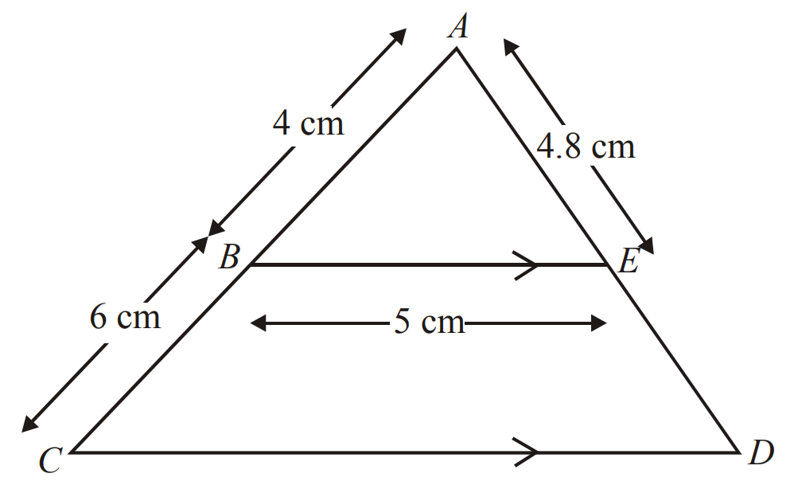
Calculate the mode from this frequency table.
Number of goals | 0 | 1 | 2 | 3 | 4
Frequency | 7 | 8 | 5 | 2 | 1
BE is parallel to CD. ABC and AED are straight lines. AB = 4 cm, BC = 6 cm, BE = 5 cm, AE = 4.8 cm. Calculate the length of CD.
Solve the inequality $4x+1>11$.

Slide 12
What are the next two terms in the sequence: 1, 3, 6, 10, 15, …, …
Write the exact value of cos $30°$.
There are 5 red pens, 3 blue pens and 2 green pens in a box. Gary takes at random a pen from the box and gives the pen to his friend. Gary then takes at random another pen from the box. Work out the probability that both pens are the same colour.

Slide 13
Calculate the angle labelled $x$ in the diagram.
Solve $3y+10=5y+3$.
Stuart drives 180 km in 2 hours 15 minutes. Work out Stuart’s average speed.
$$x°$$
$$104°$$
$$76°$$
$$53°$$

Slide 14
Name the part of the circle shown in red on the diagram.
The weight of a piece of wire ($w$ grams) is directly proportional to its length ($l$ cm). $w$ is given by the formula: $w=30l$. Find the length of a wire weighing 75 grams.
Jack sows 300 wildflower seeds. The probability of a seed flowering is 0.7. Work out an estimate for the number of these seeds that will flower.

Slide 15
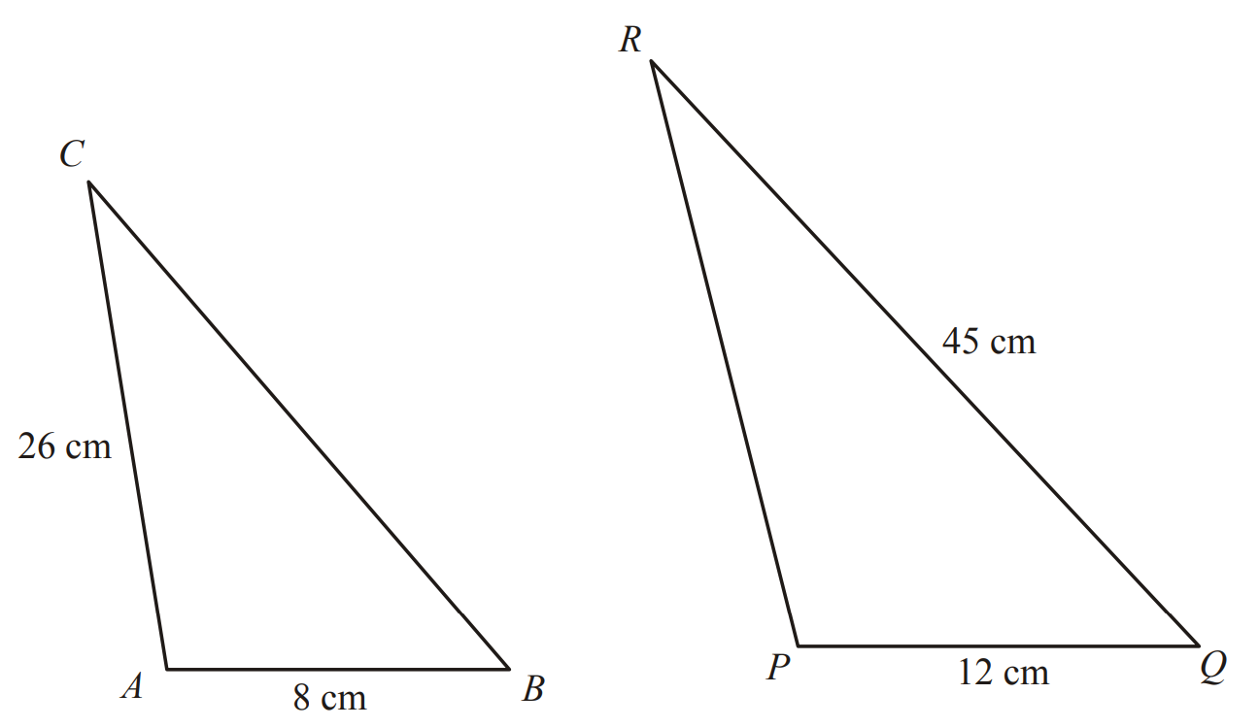
Calculate the value of $(2×{10}^{5})×(3×{10}^{6})$, giving your answer in standard form.
Factorise and solve $x^{2}+7x+12=0$.
The two triangles ABC and PQR are mathematically similar. Calculate the length of PR.

Slide 16
What type of correlation does the scatter graph show? What could the two variables be?
Factorise $x^{2}−49$.
$a=\left(\begin{matrix}2 \\ 3\end{matrix}\right)$ and $b=\left(\begin{matrix}1 \\ 5\end{matrix}\right)$
Write as a column vector $a+b$.

Slide 17
Accurately construct the triangle below in your exercise book.
Make u the subject of the formula $v^{2}=u^{2}+2as$.
Jacob answered 80% of the questions in a test correctly. He answered 32 of the questions correctly. Work out the total number of questions in the test.
$$65°$$
$$48°$$
6 cm

Slide 18
a. Sketch the graphs of $y=3x−1$ and $y=−4x+6$ on the same pair of axes.
b. Use your graphs to solve the simultaneous equations $y=3x−1$ and $y=−4x+6$.
Calculate the circumference of the circle. Give your answer correct to 3 significant figures.
There are now 29 girls in a class that originally had 25 girls in it. What is the percentage increase in the number of girls in the class?
3 cm

Slide 19
Describe fully the single transformation which maps the blue shape onto the red shape.
Jamie goes on holiday to Florida. The exchange rate is £1 = 1.70 dollars. He changes £900 into dollars. How many dollars should he get?
Solve the simultaneous equations
$3x+5y=19$
$4x–2y=–18$

Slide 20
Expand and simplify $(x−4)(x+7)$.
Calculate the length of the side labelled x. Give your answer correct to 3 significant figures.
Calculate the $n^{th}$ term of the sequence: 5, 8, 11, 14, …
11 cm
$x$ cm
8 cm

Slide 21
What are the next two terms in the sequence: 1, 4, 9, 16, …, …
The diagram shows a patio in the shape of a rectangle. The patio is 3.6 m long and 3 m wide. Matthew is going to cover the patio with paving slabs. Each paving slab is a square of side 60 cm. Matthew buys 32 of the paving slabs. Does Matthew buy enough paving slabs to cover the patio?
3.6 m
Solve the inequality
$3(2y+1)>10$
3 m

Slide 22
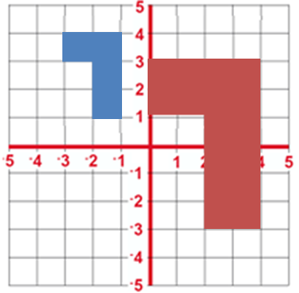
Given that $43×92=3956$, without using a calculator, work out the value of $0.43×920$.
Describe fully the single transformation which maps the blue shape onto the red shape.
Factorise $x^{2}−x+42$.

Slide 23
Simplify: $f^{7}÷f^{12}$
Calculate the distance between the points (4, 5) and (3, -2). Give your answer correct to 2 decimal places.
Copy the Venn diagram and shade the region that represents $P(A∩B)$.
$$A$$
$$B$$

Slide 24
Which of the shapes below are congruent to the red shape?
The value of a car depreciates by 35% each year. At the end of 2007 the value of the car was £5460. Work out the value of the car at the end of 2006.
A car travels for 3 hours. Its average speed is 75 km/h. Work out the total distance the car travels.
A
B
C
D

Slide 25
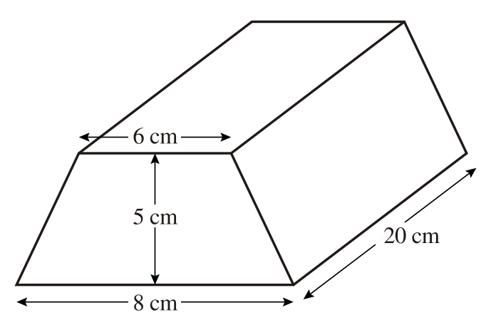
Find the equation of the line which passes through the points (3, 5) and (9, 9).
Make $x$ the subject of the formula $2x+a=b(x–2)$.
The diagram shows a triangular prism. The cross-section of the prism is a trapezium. The lengths of the parallel sides of the trapezium are 8 cm and 6 cm. The distance between the parallel sides of the trapezium is 5 cm. The length of the prism is 20 cm. Work out the volume of the prism.

Slide 26
Calculate the value of $\frac{8×{10}^{9}}{4×{10}^{3}}$, giving your answer in standard form.
Calculate the highest common factor of 72 and 54.
Solve $4x+3=5x−1$.

Slide 27
Name the part of the circle shown in red on the diagram.
Wendy goes to a fun fair. She has one go at Hoopla. She has one go on the Coconut shy. The probability that she wins at Hoopla is 0.4. The probability that she wins on the Coconut shy is 0.3. Draw a probability tree diagram.
Calculate the sum of all the angles in a pentagon.

Slide 28
Draw an angle of $75°$ in your exercise book. Use compasses and a ruler to bisect it.
Factorise and solve $x^{2}−2x−48=0$.
Jane bought a coat in a 15% off sale. The original price of the coat was £80. What did Jane pay for it?

Slide 29
Calculate the size of an exterior angle of a regular pentagon.
Solve $2y+17=6y+5$.
Owen walked to his Grandma’s house from his own at a speed of 3 mph. It took him 40 minutes. How far away does his Grandma live?

Slide 30
Calculate the median from this frequency table.
Number of goals | 0 | 1 | 2 | 3 | 4
Frequency | 7 | 8 | 5 | 2 | 1
Describe fully the single transformation which maps the blue shape onto the red shape.
$x$ is inversely proportional to $y$. $x$ is given by the formula: $x=\frac{1000}{y}$. Find the value of $x$ when $y$ = 50

Slide 31
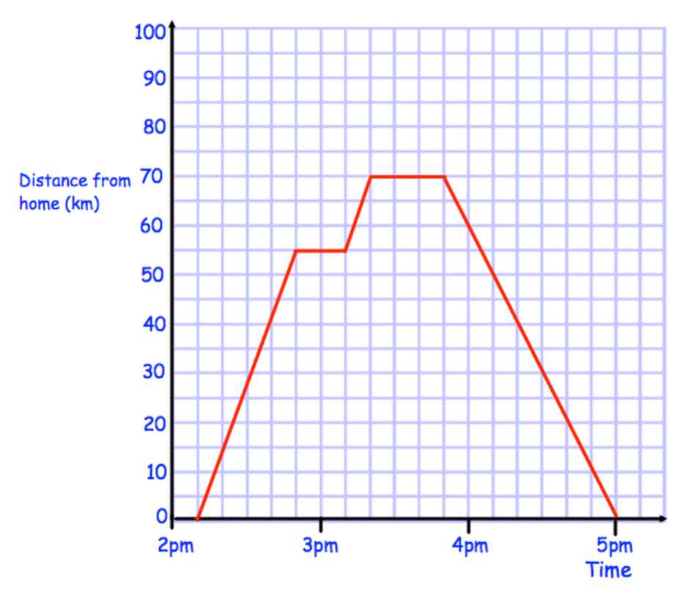
Are the graphs $y=3x+2$ and $y=−3x−5$ perpendicular? You must explain your answer.
Roy visited his aunt and then returned home. The distance-time graph shows information about Royʼs journey. Work out the total distance travelled by Roy.
Solve $2x+8=6x−2$.

Slide 32
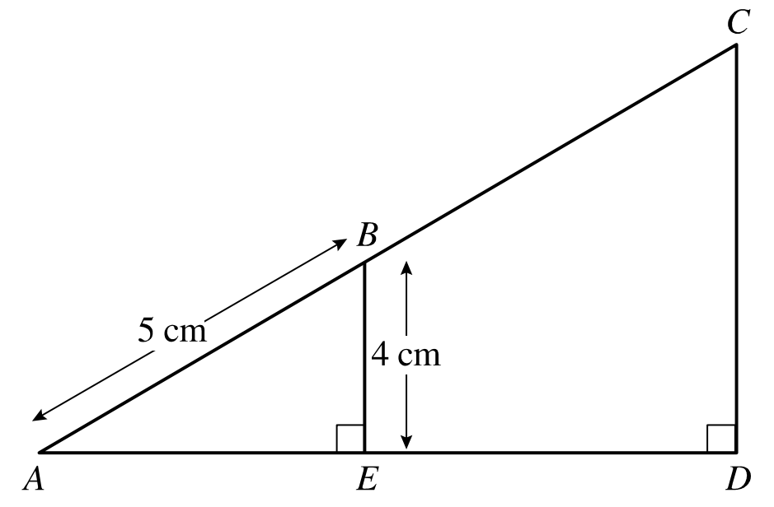
What type of correlation does the scatter graph show? What could the two variables be?
In the diagram, AB: AC = 1: 3. Calculate the length of CD.
Expand and simplify:
$2\left(x+6\right)−3(x−5)$

Slide 33
Factorise $x^{2}−81$.
Calculate the length of the line segment $AB$ where $A$ is the point (3, -2) and $B$ is the point (-7, 4). Give your answer correct to 3 significant figures.
Calculate the first five terms of the sequence $−3n+5$.

Slide 34
Accurately construct the triangle below in your exercise book.
Factorise and solve $x^{2}−36=0$.
The price of Joe’s train ticket increased by 6%. It originally cost £45. What is the new price?
4 cm
$$55°$$
7 cm

Slide 35
A circle has an area of 120cm² to the nearest 10cm². Write down the limits of accuracy, in terms of $r$, using inequality notation.
Calculate the size of the angle labelled $θ$. Give your answer correct to 1 decimal place.
Calculate the $n^{th}$ term of the sequence:
9, 4, -1, -6, …
2.5 cm
$$θ°$$
4 cm

Slide 36
Copy and complete the table of values, then sketch the graph of $y=x^{2}+x−3$.
Tania went to Italy. She changed £325 into euros (€). The exchange rate was £1 = €1.68. Change £325 into euros (€).
Clean Ltd manufacture components for washing machines. The probability that a component. will be made within a tolerance of one tenth of a millimetre is 0.995. Clean Ltd manufacture 10 000 components each day. Work out an estimate for the number of components that will not be within the tolerance of one tenth of a millimetre each day.
$$x$$ | -3 | -2 | -1 | 0 | 1 | 2 | 3
$$y$$

Slide 37
Describe fully the single transformation which maps the blue shape onto the red shape.
$n$ is an integer such that $6<3n≤15$. List all the possible values of $n$.
Calculate the lowest common multiple of 18 and 24.

Slide 38
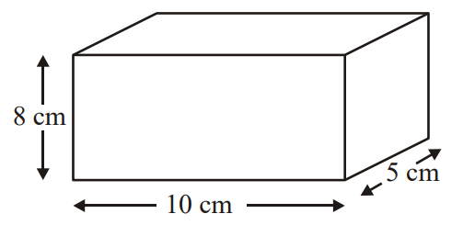
Write $3.9×{10}^{−5}$ as an ordinary number.
Write the exact value of tan $45°$.
The diagram shows a cuboid of dimensions 10cm × 8cm × 5cm. Work out the total surface area of the cuboid. State the units with your answer.

Slide 39
Calculate the length of the side labelled $x$. Give your answer correct to 3 significant figures.
Solve $12x+7=5$.
223 m
126 m
A shop sells CDs and DVDs. In one week the number of CDs sold and the number of DVDs sold were in the ratio 3:5. The total number of CDs and DVDs sold in the week was 728. Work out the number of CDs sold.
$x$ m

Slide 40
Calculate the sum of all the angles of an octagon.
$A=\frac{h(x+10)}{2}$
$A=27$ and $h=4$. Work out the value of $x$.
Show that $\frac{11}{12}+\frac{5}{6}=1\frac{3}{4}$.

Slide 41
What does it mean for two shapes to be mathematically similar?
$a=\left(\begin{matrix}2 \\ 3\end{matrix}\right)$ and $b=\left(\begin{matrix}1 \\ 5\end{matrix}\right)$
Write as a column vector $2a−b$.
Work out $3\frac{2}{3}−1\frac{7}{8}$.

Slide 42
Given that $43×92=3956$, without using a calculator, work out the value of $4300×0.92$.
Factorise $x^{2}−3x−18$.
Calculate the size of an interior angle of a regular heptagon.

Slide 43
Expand and simplify $(y−8)(y−3)$.
A piece of elastic 48 cm long is stretched to 60 cm. What percentage of the original length is the increase?
Use a ruler and pair of compasses to accurately construct an equilateral triangle of side 7 cm.

Slide 44
Calculate the distance between the coordinates (0, 6) and (4, -5). Give your answer correct to 2 decimal places.
Make $x$ the subject of the formula $x(2+a)=b(x+3)$.
Calculate the area of the circle with a radius of 4.5 cm. Give your answer correct to 3 significant figures.

Slide 45
Name the part of the circle shown in red on the diagram.
Factorise and solve $x^{2}−100=0$.
Amy, Beth and Colin share 36 sweets in the ratio 2 : 3 : 4. Work out the number of sweets that each of them receives.

Slide 46
Describe fully the single transformation which maps the blue shape onto the red shape.
Calculate $\frac{8}{11}÷\frac{4}{9}$.
Rearrange the formula to make $h$ the subject:
$V=πr^{2}h$

Slide 47
What are the next two terms in the sequence: 1, 8, 27, 64, …, …
Copy the Venn diagram and shade the region that represents $P(A′)$.
Using a table of values, or otherwise, sketch the graph of $x+y=6$ in your exercise book.
$$A$$
$$B$$

Slide 48
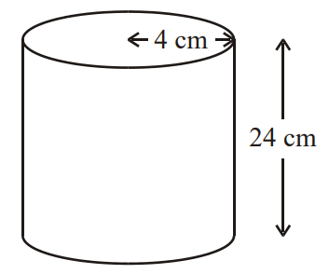
Calculate the range from this frequency table.
A cylinder has a height of 24 cm and a radius of 4 cm. Work out the volume of the cylinder. Give your answer correct to 3 significant figures.
Solve the inequality $4x+3≤5x−1$.
Number of goals | 0 | 1 | 2 | 3 | 4
Frequency | 7 | 8 | 5 | 2 | 1

Slide 49
Simplify: $m^{−4}$
Solve the simultaneous equations
$5x+2y=11$
$4x–3y=18$
The mass of 5 m³ of copper is 44 800 kg. Work out the density of copper.

Slide 50
Calculate the length of the size labelled $x$. Give your answer correct to 2 decimal places.
Mario invests £2000 for 3 years at 5% per annum compound interest. Calculate the value of the investment at the end of 3 years.
Solve $3\left(2x−4\right)=18$.
$x$ cm
4 cm
36$°$

Slide 51
Copy and complete the table of values, then sketch the graph of $y=x^{3}+x+1$.
A garage sells cars. It offers a discount of 20% off the normal price for cash. Adam pays £5200 cash for a car. Calculate the normal price of the car.
Calculate the highest common factor of 36 and 48.
$$x$$ | -3 | -2 | -1 | 0 | 1 | 2 | 3
$$y$$

Slide 52
A rectangular rugby pitch has width 74 metres, measured to the nearest metre. Write down the limits of accuracy of the width, in terms of $w$, using inequality notation.
In the diagram all measurements are in centimetres. The perimeter of the quadrilateral is twice the perimeter of the triangle. Work out the perimeter of the quadrilateral.
Factorise $5x+10$.

Slide 53
Find the equation of the line with a gradient -3 which passes through the point (-3, 1).
Describe fully the single transformation which maps the blue shape onto the red shape.
Expand and simplify $5\left(2a+b\right)+3(a−b)$.

Slide 54
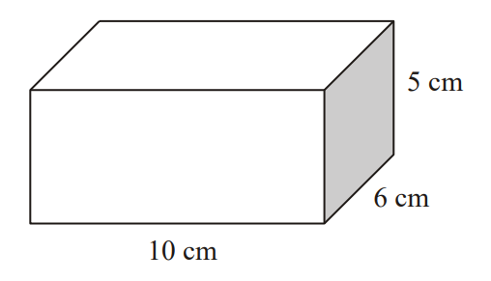
Calculate the size of an interior angle of a regular decagon.
Solve $2\left(x+5\right)=4(3x−5)$.
Here is a cuboid. What is the total surface area of the cuboid?

Slide 55
Accurately construct the triangle below in your exercise book.
Factorise and solve $x^{2}−5x+6=0$.
Calculate $2\frac{3}{4}×\frac{7}{8}$.
4 cm
9 cm
8 cm

Slide 56
a. Sketch the graphs of $y=−2x+2$ and $y=3x+12$ on the same pair of axes.
b. Use your graphs to solve the simultaneous equations $y=−2x+2$ and $y=3x+12$ .
Calculate the $n^{th}$ term of the sequence: 1, 4, 9, 16, …
$V=3b+2b^{2}$. Find the value of $V$ when $b=−4.$

Slide 57
What type of correlation does the scatter graph show? What could the two variables be?
Write the exact value of sin $60°$.
$a=\left(\begin{matrix}2 \\ 3\end{matrix}\right)$ and $b=\left(\begin{matrix}1 \\ 5\end{matrix}\right)$
Write as a column vector $3a+2b$.

Slide 58
What does it mean for two shapes to be mathematically congruent?
Roy visited his aunt and then returned home. The distance-time graph shows information about Royʼs journey. Work out Royʼs average speed on the journey home.
Show that $\frac{6}{7}+\frac{5}{16}=1\frac{19}{112}$

Slide 59
Given that $43×92=3956$, without using a calculator, work out the value of $5956÷0.92$.
Janet and John win £2400 on the lottery and decide to split their winnings in the ratio 7 : 5. How much does Janet receive?
Solve $4x+2=−2x−7$.

Slide 60
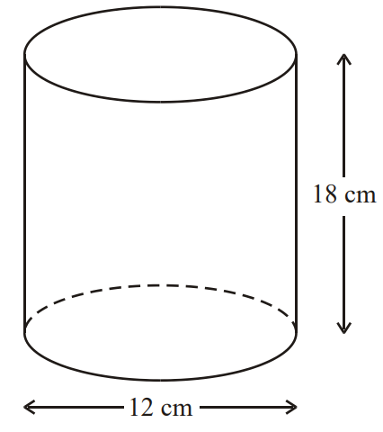
Draw a 9 cm line in your exercise book. Use compasses and a ruler to construct a perpendicular bisector.
Factorise $m^{2}−16$.
The diagram shows a solid cylinder. The cylinder has a diameter of 12 cm and a height of 18 cm. Calculate the total surface area of the cylinder. Give your answer correct to 3 significant figures.

Slide 61
Copy and complete the table of values, then sketch the graph of $y=x^{2}+4x−6$.
A man weighs 65Kg. After two weeks on a diet he weighs 58Kg. What is his percentage decrease in weight?
Factorise fully $2a^{2}b+6ab^{2}$.
$$x$$ | -3 | -2 | -1 | 0 | 1 | 2 | 3
$$y$$

Slide 62
A student bought a pair of sunglasses in the USA. He paid $35.50. In England, an identical pair of sunglasses costs £26.99. The exchange rate is £1 = $1.42. In which country were the sunglasses cheaper, and by how much?
There are only red marbles and green marbles in a bag. There are 5 red marbles and 3 green marbles. Dwayne takes at random a marble from the bag. He does not put the marble back in the bag. Dwayne takes at random a second marble from the bag. Draw a probability tree diagram.
A 20 Euro note is a rectangle 133 mm long and 72 mm wide. A 500 Euro Note is a rectangle 160 mm long and 82 mm wide. Show that the two rectangles are not mathematically similar.

Slide 63
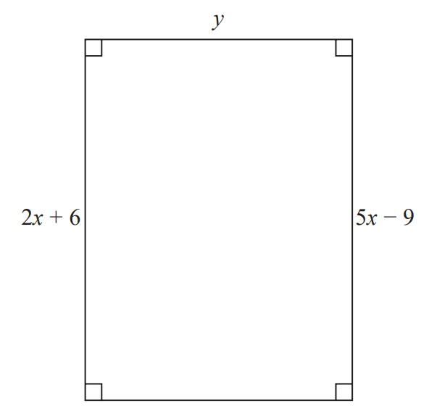
Describe fully the single transformation which maps the blue shape onto the red shape.
In a sale, the normal price of a book is reduced by 30%. The sale price of the book is £2.80. Work out the normal price of the book.
Here is a rectangle. All measurements are in centimetres. The area of the rectangle is 48 cm². Show that y = 3.

Slide 64
Calculate the value of $(3.4×{10}^{4})×(2.9×{10}^{−2})$, giving your answer in standard form.
Calculate the first five terms of the sequence $8−2n$.
Kiaria is 7 years older than Jay. Martha is twice as old as Kiaria. The sum of their three ages is 77. Find the ratio of Jay’s age to Kiaria’s age to Martha’s age.

Slide 65
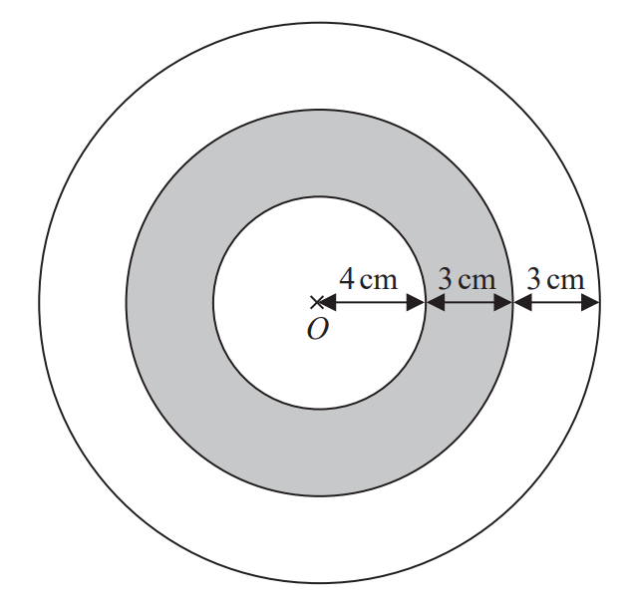
Write an equation of a graph that is parallel to $y=2x+7$.
The diagram shows a logo made from three circles. Each circle has centre O. Daisy says that exactly $\frac{1}{3}$ of the logo is shaded. Is Daisy correct?
Use your calculator to work out the value of
$$\frac{595}{{4.08}^{2}+5.3}$$
Give your answer correct to 3 significant figures.

Slide 66
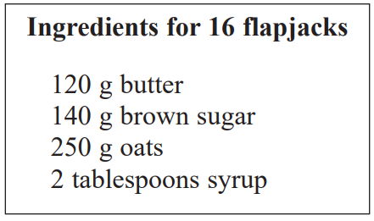
Name the part of the circle shown in red on the diagram.
Expand and simplify $(2x+3)(x−6)$.
Here is a list of ingredients for making 16 flapjacks. Ingredients for 16 flapjacks. Jenny wants to make 24 flapjacks. Work out how much of each of the ingredients she needs.

Slide 67
Describe fully the single transformation which maps the blue shape onto the red shape.
Harry, Regan and Kelan share £450 in the ratio 2 : 5 : 3. How much money does Kelan get?
The total surface area of a cube is 294 cm². Work out the volume of the cube.

Slide 68
What are the next two terms in the sequence: 1, 1, 2, 3, 5, 8, …, …
The diagram shows the plan of a floor. Angie is going to varnish the floor. She needs 1 litre of varnish for 5 m² of floor. There are 2.5 litres of varnish in each tin of varnish. Angie has 3 tins of varnish. Does she have enough varnish for all the floor? You must show all your working.
2.5 m
2.5 m
Calculate the $n^{th}$ term of the sequence: 7, 14, 21, 28, …
2 m
2 m
6 m
10 m

Slide 69
Write $1.24×{10}^{3}$ as an ordinary number.
Make $x$ the subject of the formula $a=\frac{x+4}{x+2}$.
$a=\left(\begin{matrix}2 \\ 3\end{matrix}\right)$ and $b=\left(\begin{matrix}−2 \\ 4\end{matrix}\right)$
Write as a column vector $4a+\frac{1}{2}b$.

Slide 70
Factorise ${4f}^{2}−9$.
Calculate the length of the line segment $PQ$ where $P$ is the point (3, 9) and $Q$ is the point (-3, -7). Give your answer correct to 3 significant figures.
Solve $2x^{2}=32$.

Slide 71
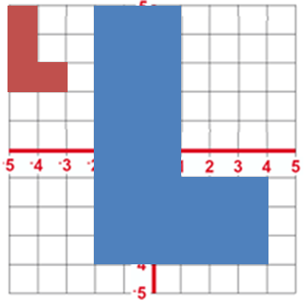
Describe fully the single transformation which maps the blue shape onto the red shape.
There are only blue cubes, yellow cubes and green cubes in a bag. There are
twice as many blue cubes as yellow cubes
four times as many green cubes as blue cubes.
Hannah takes at random a cube from the bag. Work out the probability that Hannah takes a yellow cube.
Solve $5x−6=3(x−1)$.

Slide 72
Esther went to France. She changed £300 into Euros (€). The exchange rate was £1 = €1.25. How many Euros did she get?
Calculate the height of the isosceles triangle. Give your answer correct to 2 decimal places.
Solve $3\left(2x+3\right)=2\left(4x−2\right)$.
13 cm
9 cm

Slide 73
Given that $43×92=3956$, without using a calculator, work out the value of $3956÷430$.
Solve the simultaneous equations
$3x+7y=26$
$4x+5y=13$
Steve says, “There are more prime numbers between 20 and 30 than there are between 10 and 20”. Is Steve right?

Slide 74
Accurately construct the triangle below in your exercise book.
It takes 3 painters 6 days to complete a job. Work out how many days it would take 2 painters to complete the same job.
Harley’s house has a value of £160 000 correct to 2 significant figures. Write down the least possible value of the house.
5 cm
6 cm
7 cm

Slide 75
Calculate the mean from this frequency table.
Calculate the area of the shape below. Give your answer correct to 3 significant figures.
Calculate the first five terms of the sequence
$−3n+1$
Number of goals | 0 | 1 | 2 | 3 | 4
Frequency | 7 | 8 | 5 | 2 | 1
5 cm

Slide 76
Are the two triangles below similar? You must justify your answer.
Emily buys a pack of 12 bottles of water. The pack costs £5.64. Emily sells all 12 bottles for 50p each. Work out Emily’s percentage profit. Give your answer correct to 1 decimal place.
The size of the largest angle in a triangle is 4 times the size of the smallest angle. The other angle is 27° less than the largest angle. Work out, in degrees, the size of each angle in the triangle.
$$80°$$
$$45°$$
$$80°$$
$$35°$$

Slide 77
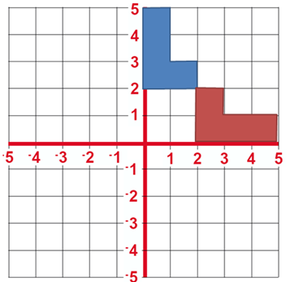
Calculate the value of ${10}^{−2}$.
Describe fully the single transformation which maps the blue shape onto the red shape.
Write the exact value of cos $90°$.

Slide 78
a. Sketch the graphs of $y=−2x+5$ and $y=x−5.5$ on the same pair of axes.
b. Use your graphs to solve the simultaneous equations $y=−2x+5$ and $y=x−5.5$.
Calculate the size of the angle labelled $θ$. Give your answer correct to 3 significant figures.
In a sale, normal prices are reduced by 12%. The sale price of a DVD player is £242. Work out the normal price of the DVD player
11 cm
6 cm
$θ°$

Slide 79
What type of correlation does the scatter graph show? What could the two variables be?
Factorise and solve $x^{2}−4x−21=0$.
Annie and Lily share some money in the ratio 4 : 3. What fraction of the money does Lily get?

Slide 80
Draw an angle of $125°$ in your exercise book. Use compasses and a ruler to bisect it.
Roy visited his aunt and then returned home. The distance-time graph shows information about Royʼs journey. At 2:50pm Roy stopped for a rest. How many minutes was this rest?
$T=4v+3$. Work out the value of $T$ when $v=2$.

Slide 81
Copy and complete the table of values, then sketch the graph of $y=\frac{1}{x}$.
Factorise $t^{2}+2t−35$.
Given that $P(A)=0.9$ find $P( A′)$.
$$x$$ | -3 | -2 | -1 | 0 | 1 | 2 | 3
$$y$$

Slide 82
The distance between the Sun and Earth is 150 000 000 km, correct to 2 significant figures. Write down the limits of accuracy of the distance, in terms of $d$, using inequality notation.
ABC is a straight line. The length AB is five times the length BC. AC = 90 cm. Work out the length AB.
Joanne wants to buy a dishwasher. The dishwasher costs £372. Joanne will pay a deposit of £36. She will then pay the rest of the cost in 4 equal monthly payments. How much is each monthly payment?

Slide 83
Write $0.00078$ as a number in standard form.
Expand and simplify $(3a+5)(4a−5)$.
Calculate the lowest common multiple of 14 and 18.

Slide 84
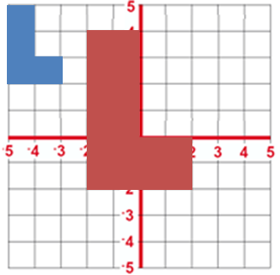
Describe fully the single transformation which maps the blue shape onto the red shape.
A machine fills 1000 bottles in 5 hours. Work out how many hours it would take the machine to fill 1200 bottles.
$\frac{4}{5}$ of a number is 32. Find the number.

Slide 85
Calculate the value of $(2.4×{10}^{3})÷(4.8×{10}^{6})$, giving your answer in standard form.
Roy visited his aunt and then returned home. The distance-time graph shows information about Royʼs journey. Write down the time that Roy started his journey.
Calculate the first five terms of the sequence $4n−2$.

Slide 86
The diagram shows a semicircle drawn inside a rectangle. The semicircle has a diameter of 8 cm. The rectangle is 8 cm by 4 cm. Work out the area of the shaded region. Give your answer correct to 3 significant figures.
Calculate the $n^{th}$ term of the sequence: 2, 8, 14, 20, …
A number, $n$, is rounded to 2 decimal places. The result is 4.76. Using inequalities, write down the error interval for $n$.
4 cm
8 cm

Slide 87
Find the equation of the line which passes through the points (0, -3) and (4, 1).
A wine manufacturer puts down 250 bottles for 3 years. After 3 years only 220 bottles are intact. What is the percentage decrease in the number of bottles?
A silver chain has a volume of 5 cm³. The density of silver is 10.5 grams per cm³. Work out the mass of the silver chain.

Slide 88
Write an equation of a graph that is perpendicular to $y=\frac{1}{2}x−3$.
Carolyn has 20 biscuits in a tin. She has 12 plain biscuits, 5 chocolate biscuits and 3 ginger biscuits. Carolyn takes at random two biscuits from the tin. Work out the probability that the two biscuits were not the same type.
Gwen bought a new car. Each year, the value of her car depreciated by 9%. Calculate the number of years after which the value of her car was 47% of its value when new.

