Slide 1
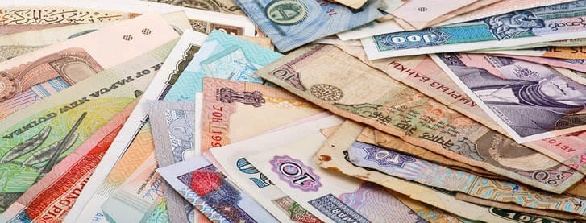
Starter
What currency is used in Japan?
What currency is used in France?
What currency is used in Ireland?
What currency is used in India?
What currency is used in Australia?
What currency is used in the USA?
Yen
Euro
Euro
Rupee
AUS dollar
US dollar

Slide 2
The currency of the United Kingdom is the British pound, or pound sterling.
When we refer to foreign currency, we mean the money that a different country uses such as baht in Thailand or rupees in India.
Not all currencies have the same value.
We use exchange rates to convert from one currency to another.
When going abroad you need to change money to the currency of the country you are visiting. It is important to know the exchange rate and amount of commission charged to get the best possible deal.

Slide 3
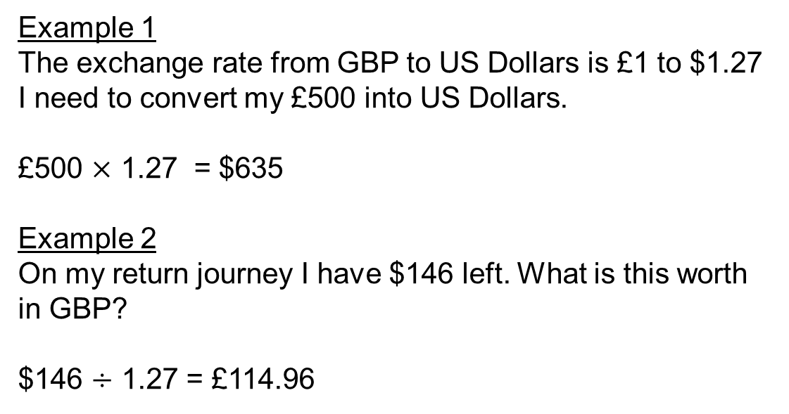
Example 1
The exchange rate from GBP to US Dollars is £1 to $1.27
I need to convert my £500 into US Dollars.
£500 $×$ 1.27 = $635
Example 2
On my return journey I have $146 left. What is this worth in GBP?
$146 $÷$ 1.27 = £114.96

Slide 4
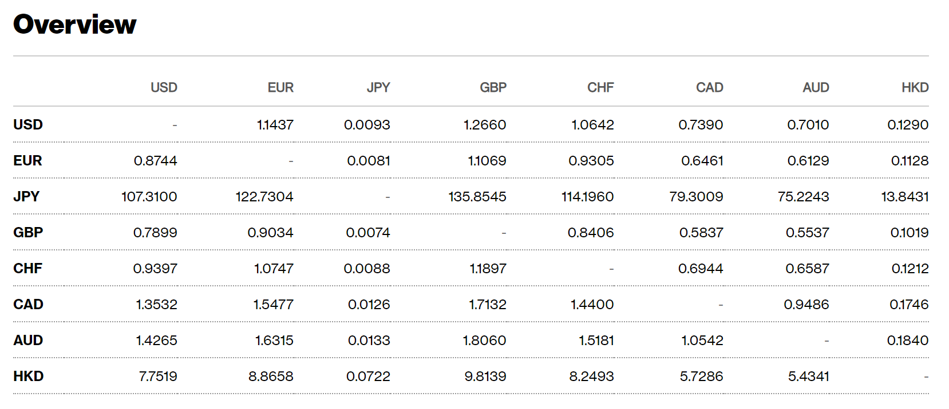
Use the exchange rates table here:
From → → →
← ← ← To
(Although these are the exact value and don’t take into account any commission that travel shops need to make money!)

Slide 5
Think – Pair – Share
Use the table to calculate the following exchange rates:
British Pound to Japanese Yen
Japanese Yen to US Dollars
US Dollars to Australian Dollars
Australian Dollars to Euros
Euros to Pounds Sterling
Extension: What are the reverse rates?

Slide 6
How confident do you feel with this topic?
Write red, amber or green in your book!
Complete the corresponding activity ☺
Extension: Complete the ‘Round the World’ activities.
Teacher – insert current exchange values here using this link!
(Answers cannot be included because the exchange rates are constantly changing. Either check as a class or work out the answers before the lesson.)

Slide 7
Plenary – Exam Question
A student bought a pair of sunglasses in the USA.
He paid $35.50
In England, an identical pair of sunglasses costs £26.99
The exchange rate is £1 = $1.42
In which country were the sunglasses cheaper, and by how much? Show all your working.
(Total 3 marks)

