Slide 1
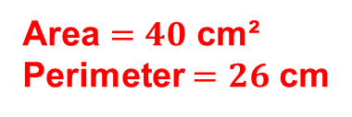

Starter
Simplify:
1) $4x+3+x+8−2x$
2) $x+7−4+2x−x$
Solve:
3) $5x+1=36$
4) $3x−7=17$
5) Find the area and perimeter of this rectangle:
$=3x+11$
$=2x+3$
$x=7$
$x=8$
$8$ cm
Area $=40$ cm²
Perimeter $=26$ cm
$5$ cm

Slide 2
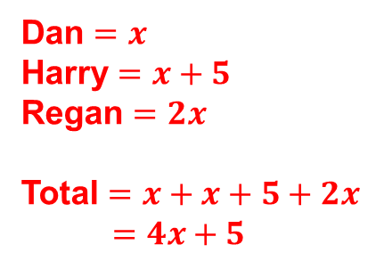
Dan, Harry and Regan sell cars.
Dan sells $x$ cars. Harry sells $5$ more cars than Dan. Regan sells twice as many cars as Dan.
Write an expression, in terms of $x$, for the total number of cars Dan, Harry and Regan sell.
(Total for question = 2 marks)
Dan $=x$
Harry $=x+5$
Regan $=2x$
Total $=x+x+5+2x$
$=4x+5$

Slide 3
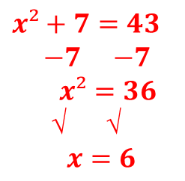
Stephanie thinks of a positive number. She squares the number and adds $7$ The result is $43$
What number did Stephanie think of?
(Total for question = 3 marks)
$x²+7=43$
$−7$ $−7$
$x²=36$
√ √
$x=6$

Slide 4

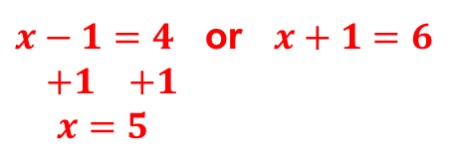
Here is a rectangle.
All measurements on the diagram are in centimetres.
Find the value of $x$.
(Total for question = 2 marks)
$$x+1$$
$$x−1$$
$$4$$
$$6$$
$x−1=4$ or $x+1=6$
$+1$ $+1$
$x=5$
$−1$ $−1$
$x=5$

Slide 5
Treasure Hunt
Use your whiteboards to move around the room and answer the questions.
Keep track of which questions you’ve done in which order.
Make sure you show ALL your working!
Loop: 1, 2, 5, 7, 6, 8, 3, 10, 4, 9

Slide 6
Extended Plenary
Use the template to write an exam question and a mark scheme on today’s topic.
Think carefully about the number of marks you allocate.
Swap with a friend and answer the question you’ve been given.
Swap back and mark it!

