Slide 1
Starter
For each of these angles, name the type of angle, estimate its size and give a definition of that type of angle.
$$b$$
$$a$$
$$c$$
$$d$$

Slide 2
Answers
Angle | Type | Estimate | Definition
$$a$$ | Acute | 45° | An angle between 0° and 90°
$$b$$ | Reflex | 320° | An angle between 180° and 360°
$$c$$ | Obtuse | 125° | An angle between 90° and 180°
$$d$$ | Right | 90° | An angle that is exactly 90°

Slide 3
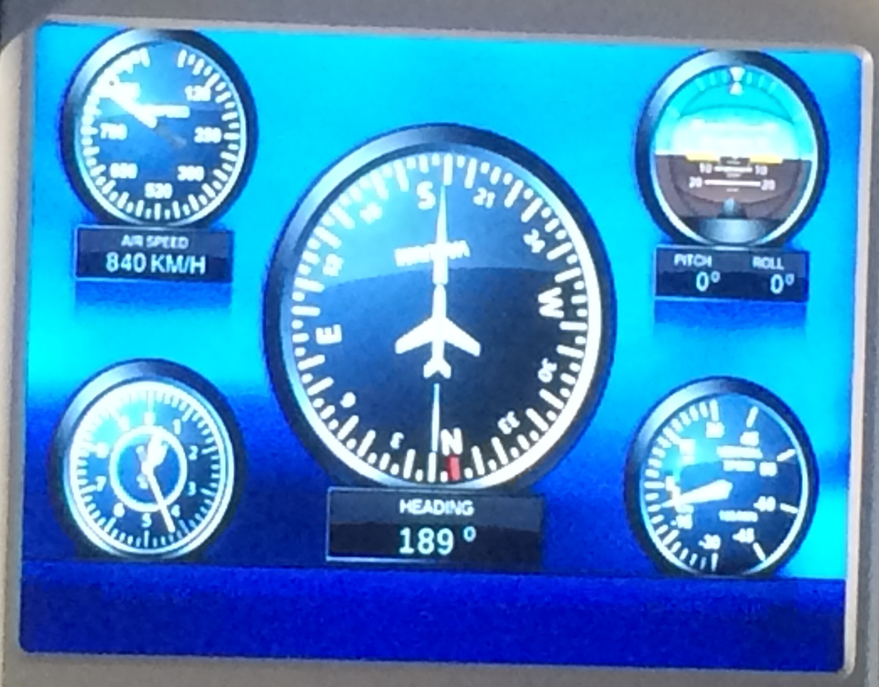
Can you see the compass in the middle?
The bearing is the number below it.
Bearings are more accurate than using North, South, East and West.

Slide 4
When working with bearings, there are 3 things you need to remember:
Always measure from the North line
Always measure in a clockwise direction
Ensure your bearing is written with 3 digits

Slide 5
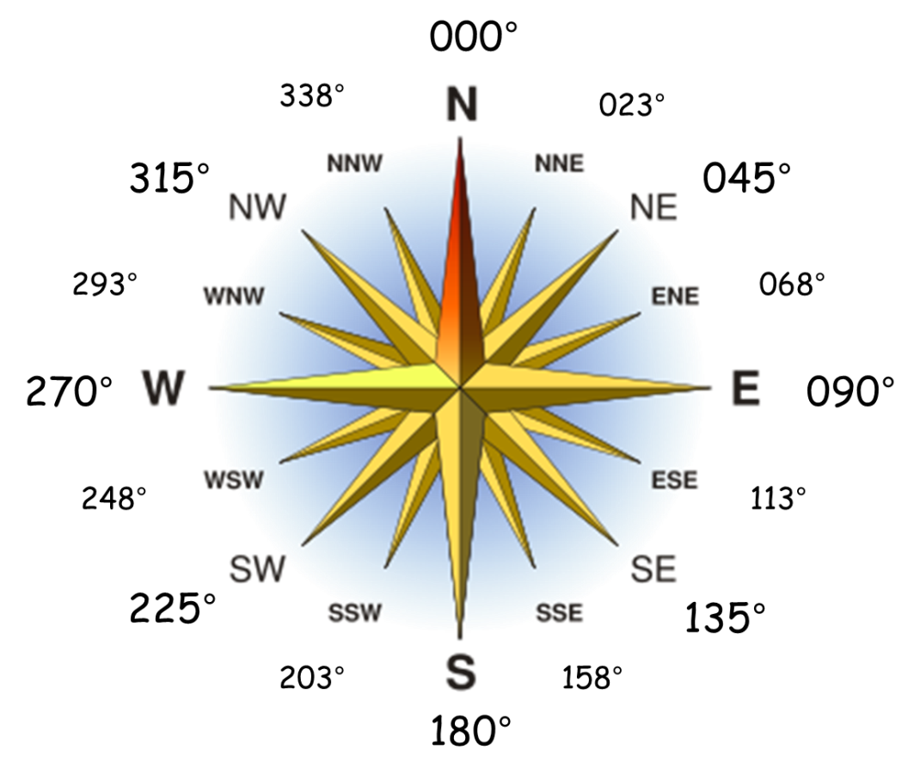
Matching compass points...

Slide 6
Measuring Bearings Example:
Find the bearing of A from B.
075°
N
Mark the North line on at B (if there isn’t a North line draw one in)
A
75°
Measure the angle clockwise from the North line to A
Give the answer as a 3-digit bearing
B

Slide 7
Measuring Bearings Example:
Find the bearing of A from B.
294°
A
N
Mark the North line on at B (if there isn’t a North line draw one in)
Measure the angle clockwise from the North line to A
B
294°
Give the answer as a 3-digit bearing

Slide 8
Task
Measure the bearings described on the sheet.

Slide 9
Answers
040° 056° 114°
159° 221° 250°
270° 302° 340°

Slide 10
Measuring Bearings Example:
A is 4cm from B on a bearing of 082°.
Mark the North line on at B (if there isn’t a North line draw one in).
N
Measure the angle clockwise from the North line and mark a point.
082°
A
4cm
B
Measure a line the right length going through the point you have just marked.

Slide 11
Measuring Bearings Example:
A is 3cm from B on a bearing of 226°.
Mark the North line on at B (if there isn’t a North line draw one in).
N
Measure the angle clockwise from the North line and mark a point.
B
Measure a line the right length going through the point you have just marked.
3cm
226°
A

Slide 12
Task
Draw the bearings described on the sheet.

Slide 13
Answers

Slide 14
Combining Bearings
The accurate scale drawing shows the positions of boat $A$ and boat $B$.
Boat $C$ is on a bearing of 060° from $A$.
Boat $C$ is on a bearing of 320° from $B$.
On the diagram, mark with a cross (×) the position of boat $C$ on the diagram.
N
Task
Draw the combined bearings on the worksheet.
N
×
320°
060°
$$B$$
$$A$$

Slide 15
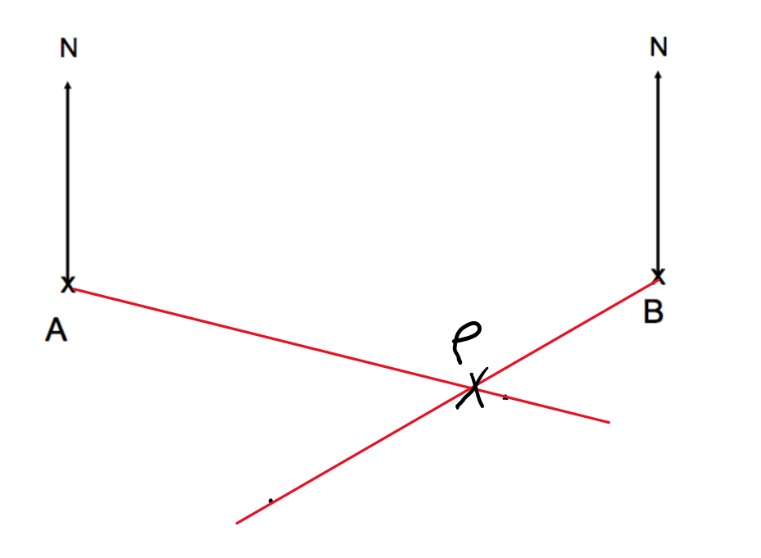
Answers

Slide 16
Angles Reminder

Slide 17
Calculating with Bearings
Adam runs from A to B and back again.
What is the bearing of his outward run from A to B?
What is the bearing of his return run from B to A? Explain your answer.
N
070°
250° because the North lines are parallel and alternate angles are equal
N
70°
B
70°
180°
A

Slide 18
Calculating with Bearings
https://www.goteachmaths.co.uk/calculating-bearings/

Slide 19
Your Turn
Elsie cycles from A to B and back again.
What is the bearing of her outward run from A to B?
What is the bearing of her return run from B to A? Explain your answer.
Nigel sails from A to B then to C and then back to A.
What is the bearing from A to B?
What is the bearing from B to C?
What is the bearing from C to A?
N
N
95°
N
B
N
A
N
220°
40°
60°
B
A
C

Slide 20
Answers
220°
40° because the North lines are parallel and co-interior angles sum to 180°
040°
135°
255°
N
N
95°
N
B
N
A
N
220°
40°
60°
B
A
C

