Slide 1
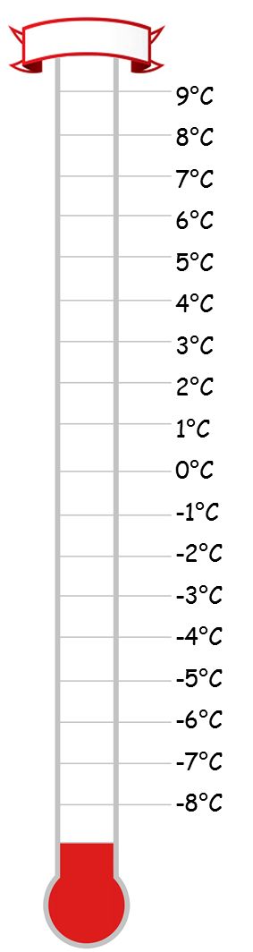
What is 3 more than 6ºC?
What is 5 less than 7ºC?
What is the difference between 8^{O}C and 2ºC?
What is 3 less than 1ºC?
What is 9 more than -3ºC?
What is 5 less than -2^{O}C?
What is the difference between 3^{O}C and -4^{O}C?
What is the difference between -2ºC and -8ºC?
9ºC
2ºC
6ºC
-2ºC
6ºC
-7ºC
7ºC
6ºC

Slide 2
Coordinates are a set of instructions to get to a location from the origin $(0, 0)$.
The first number tells us how far we go ‘along the corridor’.
The second number tells us how far we go ‘up (or down) the stairs’.
$$(x, y)$$

Slide 3
$$(x, y)$$
Left (-) or right (+)
Up (+) or down (-)
Along the corridor and up or down the stairs

Slide 4
$$(2, 3)$$
2 right
3 up
Along the corridor and up or down the stairs

Slide 5
$$(−6, 4)$$
6 left
4 up
Along the corridor and up or down the stairs

Slide 6
$$(−4, −5)$$
4 left
5 down
Along the corridor and up or down the stairs

Slide 7
$$(8, −3)$$
8 right
3 down
Along the corridor and up or down the stairs

Slide 8
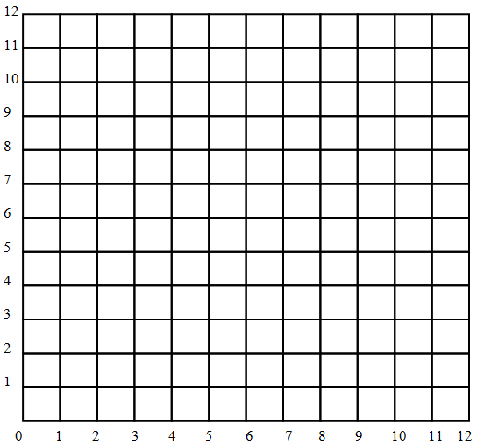
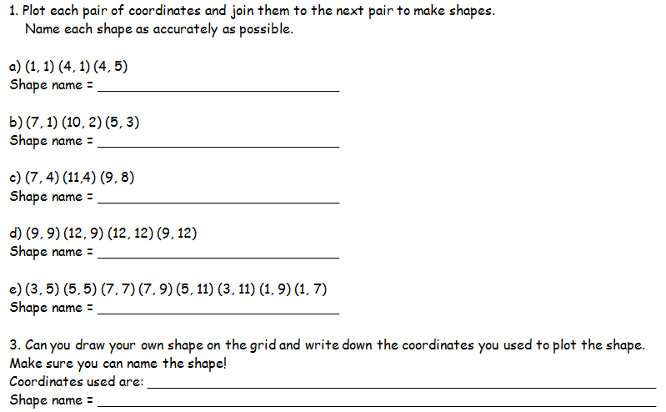
Right angled triangle
Scalene triangle
Isosceles triangle
Square
Octagon

Slide 9
Coordinates Bingo
Draw a 3 by 3 grid in your books and fill in with 9 of the following numbers:
-4 | -3 | -2.5 | -2 | -1.5
-1 | 0 | 1 | 1.5 | 2
2.5 | 3 | 3.5 | 4 | 5
Notes:
9

Slide 10
y
3
2
(?,2)
1
-3
-2
-1
1
2
3
4
5
x
-1
-2
Notes:
10

Slide 11
y
3
2
1
(?,1)
-3
-2
-1
1
2
3
4
5
x
-1
-2
Notes:
11

Slide 12
y
3
(?,2)
2
1
-3
-2
-1
1
2
3
4
5
x
-1
-2
Notes:
12

Slide 13
y
3
2
1
-3
-2
-1
1
2
3
4
5
x
(1,?)
-1
-2
Notes:
13

Slide 14
y
3
(?,3)
2
1
-3
-2
-1
1
2
3
4
5
x
-1
-2
Notes:
14

Slide 15
y
3
(?,2)
2
1
-3
-2
-1
1
2
3
4
5
x
-1
-2
Notes:
15

Slide 16
y
3
2
(?,2)
1
-3
-2
-1
1
2
3
4
5
x
-1
-2
Notes:
16

Slide 17
y
3
2
1
-3
-2
-1
1
2
3
4
5
x
(?,-1)
-1
-2
Notes:
17

Slide 18
y
3
(?,2)
2
1
-3
-2
-1
1
2
3
4
5
x
-1
-2
Notes:
18

Slide 19
y
3
2
(?,1.5)
1
-3
-2
-1
1
2
3
4
5
x
-1
-2
Notes:
19

Slide 20
y
3
(1,?)
2
1
-3
-2
-1
1
2
3
4
5
x
-1
-2
Notes:
20

Slide 21
y
(?,3)
3
2
1
-3
-2
-1
1
2
3
4
5
x
-1
-2
Notes:
21

Slide 22
y
3
2
1
-3
-2
-1
1
2
3
4
5
x
-1
(3,?)
-2
Notes:
22

Slide 23
y
(3.5,?)
3
2
1
-3
-2
-1
1
2
3
4
5
x
-1
-2
Notes:
23

Slide 24
y
3
2
(2.5, ?)
1
-3
-2
-1
1
2
3
4
5
x
-1
-2
Notes:
24

Slide 26
Extension
Draw a pair axes that go from -10 up to 10. Plot the following coordinates and join them up as you go. Follow the instructions carefully and you’ll end up with a picture of…?
Set 1: (-8, -1), (-7, -2), (-7, -4), (-5, -6), (3, -6), (5, -4), (4, -6), (6, -6), (6, -2), (7, -1), (7, 0), (2, 0), (2, -2), (-5, -2), (-6, -1), (-8, -1).
Set 2: (-5, 5), (-7, 4), (-7, 1), (-5, -2), (-3, -1), (-2, -1), (2, -2), (0, 2), (0, 4), (2, 5), (-5, 5).
Set 3: (-3, -2), (-2, -2), (-2, 7), (-3, 7), (-3, -2).
Set 4: (-2, 7), (1, 7), (2, 6), (4, 6), (5, 5), (4, 5), (1, 6), (-2, 6), (-2, 7).
Set 5: (4, 0), (4, 4), (8, 4), (7, 3), (8, 2), (4, 2).

Slide 27
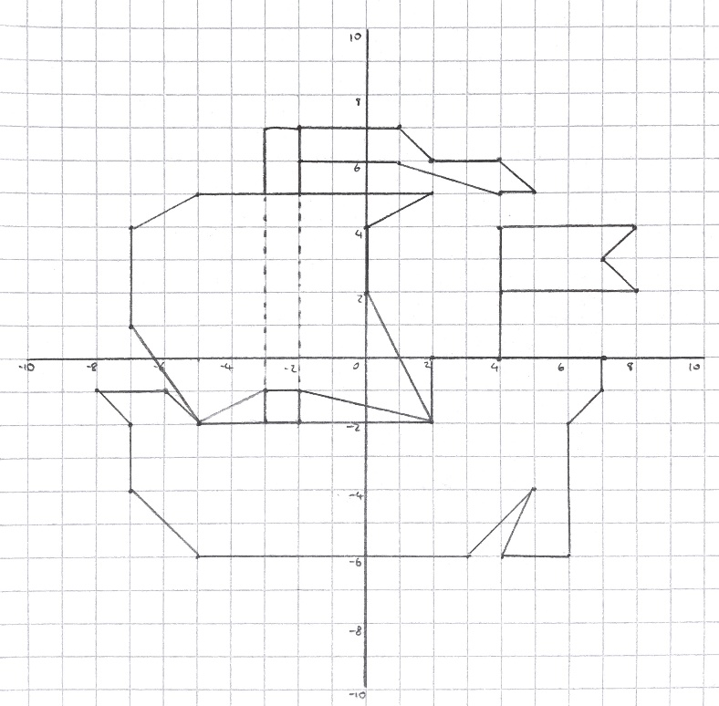
Landing jetty (-5, 2) Café (2, 3)
Swimming pool (-3, -1) Beach shop (4, -4)
Camp site (-5, 4) Post office (2, -2)
Food store (5, 1) Light house (5, 7)
Tennis court (-3, -5) Hotel (-5, -3)
1a. (5, 2)
1b. (6, 3) or (4, 1) or (3, 0) or (4, 5) or (6, 1) or (7, 0)
2a. (6, $x$) where $x$ is any number 2b. (6, 3) or (6, -1)
3a. (5, 2) 3b. (2, 1)
4a. (60, 60) 4b. M = (0, 100), N = (60, 0)

