Slide 1
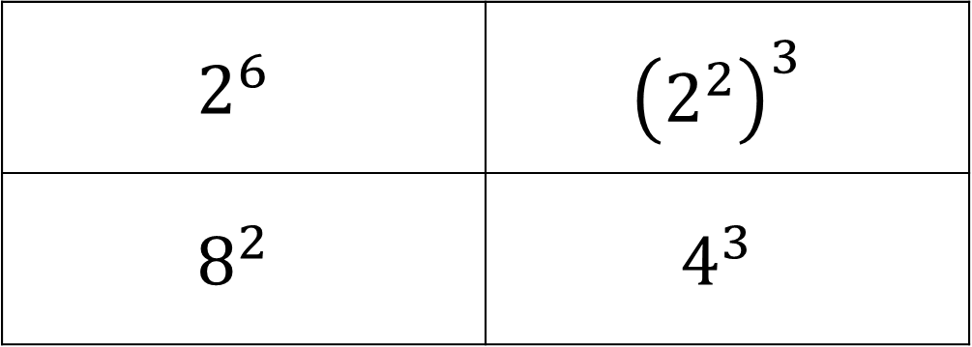
Settler
What’s the same and what’s different?
$$2^{6}$$ | $${\left(2^{2}\right)}^{3}$$
$$8^{2}$$ | $$4^{3}$$

Slide 2
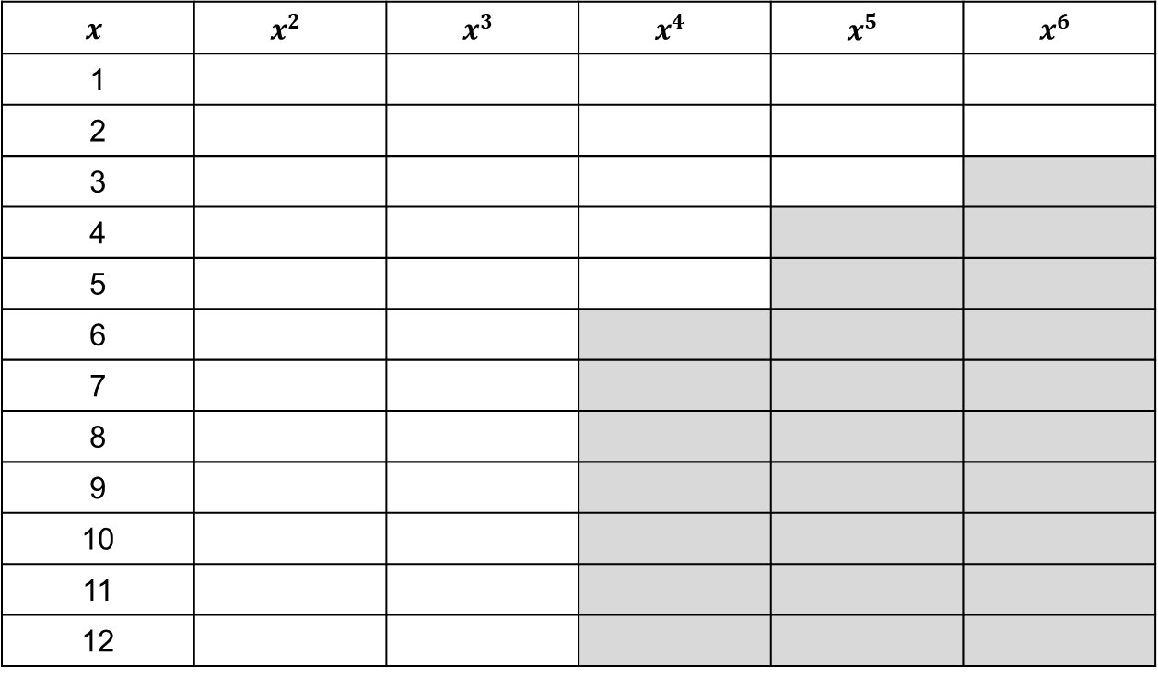
Powers and Roots
Copy and complete the table. The grey boxes are extension!
$$x$$ | $$x^{2}$$ | $$x^{3}$$ | $$x^{4}$$ | $$x^{5}$$ | $$x^{6}$$
1
2
3
4
5
6
7
8
9
10
11
12

Slide 3
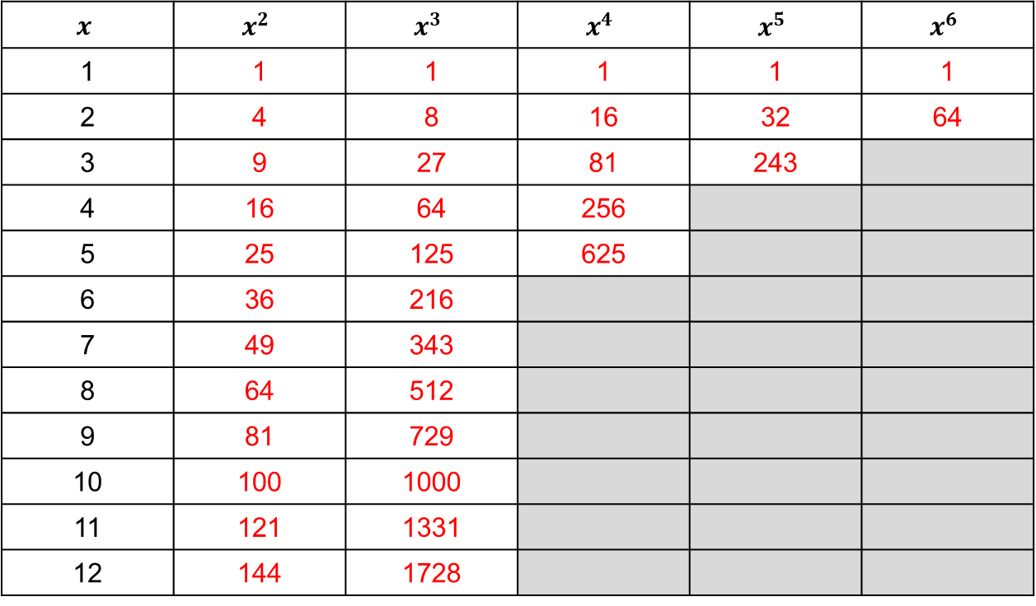
Powers and Roots
Copy and complete the table. The grey boxes are extension!
$$x$$ | $$x^{2}$$ | $$x^{3}$$ | $$x^{4}$$ | $$x^{5}$$ | $$x^{6}$$
1 | 1 | 1 | 1 | 1 | 1
2 | 4 | 8 | 16 | 32 | 64
3 | 9 | 27 | 81 | 243
4 | 16 | 64 | 256
5 | 25 | 125 | 625
6 | 36 | 216
7 | 49 | 343
8 | 64 | 512
9 | 81 | 729
10 | 100 | 1000
11 | 121 | 1331
12 | 144 | 1728

Slide 4
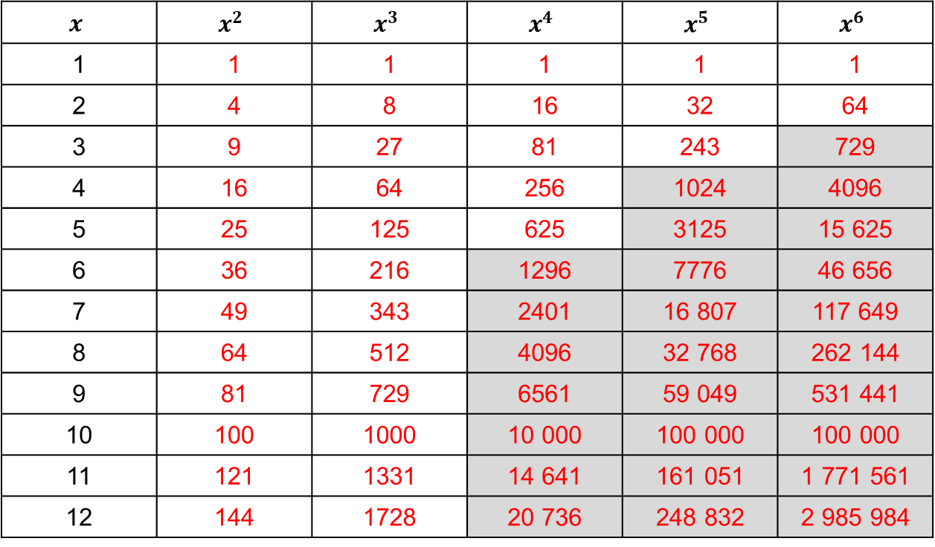
Powers and Roots
Copy and complete the table. The grey boxes are extension!
$$x$$ | $$x^{2}$$ | $$x^{3}$$ | $$x^{4}$$ | $$x^{5}$$ | $$x^{6}$$
1 | 1 | 1 | 1 | 1 | 1
2 | 4 | 8 | 16 | 32 | 64
3 | 9 | 27 | 81 | 243 | 729
4 | 16 | 64 | 256 | 1024 | 4096
5 | 25 | 125 | 625 | 3125 | 15 625
6 | 36 | 216 | 1296 | 7776 | 46 656
7 | 49 | 343 | 2401 | 16 807 | 117 649
8 | 64 | 512 | 4096 | 32 768 | 262 144
9 | 81 | 729 | 6561 | 59 049 | 531 441
10 | 100 | 1000 | 10 000 | 100 000 | 100 000
11 | 121 | 1331 | 14 641 | 161 051 | 1 771 561
12 | 144 | 1728 | 20 736 | 248 832 | 2 985 984

Slide 5
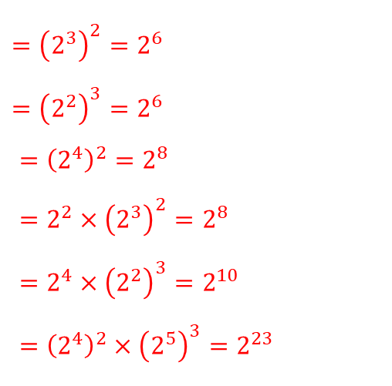
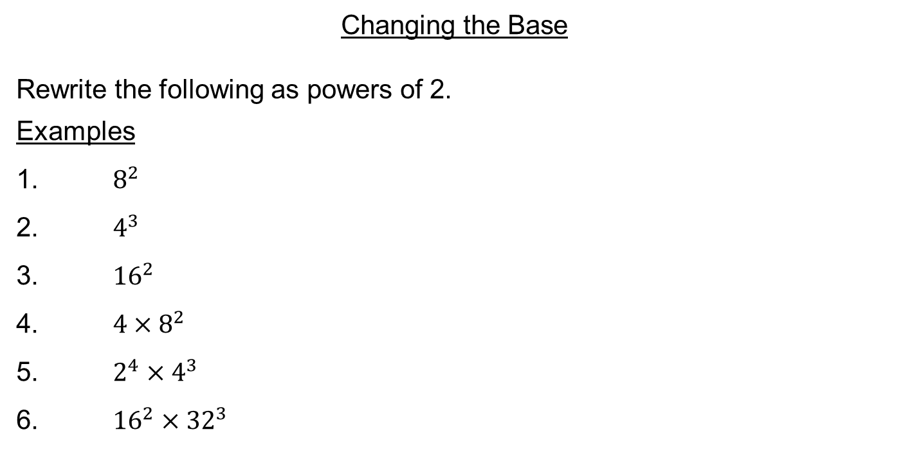
Changing the Base
Rewrite the following as powers of 2.
Examples
1. $8^{2}$
2. $4^{3}$
3. ${16}^{2}$
4. ${4×8}^{2}$
5. $2^{4}×4^{3}$
6. ${16}^{2}×{32}^{3}$
$={\left(2^{3}\right)}^{2}=2^{6}$
$={\left(2^{2}\right)}^{3}=2^{6}$
$={\left(2^{4}\right)}^{2}=2^{8}$
$={2^{2}×\left(2^{3}\right)}^{2}=2^{8}$
$=2^{4}×{\left(2^{2}\right)}^{3}=2^{10}$
$={\left(2^{4}\right)}^{2}×{\left(2^{5}\right)}^{3}=2^{23}$

Slide 6







Worked Example
Your Turn
Write 27 as a power of 3
Write 8 as a power of 2
$$2×2×2=8$$
So $8= 2^{3}$
Write 27$x$ as a power of 3
Write 8$x$ as a power of 2
$$8^{x}={(2^{3})}^{x}=2^{3x}$$
Write 8$2x$ as a power of 2
Write 8$3x$ as a power of 2
$$8^{3x}={(2^{3})}^{3x}=2^{9x}$$
@gjmcconnell88
Notes:
VariationTheory.com

Slide 7
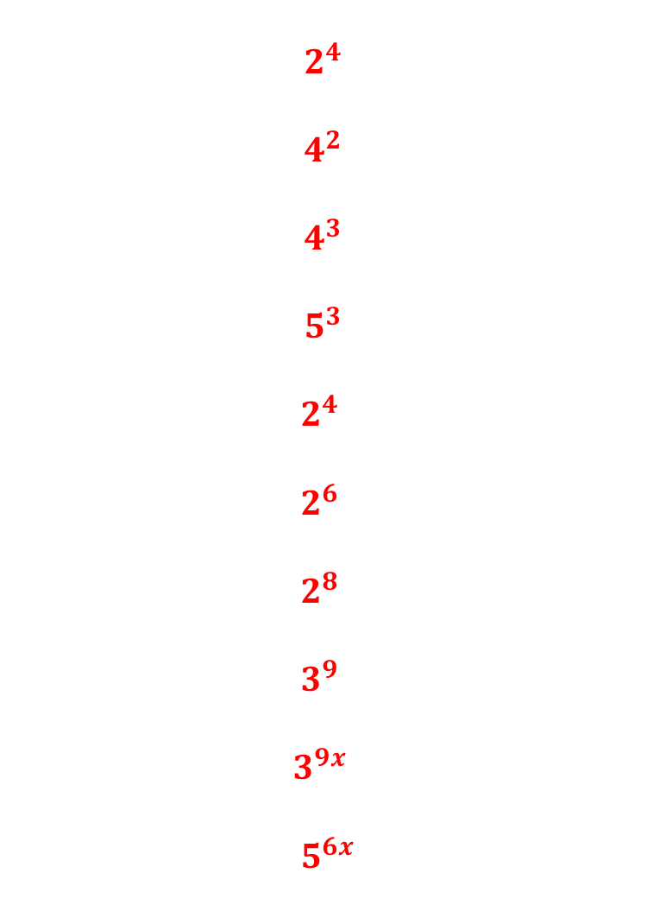
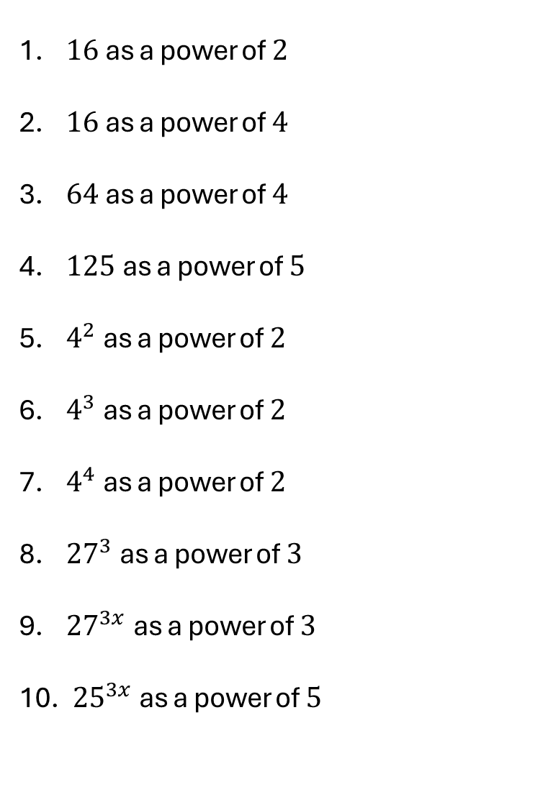
For each question, write in terms of the given number:
$$2^{4}$$
$$4^{2}$$
$$4^{3}$$
$$5^{3}$$
$$2^{4}$$
$$2^{6}$$
$$2^{8}$$
$$3^{9}$$
$$3^{9x}$$
$${ 5}^{6x}$$
$16$as a power of $2$
$16$as a power of $4$
$64$as a power of $4$
$125$as a power of $5$
$4^{2}$as a power of $2$
$4^{3}$as a power of $2$
$4^{4}$as a power of $2$
${27}^{3}$as a power of $3$
${27}^{3x}$as a power of $3$
${ 25}^{3x}$ as a power of $5$
@gjmcconnell88
Notes:
VariationTheory.com

Slide 8





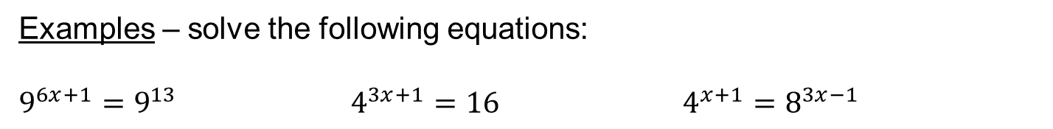








Change the base.
Equate the indices.
Solve!
Examples – solve the following equations:
$9^{6x+1}=9^{13}$ $4^{3x+1}=16$ $4^{x+1}=8^{3x−1}$
$$6x+1=13$$
$$4^{3x+1}=4^{2}$$
$${\left(2^{2}\right)}^{x+1}={\left(2^{3}\right)}^{3x−1}$$
$$6x=12$$
$$3x+1=2$$
$$2^{2x+2}=2^{9x−3}$$
$$x=2$$
$$3x=1$$
$$2x+2=9x−3$$
$x=\frac{1}{3}$
$$2=7x−3$$
$$5=7x$$
$\frac{5}{7}=x$

Slide 9



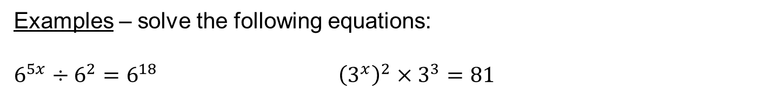






Sometimes you might need to simplify first!
Change the base.
Equate the indices.
Solve!
Examples – solve the following equations:
$6^{5x}÷6^{2}=6^{18}$ ${\left(3^{x}\right)}^{2}×3^{3}=81$
$$6^{5x−2}=6^{18}$$
$$3^{2x}×3^{3}=3^{4}$$
$$5x−2=18$$
$$3^{2x+3}=3^{4}$$
$$5x=20$$
$$2x+3=4$$
$$x=4$$
$$2x=1$$
$x=\frac{1}{2}$

Slide 10
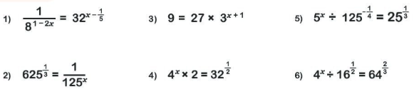






How confident do you feel with this topic?
Write red, amber or green in your book!
Complete the corresponding activity ☺
Extension
Solve the following:
$x=\frac{3}{10}$
$x=\frac{1}{5}$
$x=1$
$x=\frac{1}{2}$
$x=\frac{1}{4}$
$x=\frac{5}{3}$

Slide 11
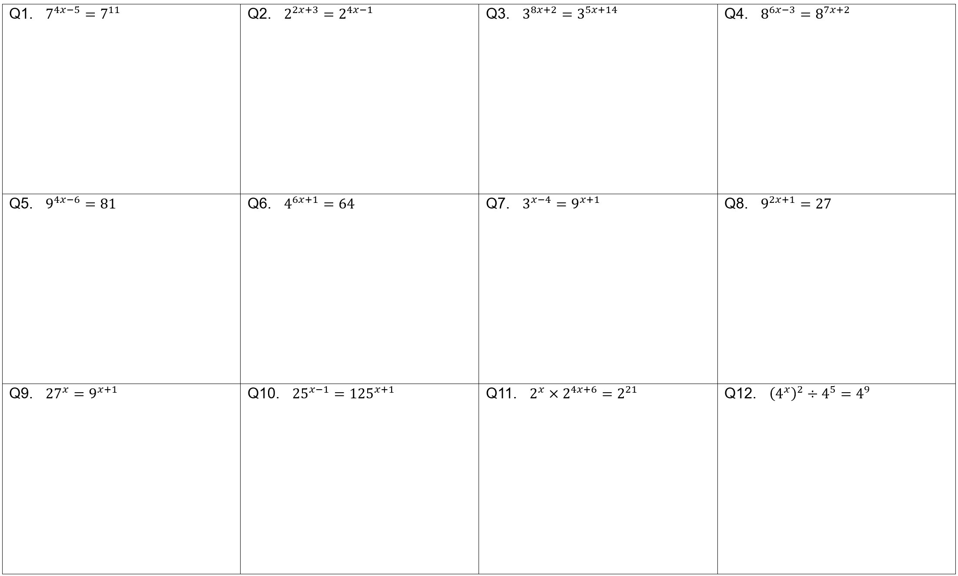

Slide 12
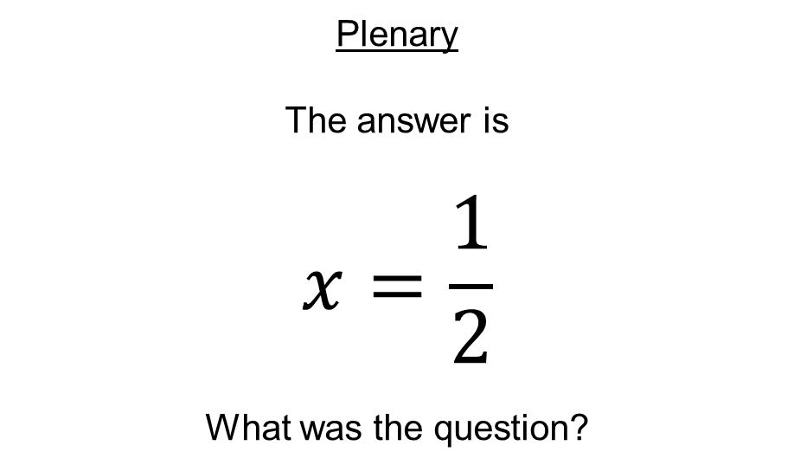
Plenary
The answer is
$$x=\frac{1}{2}$$
What was the question?

