Slide 1
Starter
What’s the same and what’s different?
$x²+3x+2$ $(x+2)(x+1)$
$(2x+1)(x+2)$ $(x+1)(x+2)$

Slide 2
Definitions
Sum → the answer when two numbers are added together.
Product → the answer when two numbers are multiplied together.

Slide 3
On your mini whiteboards (no shouting out!)
I think of two numbers…
Sum: 5
Product: 6
3
2

Slide 4
On your mini whiteboards (no shouting out!)
I think of two numbers…
Sum: 6
Product: 7
6
1

Slide 5
On your mini whiteboards (no shouting out!)
I think of two numbers…
Sum: 10
Product: 16
8
2

Slide 6
On your mini whiteboards (no shouting out!)
I think of two numbers…
Sum: 13
Product: 36
9
4

Slide 7
On your mini whiteboards (no shouting out!)
I think of two numbers…
Sum: 1
Product: -30
6
-5

Slide 8
On your mini whiteboards (no shouting out!)
I think of two numbers…
Sum: -3
Product: -54
6
-9

Slide 9
On your mini whiteboards (no shouting out!)
I think of two numbers…
Sum: -15
Product: 56
-7
-8

Slide 10
On your mini whiteboards (no shouting out!)
I think of two numbers…
Sum: -18
Product: 72
-12
-6

Slide 11
On your mini whiteboards (no shouting out!)
I think of two numbers…
Sum: 18
Product: 56
14
4

Slide 12
On your mini whiteboards (no shouting out!)
I think of two numbers…
Sum: -5
Product: -66
-11
6

Slide 13
On your mini whiteboards (no shouting out!)
I think of two numbers…
Sum: -19
Product: 78
-6
-13

Slide 14

Example
Factorise $x^{2}+15x+44$
The sum is 15 and the product is 44
$$×$$
 | $$x^{2}$$
 |  | $$+44$$
$$x$$
$$+11$$
Find the HCF of the top row, then fill in the rest!
$$x$$
$$+11x$$
$$+4$$
$$+4x$$
Check this box!
$$(x+4)(x+11)$$

Slide 15

Example
Factorise $x^{2}−8x+16$
The sum is -8 and the product is 16
$$×$$
 | $$x^{2}$$
 |  | $$+16$$
$$x$$
$$−4$$
Find the HCF of the top row, then fill in the rest!
$$x$$
$$−4x$$
$$−4$$
$$−4x$$
Check this box!
$$(x−4)(x−4)$$

Slide 16

Example
Factorise $x^{2}−2x−63$
The sum is -2 and the product is -63
$$×$$
 | $$x^{2}$$
 |  | $$−63$$
$$x$$
$$−9$$
Find the HCF of the top row, then fill in the rest!
$$x$$
$$−9x$$
$$+7$$
$$+7x$$
Check this box!
$$(x+7)(x−9)$$

Slide 18
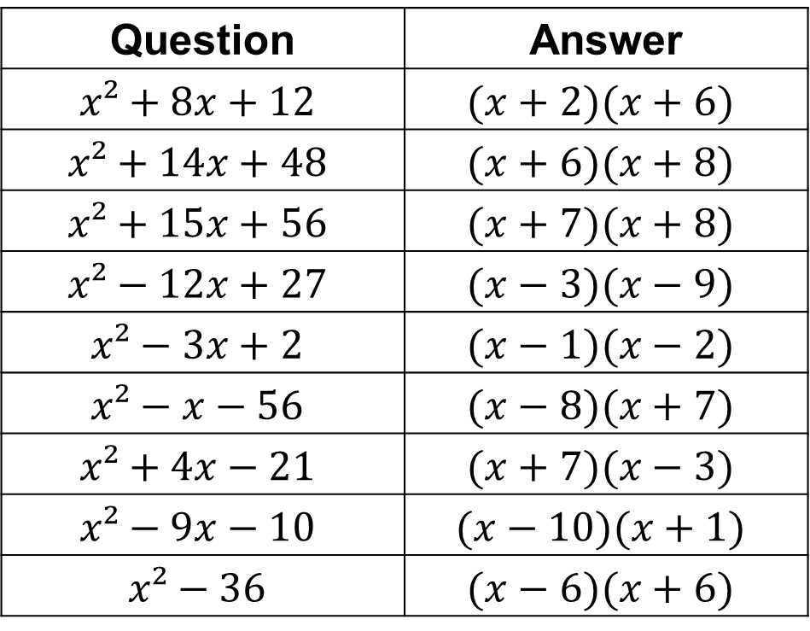
Question | Answer
$$x²+8x+12$$ | $$(x+2)(x+6)$$
$$x²+14x+48$$ | $$(x+6)(x+8)$$
$$x²+15x+56$$ | $$(x+7)(x+8)$$
$$x²−12x+27$$ | $$(x−3)(x−9)$$
$$x²−3x+2$$ | $$(x−1)(x−2)$$
$$x²−x−56$$ | $$(x−8)(x+7)$$
$$x²+4x−21$$ | $$(x+7)(x−3)$$
$$x²−9x−10$$ | $$(x−10)(x+1)$$
$$x²−36$$ | $$(x−6)(x+6)$$

Slide 19

Example
Factorise $2x^{2}+11x+12$
The sum is 11 and the product is 24
$$24$$
$$×$$
 | $$2x^{2}$$
 |  | $$+12$$
$$x$$
$$+4$$
Find the HCF of the top row, then fill in the rest!
$$2x$$
$$+8x$$
$$+3$$
$$+3x$$
Check this box!
$$(2x+3)(x+4)$$

Slide 20

Example
Factorise $6x^{2}−7x−3$
The sum is -7 and the product is -18
$$−18$$
$$×$$
 | $$6x^{2}$$
 |  | $$−3$$
$$2x$$
$$−3$$
Find the HCF of the top row, then fill in the rest!
$$3x$$
$$−9x$$
$$+1$$
$$+2x$$
Check this box!
$$(3x+1)(2x−3)$$

Slide 22
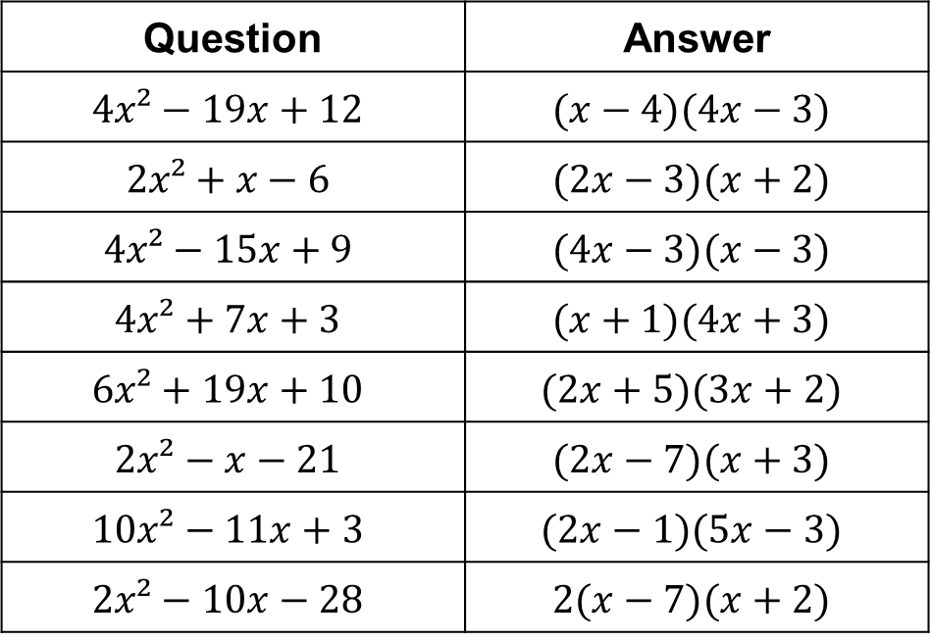
Question | Answer
$$4x²−19x+12$$ | $$(x−4)(4x−3)$$
$$2x²+x−6$$ | $$(2x−3)(x+2)$$
$$4x²−15x+9$$ | $$(4x−3)(x−3)$$
$$4x²+7x+3$$ | $$(x+1)(4x+3)$$
$$6x²+19x+10$$ | $$(2x+5)(3x+2)$$
$$2x²−x−21$$ | $$(2x−7)(x+3)$$
$$10x²−11x+3$$ | $$(2x−1)(5x−3)$$
$$2x²−10x−28$$ | $$2(x−7)(x+2)$$

