Slide 1

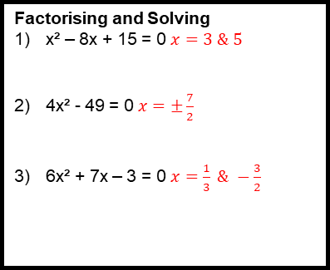
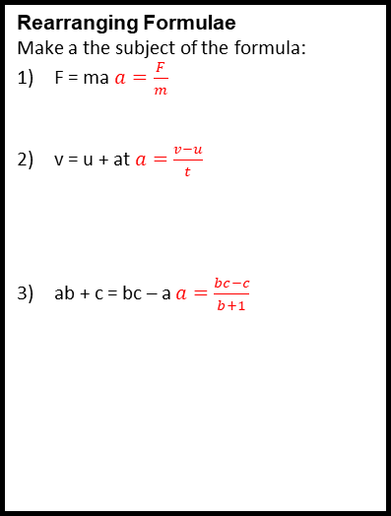
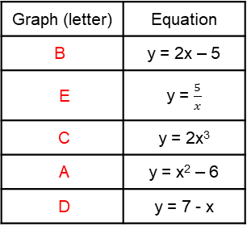
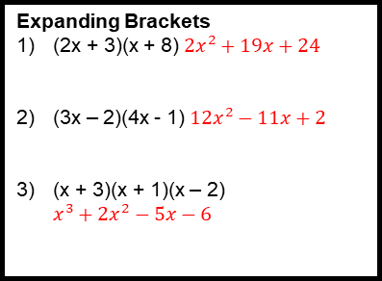
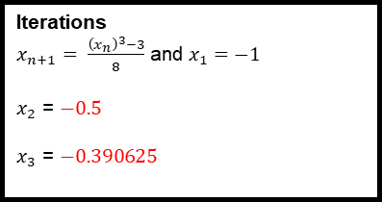
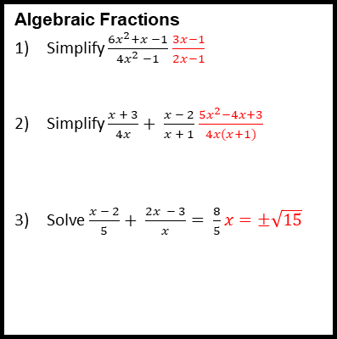
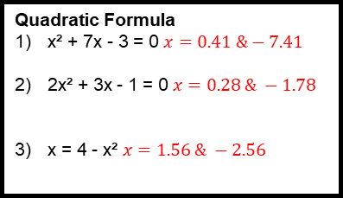
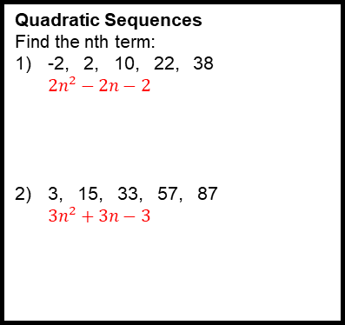
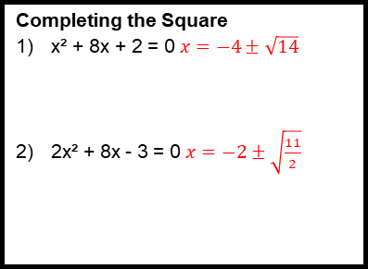
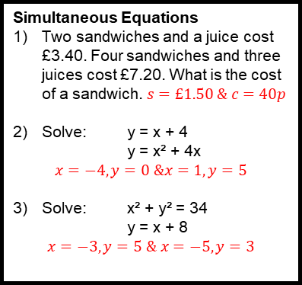
Algebra Revision Mat
Quadratic Formula
x² + 7x - 3 = 0 $x=0.41 \&−7.41$
2x² + 3x - 1 = 0 $x=0.28 \& −1.78$
x = 4 - x² $x=1.56 \& −2.56$
Simultaneous Equations
Two sandwiches and a juice cost £3.40. Four sandwiches and three juices cost £7.20. What is the cost of a sandwich. $s=£1.50 \& c=40p$
Solve: y = x + 4
y = x² + 4x
$$x=−4, y=0 \&x=1, y=5$$
Solve: x² + y² = 34
y = x + 8
$$x=−3, y=5 \& x=−5, y=3$$
Solving Inequalities
Show the region satisfying x > 2, y > - 1 and x + y < 5
2x + 4 < x – 3 $x<−7$
x² - 7x + 12 ≥ 0 $x≤3 \& x≥4$
Expanding Brackets
(2x + 3)(x + 8) $2x^{2}+19x+24$
(3x – 2)(4x - 1) $12x^{2}−11x+2$
(x + 3)(x + 1)(x – 2) $x^{3}+2x^{2}−5x−6$
 |  | 6 | y
 |  | 5
 |  | 4
 |  | 3
 |  | 2
 |  | 1 |  |  |  |  |  | x
-2 | -1 | 0 | 1 | 2 | 3 | 4 | 5 | 6
 |  | -1
 |  | -2
Completing the Square
x² + 8x + 2 = 0 $x=−4±\sqrt{14}$
2x² + 8x - 3 = 0 $x=−2±\sqrt{\frac{11}{2}}$
Factorising and Solving
x² – 8x + 15 = 0 $x=3 \& 5$
4x² - 49 = 0 $x=±\frac{7}{2}$
6x² + 7x – 3 = 0 $x=\frac{1}{3} \& −\frac{3}{2}$
Quadratic Sequences
Find the nth term:
-2, 2, 10, 22, 38 $2n^{2}−2n−2$
3, 15, 33, 57, 87 $3n^{2}+3n−3$
Iterations
$x_{n+1}= \frac{{\left(x_{n}\right)}^{3}−3}{8}$ and $x_{1}=−1$
$x_{2}$ = $−0.5$
$x_{3}$ = $−0.390625$
Rearranging Formulae
Make a the subject of the formula:
F = ma $a=\frac{F}{m}$
v = u + at $a=\frac{v−u}{t}$
ab + c = bc – a $a=\frac{bc−c}{b+1}$
Algebraic Fractions
Simplify $\frac{6x^{2}+x −1}{4x^{2} −1}$ $\frac{3x−1}{2x−1}$
Simplify $\frac{x + 3}{4x}+ \frac{x − 2}{x + 1}$ $\frac{5x^{2}−4x+3}{4x(x+1)}$
Solve $\frac{x − 2}{5}+ \frac{2x − 3}{x}= \frac{8}{5}$ $x=±\sqrt{15}$
Types of Graphs
Match the equation to its graph:
Graph (letter) | Equation
B | y = 2x – 5
E | y = $\frac{5}{x}$
C | y = 2x³
A | y = x² – 6
D | y = 7 - x

Slide 2
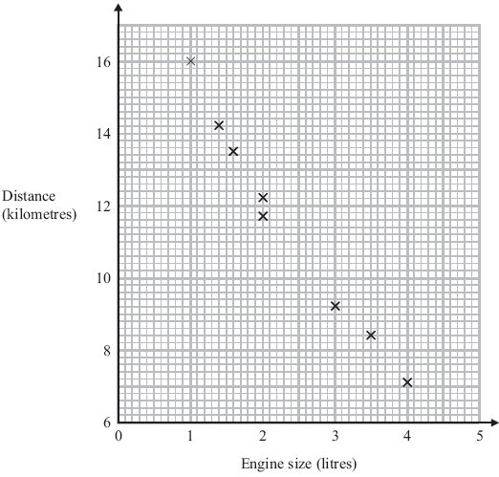
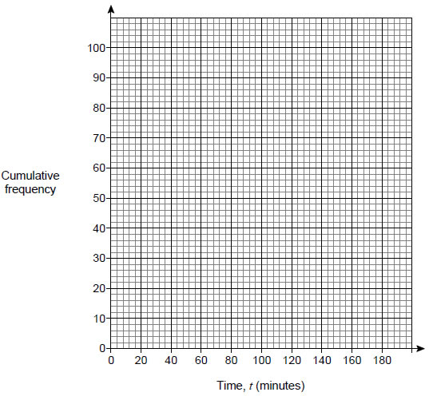
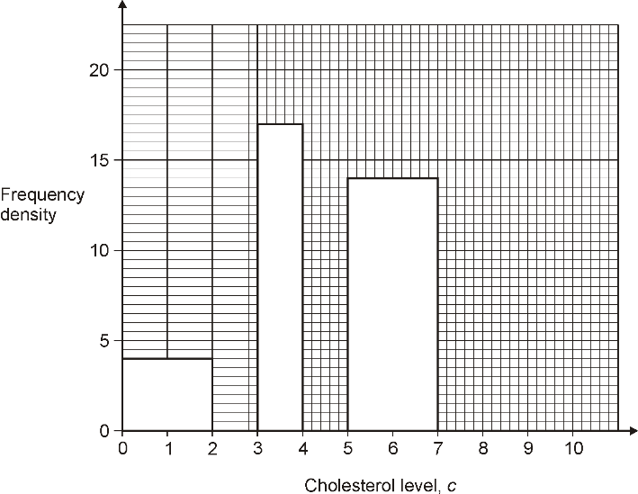
Data Handing Revision Mat
Scatter Graphs
The scatter graph shows some information about 8 cars.
What type of correlation does the scatter graph show?
$$Negative$$
A car has an engine size of 2.5 litres. Estimate the distance travelled on one litre. $11$
Cumulative Frequency Graphs
The table shows the running times of some films.
Draw a cumulative frequency graph on the grid to represent the data.
Estimate the number of these films with a running time of less than 2 ½ hours. $86$
The shortest film was 84 minutes long. The longest film was 179 minutes long. Use this information to draw a box plot below.
Histograms
The table and histogram show some information about the cholesterol level in the blood of 100 hospital patients.
Use the table to complete the histogram.
Use the histogram to complete the table.
Time, t (minutes) | Number of films
0 ≤ t < 80 | 0 | 0
80 ≤ t < 100 | 9 | 9
100 ≤ t < 120 | 35 | 44
120 ≤ t < 140 | 30 | 74
140 ≤ t < 160 | 18 | 92
160 ≤ t < 180 | 8 | 100
Cholesterol level, c | Frequency
0 < c ≤ 2 | 8
2 < c ≤ 3 | 13
3 < c ≤ 4 | $17$
4 < c ≤ 5 | 19
5 < c ≤ 7 | $28$
7 < c ≤ 10 | 15
Averages from Tables
Bob asked each of 40 friends how many minutes they took to get to work.
The table shows some information about his results.
Write down the modal class. $20<w≤30$
State the class in which the median lies. $20<w≤30$
Work out an estimate for the mean time taken. $\frac{1130}{40}=28.25$
Time taken (m minutes) | Frequency
0 < w ≤ 10 | 3
10 < w ≤ 20 | 8
20 < w ≤ 30 | 11
30 < w ≤ 40 | 9
40 < w ≤ 50 | 9
Capture/Recapture Method
A park ranger wants to estimate the number of fish in a lake. She catches 400 fish. She marks them with ink and puts them back in the lake. The next day she catches 60 fish. There are 3 marked with ink.
The ranger says, “There are about 8000 fish in the lake.” Show that she is correct.
$$\frac{400}{8000}=\frac{3}{60}$$

Slide 3
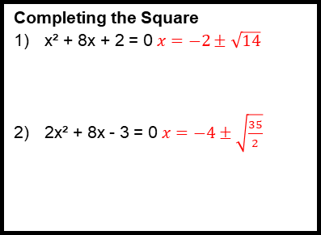
Number Revision Mat
Simplifying Surds
$\sqrt{8}$ $=2\sqrt{2}$
$\sqrt{125}$ $=5\sqrt{5}$
$\sqrt{147}$ $7\sqrt{3}$
$\sqrt{24}$ x $\sqrt{6}$ $=12$
$4\sqrt{27}$ x $6\sqrt{3}$ $=216$
$\frac{6\sqrt{160}}{3\sqrt{10}}$ $=8$
$(5+ \sqrt{3})(6+\sqrt{3)}$ $=33+11\sqrt{3}$
$(6+3\sqrt{3})(6−3\sqrt{3})$ $=63$
Rationalising the Denominator
$\frac{5}{\sqrt{2}}$ $=\frac{5\sqrt{2}}{2}$
$\frac{9}{\sqrt{3}}$ $=3\sqrt{3}$
$\frac{5}{2\sqrt{5}}$ $=\frac{\sqrt{5}}{2}$
$\frac{8}{2−\sqrt{5}}$ $=−16−8\sqrt{5}$
Limits of Accuracy
These numbers have been rounded to the nearest hundred. Write down the upper and lower limits:
300 $250 \& 350$
2700 $2650 \& 2750$
These numbers have been rounded to the nearest whole number. Write down the upper and lower limits:
3 $2.5 \& 3.5$
17 $16.5 \& 17.5$
These numbers have been rounded to one decimal place. Write down the upper and lower limits:
6.2 $6.15 \& 6.25$
15.9 $15.85 \& 15.95$
These numbers have been rounded to one significant figure. Write down the upper and lower limits:
30 $25 \& 35$
9 $8.5 \& 9.5$
0.02 $0.015 \& 0.025$
0.8 $0.75 \& 0.85$
Indices
Simplify the following:
a⁶ x a³ ${=a}^{9}$
b⁵ ÷ b³ $=b^{2}$
d⁰ $=1$
(c²)⁴ $=c^{8}$
3a⁴ x 3a⁻² $=9a^{2}$
$\frac{6a^{4}b^{3}}{2ab}$ $=3a^{3}b^{2}$
f⁻⁴ $=\frac{1}{f^{4}}$
Work out the value of:
${81}^{1/2}$ $=9$
${16}^{3/2}$ $=64$
Standard Form
Write as ordinary numbers:
2.6 x 10² $=260$
8.65 x 10⁻³ $=0.00865$
Write in standard form:
0.345 $=3.45×{10}^{−1}$
46700 $=4.67×{10}^{4}$
1.6 x 10³ x 3.8 x 10³ $=6.08×{10}^{6}$
(2 x 10⁻⁴) ÷ (5 x 10³) $=4×{10}^{−8}$
Each day there are eight million cash withdrawals from 32000 cash machines. What is the average number of withdrawals per machine per day? $250$
Bounds Calculations
Anthony measured the length and width of a rectangle. He measured the length to be 18cm correct to the nearest centimetre. He measured the width to be 10cm correct to the nearest 10 centimetres. Calculate the lower bound for the area of this rectangle. $17.5×5=87.5{cm}^{2}$
A circular mirror has a diameter of 60cm to the nearest centimetre. Find the greatest possible area of the mirror. Give your answer in cm². $π×{\left(\frac{60.5}{2}\right)}^{2}=2875{cm}^{2}$
Identical wooden sheds are displayed side by side along a straight wall in a builders’ yard. The sheds are 270 cm wide, measured correct to the nearest 10 cm. The wall is 36 m long, measured to the nearest metre. How many sheds can the builders definitely display along the wall? $35.5÷2.75=12.\dot{9}\dot{0}$ so $12$ sheds

Slide 4


















Probability Revision Mat
Venn Diagrams
100 men who drink coffee were asked if they have milk and sugar in their coffee.
Some of the results are shown in the Venn diagram.
(a) Complete the Venn diagram.
(b) What is the probability that one of the men, chosen at random, has milk but no sugar in his coffee? $0.27$
(c) What is the probability that one of the men, chosen at random, has no milk and no sugar in his coffee? $0.12$
Probability Trees
1) An ordinary fair dice is rolled.
(a) Complete the tree diagram for the dice landing on the number 4.
(b) Work out the probability of the dice landing on 4 both times. $\frac{1}{36}$
2) A team has 7 boys and 3 girls. Stevie chooses two of the team at random.
(a) Complete the probability tree diagram.
(b) Work out the probability that he chooses one boy and one girl. $\frac{21}{45}$
Probability Essentials
1) An electronic game can show red or blue or green or yellow. The table shows the probabilities that the colour shown will be red or will be green or will be yellow. Arthur plays the game.
(a) Work out the probability that the colour shown will be blue.
Janice is going to play the game 50 times.
(b) Work out an estimate for the number of times the colour shown will be yellow. $12$
2) Josh plays a game with two sets of cards.
Set A
Set B
Josh takes at random one card from each set. He adds the numbers on the two cards to get the total score.
(a) Complete the table to show all the possible total scores.
(b) What is the probability that Josh's total score will be greater than 12? $\frac{6}{20}=\frac{3}{10}$
Second
First
$$\frac{1}{6}$$
ξ
Sugar
4
Milk
$$\frac{1}{6}$$
4
$$\frac{5}{6}$$
27
21
$$40$$
Not 4
$$\frac{1}{6}$$
4
Colour | red | blue | green | yellow
Probability | 0.15 | $$0.2$$ | 0.41 | 0.24
$$\frac{5}{6}$$
12
Not 4
$$\frac{5}{6}$$
Not 4
1
2
4
5
7
3
6
8
9
Set Theory
ξ = {1, 2, 3, 4, 5, 6, 7, 8, 9, 10, 11, 12}
S = square numbers, E = even numbers
(a) Complete the Venn diagram.
One of the numbers is chosen at random.
(b) Write down P (S) $\frac{1}{4}$
(c) Write down P (E’) $\frac{1}{2}$
(d) Write down P (S ∩ E) $\frac{1}{12}$
First
Second
$$\frac{6}{9}$$
Boy
ξ
 | Set A
Set B |  | 1 | 2 | 4 | 5 | 7
 | 3 | 4 | 5 | 7 | 8 | 10
 | 6 | 7 | 8 | 10 | 11 | 13
 | 8 | 9 | 10 | 12 | 13 | 15
 | 9 | 10 | 11 | 13 | 14 | 16
S
E
$$11$$
$$1$$
$$6$$
$$\frac{7}{10}$$
Boy
$$9$$
$$4$$
$$10$$
$$\frac{3}{9}$$
$$8$$
Girl
$$12$$
$$\frac{3}{10}$$
$$\frac{7}{9}$$
Boy
$$7$$
$$2$$
$$3$$
$$5$$
Girl
$$\frac{2}{9}$$
Girl

Slide 5
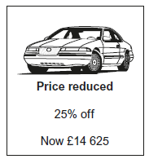
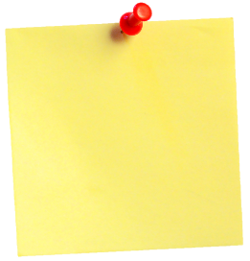
Ratio and Proportion Revision Mat
Direct and Inverse Proportion
y is directly proportional to $R^{2}$. When R = 4, y = 24. Work out the value of R when y = 1350 $30$
y is inversely proportional to $x^{2}$ where x > 0. When x = 2, y = 20. Work out the value of x when y = 5 $4$
w is directly proportional to y. When y = 4, w = 14. Work out the value of w when y = 9 $31.5$
w is inversely proportional to $x^{2}$. When x = 2, w = 5. Work out the value of w when x = 10 $0.2$
Recurring Decimals
Which of these when converted to decimals are recurring decimals? Circle your answers.
$$\frac{1}{3} π \sqrt{3} \frac{3}{16} \frac{5}{7}$$
2a) Show that $\frac{4}{9}$ is equivalent to $0.\dot{4}$
Divide…
b) Using part (a), or otherwise, write
$0.9\dot{4}$ as a fraction. $n=\frac{17}{18}$
3) Convert $0.1\dot{7}\dot{2}$ to a fraction in its
lowest terms. $\frac{171}{990}=\frac{19}{110}$
Reverse Percentages
Work out the price
of the car before it
was reduced. $£19500$
I increase a number
by 24%. The answer
is 6014. What number did I start
with? $4850$
In a sale the normal price of a dress is reduced by 25%. The sale price is then reduced by £10. The dress is now priced at £80. The manager says, “The price is now one-third less than the normal price.” Show that he is correct. Original price: $£120$
Jane and Laura each have a meal. Jane pays £41.80 which includes a £4 tip. Laura also pays £41.80 which includes a 10% tip. Who pays the greater tip? Jane by $20p$
Applied Ratio
A drink is mixed in the ratio lemonade : orange : cranberry = 6 : 3 : 2. What fraction is orange? $\frac{3}{11}$
Washing powder is sold in two sizes, 600 grams and 1500 grams. Which size is better value for money?
Small: $1.\dot{8}\dot{1}g/p$; Large: $1.838g/p$
Laura buys a saddle in the UK for £850. Delivery is free. Steve buys the same saddle from Holland for 990 Euros. He pays 15 Euros for delivery. £1 = 1.18 Euros. Including the delivery charge, whose saddle is cheaper? $990+15 euros=£851.69$ so the answer is UK.
Here are the ingredients to make 8 biscuits. Work out the ingredients to make 20 biscuits.
Washing powder
1500 g
Washing powder
600 g
£3.30
Was £9.60
Now 15% off
Compound Interest
Loren puts £600 in a bank account. The account pays 3% compound interest each year. After one year she withdraws £200. How much will she have in the account after two years? $£430.54$
An amount of money was invested for 8 years. It earned
compound interest at 2.5% per year. After 8 years the total
value of the investment was £11 696.67. Tom is trying to
work out the total interest earned. State what is wrong with
Tom’s method. Tom has calculated $8$ lots of $2.5\%$ of the final amount.
John bought a 2-year-old car for £ 12 000. Three years later he decides to sell the car; “I think that the value of the car is inversely proportional to its age”. John estimates the value of the car using this idea. The actual value of the car depreciates by 20% each year. Work out the difference between John’s estimate and the actual value. Difference: $£1344$
Exponential Growth and Decay
The population of Knapsford in 2010 was 3800 and is believed to be grow at a rate of 1.5% a year. Calculate the population of Knapsford in 2011 and 2012.
2010: $3857$
2011: $3915$
The population of a form of algae is believed to grow exponentially. On day 1 the population of algae was 2240. By day 4 it increased to 35000. Calculate the population of the algae by day 10.
$$2240x^{n−1}$$
Day 4: $2240x^{3}=35000$ so $x=\frac{5}{2}$
Day 10: $2240×{\left(\frac{5}{2}\right)}^{9}=8544922$
Interest for
8 years =
£11 696.67 x
0.025 x 8
75 g flour
50 g sugar
40 g butter
2 egg yolks
187.5 g flour
125 g sugar
100 g butter
5 egg yolks

Slide 6
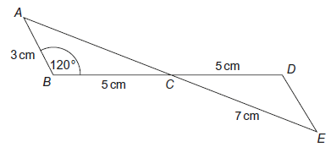
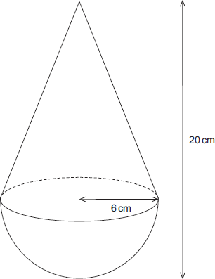
Shape, Space and Measure Revision Mat
Circle Theorems
The diagram shows a circle centre O. A, B and C are points on the circumference. DCO is a straight line. DA is a tangent to the circle. Angle ADO = 36°
1) Work out the size of angle AOD. $54°$
2) Work out the size of angle ABC. $27°$
In the diagram, A, B, C and
D are points on the
circumference of a circle,
centre O. Angle BAD = 70°.
Angle BOD = x°. Angle
BCD = y°.
3) Work out the value of x. $140°$
4) Work out the value of y. $110°$
Pythagoras’ Theorem and Trigonometry
Work out the value of x. $17.5°$
Work out the value of y. $9.54cm$
Use the cosine rule to calculate angle x. $81.3°$
Find the area of triangle PQR. $65.2{cm}^{2}$
Vectors
OABC is a parallelogram. P is the point on AC such that AP = $\frac{2}{3}$AC. $\overset{→}{OA}$ = 6a, $\overset{→}{OC}$ = 6c.
1) Find the vector $\overset{→}{OP}$ . Give your answer in terms of a and c. $2a+4c$
The midpoint of CB is M.
2) Prove that OPM is a straight line. $\vec{OM}=3a+6c$
3 cm
10 cm
x°
y cm
R
11 cm
12 cm
P
15 cm
Q
Similarity and Congruence
The straight lines AE and BD intersect at C.
Prove that triangles ABC and EDC are congruent.
Using cosine rule $AC=7cm$, so we have SAS.
Cylinder A and cylinder B are mathematically similar. The volume of cylinder A is 80 cm³. Calculate the volume of cylinder B. $270{cm}^{3}$
Volume of Pyramids and Spheres
Calculate the volume and surface area:
$$312π=980.2{cm}^{3}$$
6 cm
8 cm
5 cm
$$288π=904.8{cm}^{3}$$
7 cm
$$93.\dot{3}{cm}^{3}$$

