Slide 1
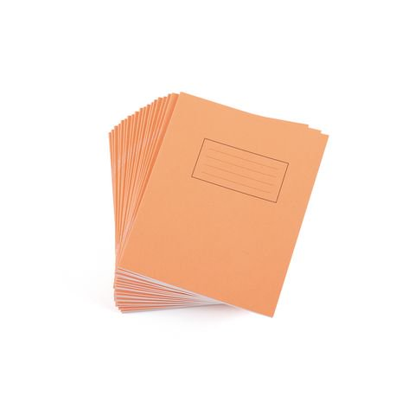
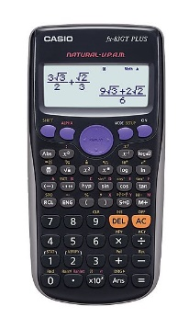
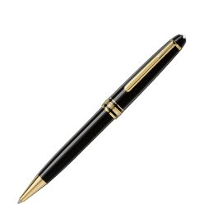
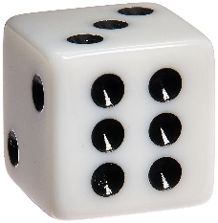
Life Game Set Up
You should have four different types of cards.
Sort them into piles four piles with these sides facing upwards:
You should also have a sheet with three houses.
…And an information sheet.
You will also need:
A calculator
Something to write with/on
A die

Slide 2
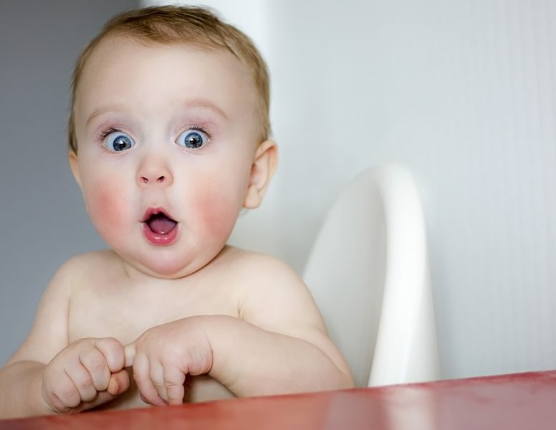
Happy birthday!
You’ve just been born.
To celebrate your birth, your grandparents set aside £5000 for you in a high-interest savings account.
Roll the die to see which bank they choose.
Goodlife Bank Group Spotlight Holdings Inc.
Elite Credit Union Felicity Banks Inc.
Cloud Nine Banks Goldleaf Corporation

Slide 3
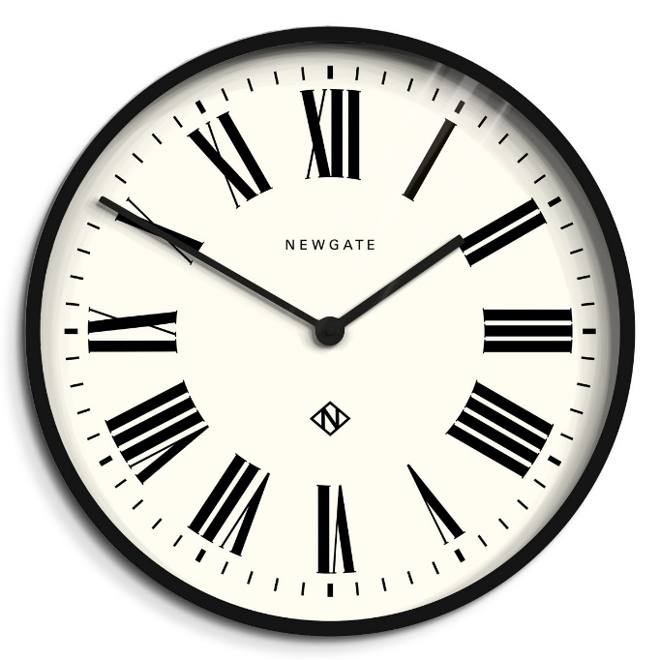
18 years later…

Slide 4
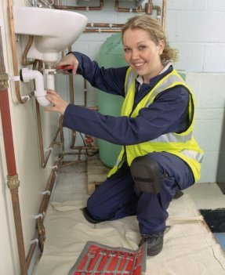
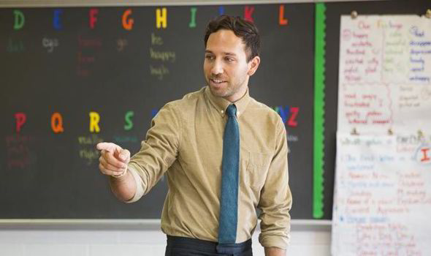
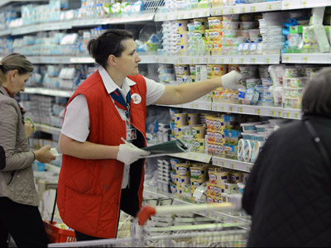
Roll the die to secure a job!

Slide 5
Salary → Annual earnings. Paid monthly, the same amount each month. Doesn’t usually change depending on the hours you work.
Wage → Earnings per hour. The more hours you work, the more money you will make.
Task
How much money would you earn per month?
Use the information sheet to calculate how much you would receive each month
Unfortunately we don’t get all of this money. We have to pay tax and national insurance (and possibly a pension too) ☹

Slide 6
Remember that money your grandparents put aside for you?
They’ve decided now you have a job you’re mature enough to receive it!
Task
Have a look at the interest rates you received on your money.
How much would it be worth now?

Slide 7
You are going to use this money along with your earnings for your first month of working to buy a house.
This money will form a 10% house deposit (the bank will lend you the other 90%).
Task
What’s your budget for your new house?

Slide 8
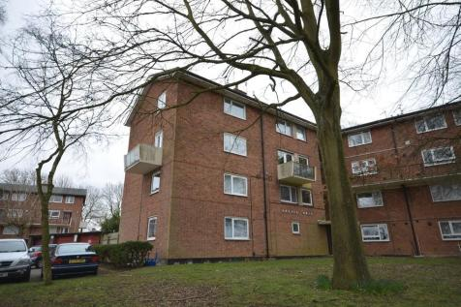
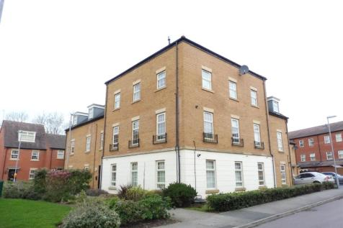
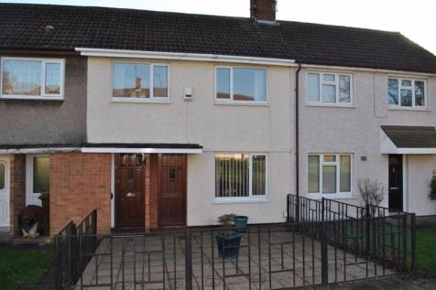
No rolling of the die this time – you get to CHOOSE!
Bear in mind other monthly costs that might come up though…
How much money does that leave you with in savings?

Slide 9
Roll the die to determine which type of mortgage you will be offered.
Odd number
The People’s Bank
3% compound interest per annum over 20 years
Even number
McKinley Savings
4% compound interest per annum over 25 years
Task
How much will you have to pay per month towards your mortgage?

Slide 10
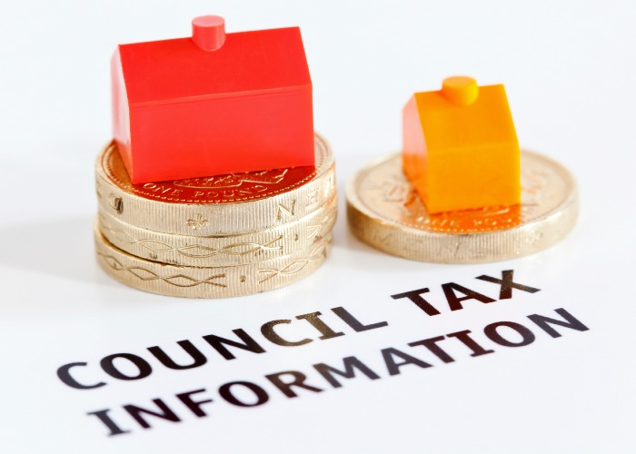
What is Council Tax?
Council Tax funds local services including:
Education
Fire and Police Services
Roads
Libraries
Rubbish collection
Planning
Most domestic properties are subject to Council Tax. Each property is placed in one of eight bands (A to H) based on the property's estimated value.
Task
Calculate how much extra you need to pay in terms of bills and council tax per month.

Slide 11
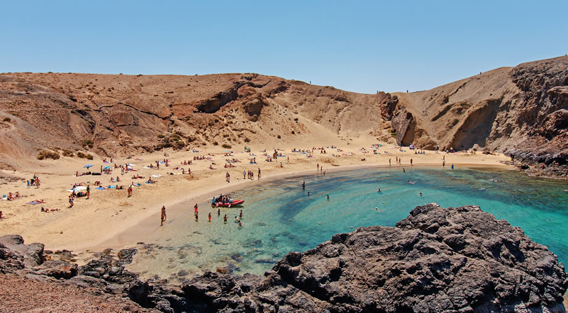
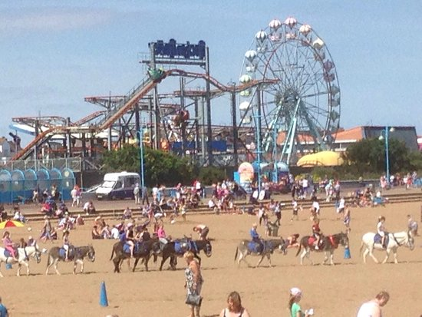
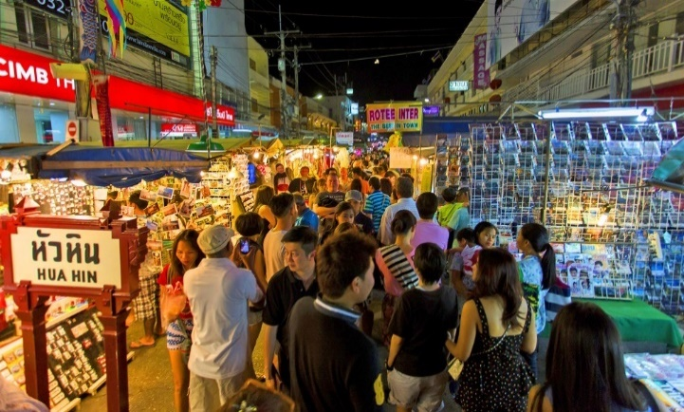
Roll the die to book a holiday!

Slide 12
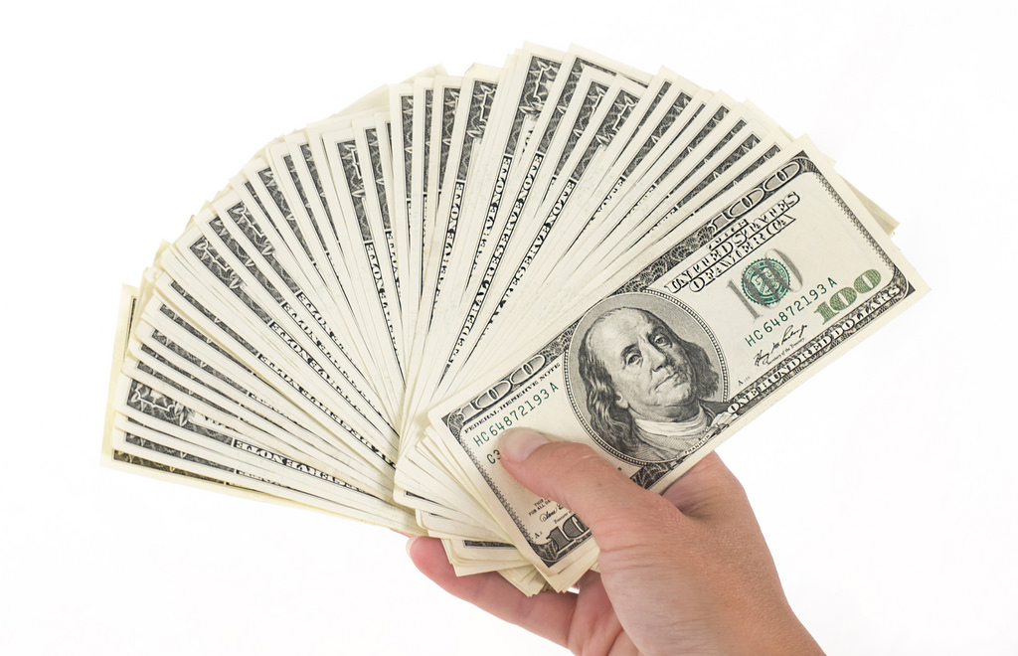
You are going to use what’s left of your savings, as well as 10% of your monthly earnings.
Task
How much money are you going to have to borrow from the bank?
Interest rate of 10%, paid back over 6 months
How much will this loan cost you per month?
Are you keeping track of your monthly outgoings?

Slide 13
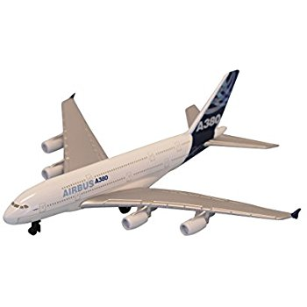
You are going to use 15% monthly earnings as your holiday spending money.
Unfortunately, not every country uses the Great British Pound, so you are going to have to convert this amount into whichever currency you will need for your holiday.
Task
Calculate how much spending money you have in pounds and pence, then use the current exchange rates to find out how much you have in the required currency.
(Note to teacher: Google these!)

Slide 14
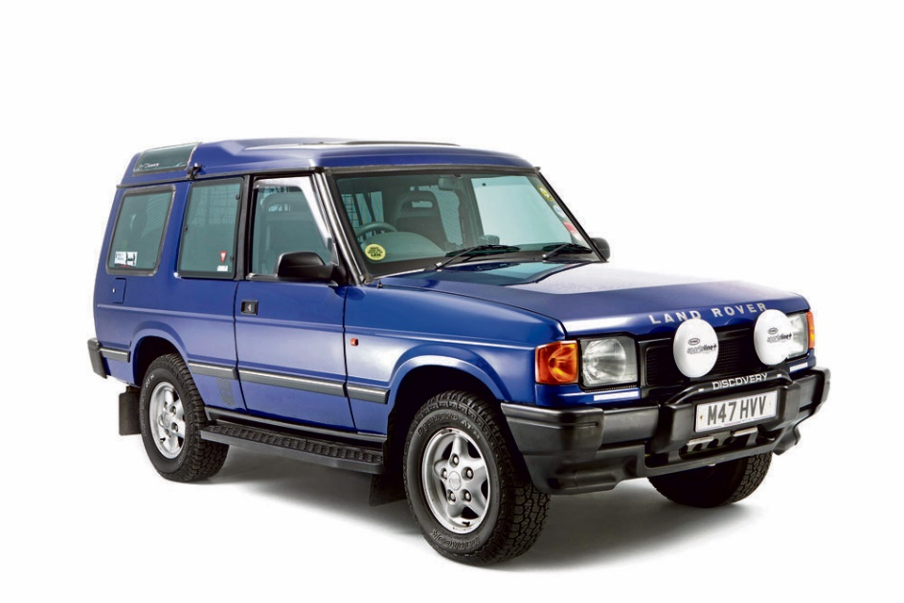
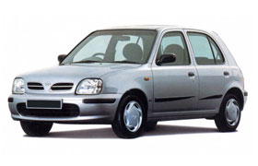
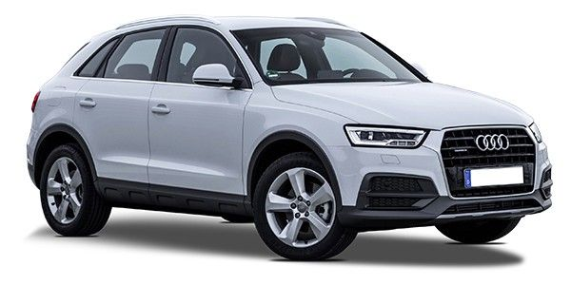
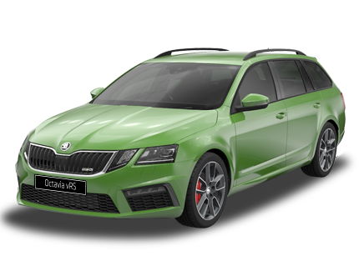
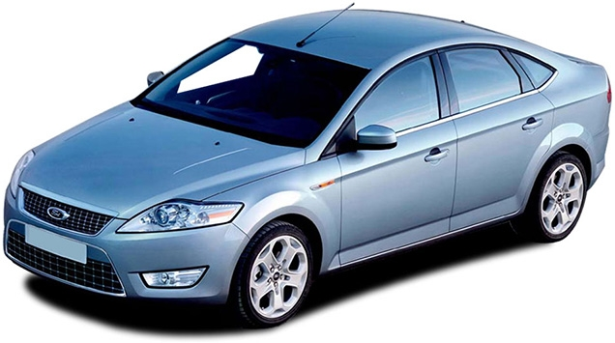
Roll the die to buy a car!

Slide 15
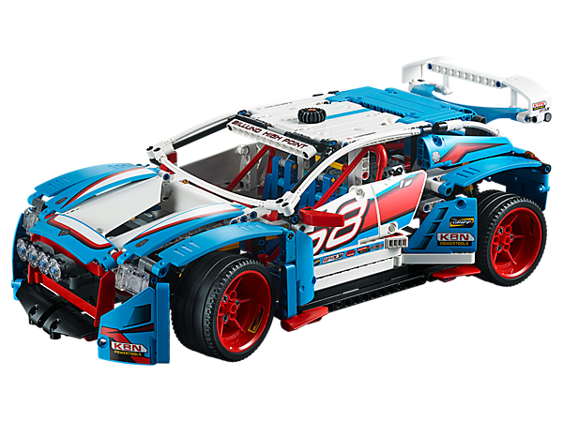
You are going to use save 10% of you monthly earnings for 6 months to either pay for the car, or put that money down as a deposit.
Task
How much money are you going to have to borrow from the bank?
Interest rate of 12%, paid back over 36 months
How much will this loan cost you per month?
Are you keeping track of your monthly outgoings?

Slide 16
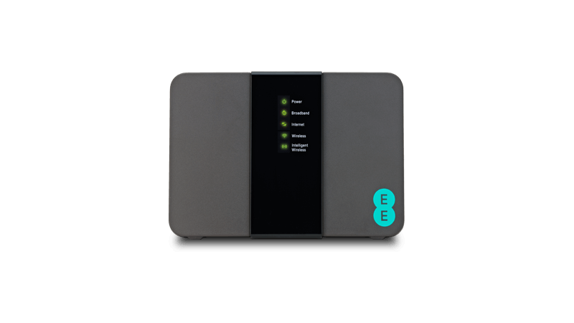
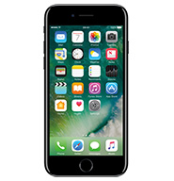
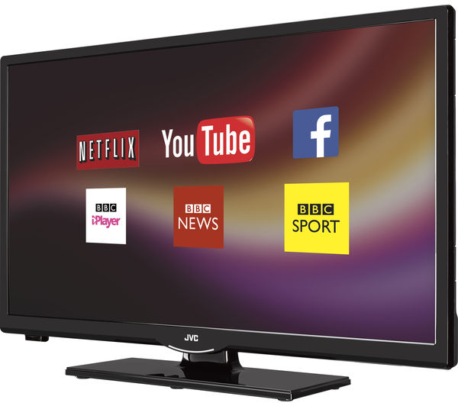
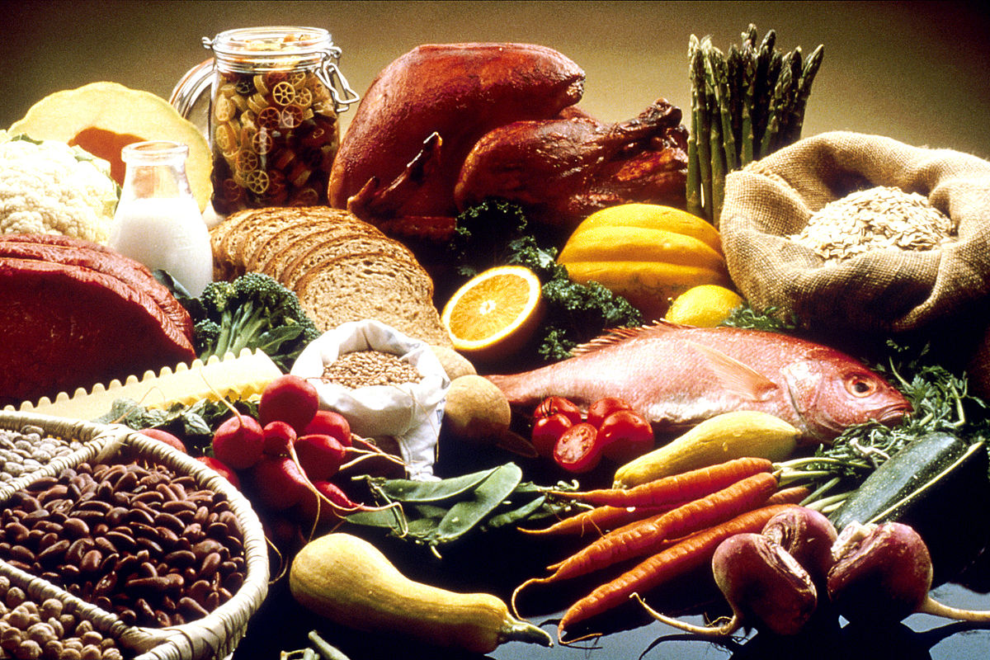
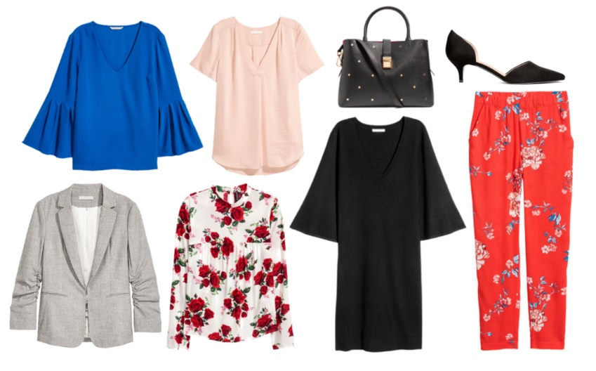
How much money have you got left after your monthly outgoings?
Task
What else will you need to buy/spend money on each month? Make a list with your partner.
How much do you think these things cost?
Discuss.

Slide 17
Plenary
Complete the triangle with what you’ve learned and still have questions about. I’ll answer the questions at the start of next lesson ☺
1 question about today’s topic
2 things you learnt today
3 things you knew already

