Slide 1
Starter
What can you remember about vectors from GCSE maths?

Slide 2
The most common notation for vectors is threefold:
$$A$$
$\vec{AB}=a=\underline{a}$
$$B$$
The resultant is a single vector which is equivalent to a set of vectors
$$\underline{a}$$
$$\underline{b}$$
$$\underline{c}=\underline{a}+\underline{b}$$

Slide 3
Vectors with the same magnitude and direction are equal
If vectors have the same magnitude and opposite directions then:
$\vec{AB}=a$ and $\vec{BA}=−a$
$$a$$
$$−a$$

Slide 4
If different sized vectors have the same direction they are scalar multiples of each other.
$$\underline{m}$$
$$\underline{n}$$
$$\underline{m}=2n$$

Slide 5
Adding and Subtracting Vectors
$$\left[\begin{matrix}a \\ b\end{matrix}\right]$$
$$\left[\begin{matrix}c \\ d\end{matrix}\right]$$
$$\left[\begin{matrix}a+c \\ b+d\end{matrix}\right]$$
+
=
$$\left[\begin{matrix}a \\ b\end{matrix}\right]$$
$$\left[\begin{matrix}c \\ d\end{matrix}\right]$$
$$\left[\begin{matrix}a−c \\ b−d\end{matrix}\right]$$
-
=

Slide 6
Multiplying Vectors
$$k\left[\begin{matrix}a \\ b\end{matrix}\right]$$
$$\left[\begin{matrix}ka \\ kb\end{matrix}\right]$$
=
Two vectors are parallel if one is a scalar multiple of the other.

Slide 7
Task
1. Calculate the following:
a) $\left[\begin{matrix}0 \\ 3\end{matrix}\right]+ \left[\begin{matrix}6 \\ 4\end{matrix}\right]$ b) $\left[\begin{matrix}7 \\ 3\end{matrix}\right]− \left[\begin{matrix}3 \\ 1\end{matrix}\right]$
c) $4\left[\begin{matrix}5 \\ 2\end{matrix}\right]$
2. Are the following pairs of vectors parallel?
a) $\left[\begin{matrix}10 \\ 1\end{matrix}\right]$ and $\left[\begin{matrix}−30 \\ −3\end{matrix}\right]$ b) $\left[\begin{matrix}32 \\ −16\end{matrix}\right]$ and $\left[\begin{matrix}8 \\ 4\end{matrix}\right]$
= $\left[\begin{matrix}6 \\ 7\end{matrix}\right]$
= $\left[\begin{matrix}4 \\ 2\end{matrix}\right]$
= $\left[\begin{matrix}20 \\ 8\end{matrix}\right]$
Yes
No

Slide 8
Rewrite the following vectors in terms of $\underline{a}$, $\underline{b}$ and $\underline{c}$.
$\vec{BA}$
$\vec{CB}$
$\vec{DC}$
$\vec{AC}$
$\vec{AD}$
$=−\underline{a}$
$=−\underline{b}$
$=−\underline{c}$
$=\underline{a}+\underline{b}$
$=\underline{a}+\underline{b}+\underline{c}$
$$E$$
$$D$$
$$\underline{c}$$
$$F$$
$$C$$
$$\underline{b}$$
$$A$$
$$\underline{a}$$
$$B$$

Slide 9
Two vectors are parallel if they share a common factor.
Eg. $4\underline{a}$ and $7\underline{a}$ are parallel as $\underline{a}$ is a common factor.
Eg. $4\underline{m}−2\underline{n}$ and $6\underline{m}−3\underline{n}$ are parallel as
$2\underline{m}−\underline{n}$ is a common factor.

Slide 10
Two vectors are on a straight line if they are parallel and share a common point. Similarly, three points are collinear if they exist on a single straight line.
Eg. $\vec{RQ}=4\underline{a}$ and $\vec{RS}=7\underline{a}$ are parallel as $\underline{a}$ is a common factor, and share the point $R$ so are on a straight line.

Slide 11
$$A$$
$$B$$
$$Y$$
$\vec{AB}=\underline{r}$ and $\vec{AD}=\underline{s}$
$AY:YD=1:2$
$DX:XB=1:2$
$$X$$
$$D$$
$$C$$
Show that $\vec{YX}$ is parallel to $\vec{AC}$.
$\vec{YX}=\frac{2}{3}\vec{AD}+\frac{1}{3}\vec{DB}$
$=\frac{2}{3}\underline{s}+\frac{1}{3}\left(\underline{r}−\underline{s}\right)$
$=\frac{1}{3}\left(\underline{r}+\underline{s}\right)$
$\vec{AC}=\vec{AD}+\vec{BC}$
$=\underline{r}+\underline{s}$
$\left(\underline{r}−\underline{s}\right)$ is a common factor so $\vec{YX}$ is parallel to $\vec{AC}$.

Slide 13
Answers
1.
2. a) i) $b – a$ ii) $\frac{1}{2}a$
iii) $\frac{1}{2}(a+b)$ iv) $\frac{1}{2}b$
b) $b$ is a common factor
3. a) i) $2b$ ii) $a−b$
b) $b$ is a common factor
4. $k=\frac{5}{6}$
Group 1
$$2a + b$$
$$4b + 8a$$
$$−b−2a$$
Group 2
$$2p + q$$
$$\frac{1}{2}q +p$$
Group 3
$$2a− b$$
$$10a−5b$$

Slide 14
We can use unit vectors to represent vectors in two dimensions.
A unit vector is a vector of length 1.
The unit vectors along the $x$ axis and $y$ axis are usually represented by $i$ and $j$ respectively.
$i = \left(\begin{matrix}1 \\ 0\end{matrix}\right)$ $j = \left(\begin{matrix}0 \\ 1\end{matrix}\right)$
For example, $4i−3j = \left(\begin{matrix}4 \\ −3\end{matrix}\right)$

Slide 15
We can use Pythagoras’ Theorem to calculate the magnitude of a vector.
For the vector $a=xi+yj=\left(\begin{matrix}x \\ y\end{matrix}\right)$ , the magnitude is given by:
$\left|a\right|= \sqrt{x^{2}+y^{2}}$
A unit vector (length 1) in the direction of $a$ is $\frac{a}{\left|a\right|}$
For example, if $\left|a\right|$ = 7, then a unit vector in the direction of $a$ is $\frac{a}{7}$
$$a$$
$$\frac{a}{7}$$

Slide 16
Task
Calculate the magnitude of the following vectors:
$a= \left(\begin{matrix}6 \\ 3\end{matrix}\right)$
$b=\left(\begin{matrix}4 \\ −6\end{matrix}\right)$
$c=\left(\begin{matrix}−8 \\ 6\end{matrix}\right)$
$$\left|a\right|=3\sqrt{5}$$
$$\left|b\right|=2\sqrt{13}$$
$$\left|c\right|=10$$

Slide 17
Cartesian coordinates
These are the coordinates you are used to
Polar coordinates
These measured in the distance from the origin and the angle from the positive x axis

Slide 18
We can use Pythagoras’ Theorem and trigonometry to find $θ$ and $r$ given $x$ and $y$.
$$r$$
$$y$$
$$(x, y)$$
$$r$$
$$θ$$
$$x$$
$$θ$$
$$r= \sqrt{x^{2}+y^{2}}$$
$$θ=\tan^{−1}\left(\frac{y}{x}\right)$$

Slide 19
Vectors are commonly expressed in one of four ways:
$$y$$
$$\left(\begin{matrix}3 \\ 5\end{matrix}\right)$$
$$3i+5j$$
$$x$$
$$(5.83, 59°)$$

Slide 20
Task
Match the groups of vectors.
There are 6 sets of 4 cards.
Some are blank for you to fill in at the end.

Slide 21
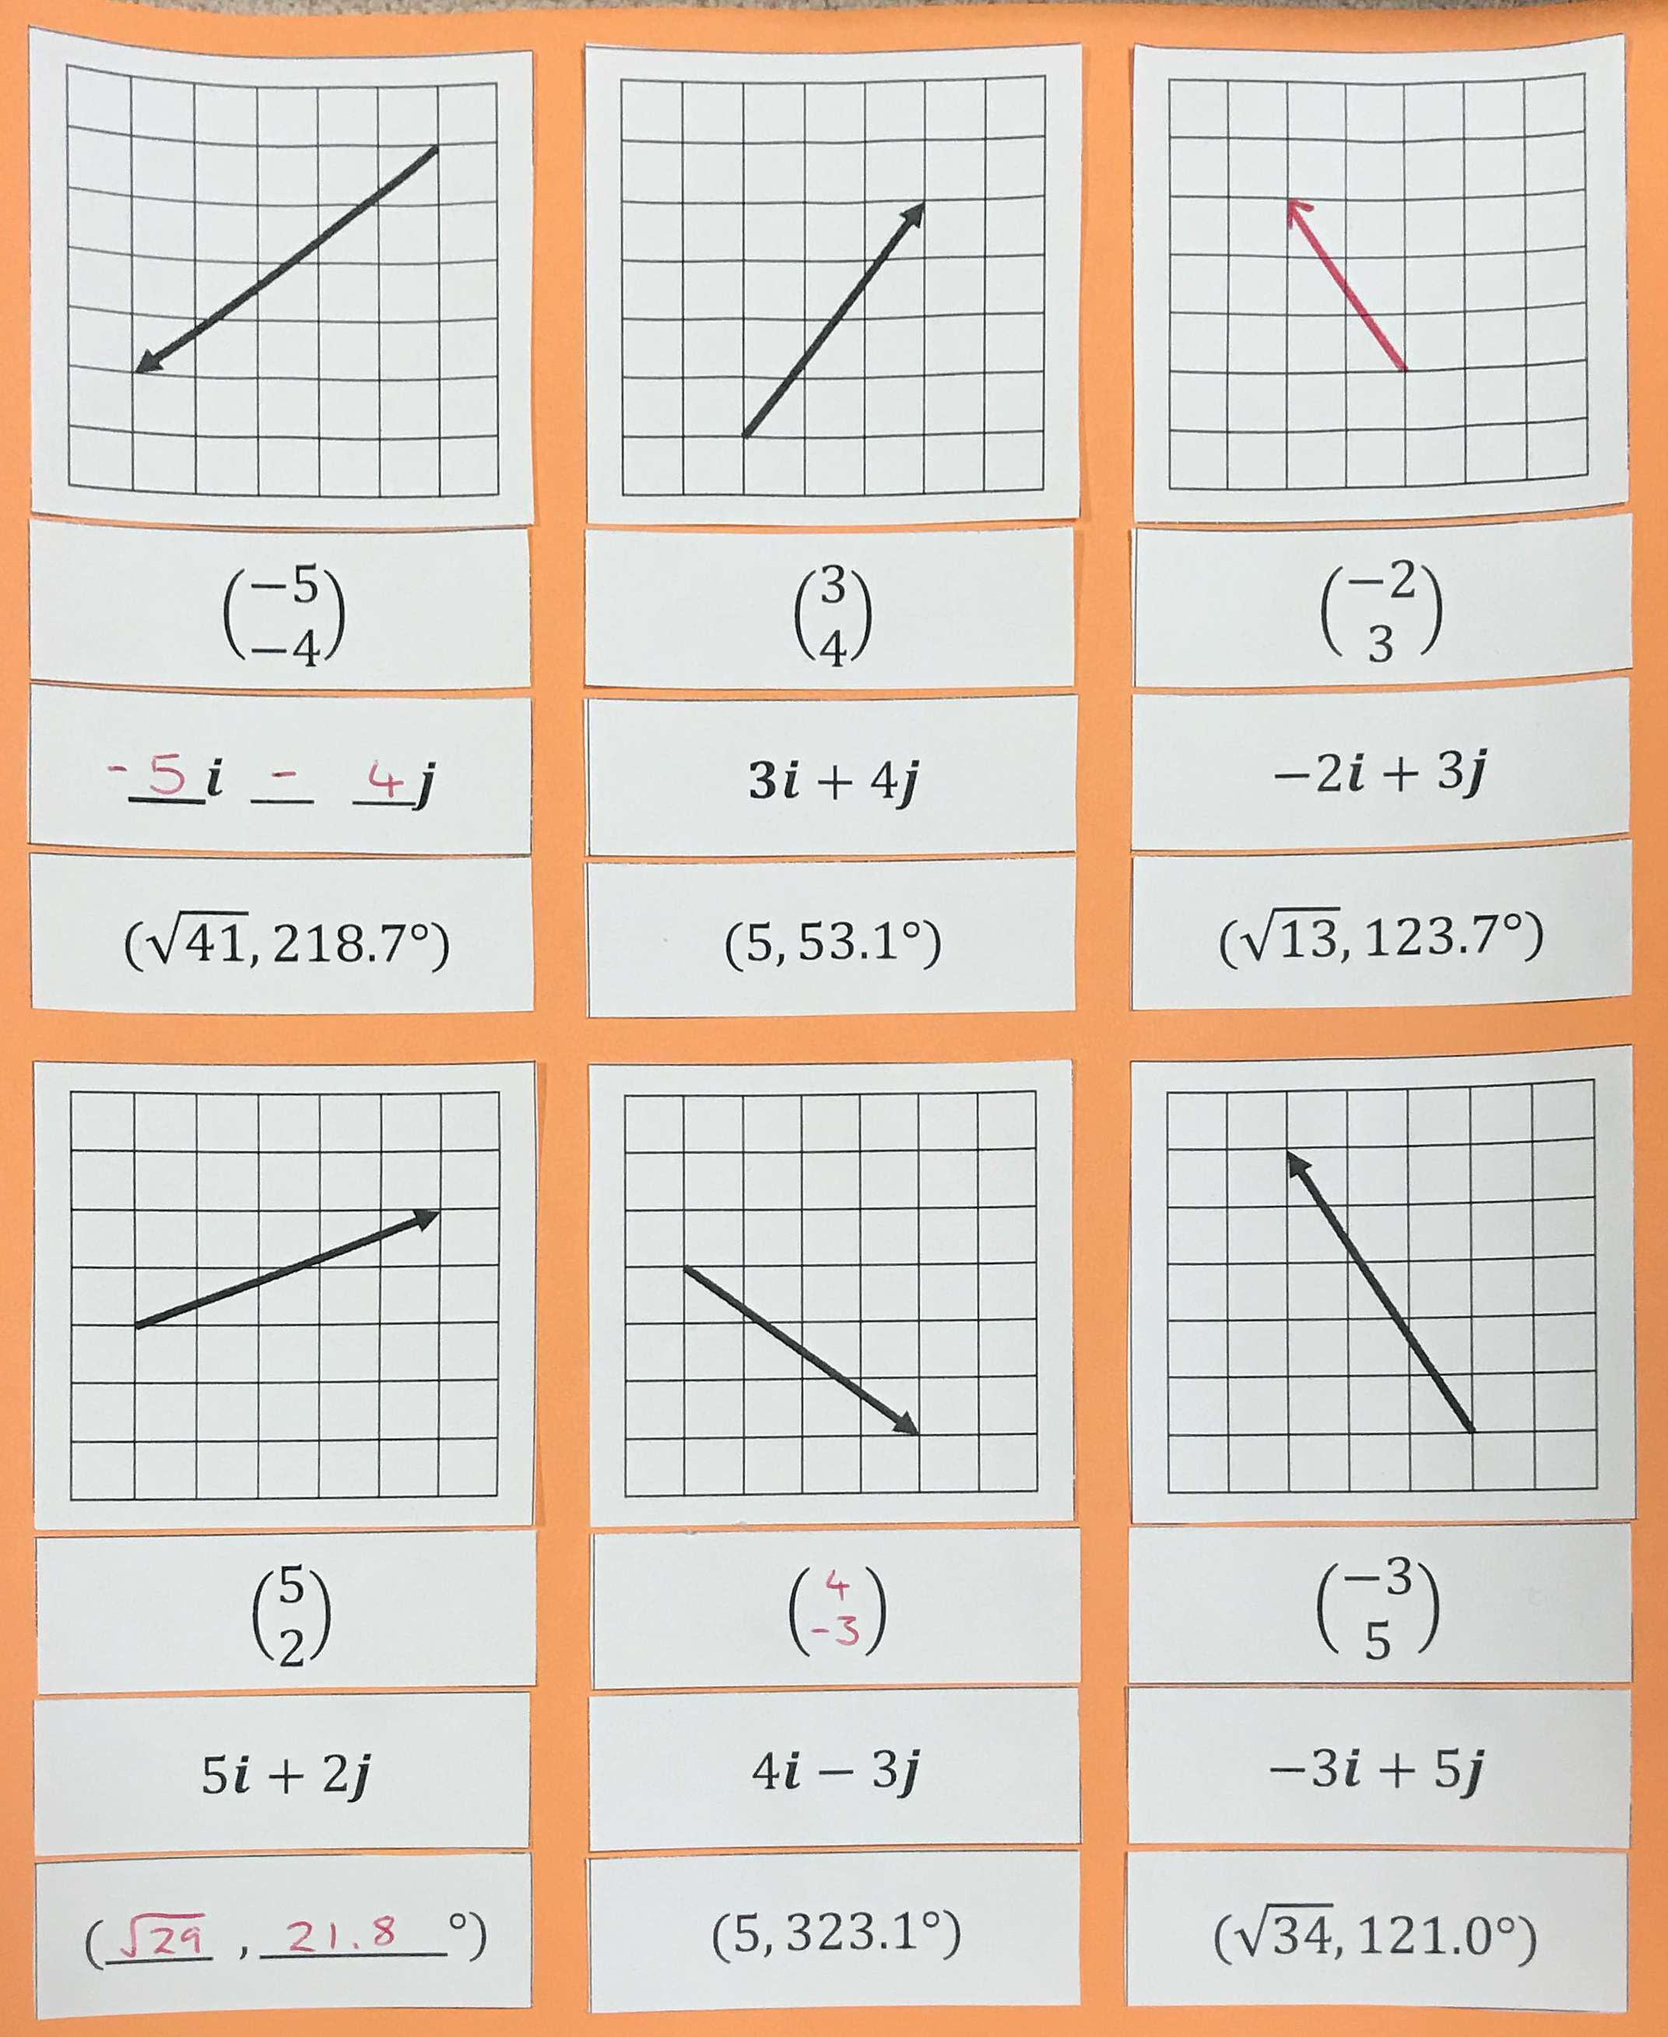

Slide 23
Vectors are commonly expressed in one of four ways:
$$y$$
$$\left(\begin{matrix}3 \\ 5\end{matrix}\right)$$
$$3i+5j$$
How would you identify parallel pairs of vectors for each of these formats?
$$x$$
$$(5.83, 59°)$$

Slide 24
Which of the following pairs of vectors are parallel?
$\left(\begin{matrix}4 \\ 10\end{matrix}\right)$ and $\left(\begin{matrix}6 \\ 15\end{matrix}\right)$
$\left(3.2, 126°\right)$ and $(4.12, 126°)$
$\left(\begin{matrix}3 \\ 5\end{matrix}\right)$ and $\left(\begin{matrix}6 \\ 9\end{matrix}\right)$
$5i+6j$ and $9i−15j$
$\left(2.7, 44°\right)$ and $(5.4, 316°)$
$−2i+6j$ and $9j−3i$
$8i+18j$ and $−4i−9j$
$\left(6, 60°\right)$ and $(4, 300°)$

