Slide 1
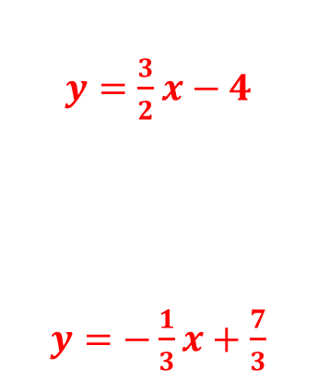
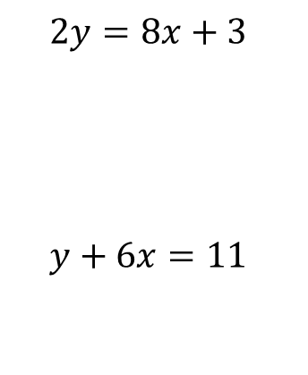
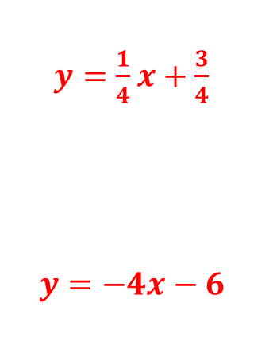
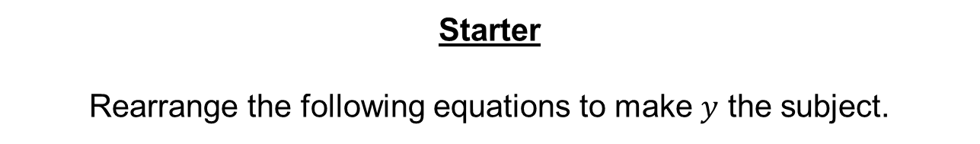
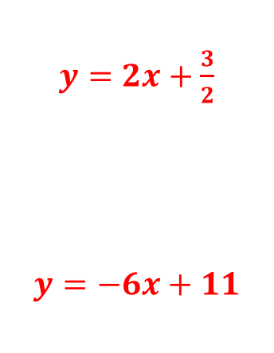
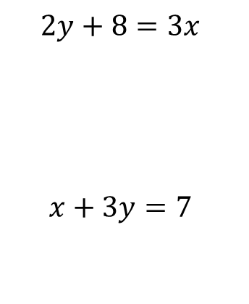
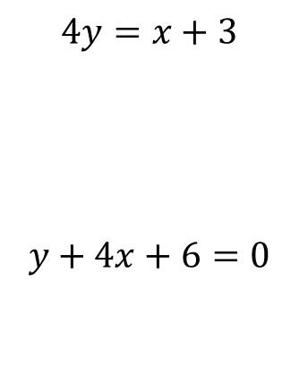
Starter
Rearrange the following equations to make $y$ the subject.
$$2y=8x+3$$
$$y+6x=11$$
$$4y=x+3$$
$$y+4x+6=0$$
$$2y+8=3x$$
$$x+3y=7$$
$y=2x+\frac{3}{2}$
$$y=−6x+11$$
$y=\frac{1}{4}x+\frac{3}{4}$
$$y=−4x−6$$
$y=\frac{3}{2}x−4$
$y=−\frac{1}{3}x+\frac{7}{3}$

Slide 2


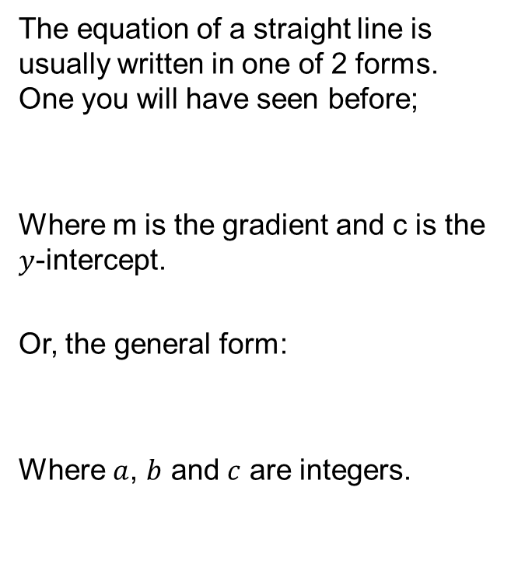



The equation of a straight line is usually written in one of 2 forms. One you will have seen before;
Where m is the gradient and c is the $y$-intercept.
Or, the general form:
Where $a$, $b$ and $c$ are integers.
$$y$$
$y$-intercept
gradient
$$y=mx+c$$
1
$$x$$
$$ax+by+c=0$$

Slide 3



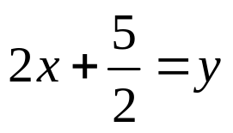
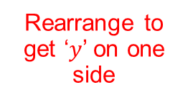
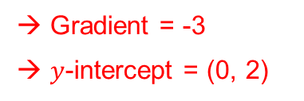
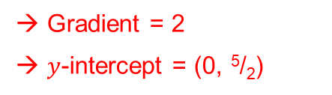
Example
Write down the gradient and y-intercept of the following graphs.
a)
b)
Rearrange to get ‘$y$’ on one side
→ Gradient = -3
→ $y$-intercept = (0, 2)
Divide by 2
→ Gradient = 2
→ $y$-intercept = (0, ⁵/₂)

Slide 4



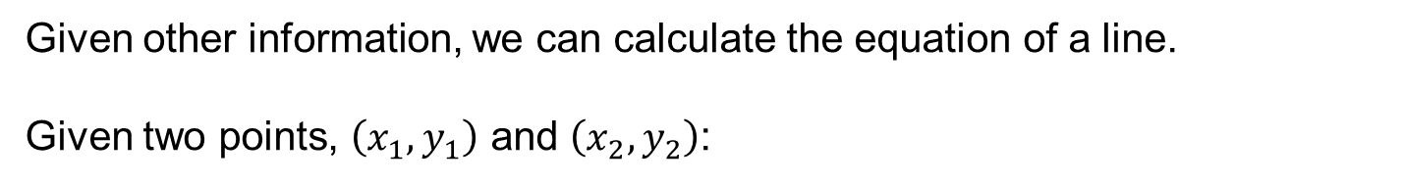

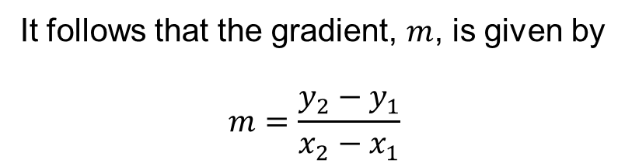



Given other information, we can calculate the equation of a line.
Given two points, $\left(x_{1},y_{1}\right)$ and $\left(x_{2},y_{2}\right)$:
$$y$$
It follows that the gradient, $m$, is given by
$$m=\frac{y_{2}−y_{1}}{x_{2}−x_{1}}$$
$$y_{2}$$
$$y_{1}$$
$$x_{1}$$
$$x_{2}$$
$$x$$
Rearranging gives $y−y_{1}=m\left(x−x_{1}\right)$

Slide 5
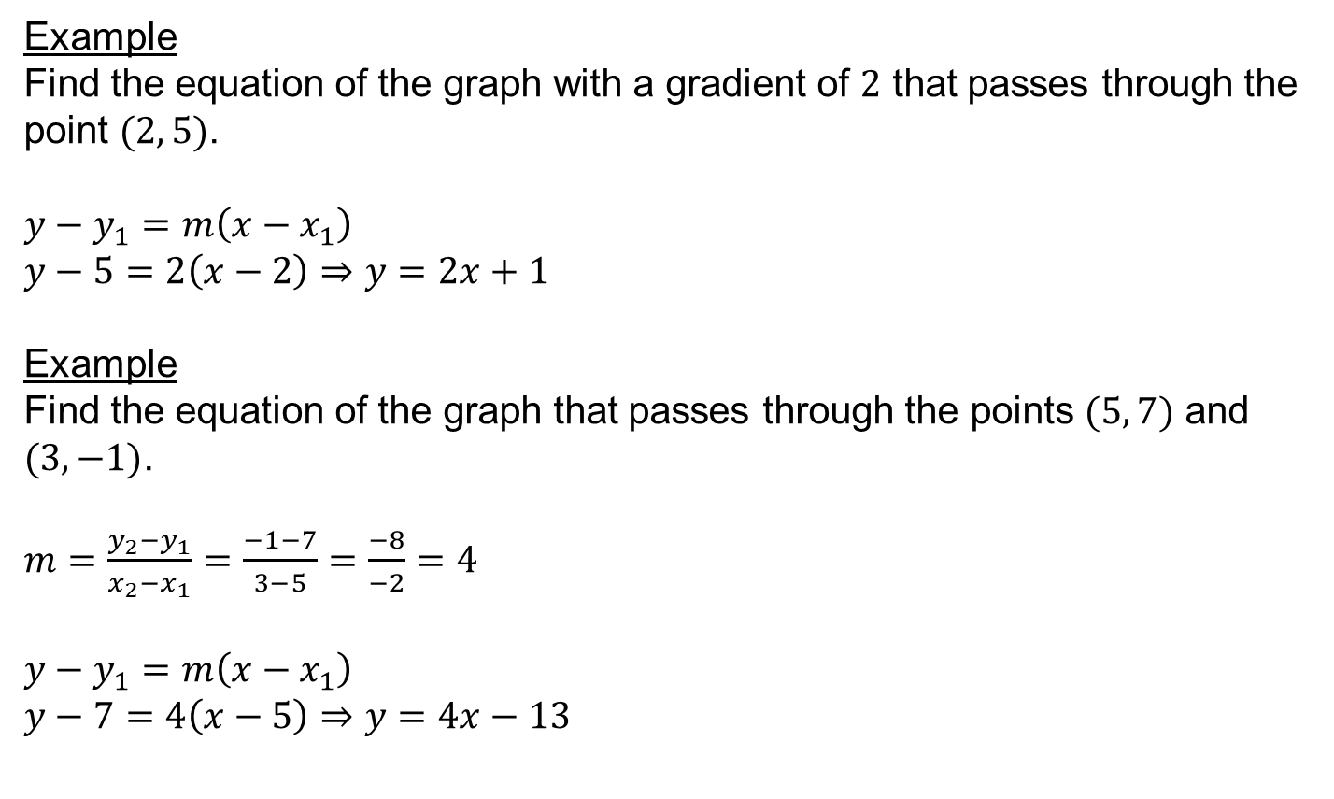
Example
Find the equation of the graph with a gradient of $2$ that passes through the point $(2, 5)$.
$y−y_{1}=m\left(x−x_{1}\right)$
$y−5=2\left(x−2\right)$ $⇒$ $y=2x+1$
Example
Find the equation of the graph that passes through the points $(5, 7)$ and $(3, −1)$.
$m=\frac{y_{2}−y_{1}}{x_{2}−x_{1}}=\frac{−1−7}{3−5}=\frac{−8}{−2}=4$
$y−y_{1}=m\left(x−x_{1}\right)$
$y−7=4\left(x−5\right)$ $⇒$ $y=4x−13$
Complete the red, amber or green worksheet depending on how confident you feel.

Slide 6
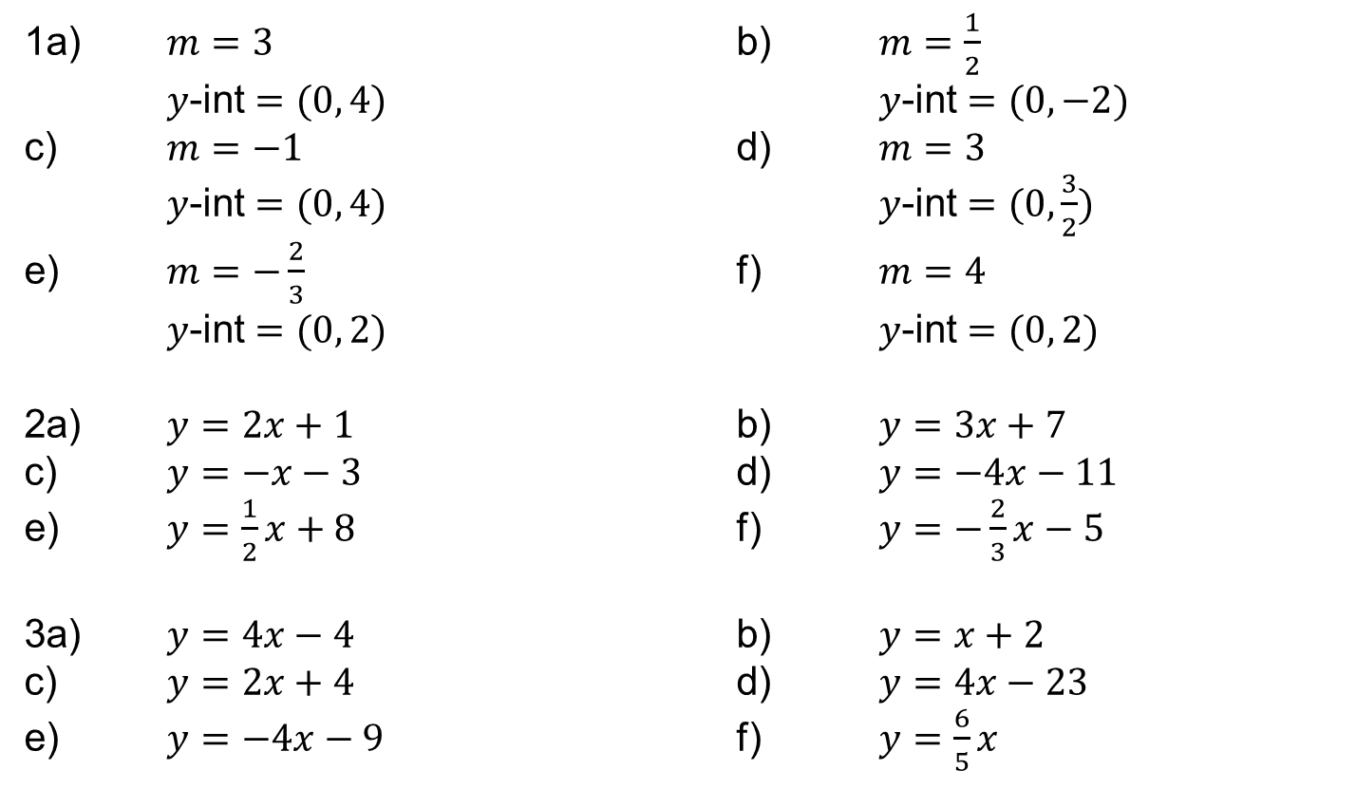
Answers
1a) $m=3$ b) $m=\frac{1}{2}$
$y$-int $=(0, 4)$ $y$-int $=(0, −2)$
c) $m=−1$ d) $m=3$
$y$-int $=(0, 4)$ $y$-int $=(0, \frac{3}{2})$
e) $m=−\frac{2}{3}$ f) $m=4$
$y$-int $=(0, 2)$ $y$-int $=(0, 2)$
2a) $y=2x+1$ b) $y=3x+7$
c) $y=−x−3$ d) $y=−4x−11$
e) $y=\frac{1}{2}x+8$ f) $y=−\frac{2}{3}x−5$
3a) $y=4x−4$ b) $y=x+2$
c) $y=2x+4$ d) $y=4x−23$
e) $y=−4x−9$ f) $y=\frac{6}{5}x$

Slide 7
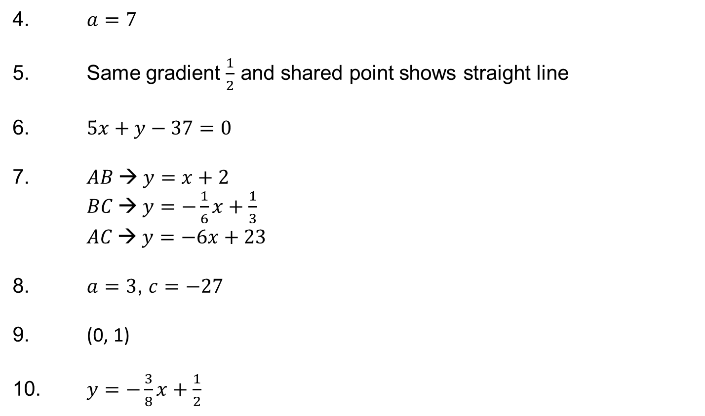
Answers
4. $a=7$
5. Same gradient $\frac{1}{2}$ and shared point shows straight line
6. $5x+y−37=0$
7. $AB → y=x+2$
$BC → y=−\frac{1}{6}x+\frac{1}{3}$
$AC → y=−6x+23$
8. $a=3$, $c=−27$
9. (0, 1)
10. $y=−\frac{3}{8}x+\frac{1}{2}$

Slide 8
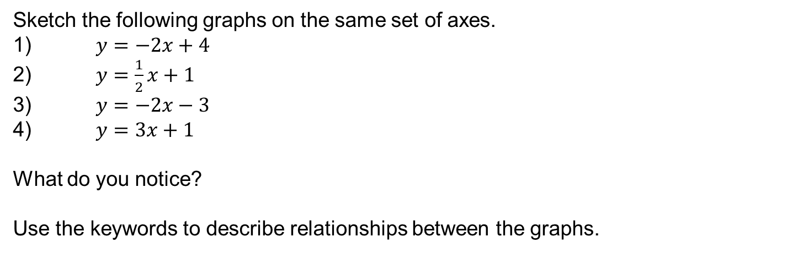
Sketch the following graphs on the same set of axes.
1) $y=−2x+4$
2) $y=\frac{1}{2}x+1$
3) $y=−2x−3$
4) $y=3x+1$
What do you notice?
Use the keywords to describe relationships between the graphs.

Slide 9
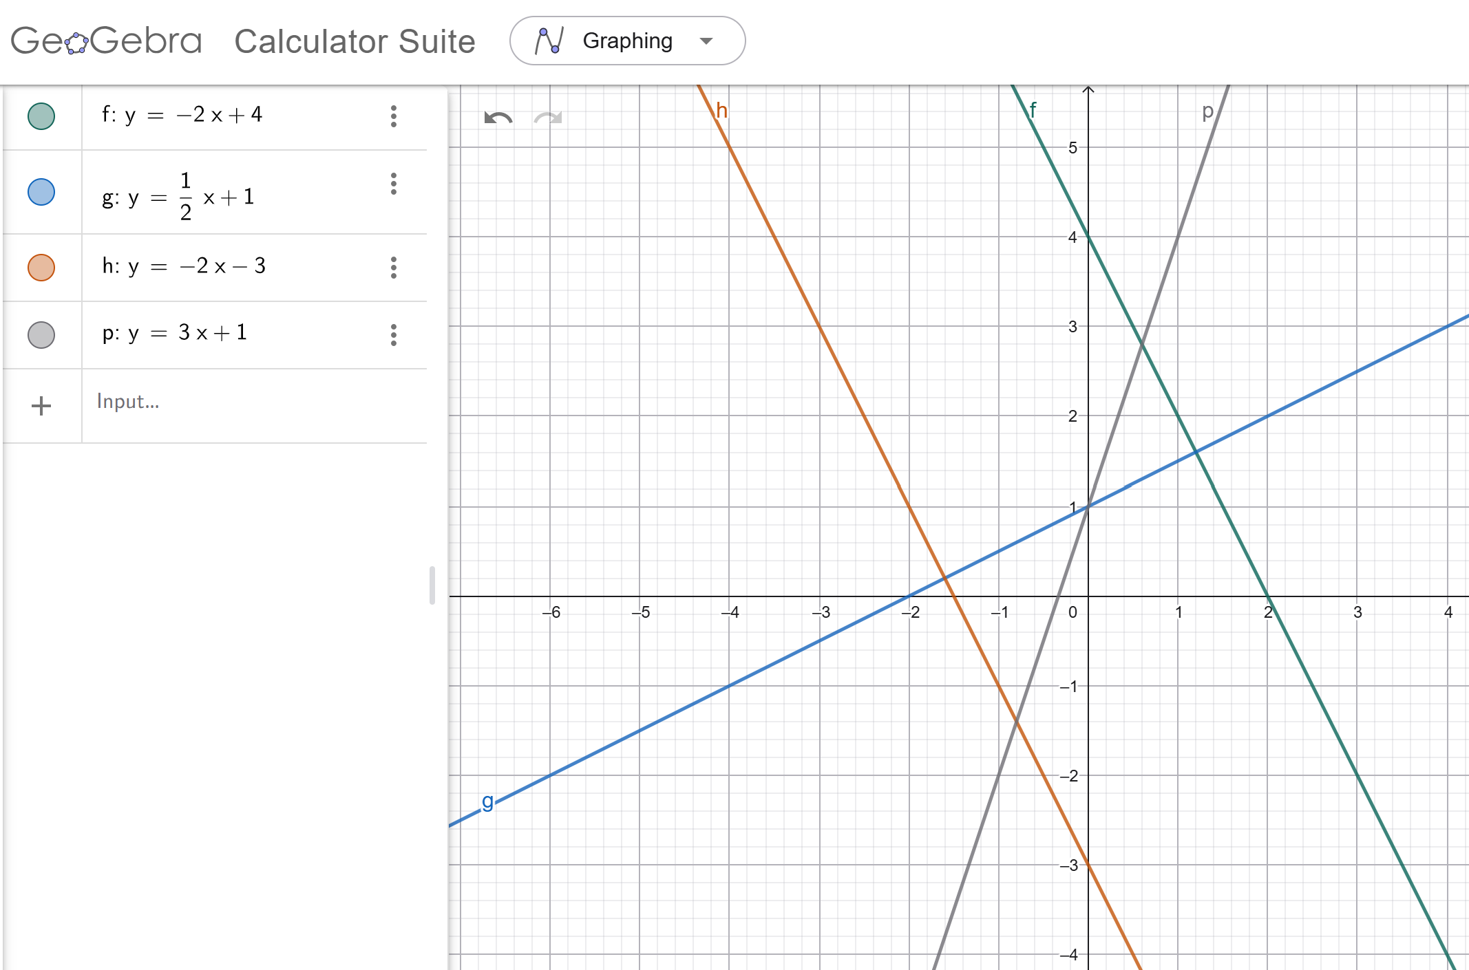

Slide 10
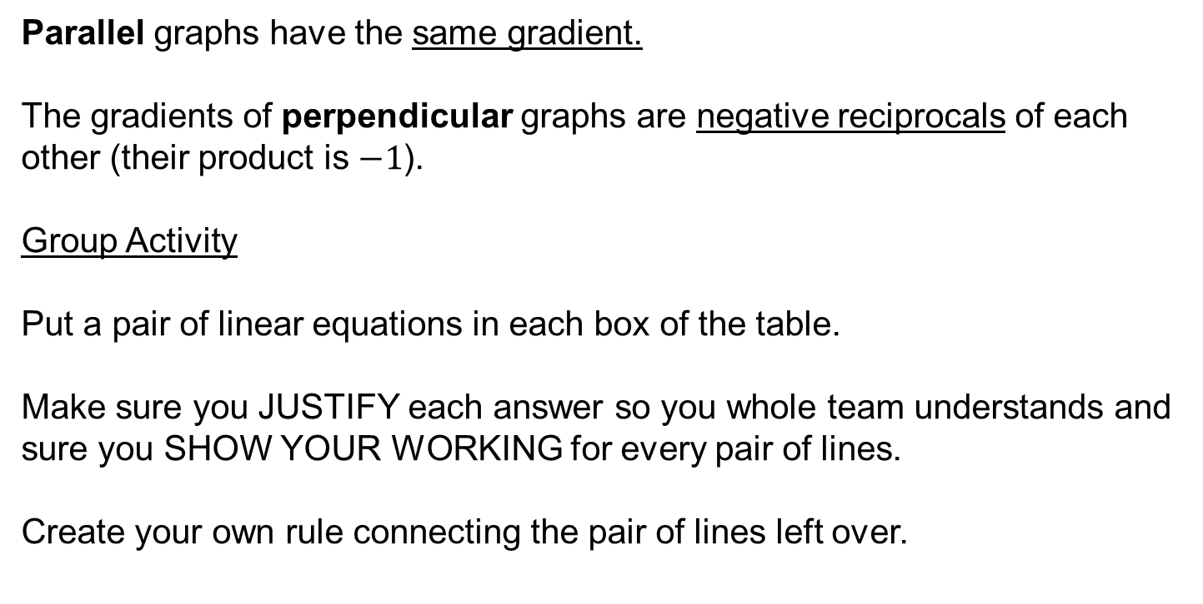
Parallel graphs have the same gradient.
The gradients of perpendicular graphs are negative reciprocals of each other (their product is $−1$).
Group Activity
Put a pair of linear equations in each box of the table.
Make sure you JUSTIFY each answer so you whole team understands and sure you SHOW YOUR WORKING for every pair of lines.
Create your own rule connecting the pair of lines left over.

Slide 11
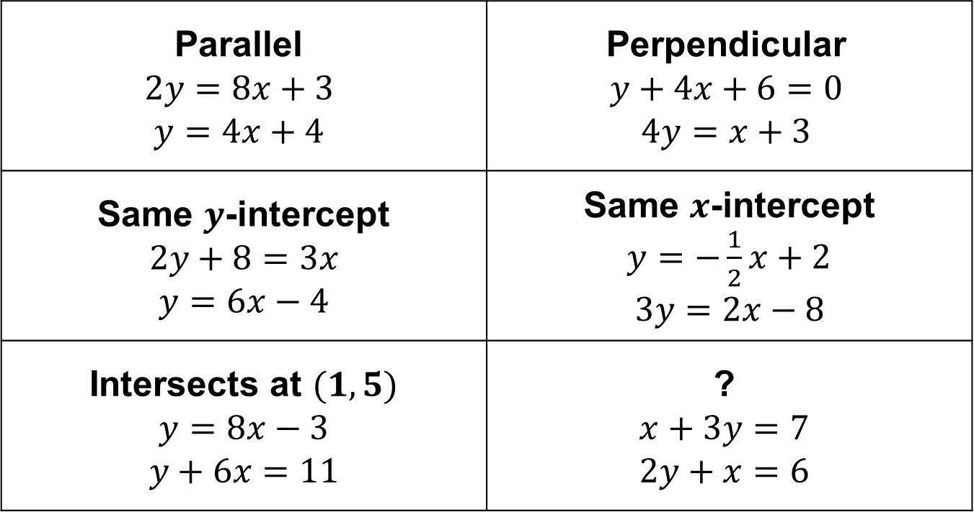
Answers
Parallel $$2y=8x+3$$ $$y=4x+4$$ | Perpendicular $$y+4x+6=0$$ $$4y=x+3$$
Same $y$-intercept $$2y+8=3x$$ $$y=6x−4$$ | Same $x$-intercept $y=−\frac{1}{2}x+2$ $$3y=2x−8$$
Intersects at $(1, 5)$ $$y=8x−3$$ $$y+6x=11$$ | ? $$x+3y=7$$ $$2y+x=6$$

Slide 12

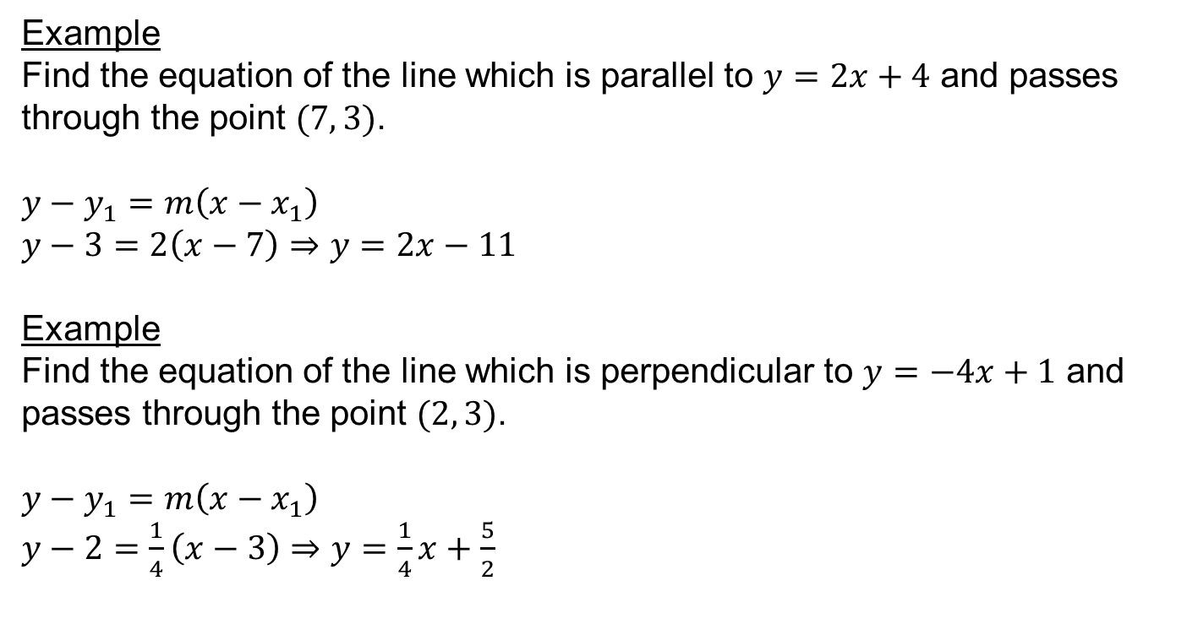
Example
Find the equation of the line which is parallel to $y=2x+4$ and passes through the point $(7, 3)$.
$y−y_{1}=m\left(x−x_{1}\right)$
$y−3=2\left(x−7\right)$ $⇒$ $y=2x−11$
Example
Find the equation of the line which is perpendicular to $y=−4x+1$ and passes through the point $(2, 3)$.
$y−y_{1}=m\left(x−x_{1}\right)$
$y−2=\frac{1}{4}\left(x−3\right)$ $⇒$ $y=\frac{1}{4}x+\frac{5}{2}$
Parallel graphs have the same gradient
Gradients of perpendicular graphs have a product of $−1$

Slide 13
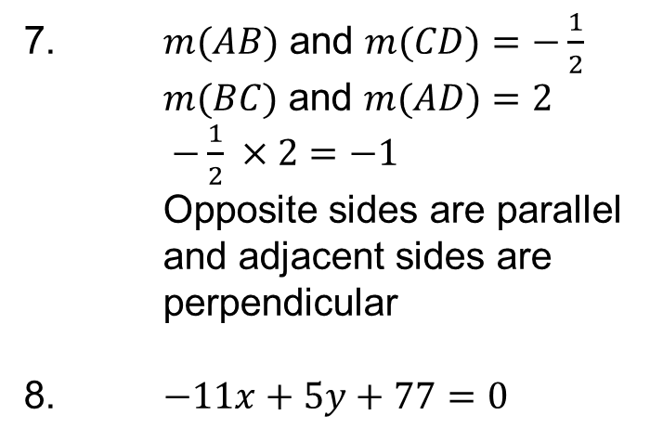
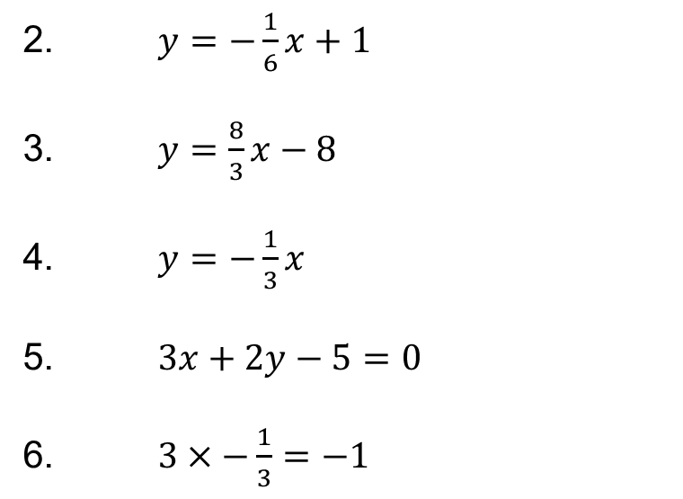
Answers
1a) Perpendicular b) Parallel c) Neither
d) Parallel e) Neither f) Perpendicular
2. $y=−\frac{1}{6}x+1$
3. $y=\frac{8}{3}x−8$
4. $y=−\frac{1}{3}x$
5. $3x+2y−5=0$
6. $3×−\frac{1}{3}=−1$
7. $m(AB)$ and $m(CD)$ $=−\frac{1}{2}$
$m(BC)$ and $m(AD)$ $=2$
$−\frac{1}{2} ×2=−1$
Opposite sides are parallel and adjacent sides are perpendicular
8. $−11x+5y+77=0$

