Slide 1
Starter
What are the midpoints of the following pairs of numbers?
0 – 10
40 – 50
30 – 40
0 – 100
0 – 50
54 – 56
5 – 9
8 – 14
38 – 52
0 – 5
5
45
35
50
25
55
7
11
45
2.5

Slide 2
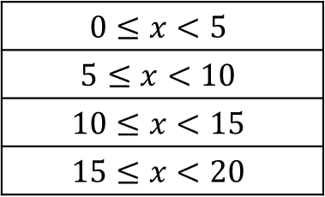
In maths, we represent a numerical group using specific symbols
$x<4$ means $x$ is less than $4$
$x>10$ means $x$ is greater than $10$
Example
How much money do you spend per month on your phone?
Up to £5
£5 or more and less than £10
£10 or more and less than £15
£15 or more and less than £20
$$0≤x<5$$
$$5≤x<10$$
$$10≤x<15$$
$$15≤x<20$$
We can use inequality symbols to represent this

Slide 3
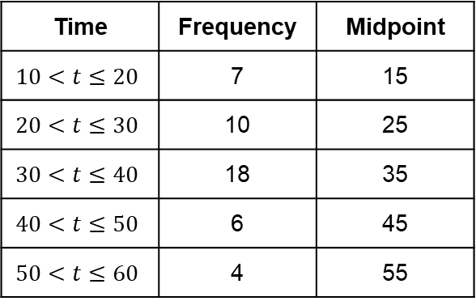
Frequency Polygons
A frequency polygon can be drawn from a frequency table by using by finding the midpoint of each class interval.
Example
Time Taken for Race
Time | Frequency | Midpoint
$$10<t≤20$$ | 7 | 15
$$20<t≤30$$ | 10 | 25
$$30<t≤40$$ | 18 | 35
$$40<t≤50$$ | 6 | 45
$$50<t≤60$$ | 4 | 55
Frequency
20
15
10
5
0
10
30
40
50
60
0
20
Time in minutes
Remember, a polygon has straight sides

Slide 4
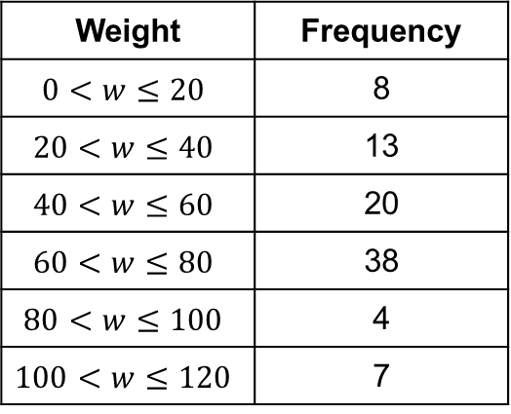
Frequency Polygons
Can you identify the 6 errors in this frequency polygon?
Extension: What should it look like?
Label
40
Weight | Frequency
$$0<w≤20$$ | 8
$$20<w≤40$$ | 13
$$40<w≤60$$ | 20
$$60<w≤80$$ | 38
$$80<w≤100$$ | 4
$$100<w≤120$$ | 7
35
30
25
Straight
20
Extra
15
10
Scale
Midpoints
0
40
60
80
120
20
100
Label

Slide 5
Frequency Polygons
Can you identify the 6 errors in this frequency polygon?
Extension: What should it look like?
Frequency Polygon to show the weight of…
40
Weight | Frequency
$$0<w≤20$$ | 8
$$20<w≤40$$ | 13
$$40<w≤60$$ | 20
$$60<w≤80$$ | 38
$$80<w≤100$$ | 4
$$100<w≤120$$ | 7
35
30
25
Frequency
20
15
10
5
0
40
60
80
120
20
100
Weight

Slide 7
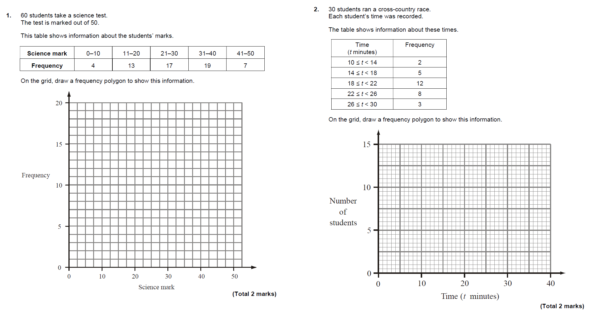
Solutions

Slide 8
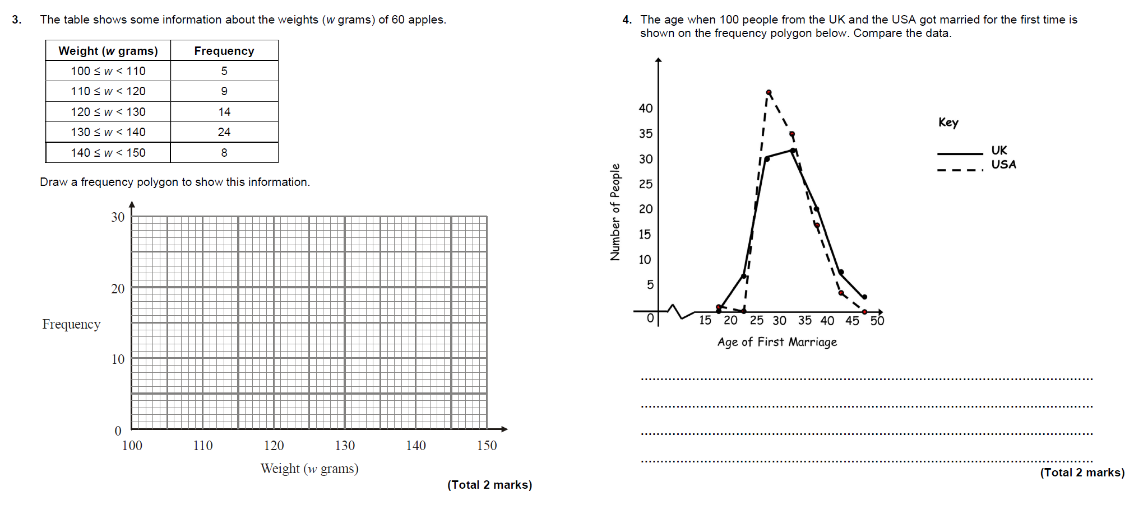
Solutions

Slide 9
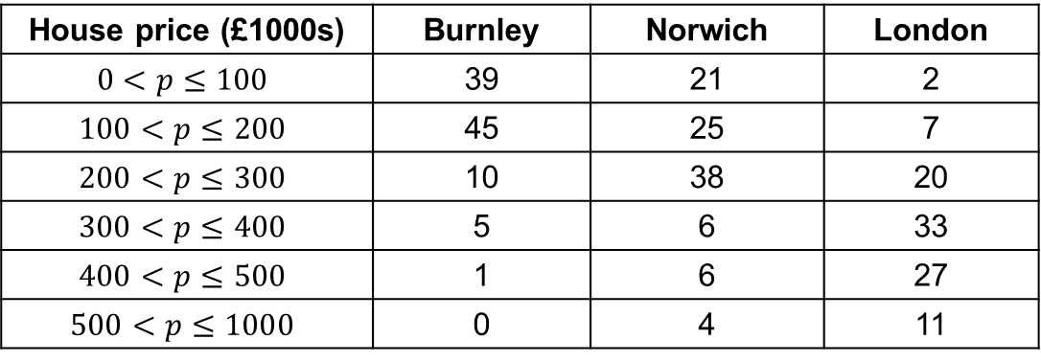
Group Task (3s)
The price of 100 houses in different parts of the country are shown in the table.
Draw frequency polygons to illustrate the data.
Compare your data
House price (£1000s) | Burnley | Norwich | London
$$0<p≤100$$ | 39 | 21 | 2
$$100<p≤200$$ | 45 | 25 | 7
$$200<p≤300$$ | 10 | 38 | 20
$$300<p≤400$$ | 5 | 6 | 33
$$400<p≤500$$ | 1 | 6 | 27
$$500<p≤1000$$ | 0 | 4 | 11

Slide 10
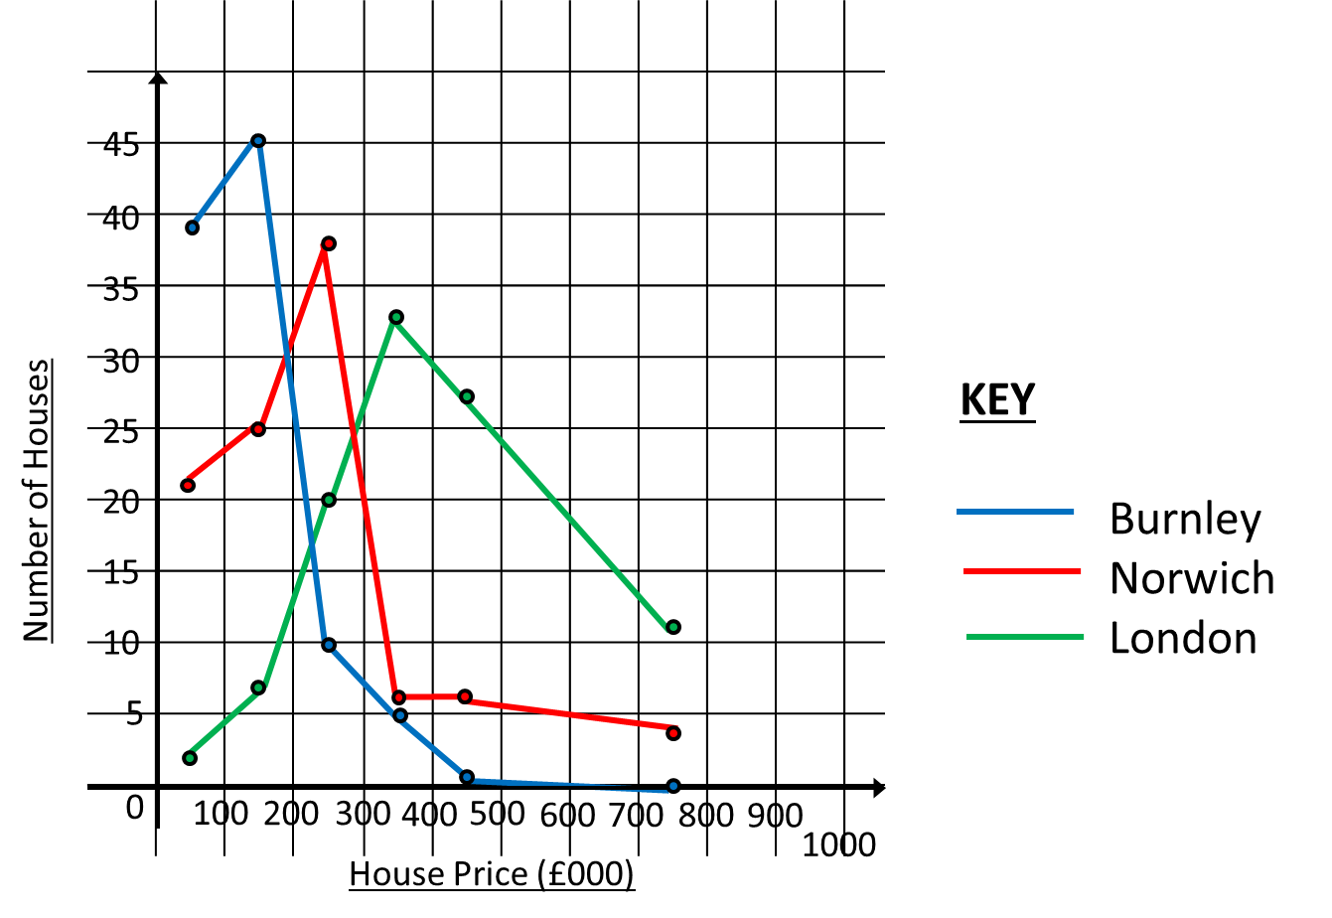
Group Task (3s)

Slide 11
Recap
Calculate the mode, median, mean and range of the following sets of data:
6 8 9 6 4 8 8
16 12 14 14 17 14
23 16 13 22 20 19
Mode = 8, Median = 8, Mean = 7, Range = 5
Mode = 14, Median = 14, Mean = 14.5, Range = 5
Mode = None, Median = 19.5, Mean = 18.83, Range = 7

Slide 12
Show me a set of 5 numbers that have:
• i) a mean of 6 ii) a range of 8 iii) a mean of 6 and a range of 8
• i) a median of 6 ii) a range 8 iii) a median of 6 and a range of 8
• i) a mode of 6 ii) a range 8 iii) a mode of 6 and a range of 8

Slide 13
True/Never/Sometimes:
• For a set of numbers, the mean is one of the numbers in the set.
• For a set of numbers, the mode is one of the numbers in the set.
• For a set of numbers, the median is one of the numbers in the set.
• For a set of numbers, the range is one of the numbers in the set.

Slide 14
True/Never/Sometimes:
• A set of numbers has one value for the mode.
• A set of numbers has one value for the range.
• The value for the range of a set of numbers is positive.

Slide 15
Moving Averages
Moving averages, when graphed, allow us to see any trends in data that are cyclical.
By calculating the average of 2 or more items in the data, any peaks and troughs are smoothed out allowing us to see trends more clearly.
Usually you will be asked to calculate a 3- or 4-point moving average.

Slide 16
Example
Calculate a 4-point moving average for the data below.
Year | 2016 |  |  |  | 2017 |  |  |  | 2018
Quarter | 1 | 2 | 3 | 4 | 1 | 2 | 3 | 4 | 1 | 2 | 3 | 4
Sales | 189 | 244 | 365 | 262 | 190 | 266 | 359 | 250 | 201 | 259 | 401 | 265
265
265.25
270.75
269.25
4 point Moving Average data
Quarters | 1 - 4 | 2 - 5 | 3 - 6 | 4 - 7 | 5 - 8 | 6 - 9 | 7 - 10 | 8 - 11 | 9 - 12
Moving Average | 265 | 265.25 | 270.75 | 269.25 | 266.25 | 269 | 267.25 | 277.75 | 281.5

Slide 17
Example
Show this data on a graph.
Year | 2016 |  |  |  | 2017 |  |  |  | 2018
Quarter | 1 | 2 | 3 | 4 | 1 | 2 | 3 | 4 | 1 | 2 | 3 | 4
Sales | 189 | 244 | 365 | 262 | 190 | 266 | 359 | 250 | 201 | 259 | 401 | 265
500
400
300
200
100
0
Sales
$$×$$
$$×$$
$$×$$
$$×$$
$$×$$
$$×$$
$$×$$
$$×$$
$$×$$
$$×$$
$$×$$
$$×$$
1 2 3 4 1 2 3 4 1 2 3 4
2016 2017 2018
Quarter

Slide 18
Example
Show this data on a graph.
Quarters | 1 - 4 | 2 - 5 | 3 - 6 | 4 - 7 | 5 - 8 | 6 - 9 | 7 - 10 | 8 - 11 | 9 - 12
Moving Average | 265 | 265.25 | 270.75 | 269.25 | 266.25 | 269 | 267.25 | 277.75 | 281.5
500
400
300
200
100
0
Sales
$$×$$
$$×$$
$$×$$
$$×$$
$$×$$
$$×$$
$$×$$
$$×$$
$$×$$
$$×$$
$$×$$
$$×$$
$$×$$
$$×$$
$$×$$
$$×$$
$$×$$
$$×$$
$$×$$
$$×$$
$$×$$
Gradual increasing trend
1 2 3 4 1 2 3 4 1 2 3 4
2016 2017 2018
Quarter

Slide 19
Extension: Draw a graph in your book for each question, illustrating the raw data and the moving averages

Slide 20
Answers
1) 74, 83
2) 20, 19
3a) 78, 79.75, 81.25
b) There is an increasing trend
4) 1420

