Slide 1

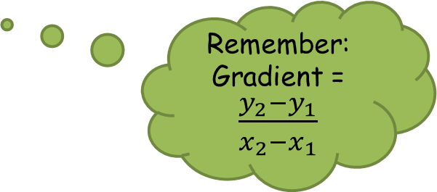


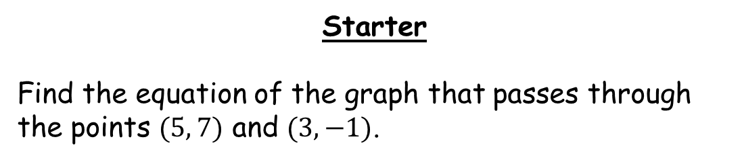

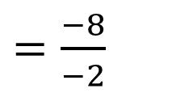

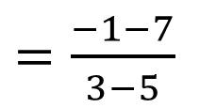
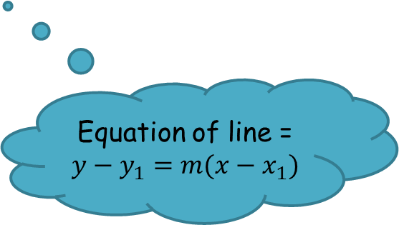
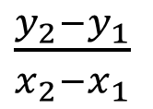
Starter
Find the equation of the graph that passes through the points $(5, 7)$ and $(3,−1)$.
Remember:
Gradient = $\frac{y_{2}−y_{1}}{x_{2}−x_{1}}$
$\frac{y_{2}−y_{1}}{x_{2}−x_{1}}$
$=\frac{−1−7}{3−5}$
$=\frac{−8}{−2}$
$=4$
$$y−y_{1}=m(x−x_{1})$$
$$y–7=4(x–5)$$
Equation of line =
$$y−y_{1}=m(x−x_{1})$$
$$y=4x–20+7$$
$$y=4x−13$$

Slide 2











How could we sketch a tangent at a point?
$$y$$
$$y$$
$$y=f(x)$$
$$y=f(x)$$
$$B$$
$$A$$
$$A$$
$$0$$
$$x$$
$$0$$
$$x$$
Discuss.

Slide 3
https://www.geogebra.org/m/NtY76qTq

Slide 4






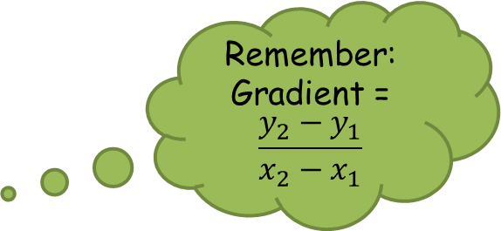




$$y$$
$$y=f(x)$$
Remember:
Gradient =
$$\frac{y_{2}−y_{1}}{x_{2}−x_{1}}$$
$$f(x0+h)$$
$$B$$
$$A$$
$$f(x0)$$
$$0$$
$$x0$$
$$x0+h$$
$$x$$

Slide 5



$$B$$
$$f(x0+h)−f(x0)$$
$$A$$
$$h$$

Slide 6



$$B$$
Gradient = $\frac{y_{2}−y_{1}}{x_{2}−x_{1}}$
$$f(x0+h)−f(x0)$$
$$A$$
Gradient = $\frac{f(x0+h)−f(x0) }{h}$
$$h$$
As h tends towards $0$, the gradient of $AB$ gets closer to the gradient of the tangent to the curve at $A$.
We can use this to define the gradient function.

Slide 7
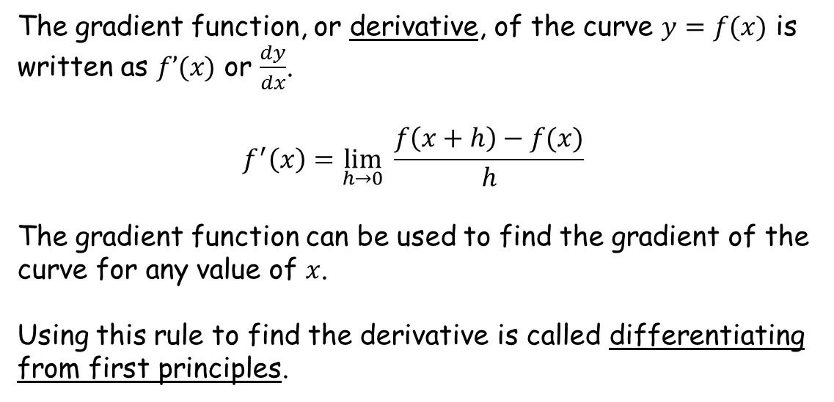
The gradient function, or derivative, of the curve $y=f(x)$ is written as $f’(x)$ or $\frac{dy}{dx}$.
$$f^{′}\left(x\right)=\lim_{h→0}{ \frac{f\left(x+h\right)−f(x)}{h}}$$
The gradient function can be used to find the gradient of the curve for any value of $x$.
Using this rule to find the derivative is called differentiating from first principles.
What does this mean?

Slide 8



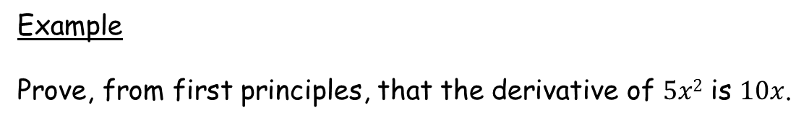
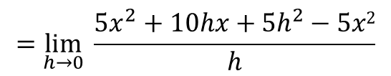
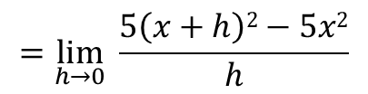

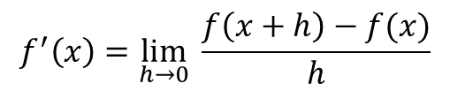

Example
Prove, from first principles, that the derivative of $5x2$ is $10x$.
$$f(x)=5x2$$
$$f^{′}\left(x\right)=\lim_{h→0}{ \frac{f\left(x+h\right)−f(x)}{h}}$$
$$=\lim_{h→0}{ \frac{5\left(x+h\right)2−5x2}{h}}$$
$$=\lim_{h→0}{ \frac{{5x}^{2}+10hx+{5h}^{2}−5x2}{h}}$$
Any terms containing $h$, $h2$, $h3$ etc will have a limiting value of $0$ as $h→0$
$$=\lim_{h→0}{ 10x+5h}$$
As $h→0$, $f’\left(x\right)→10x$
So $f’(x)=10x$

Slide 9



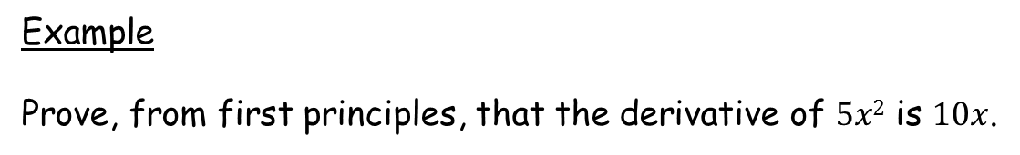
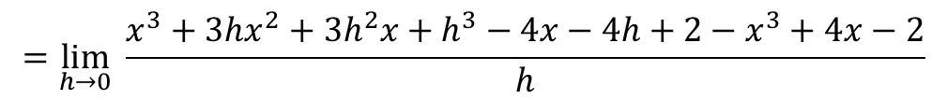
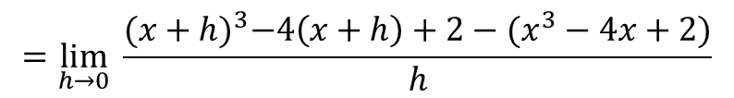
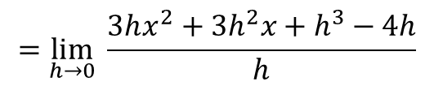
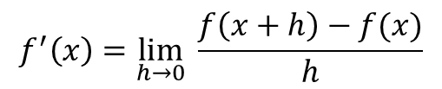

Example
Prove, from first principles, that the derivative of $5x2$ is $10x$.
$f\left(x\right)=x^{3}−4x+2$
$$f^{′}\left(x\right)=\lim_{h→0}{ \frac{f\left(x+h\right)−f(x)}{h}}$$
$$=\lim_{h→0}{ \frac{{(x+h)}^{3}−4\left(x+h\right)+2−(x^{3}−4x+2)}{h}}$$
$$=\lim_{h→0}{ \frac{x^{3}+3hx^{2}+{3h}^{2}x+h^{3}−4x−4h+2−x^{3}+4x−2}{h}}$$
$$=\lim_{h→0}{ \frac{3hx^{2}+{3h}^{2}x+h^{3}−4h}{h}}$$
$$=\lim_{h→0}{ {3x}^{2}+3hx+h^{2}−4}$$
As $h→0$, $f’\left(x\right)→3x^{2}−4$
So $f’(x)=3x^{2}−4$

Slide 10
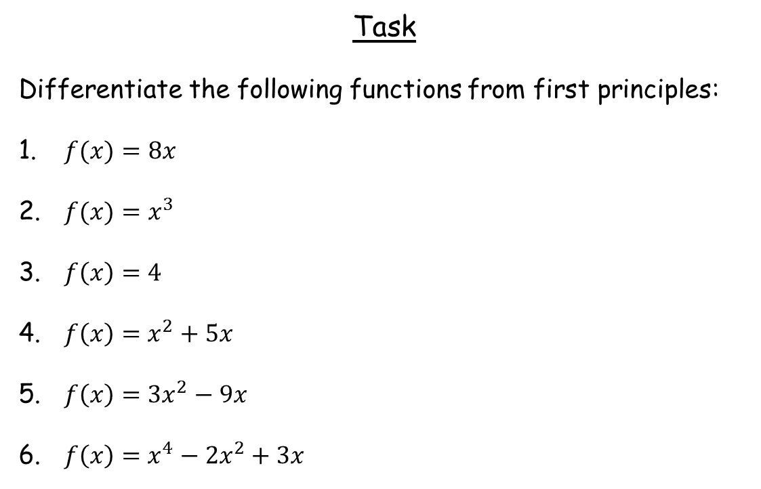
Task
Differentiate the following functions from first principles:
$f(x)=8x$
$f(x)=x^{3}$
$f\left(x\right)=4$
$f\left(x\right)=x^{2}+5x$
$f\left(x\right)=3x^{2}−9x$
$f\left(x\right)=x^{4}−2x^{2}+3x$
Binomial expansion will be useful with this one

Slide 11
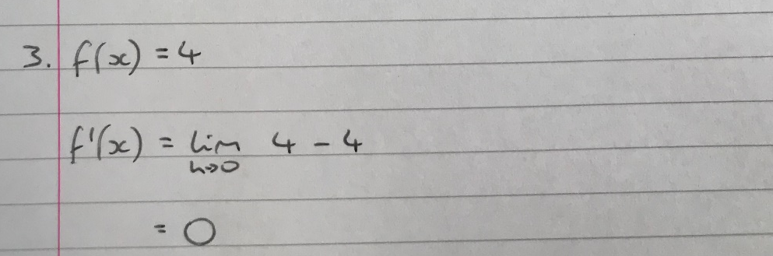

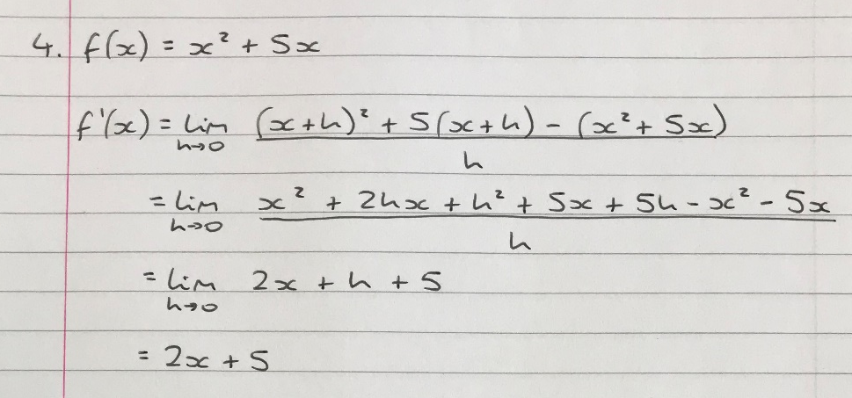
Worked Solutions

Slide 12
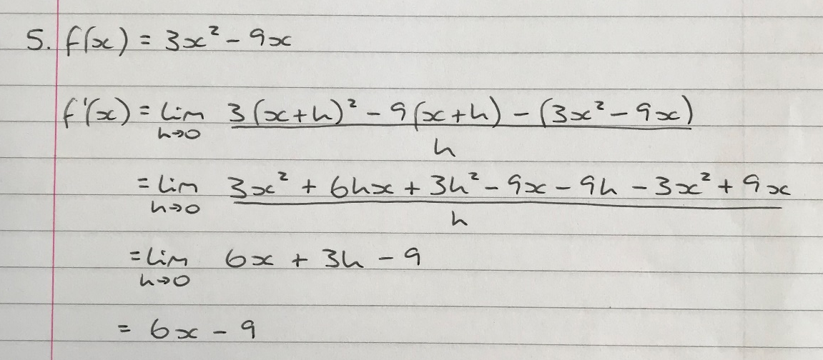
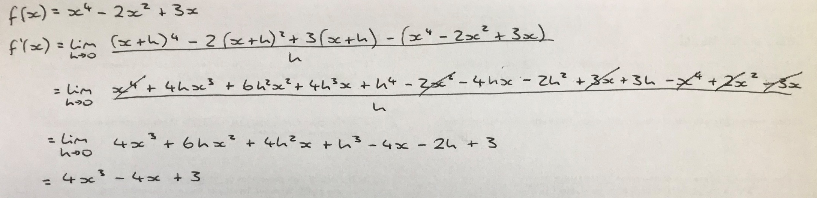
Worked Solutions

Slide 13

Plenary
Can you come up with a general rule for differentiating any term ${ax}^{n}$?

