Slide 1
Starter
Complete the jigsaw on averages.
Remember:
Mode is most
Median is middle
Mean is mean to work out
Range is the spread

Slide 2
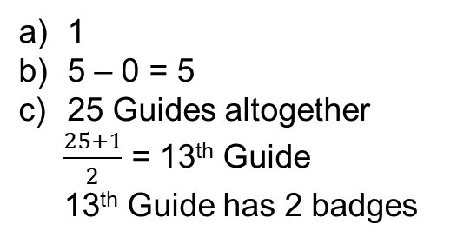
The table gives information about the numbers of badges gained by the girls in a Guide group.
Write down the mode.
Find the range.
Work out the median.
Calculate the mean.
Number of badges | Frequency
0 | 2
1 | 8
2 | 4
3 | 3
4 | 5
5 | 3
First 2
Up to 10
Up to 14
1
5 – 0 = 5
25 Guides altogether
$\frac{25+1}{2}$ = 13th Guide
13th Guide has 2 badges
Mode = most frequent
Range = biggest - smallest
Median = middle
Total number of badges ÷ total number of Guides
Mean = mathematical average
(add, then divide)

Slide 3
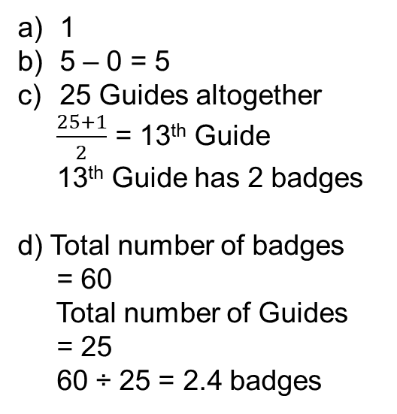
The table gives information about the numbers of badges gained by the girls in a Guide group.
Write down the mode.
Find the range.
Work out the median.
Calculate the mean.
Number of badges | Frequency
0 | 2
1 | 8
2 | 4
3 | 3
4 | 5
5 | 3
$$fx$$
0
8
8
9
1
5 – 0 = 5
25 Guides altogether
$\frac{25+1}{2}$ = 13th Guide
13th Guide has 2 badges
d) Total number of badges
= 60
Total number of Guides
= 25
60 ÷ 25 = 2.4 badges
20
15
Multiply the number of badges by the frequency
Total number of badges ÷ total number of Guides

Slide 5
Answers
 | Mode | Range | Median | Mean
Q1 | 4 | 5 | 3 | 2.75
Q2 | 1 | 5 | 1 | 1.61
Q3 | 1 | 4 | 2 | 1.8
Q4 | 2 | 5 | 2 | 2.1

Slide 6
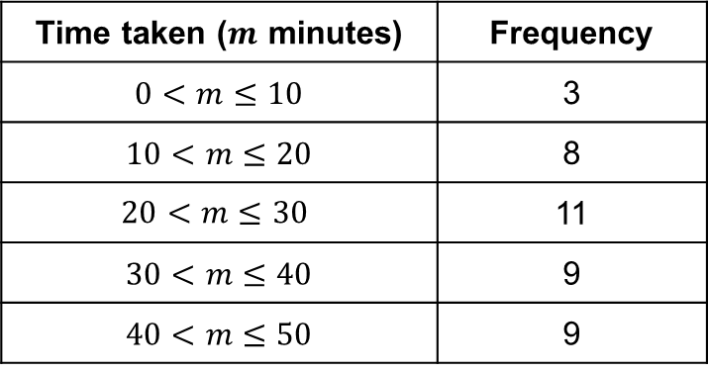
Bob asked each of 40 friends how many minutes they took to get to work. The table shows some information about his results.
Write down the modal class.
Work out the class in which the median lies.
Calculate an estimate for the mean.
Time taken ($m$ minutes) | Frequency
$0<m≤10$ | 3
$10<m≤20$ | 8
$$20<m≤30$$ | 11
$30<m≤40$ | 9
$40<m≤50$ | 9
What differences can you spot between these questions and the ones asked previously? Why??
Notes:
Class for mode and median
Why can’t we calculate the range?
Why can’t we calculate the exact value of the mean?

Slide 7
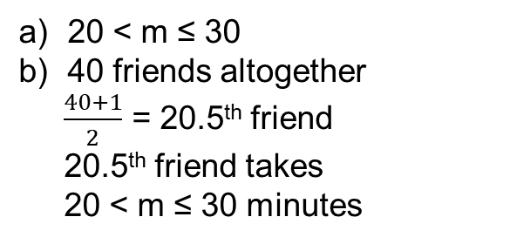
Bob asked each of 40 friends how many minutes they took to get to work. The table shows some information about his results.
Write down the modal class.
Work out the class in which the median lies.
Calculate an estimate for the mean.
Time taken ($m$ minutes) | Frequency
$0<m≤10$ | 3
$10<m≤20$ | 8
$$20<m≤30$$ | 11
$30<m≤40$ | 9
$40<m≤50$ | 9
First 3
Up to 11
Up to 22
20 < m ≤ 30
40 friends altogether
$\frac{40+1}{2}$ = 20.5th friend
20.5th friend takes
20 < m ≤ 30 minutes
Mode = most frequent
Total number of minutes ÷ total number of friends
Median = middle
Mean = mathematical average
(add, then divide)

Slide 8
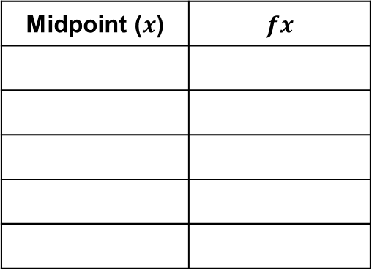
Bob asked each of 40 friends how many minutes they took to get to work. The table shows some information about his results.
Write down the modal class.
Work out the class in which the median lies.
Calculate an estimate for the mean.
Time taken ($m$ minutes) | Frequency
$0<m≤10$ | 3
$10<m≤20$ | 8
$$20<m≤30$$ | 11
$30<m≤40$ | 9
$40<m≤50$ | 9
Midpoint ($x$) | $fx$
5
15
15
120
25
275
35
315
45
405
20 < m ≤ 30
40 friends altogether
$\frac{40+1}{2}$ = 20.5th friend
20.5th friend takes
20 < m ≤ 30 minutes
Total number of minutes ÷ total number of friends
This is where the estimating happens

Slide 9
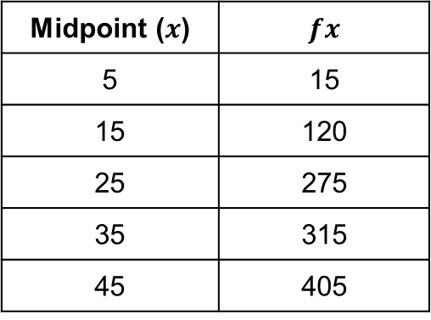
Bob asked each of 40 friends how many minutes they took to get to work. The table shows some information about his results.
Write down the modal class.
Work out the class in which the median lies.
Calculate an estimate for the mean.
Time taken ($m$ minutes) | Frequency
$0<m≤10$ | 3
$10<m≤20$ | 8
$$20<m≤30$$ | 11
$30<m≤40$ | 9
$40<m≤50$ | 9
Midpoint ($x$) | $fx$
5 | 15
15 | 120
25 | 275
35 | 315
45 | 405
20 < m ≤ 30
40 friends altogether
$\frac{40+1}{2}$ = 20.5th friend
20.5th friend takes
20 < m ≤ 30 minutes
c) Total number of minutes
= 1130
Total number of friends
= 40
1130 ÷ 40 = 28.25 minutes
Total number of minutes ÷ total number of friends

Slide 11
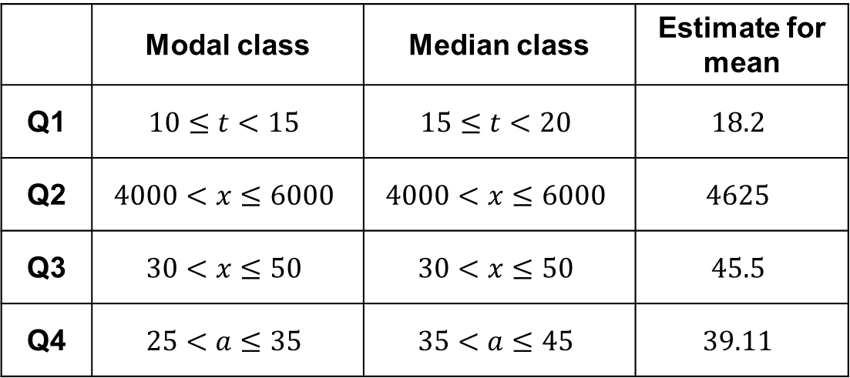
Answers
 | Modal class | Median class | Estimate for mean
Q1 | $$10≤t<15$$ | $$15≤t<20$$ | $$18.2$$
Q2 | $$4000<x≤6000$$ | $$4000<x≤6000$$ | $$4625$$
Q3 | $$30<x≤50$$ | $$30<x≤50$$ | $$45.5$$
Q4 | $$25<a≤35$$ | $$35<a≤45$$ | $$39.11$$

