Slide 1
Coordinates Picture
For each instruction, join up the coordinates.
Do not join one instruction to the next.
(2, 0) → (2, 7) → (6, 9) → (10, 7) → (10, 0)
(2, 7) → (10, 7)
(8, 8) → (8, 9) → (9, 9) → (9, 7½)
(3, 0) → (3, 3) → (5, 3) → (5, 0)
(3, 6) → (3, 4) → (5, 4) → (5, 6)
(7, 6) → (7, 4) → (9, 4) → (9, 6)
(7, 3) → (7, 1) → (9, 1) → (9, 3)

Slide 2
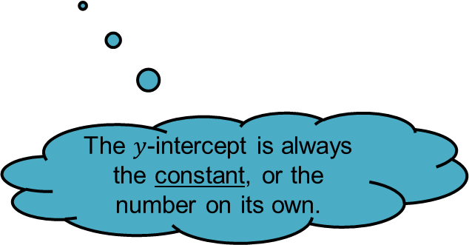
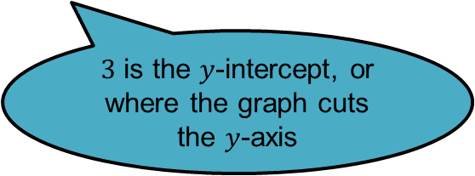
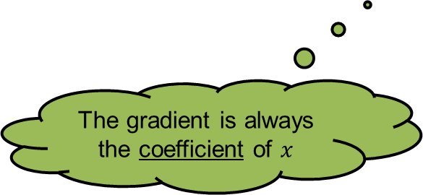
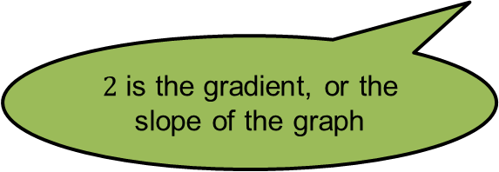
Given an equation for a graph that is not horizontal or vertical, we can sketch its graph using its gradient and y-intercept.
Suppose we want to sketch:
$$y=2x+3$$
$2$ is the gradient, or the slope of the graph
$3$ is the $y$-intercept, or where the graph cuts the $y$-axis
The gradient is always the coefficient of $x$
The $y$-intercept is always the constant, or the number on its own.

Slide 3
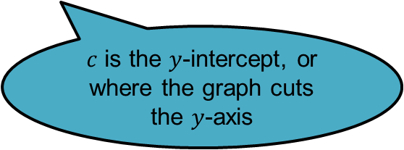
Given an equation for a graph that is not horizontal or vertical, we can sketch its graph using its gradient and y-intercept.
Generally:
$$y=mx+c$$
$m$ is the gradient, or the slope of the graph
$c$ is the $y$-intercept, or where the graph cuts the $y$-axis

Slide 4
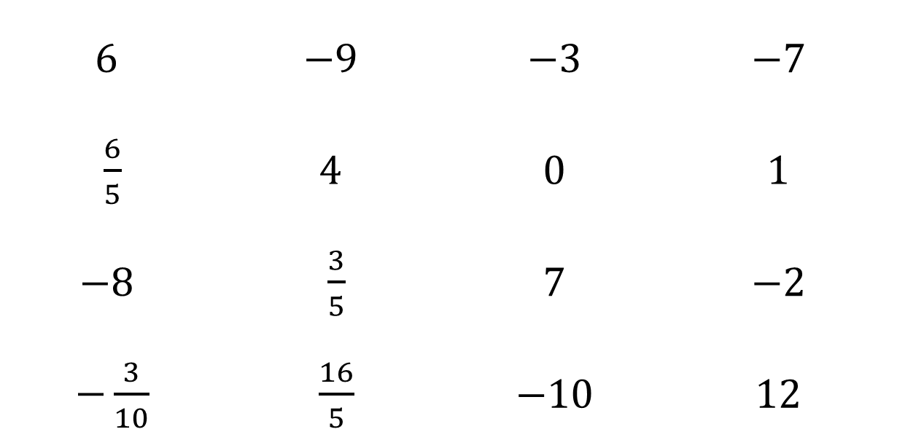
Linear Equation Bingo
Use any of these numbers in your grid (NO REPEATS)
$$6$$ | $$−9$$ | $$−3$$ | $$−7$$
$\frac{6}{5}$ | $$4$$ | $$0$$ | $$1$$
$$−8$$ | $\frac{3}{5}$ | $$7$$ | $$−2$$
$−\frac{3}{10}$ | $\frac{16}{5}$ | $$−10$$ | $$12$$

Slide 5
$$y=7x−2$$
gradient?

Slide 6
$$y=−2x+4$$
gradient?

Slide 7
$$y=5x+4$$
$y$-intercept?

Slide 8

$y=\frac{3}{5}x+0.5$
gradient?

Slide 9

$$y=6−7x$$
$y$-intercept?

Slide 10

$$y=1−8x$$
gradient?

Slide 11
$y=−\frac{3}{10}x+5$
gradient?

Slide 12
y = 1.2x + 1
gradient?

Slide 13
$y=\frac{1}{2}x−3$
$y$-intercept?

Slide 14

$$y=x+14$$
gradient?

Slide 15
$$y=8x$$
$y$-intercept?

Slide 16

$$y=−5x−7$$
$y$-intercept?

Slide 17

$$y=−9$$
$y$-intercept?

Slide 18
$y=\frac{16}{5}−\frac{9}{2}x$
$y$-intercept?

Slide 19
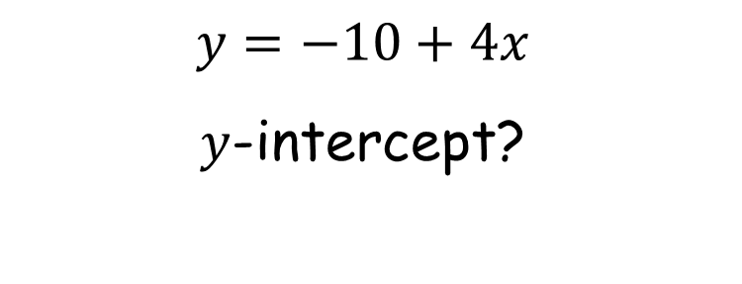
$$y=−10+4x$$
$y$-intercept?

Slide 20
$$y+x=12$$
$y$-intercept?

Slide 21
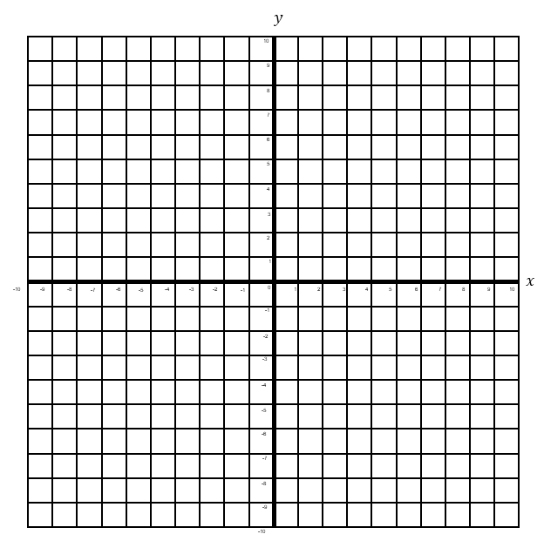
Examples
Plot the following straight line graphs:
1. $y=2x−3$
2. $y=3−2x$
3. $y= x$
$y$-intercept
2
$$×$$
$$×$$
$$×$$
Gradient
$$×$$
1
$$×$$
$$×$$
$$×$$
$$×$$
$y$-intercept
1
$$×$$
$$×$$
2
Gradient
$$×$$
$$×$$
$$1$$
$$+0$$
$y$-intercept
1
Gradient
1

Slide 22
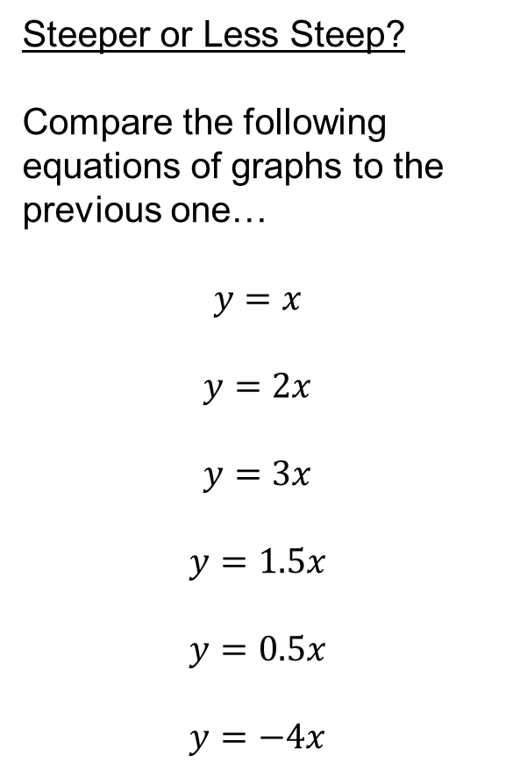
Steeper or Less Steep?
Compare the following equations of graphs to the previous one…
$$y=x$$
$$y=2x$$
$$y=3x$$
$$y=1.5x$$
$$y=0.5x$$
$$y=−4x$$
Steeper
Steeper
Less steep
Less steep
Steeper

Slide 23
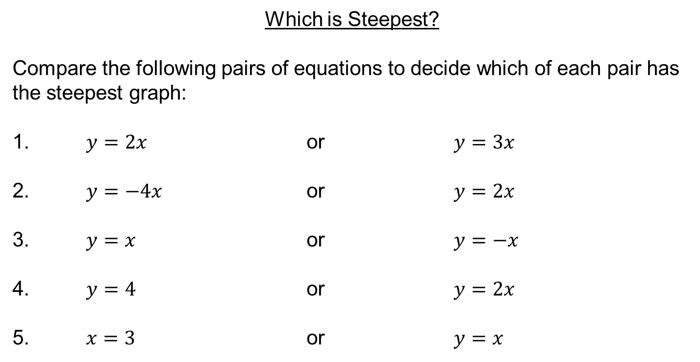
Which is Steepest?
Compare the following pairs of equations to decide which of each pair has the steepest graph:
1. $y=2x$ or $y=3x$
2. $y=−4x$ or $y=2x$
3. $y=x$ or $y=−x$
4. $y=4$ or $y=2x$
5. $x=3$ or $y=x$

Slide 24
Task
Sketch the linear graphs on the worksheet.
Reflect – what do you already know?
Expect – what do you think the will look like? Why?
Check – show your working here!
Use the keywords below to help you reflect and expect.

