Slide 1
Starter
Simplify the fractions below:
$\frac{5}{10}$ $\frac{6}{8}$ $\frac{8}{24}$ $\frac{36}{90}$ $\frac{48}{60}$
$\frac{1}{2}$ $\frac{3}{4}$ $\frac{1}{3}$ $\frac{2}{5}$ $\frac{4}{5}$

Slide 2

Example
$$4.2÷0.6$$
$$=\frac{4.2}{0.6}$$
$$=\frac{42}{6}$$
$$=7$$
So… $4.2÷0.6=7$
Start by expressing this as a fraction
Find an equivalent fraction without decimals
Simplify the fraction

Slide 3

Example
$$36.8÷0.4$$
$$=\frac{36.8}{0.4}$$
$$=\frac{368}{4}$$
$$=92$$
So… $36.8÷0.4=92$
Start by expressing this as a fraction
Find an equivalent fraction without decimals
Simplify the fraction
Use short division!

Slide 4

Example
$$14.4÷1.2$$
$$=\frac{14.4}{1.2}$$
$$=\frac{144}{12}$$
$$=12$$
So… $14.4÷1.2=12$
Start by expressing this as a fraction
Find an equivalent fraction without decimals
Simplify the fraction

Slide 5
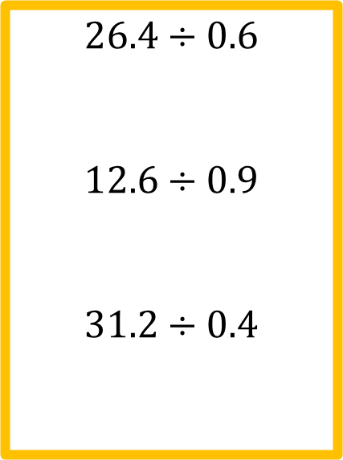
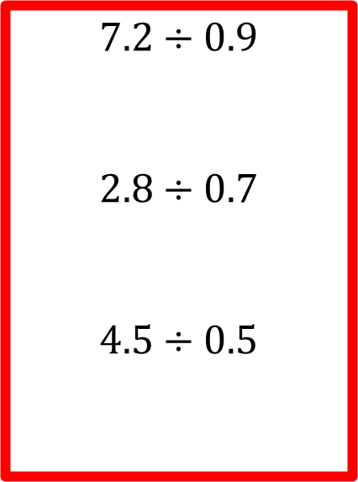
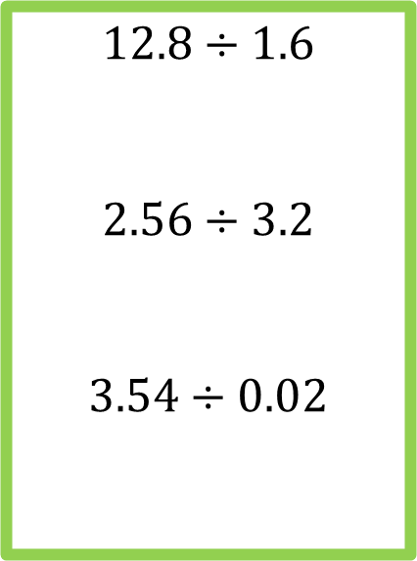
Checkpoint
$$7.2÷0.9$$
$$2.8÷0.7$$
$$4.5÷0.5$$
$$26.4÷0.6$$
$$12.6÷0.9$$
$$31.2÷0.4$$
$$12.8÷1.6$$
$$2.56÷3.2$$
$$3.54÷0.02$$

Slide 6
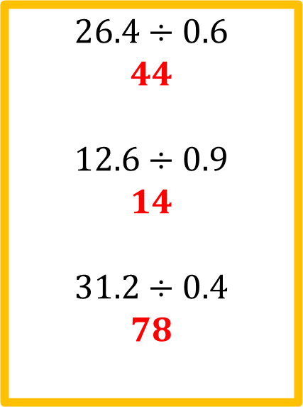
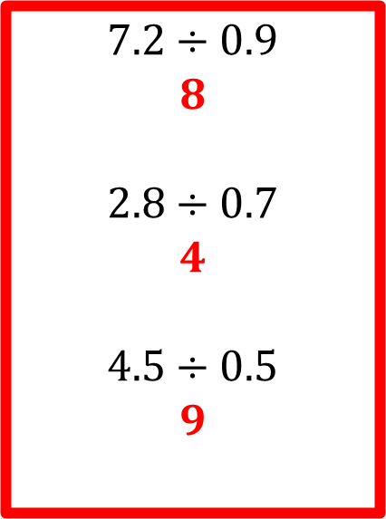
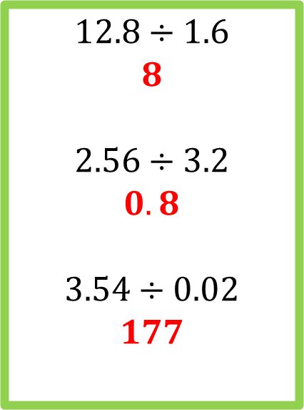
Answers
$$7.2÷0.9$$
$$8$$
$$2.8÷0.7$$
$$4$$
$$4.5÷0.5$$
$$9$$
$$26.4÷0.6$$
$$44$$
$$12.6÷0.9$$
$$14$$
$$31.2÷0.4$$
$$78$$
$$12.8÷1.6$$
$$8$$
$$2.56÷3.2$$
$$0.8$$
$$3.54÷0.02$$
$$177$$

Slide 7
Pair Activity
Dividing and multiplying decimals
CODE-BREAKER!
Show ALL your working so I know you haven’t used a calculator ☺
The canine teeth of a hippopotamus grow up to twenty inches long.

Slide 8
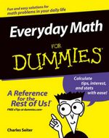
Plenary
Write a “Dividing Decimals for Dummies” guide!
Really clear steps
Get your partner to read it through afterwards
Decide if either of you have missed any important steps you need to fill in

