Slide 1
Starter
Find the differences between the two bar charts.
Which one is correct?

Slide 2
Rules for a bar chart
Frequency on vertical axes
Labels on axes
Right scales
Space between bars
Bars with equal widths
Title

Slide 3
Example
Draw a bar chart for the information in this table.
Tree | Frequency
Oak | 2
Birch | 5
Evergreen | 8
Pine | 10
Cedar | 7
A bar chart to show types of trees
10
8
6
Frequency
4
2
0
Oak
Birch
Pine
Cedar
Evergreen
Type of tree

Slide 4
Copy and complete the tally charts based on the students in your class. Once you have asked everybody, draw a bar chart for each in your book to show the results.
Eye Colour | Tally | Frequency
Blue
Brown
Green
Favourite Season | Tally | Frequency
Winter
Spring
Summer
Autumn
Notes:
TEACHER – use your visualiser to demonstrate exemplars within the class

Slide 5
Comparative Bar Charts
We can compare two sets of data using bar charts.
We must draw the bars for the two sets of data next to each other for each category.

Slide 6
Example
Draw a bar chart for the information in this table.
Eye Colour | Boys | Girls
Blue | 9 | 7
Green | 4 | 4
Brown | 2 | 4
A bar chart to compare boys’ and girls’ eye colour
10
8
6
Boys
Frequency
4
Girls
2
You must include a key to show which bar represents which data set
0
Blue
Green
Brown
Eye colour

Slide 7
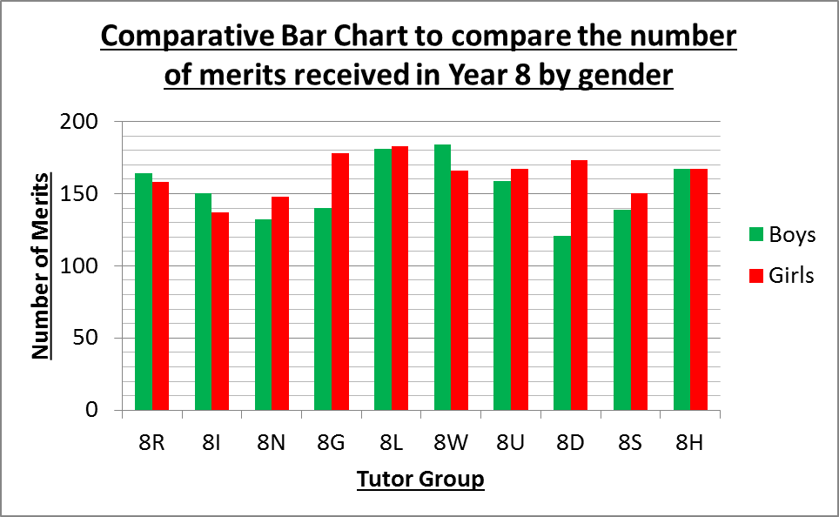
Which tutor group had the boys with the most merits?
In which tutor groups did the boys receive more merits than the girls?
In which tutor group did the boys and girls receive the same number of merits?
Who received more merits; 8D or 8S?
8W
8R, 8I, 8W
8H
8D

Slide 9
Answers
A bar chart to show gold medals won by Great Britain and Australia
3 Olympics out of 5
5 medals more
Australia 8 and Great Britain 26 because they have been quite consistent the last 2 Olympics
Great Britain
25
Australia
20
15
Medals won
10
5
0
Sydney
2000
Athens
2004
Beijing
2008
Great Britain
2012
Rio
2016
Olympic location and year

Slide 10
Answers
A bar chart to show temperature in Rome and New York
New York
Rome
3 months
2 ºC difference
Rome – I don’t like it too hot!
Rome
25
New York
20
15
Average temperature (ºC)
10
5
0
May
June
July
August
September
Month

