Slide 1
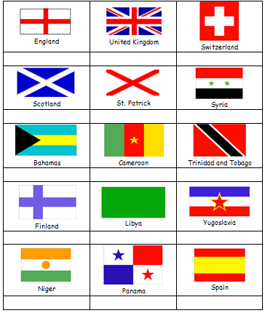
Starter
How many lines of symmetry do the flags have?

Slide 2
Answers
2 1 4
2 2 1
1 0 0
1 2 1
1 0 2

Slide 3
Reflection is a type of transformation.
A reflection flips an object. The size and shape stay exactly but the shape is mirrored.
We describe reflections with a line of symmetry.

Slide 4
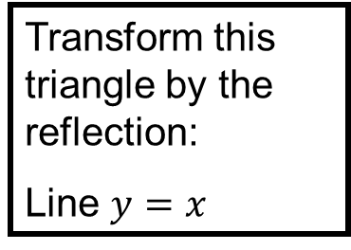
10
Transform this triangle by the reflection:
Line $y=x$
9
Draw the line of symmetry.
8
7
6
5
4
3
2
1
0
0
1
2
3
4
5
6
7
8
9
10

Slide 5
10
Transform this triangle by the reflection:
Line $y=x$
9
Flip the shape over the line.
8
7
6
5
4
3
2
1
0
0
1
2
3
4
5
6
7
8
9
10

Slide 6
10
Transform this triangle by the reflection:
Line $y=x$
9
You may choose to use tracing paper to make it easier.
8
7
6
5
4
3
2
1
0
0
1
2
3
4
5
6
7
8
9
10

Slide 7
10
Transform this triangle by the reflection:
Line $y=x$
9
Place the tracing paper over the top and draw on the line of symmetry and the object.
8
7
6
5
4
3
2
1
0
0
1
2
3
4
5
6
7
8
9
10

Slide 8
10
Transform this triangle by the reflection:
Line $y=x$
9
Flip the tracing paper and line up the line of symmetry.
8
7
6
5
4
3
2
1
0
0
1
2
3
4
5
6
7
8
9
10

Slide 9
10
Transform this triangle by the reflection:
Line $y=x$
9
Remove the tracing paper and draw the new shape.
8
7
6
5
4
3
2
1
0
0
1
2
3
4
5
6
7
8
9
10

Slide 10
10
Transform this triangle by the reflection:
Line $y=x$
9
Remove the tracing paper and draw the new shape.
8
7
6
5
4
3
2
1
0
0
1
2
3
4
5
6
7
8
9
10

Slide 11
Extension: What word do the reflections make?

Slide 12
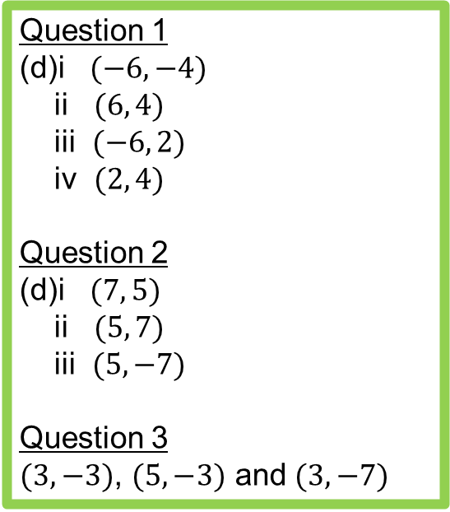
Answers
Question 1
(d)i $(−6,−4)$
ii $(6, 4)$
iii $(−6, 2)$
iv $(2, 4)$
Question 2
(d)i $(7, 5)$
ii $(5, 7)$
iii $(5, −7)$
Question 3
$(3, −3)$, $(5, −3)$ and $(3, −7)$

Slide 13
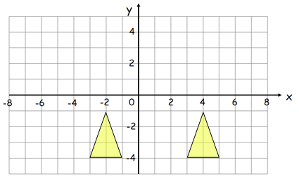

What’s the equation of the line of symmetry?
$$x=1$$

Slide 14
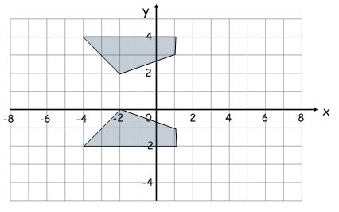

What’s the equation of the line of symmetry?
$$y=1$$

Slide 15
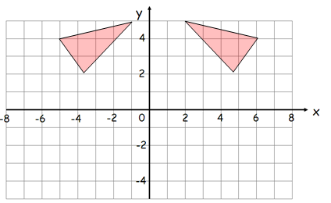

What’s the equation of the line of symmetry?
$$x=0.5$$

Slide 16
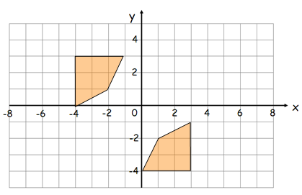

What’s the equation of the line of symmetry?
$$y=x$$

