Slide 1
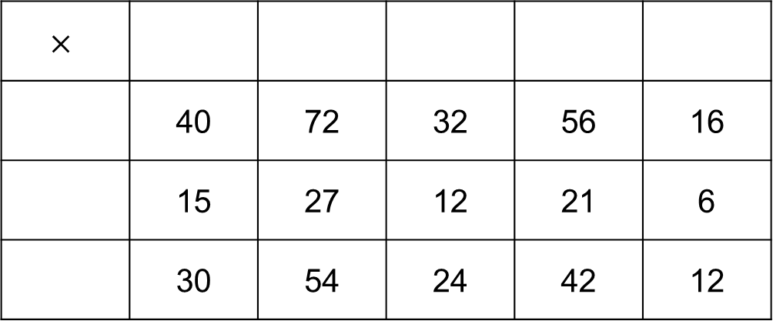
Starter
Work out which numbers go around the outside of the mixed-up times tables grid.
$$×$$
 | 40 | 72 | 32 | 56 | 16
 | 15 | 27 | 12 | 21 | 6
 | 30 | 54 | 24 | 42 | 12
5
9
4
7
2
8
3
6

Slide 2
2742 ÷ 3
0
9
1
4
3
2 7 4 2
2
1
Answer = 914

Slide 3
7364 ÷ 7
1
0
5
2
7
7 3 6 4
3
1
Answer = 1052

Slide 4
3231 ÷ 9
0
3
5
9
9
3 2 3 1
3
5
8
Answer = 359

Slide 6
Answers
£27
23 weeks
£13.18
57.6 kg
a) £72.35
b) £115.76
100 g flour, 1 egg, 300 ml milk, 25 g lard
£27.18
£4.90
450 g pasta, 200 g mushrooms, 300 g cheese, 225 g bacon
416 236 178 823
374 932 988 788
991 785 526 577
258 ÷ 6 = 43 558 ÷ 9 = 62
385 ÷ 7 = 55 855 ÷ 9 = 95
266 ÷ 7 = 38 225 ÷ 5 = 45
234 ÷ 9 = 26 664 ÷ 8 = 83
208 ÷ 8 = 26 384 ÷ 8 = 48
438 ÷ 6 = 73 198 ÷ 9 = 22

Slide 7
Pair Task
Work out the answers to break the code!
Work as a team and make sure you clearly show your working.

