Slide 1
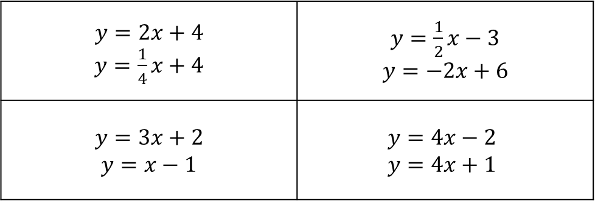
What can you tell me about the following pairs of linear equations?
$y=2x+4$ $y=\frac{1}{4}x+4$ | $y=\frac{1}{2}x−3$ $y=−2x+6$
$y=3x+2$ $y=x−1$ | $$y=4x−2$$ $y=4x+1$

Slide 2
What can you tell me about
$$y=mx+c$$
Gradient
(the slope of the line)
$y$-intercept
(where the graph cuts
the $y$-axis)

Slide 3
Calculate the gradient of the line which passes through $(2, 6)$ and $(4, −2)$.
The gradient is
rise
run
But you also need to think about whether its +ve or –ve
$$(2, 6)$$
$$8$$
$$(4, −2)$$
$$2$$
$$\frac{rise}{run}=$$
$$\frac{8}{2}=$$
$4$
The graph slopes downwards so the gradient is negative.
$m=−4$

Slide 4
Calculate the gradient of the line which passes through $(7, 12)$ and $(15, 32)$.
The gradient is
rise
run
But you also need to think about whether its +ve or –ve
$$(15, 32)$$
$$20$$
$$(7, 12)$$
$$8$$
$$\frac{rise}{run}=$$
$$\frac{20}{8}=$$
$$\frac{5}{2}$$
The graph slopes upwards so the gradient is positive.
Leave your answer as a fraction – fractions are easier to work with than decimals
$m=\frac{5}{2}$

Slide 5
Calculate the gradients of the lines which pass through the following pairs of points
(3, 6) and (5, 12)
(2, 1) and (5, 10)
(3, 5) and (5, 1)
(2, 7) and (6, -1)
(4, 3) and (8, 5)
(2, 6) and (10, 10)
(-1, 3) and (3, -1)
(4, 2) and (3, -4)
(3, 1) and (6, -8)
(5, 8) and (1, 5)
(4, 9) and (1, 15)
(2, 7) and (3, 4)
(2, 1) and (-3, 5)
(-2, 3) and (-5, -2)
(6, -1) and (-3, 2)
Remember to sketch each pair of coordinates and think about the sign!
Extension: Does the line $y=3x+2$ go through $(−2, −3)$? How do you know?

Slide 6
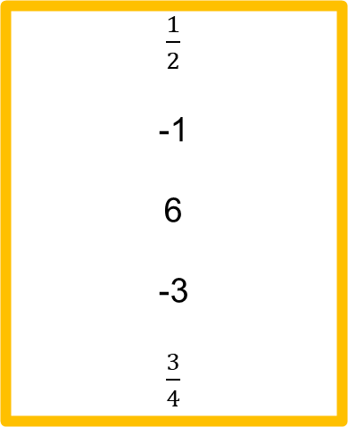
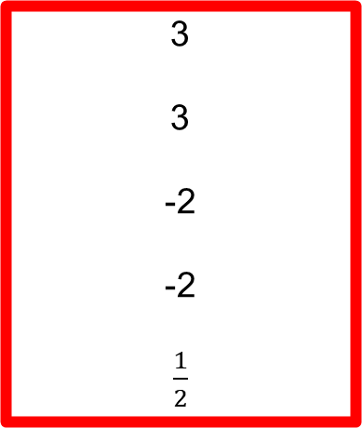
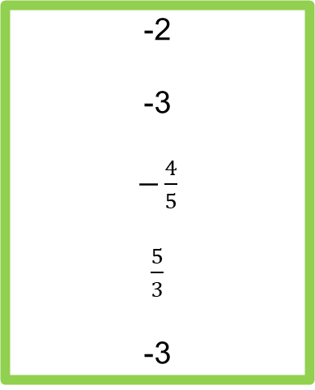
Answers
3
3
-2
-2
$\frac{1}{2}$
$\frac{1}{2}$
-1
6
-3
$\frac{3}{4}$
-2
-3
$−\frac{4}{5}$
$\frac{5}{3}$
-3
Extension: No → substitute $x=−2$ and $y=−4$, not $−3$

Slide 7
Find the equation of the line which passes through $(2, 6)$ and $(4, −2)$.
We found earlier that the gradient was $–4$.
Substitute the gradient and one of the coordinates ($x$ and $y$) into $y=mx+c$.
We now need the $y$-intercept.
$y=−4x+c$
$6=−4(2)+c$
$6=−8+c$
$14=c$
$y=−4x+14$

Slide 8
Find the equation of the line which passes through $(7, 12)$ and $(15, 32)$.
We found earlier that the gradient was $\frac{5}{2}$
We now need the $y$-intercept.
Substitute the gradient and one of the coordinates ($x$ and $y$) into $y=mx+c$.
$y=\frac{5}{2}x+c$
$12=\frac{5}{2}\left(7\right)+c$
$12=\frac{35}{2}+c$
$−\frac{9}{2}=c$
$y=\frac{5}{2}x−\frac{9}{2}$

Slide 9
Finished? Complete the extension activity!

Slide 10
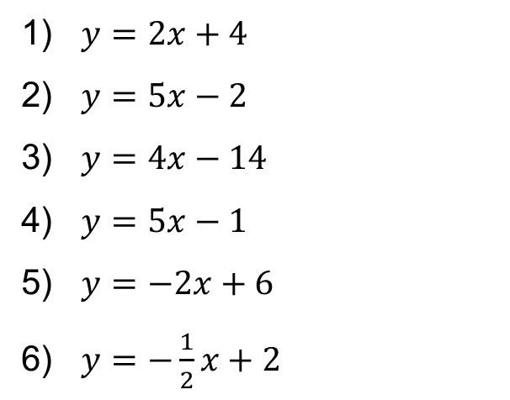
RAG Answers
1) $y=2x+4$
2) $y=5x−2$
3) $y=4x−14$
4) $y=5x−1$
5) $y=−2x+6$
6) $y=−\frac{1}{2}x+2$

Slide 11
Spot the Mistake
Find the equation of the line which passes through $(9, 2)$ and $(3, −7)$.
$\frac{rise}{run}=\frac{6}{9}=\frac{2}{3}$
$y=\frac{2}{3}x+c$
$2=\frac{2}{3}\left(9\right)+c$
$−4=c$
$y=\frac{2}{3}x−4$

