Slide 1
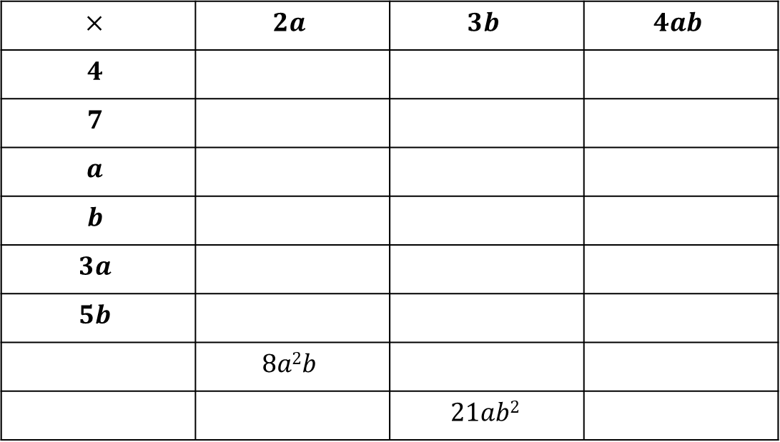
Starter Questions
Copy and complete at least two sections of the following multiplication grid:
Hint: for the extension question, try solving ___ $×2a=8a2b$ and
___ $×3b=21ab2$ to fill the first column.
$$×$$ | $$2a$$ | $$3b$$ | $$4ab$$
$$4$$
$$7$$
$$a$$
$$b$$
$$3a$$
$$5b$$
 | $$8a2b$$
 |  | $$21ab2$$

Slide 2
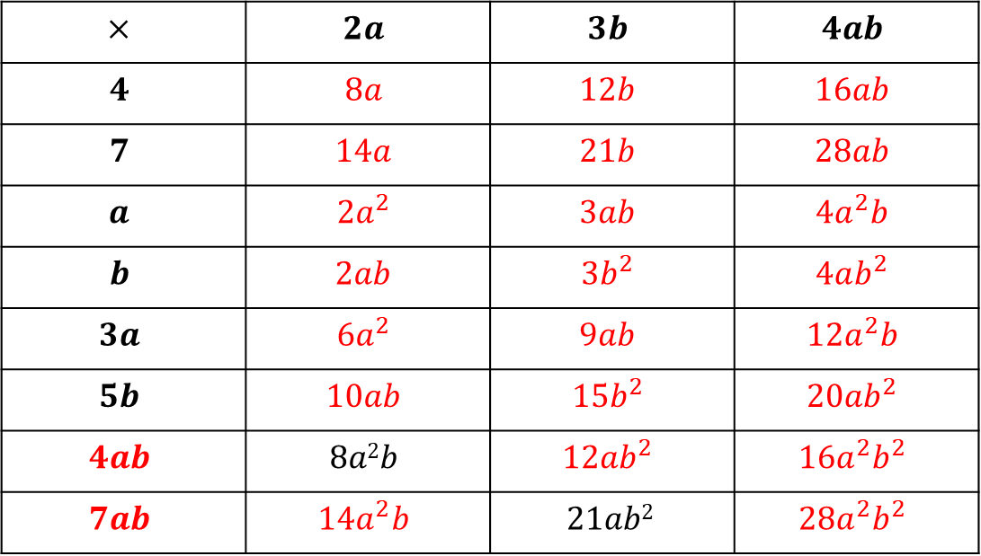
Answers
$$×$$ | $$2a$$ | $$3b$$ | $$4ab$$
$$4$$ | $$8a$$ | $$12b$$ | $$16ab$$
$$7$$ | $$14a$$ | $$21b$$ | $$28ab$$
$$a$$ | $$2a^{2}$$ | $$3ab$$ | $$4a^{2}b$$
$$b$$ | $$2ab$$ | $$3b^{2}$$ | $$4ab^{2}$$
$$3a$$ | $$6a^{2}$$ | $$9ab$$ | $$12a^{2}b$$
$$5b$$ | $$10ab$$ | $$15b^{2}$$ | $$20ab^{2}$$
$$4ab$$ | $$8a2b$$ | $$12ab^{2}$$ | $$16a^{2}b^{2}$$
$$7ab$$ | $$14a^{2}b$$ | $$21ab2$$ | $$28a^{2}b^{2}$$

Slide 3
The contents of a bracket may be regarded as equivalent to a single number.
Examples:
The product of $7$ and $(8+6)$is written $7(8+6)$
The product of $7$ and $(x+y)$is written $7(x+y)$
The product of $(p−q)$ and $(x+y)$is written $(p+q)(x+y)$
$(a−b)÷5$ means “subtract $b$ from $a$ and divide the result by $5$”. It is usually written as $\frac{a−b}{5}$ or $\frac{1}{5}(a−b)$.
$\frac{p−q}{s+t}$
${(c+d)}^{2}$
${(x−y)}^{3}$

Slide 4
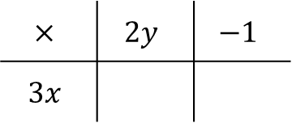
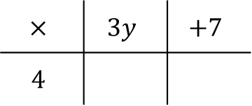
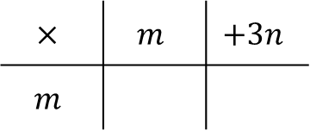
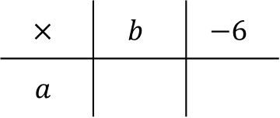
Everything outside the brackets must multiply everything inside the brackets.
Examples
Expand $4(3y+7)$ Expand $a(b−6)$
Expand $3x(2y−1)$ Expand $m(m+3n)$
$$=12y+28$$
$$=ab−6a$$
$$×$$ | $$3y$$ | $$+7$$
$$4$$
$$×$$ | $$b$$ | $$−6$$
$$a$$
$$12y$$
$$+28$$
$$ab$$
$$−6a$$
$$=6xy−3x$$
$$=m^{2}+3mn$$
$$×$$ | $$2y$$ | $$−1$$
$$3x$$
$$×$$ | $$m$$ | $$+3n$$
$$m$$
$$6xy$$
$$−3x$$
$$m^{2}$$
$$+3mn$$

Slide 5

Task
Expand the brackets in the following expressions:
$2(a−3)$ $3(b+5)$
$2(c−1)$ $3(d+1)$
$5(2e−4)$ $4(2−3f)$
$g(g+4)$ $h(h−3)$
$k(2k+5)$ $m(3n−2m)$
$2p(q+6)$ $3r(2r−3s)$

Slide 6
Answers
$2(a−3)$ $=2a−6$ $3(b+5)$ $=3b+15$
$2(c−1)$ $=2c−1$ $3(d+1)$ $=3d+3$
$5(2e−4)$ $=10e−20$ $4(2−3f)$ $=8−12f$
$g(g+4)$ $=g^{2}+4g$ $h(h−3)$ $=h^{2}−3h$
$k(2k+5)$ $=2k^{2}+5k$ $m(3n−2m)$ $=3mn−2m^{2}$
$2p(q+6)$ $=2pq+12p$ $3r(2r−3s)$ $=6r^{2}−9rs$

Slide 7
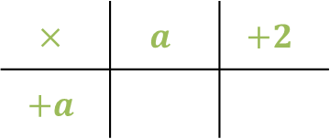
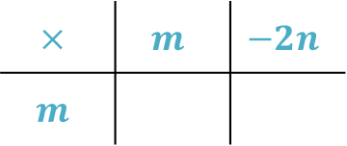
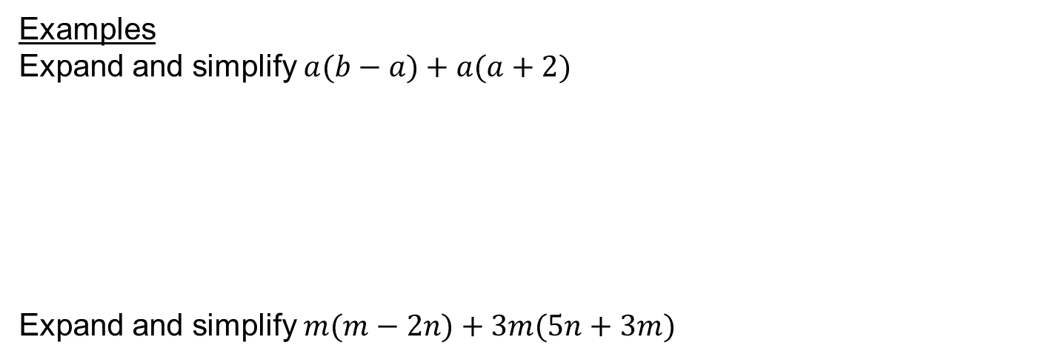
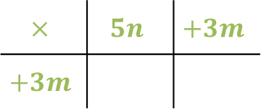
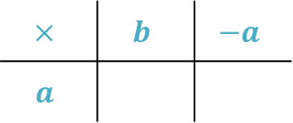
Examples
Expand and simplify $a(b−a)+a(a+2)$
Expand and simplify $m(m−2n)+3m(5n+3m)$
$$=ab−a^{2}+a^{2}+2a$$
$$=ab+2a$$
$$×$$ | $$b$$ | $$−a$$
$$a$$
$$×$$ | $$a$$ | $$+2$$
$$+a$$
$$ab$$
$$−a^{2}$$
$$+a^{2}$$
$$+2a$$
$$=m^{2}−2mn+15mn+9m^{2}$$
$$=10m^{2}+13mn$$
$$×$$ | $$m$$ | $$−2n$$
$$m$$
$$×$$ | $$5n$$ | $$+3m$$
$$+3m$$
$$m^{2}$$
$$−2mn$$
$$15mn$$
$$+9m^{2}$$

Slide 9
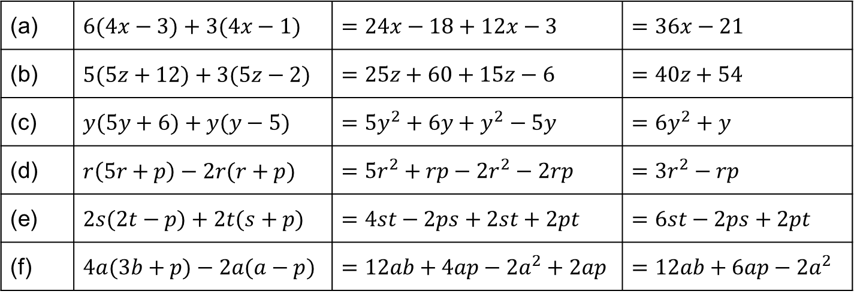
Answers
(a) | $6(4x−3)+3(4x−1)$ | $=24x−18+12x−3$ | $=36x−21$
(b) | $5(5z+12)+3(5z−2)$ | $=25z+60+15z−6$ | $=40z+54$
(c) | $y(5y+6)+y(y−5)$ | $=5y^{2}+6y+y^{2}−5y$ | $=6y^{2}+y$
(d) | $r\left(5r+p\right)−2r(r+p)$ | $=5r^{2}+rp−2r^{2}−2rp$ | $=3r^{2}−rp$
(e) | $2s(2t−p)+2t(s+p)$ | $=4st−2ps+2st+2pt$ | $=6st−2ps+2pt$
(f) | $4a(3b+p)−2a(a−p)$ | $=12ab+4ap−2a^{2}+2ap$ | $=12ab+6ap−2a^{2}$

