Slide 1

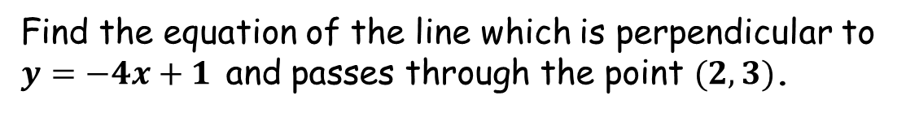
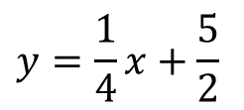
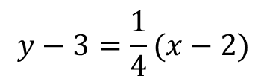

Starter
Find the equation of the line which is perpendicular to
$y=−4x+1$ and passes through the point $(2, 3)$.
Gradient $=−1÷−4=\frac{1}{4}$
$$y−y1=m(x−x1)$$
$$y−3=\frac{1}{4}(x−2)$$
$$y=\frac{1}{4}x+\frac{5}{2}$$

Slide 2



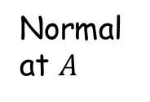
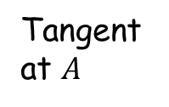

A tangent and a normal are perpendicular
$$y$$
$$y=f(x)$$
Tangent at $A$
$$A$$
What can you remember about perpendicular gradients?
0
$$x$$
Normal at $A$

Slide 3


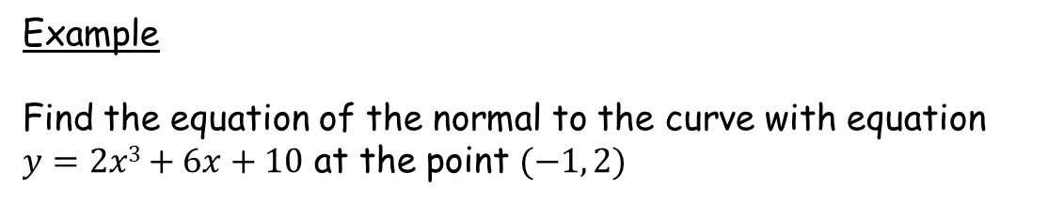






Example
Find the equation of the normal to the curve with equation $y=2x3+6x+10$ at the point $(−1, 2)$
Start by finding the gradient of the tangent at $(−1, 2)$
$\frac{dy}{dx}={6x}^{2}+6$
$\frac{dy}{dx}=6(−1)2+6$
$$=12$$
When $x=−1$, the gradient of the tangent is $12$
When $x=−1$, the gradient of the normal is $−\frac{1}{12}$
$$y−y1=m(x−x1)$$
$y−2=−\frac{1}{12} \left(x−−1\right)$
$y=−\frac{1}{12} x−\frac{1}{12}+2$
$$x+12y–23=0$$

Slide 4
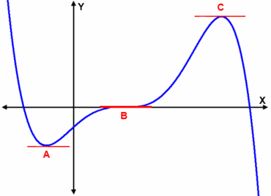

A stationary point on a curve is any point where the curve has gradient zero.
We can determine whether a stationary point is a local minimum, local maximum or point of inflection by finding the second derivative at that point.
Local maximum
$$y=f(x)$$
Local minimum
Point of inflection

Slide 5
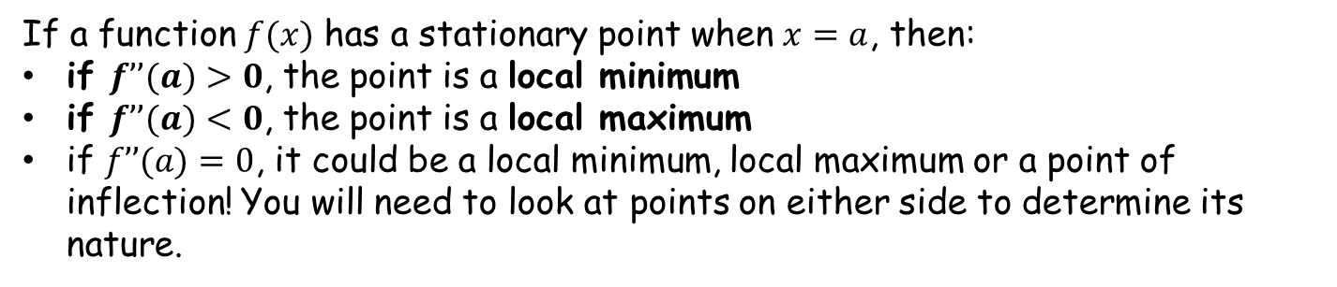

Local maximum
$$y=f(x)$$
Local minimum
Point of inflection
If a function $f(x)$ has a stationary point when $x=a$, then:
if $f’’(a)>0$, the point is a local minimum
if $f’’(a)<0$, the point is a local maximum
if $f’’(a)=0$, it could be a local minimum, local maximum or a point of inflection! You will need to look at points on either side to determine its nature.

Slide 6





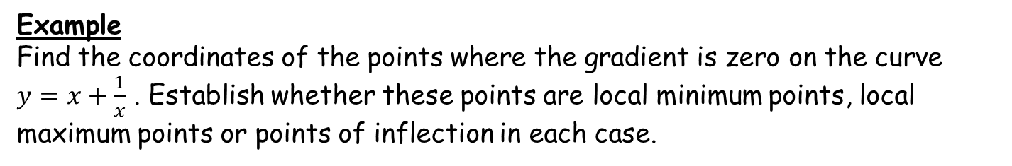

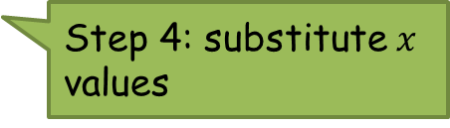
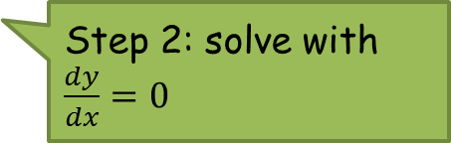


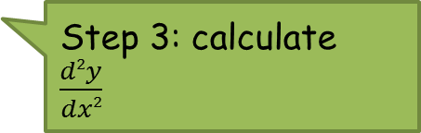
Example
Find the coordinates of the points where the gradient is zero on the curve
$y=x+\frac{1}{x}$ . Establish whether these points are local minimum points, local maximum points or points of inflection in each case.
$y=x+\frac{1}{x}=x+x^{−1}$
Step 1: differentiate
$\frac{dy}{dx}=1−x^{−2}=1−\frac{1}{x^{2}}$
Step 2: solve with
$\frac{dy}{dx}=0$
$1−\frac{1}{x^{2}}=0$
⇒ $x=1$ and $−1$
Stationary points at $(1, 2)$ and $(−1, −2)$
Step 3: calculate
$\frac{d2y}{dx2}$
$\frac{d2y}{dx2}=2x^{−3}=\frac{2}{x^{3}}$
If $x=1$, $\frac{d2y}{dx2}=\frac{2}{1^{3}}=2>0$
∴ local minimum
Step 4: substitute $x$ values
If $x=−1$, $\frac{d2y}{dx2}=\frac{2}{{(−1)}^{3}}=−2<0$
∴ local maximum

Slide 8
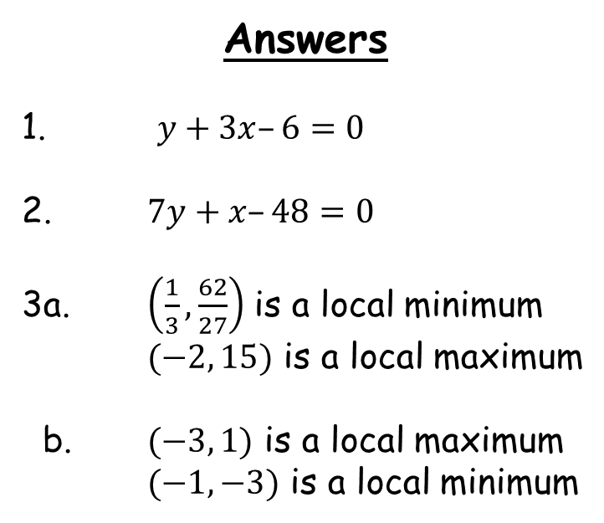
Answers
1. $y+3x–6=0$
2. $7y+x–48=0$
3a. $\left(\frac{1}{3}, \frac{62}{27}\right)$ is a local minimum
$(−2, 15)$ is a local maximum
b. $(−3, 1)$ is a local maximum
$(−1, −3)$ is a local minimum

