Slide 1

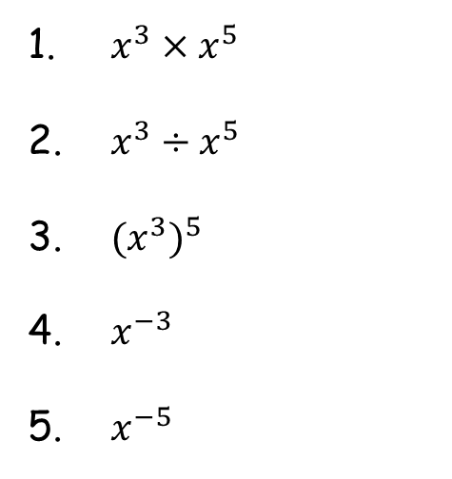


Starter
Simplify the following using laws of indices.
$x^{3}×x^{5}$
$x^{3}÷x^{5}$
${(x^{3})}^{5}$
$x^{−3}$
$x^{−5}$
$\frac{x^{3}×x^{5}}{x^{2}}$
$\frac{x^{2}}{x^{3}×x^{5}}$
$\frac{{(x^{3})}^{5}}{x^{3}×x^{5}}$
${=x}^{8}$
$=\frac{1}{x^{2}}$
$=x^{15}$
$=\frac{1}{x^{3}}$
$=x^{−5}$
${=x}^{6}$
$=\frac{1}{x^{6}}$
$=x^{7}$

Slide 2
The rate of change of $f(x)$ with respect to $x$ is measured by the derived function which is denoted by $f’(x)$.
Where $y=f(x)$, common notations for the derived functions are $f’(x)$ and $\frac{dy}{dx}$.
The most common rate of change of one variable with respect to another that you will meet is the gradient of a curve (at a point), defined to be the gradient of the tangent to the curve at that point.
We’ll meet this later on in this topic.

Slide 3
As a general rule, if $f\left(x\right)={ax}^{n}$
Then $f′\left(x\right)={anx}^{n−1}$
Multiply the coefficient by the index, then reduce the index by 1
Examples
Find f’(x) given that f(x) equals:
a. x⁵ b. 3x⁴ c. $\frac{1}{x^{2}}$
f’(x) = 5x⁴
f’(x) = 12x³
f(x) = x⁻²
f’(x) = -2x⁻³
f’(x) = $−\frac{2}{x^{3}}$

Slide 4

Examples
Find $\frac{dy}{dx}$ given that y equals:
a. 2x² – 6x + 3
b. 2x⁵ + 3x⁻²
$\frac{dy}{dx}$ =
4x
- 6
$\frac{dy}{dx}$ =
10x⁴
- 6x⁻³
$\frac{dy}{dx}$ = 10x⁴ - $\frac{6}{x^{3}}$
Notes:
Discuss what happens to constants (index of x is 0, anything multiplied by 0 = 0)

Slide 6
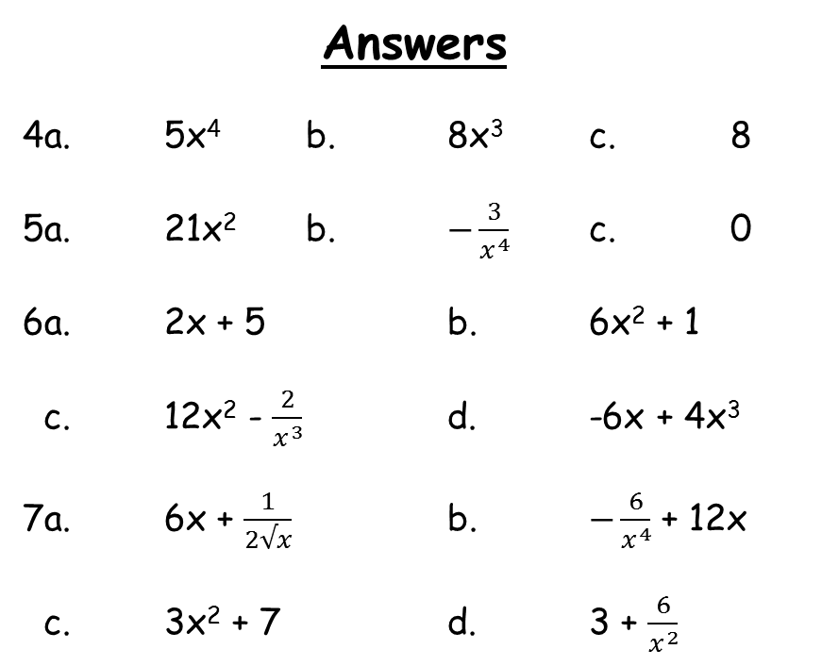
Answers
4a. 5x⁴ b. 8x³ c. 8
5a. 21x² b. $−\frac{3}{x^{4}}$ c. 0
6a. 2x + 5 b. 6x² + 1
c. 12x² - $\frac{2}{x^{3}}$ d. -6x + 4x³
7a. 6x + $\frac{1}{2√x}$ b. $−\frac{6}{x^{4}}$ + 12x
c. 3x² + 7 d. 3 + $\frac{6}{x^{2}}$

