Slide 1
Starter – Solve:
$$p=6$$
$$2p+9=21$$
$$x=½$$
$$4x–2=8–16x$$
$$a=4$$
$$3(a+2)=26–2a$$

Slide 2
Rearrange the formula to make $a$ the subject:
$$a+4=b$$
$−4$ $−4$
$a=b−4$
Same algebra rules apply:
Keep equals sign in line
Use inverse operations
Keep the equation balanced
Why can’t we simplify this further?
Rearrange the formula to make $c$ the subject:
$$c−6=d$$
$+6$ $+6$
$c=d+6$

Slide 3
Rearrange the formula to make $x$ the subject:
$$7x=y$$
$\overline{7}$ $\overline{7}$
$x=\frac{y}{7}$
Remember we don’t use the $÷$ or $×$ symbols in algebra
Rearrange the formula to make $m$ the subject:
$$\frac{m}{3}=n$$
$×3$ $×3$
$m=3n$

Slide 4
Rearrange the formula to make $t$ the subject:
$$r+4t=s$$
$−r$ $−r$
$4t=s−r$
$\overline{4}$ $\overline{ 4 }$
$t=\frac{s−r}{4}$

Slide 5
$$V=IR$$
$$I=?$$
$$VR$$
$$\frac{V}{R}$$
$$\frac{R}{V}$$
Ohm’s Law (physics)
Notes:
Amber

Slide 6
$$V=πr²h$$
$$h=?$$
$$Vπr²$$
$$\frac{V}{πr^{2}}$$
$$\frac{Vr^{2}}{π}$$
Volume of a cylinder
Notes:
Amber

Slide 7
$$a(v–u)$$
$$v=u+at$$
$$t=?$$
$$\frac{v+u}{a}$$
$$\frac{v−u}{a}$$
Final velocity formula
Notes:
Amber

Slide 8
$$A=½bh$$
$$b=?$$
$$\frac{A}{2h}$$
$$\frac{2A}{h}$$
$$2Ah$$
Area of a triangle
Notes:
Amber

Slide 9
$$\frac{2A−b}{h}$$
$$A=½(a+b)h$$
$$a=?$$
$$\frac{2Ah}{b}$$
$$\frac{2A}{h}−b$$
Area of a trapezium
Notes:
Amber

Slide 10
$$c−a$$
$$a²+b²=c²$$
$$b=?$$
$$\sqrt{c^{2}−a^{2}}$$
$$\sqrt{a^{2}−c^{2}}$$
Pythagoras’ Theorem
Notes:
Amber

Slide 11
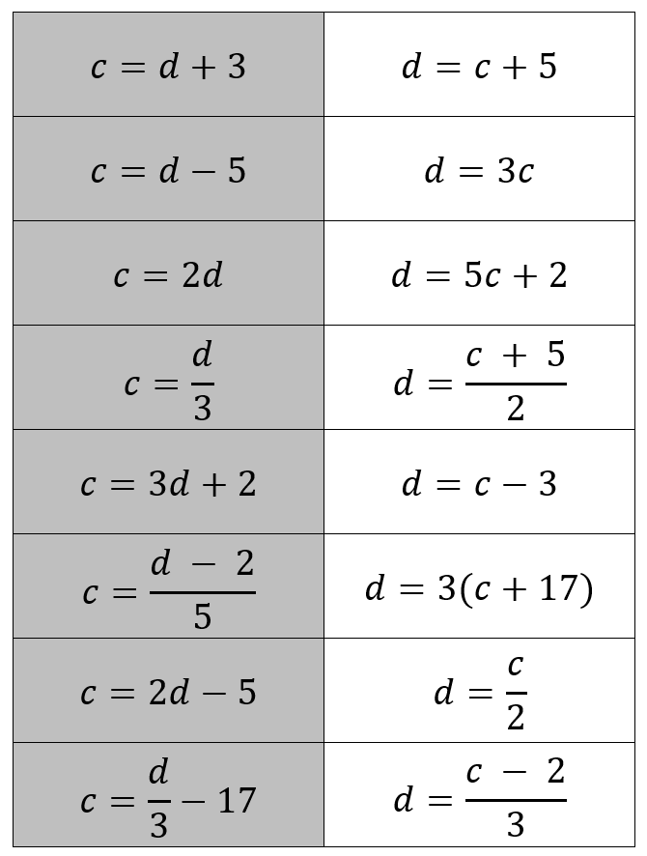
Cut out the cards ONE AT A TIME.
Stick the first “$c=$…” into your book.
Show ALL your working.
Stick the corresponding “$d=$…” into your book.

Slide 12
Answers

Slide 13
Answers

Slide 14
Answers

Slide 15
Step-by-Step Guide
Firstly, highlight the unknown that needs to be the subject of the formula.
Secondly, move all terms that contain that unknown to one side. Remember to move all terms if it appears in more than one.
Thirdly, separate out the required letter on its own (this step may require factorisation).

Slide 16
Rearrange the formula to make $t$ the subject:
$$rt+4t=s$$

Slide 17
Rearrange the formula to make $t$ the subject:
$$rt+4t=s$$
$t\left(r+4\right)=s$
$\overline{(r+4)}$ $\overline{(r+4)}$
$t=\frac{s}{r+4}$

Slide 18
Rearrange the formula to make $m$ the subject:
$$am−5=nm+a$$

Slide 19
Rearrange the formula to make $m$ the subject:
$$am−5=nm+a$$
$−nm$ $−nm$
$am−nm−5=a$
$+5$ $+5$
$am−nm=a+5$
$m(a−n)=a+5$
$\overline{(a−n)}$ $\overline{(a−n)}$
$m=\frac{a+5}{a−n}$

Slide 21
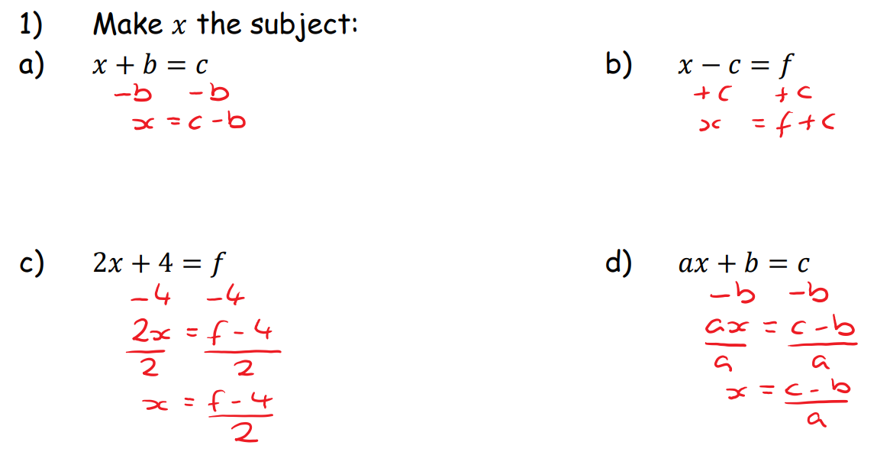
Answers

Slide 22
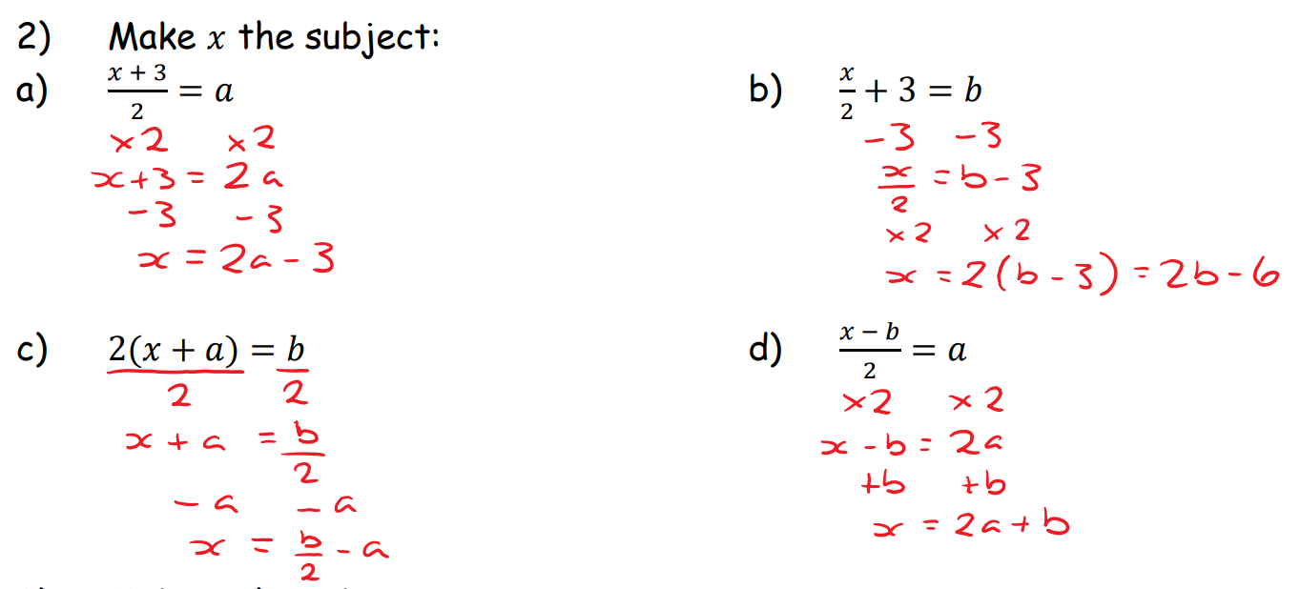
Answers

Slide 23
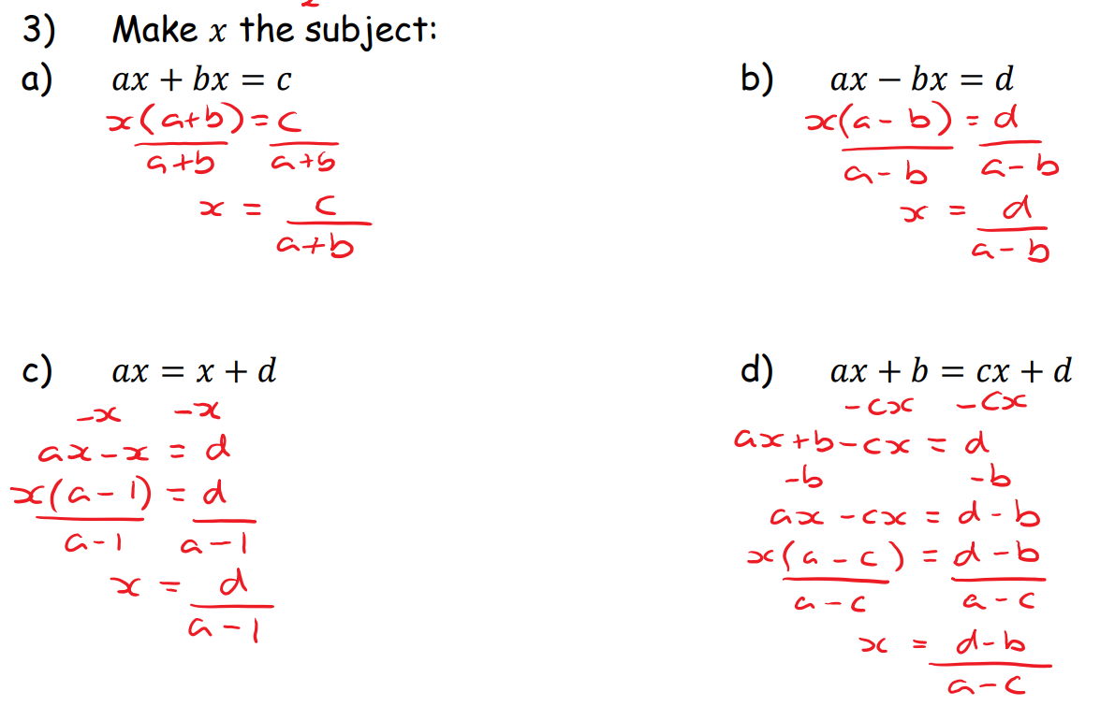
Answers

Slide 24
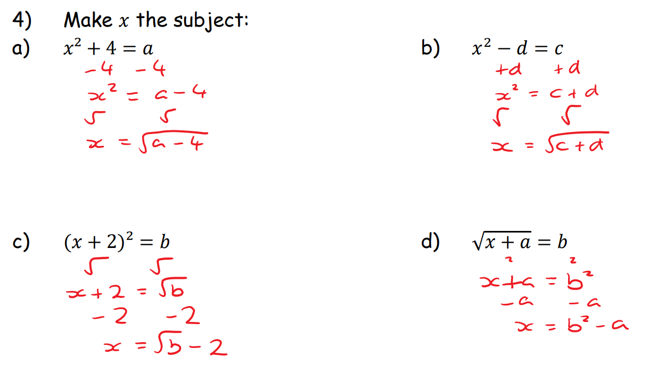
Answers

Slide 25
Answers

Slide 26
Answers

Slide 27
Plenary
Write a formula in your books for your partner to change the subject of.
Swap books and rearrange.

