Slide 1
Starter
Can you work out the area of each shape?
Each square is 1 cm².

Slide 2
Glossary
Area: the amount of space th shape takes up. Measured in cm², m², mm².
Perimeter: the distance around the edge of the shape. Measured in cm, m, mm.
Area
Perimeter

Slide 3
Count the squares inside the shape
Area =

Slide 4
 |  | 1 | 2 | 3 | 4 | 5 | 6 | 7
 |  | 8 | 9 | 10 | 11 | 12 | 13 | 14
 |  | 15 | 16 | 17 | 18 | 19 | 20 | 21
 |  | 22 | 23 | 24 | 25 | 26 | 27 | 28
 |  | 29 | 30 | 31 | 32 | 33 | 34 | 35
 |  | 36 | 37 | 38 | 39 | 40 | 41 | 42
Area =
42 cm²

Slide 5
Count the squares around the edge
Area =
42 cm²
Perimeter =

Slide 6
 |  | 7 | 8 | 9 | 10 | 11 | 12 | 13
 | 6 |  |  |  |  |  |  |  | 14
 | 5 |  |  |  |  |  |  |  | 15
 | 4 |  |  |  |  |  |  |  | 16
 | 3 |  |  |  |  |  |  |  | 17
 | 2 |  |  |  |  |  |  |  | 18
 | 1 |  |  |  |  |  |  |  | 19
 |  | 26 | 25 | 24 | 23 | 22 | 21 | 20
Area =
42 cm²
Perimeter =
26 cm

Slide 7
Review
Can you work out the area of each shape?
Each square is 1 cm².
20 cm²
24 cm²
15 cm²

Slide 8
Task
Complete the dominoes activity by matching each question to its answer.
Cut along the bold lines only.
Each square is 1 cm².

Slide 9
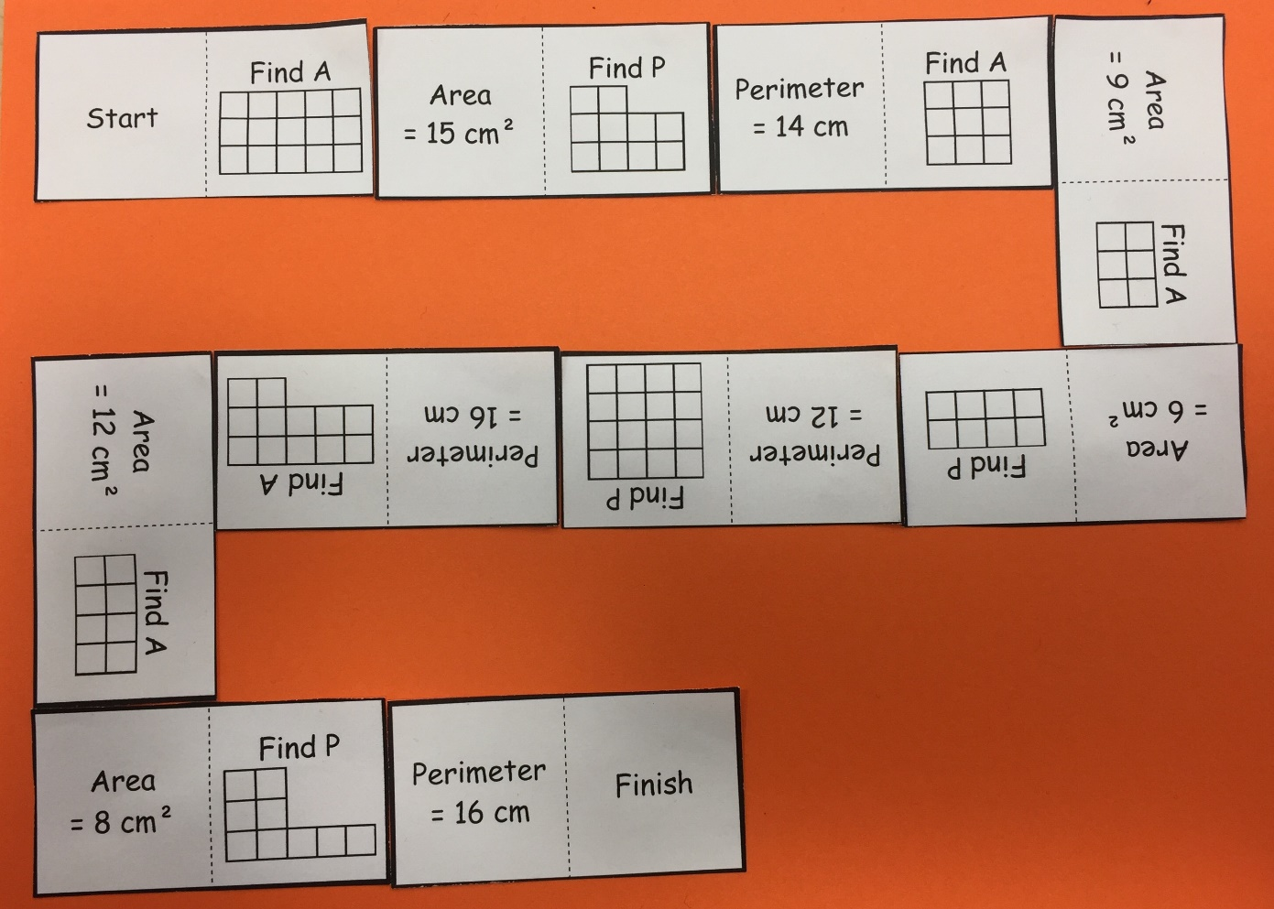
Answers

Slide 10
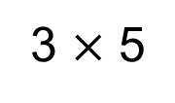
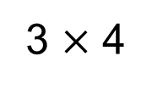
4 cm
Area = 12 cm²
3 lots of 4
3 cm
3 $×$ 4
= 12 cm²
5 cm
3 lots of 5
3 cm
3 $×$ 5
= 15 cm²

Slide 11
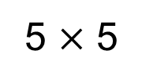
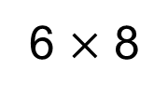
Area =
8 cm
6 lots of 8
6 $×$ 8
= 48 cm²
6 cm
Area =
5 m
5 lots of 5
5 $×$ 5
= 25 m²
5 m

Slide 12
Perimeter =
8 cm
8 + 6 + 8 + 6
= 28 cm
6 cm
Perimeter =
5 m
5 + 5 + 5 + 5
= 20 m
5 m

Slide 13
Place any nine numbers below into the grid (repeats forbidden)
24 12 25 63
49 48 15 36
21 54 30 16
9 10 55 33
Notes:
13

Slide 14
Find the area
5 cm
6 cm
30 cm²
Notes:
14

Slide 15
Find the perimeter
1 cm
5 cm
12 cm
Notes:
15

Slide 16
Find the area
6 cm
9 cm
54 cm²
Notes:
16

Slide 17
Find the area
3 cm
8 cm
24 cm²
Notes:
17

Slide 18
Find the area
3 cm
11 cm
33 cm²
Notes:
18

Slide 19
Find the perimeter
10 cm
14 cm
48 cm
Notes:
19

Slide 20
Find the area
7 cm
9 cm
63 cm
2
Notes:
20

Slide 21
Find the area
7 cm
7 cm
49 cm²
Notes:
21

Slide 22
Find the perimeter
9 cm
9 cm
36 cm
Notes:
22

Slide 23
Find the area
2 cm
5 cm
10 cm²
Notes:
23

Slide 24
Find the perimeter
Does it matter that it’s a triangle?
3 cm
3 cm
3 cm
9 cm
Notes:
24

Slide 25
Find the area
3 cm
5 cm
15 cm²
Notes:
25

Slide 26
Find the perimeter
4 cm
4 cm
16 cm
Notes:
26

Slide 27
Find the area
5 cm
5 cm
25 cm²
Notes:
27

Slide 28
Find the area
3 cm
7 cm
21 cm²
Notes:
28

Slide 29
Find the area
5 cm
11 cm
55 cm²
Notes:
29

Slide 31
Answers
A = 15 cm² A = 1 cm² A = 24 cm²
P = 16 cm P = 4 cm P = 20 cm
A = 20 cm² A = 80 cm² A = 5 cm²
P = 18 cm P = 36 cm P = 9 cm
A = 12.5 cm² A = 2 cm² A = 0.75 m²
P = 15 cm P = 7.4 cm P = 4 m
A = 1.615 m² A = 0.6 cm² A = 39 mm²
P = 5.3 m P = 3.4 cm P = 3.2 mm
18 cm 9 cm² 30 cm
22 m 20 mm² 56 mm²

