Slide 1
Starter
Calculate the midpoints of the following pairs of numbers
10 and 20
7 and 26
4.5 and 8.3
-5.3 and 2.1
Discuss your method with a partner.
15
16.5
6.4
-1.6

Slide 2
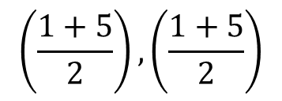
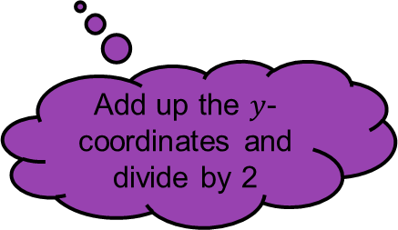
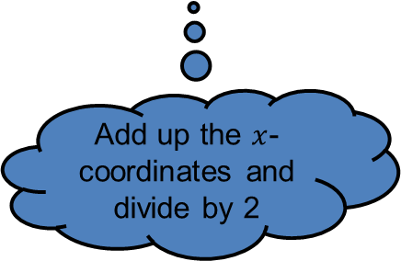
$$y$$
(5, 5)
$$\left(\frac{x_{1}+x_{2}}{2}\right),\left(\frac{y_{1}+y_{2}}{2}\right)$$
(3, 3)
4
Add up the $y$-coordinates and divide by 2
Add up the $x$-coordinates and divide by 2
2
(1, 1)
2
4
$$x$$
$$\left(\frac{1+5}{2}\right),\left(\frac{1+5}{2}\right)$$
$$=(3, 3)$$
The midpoint is exactly half way between two coordinates

Slide 3
Examples
Calculate the midpoints of the following line segments:
$(4, 6)$ and $(8, 22)$ $(−3, 6)$ and $(4, −3)$ $(−2, 5)$ and $(−3, −5)$
$$\left(\frac{4+8}{2}\right),\left(\frac{6+22}{2}\right)$$
$$\left(\frac{−3+4}{2}\right),\left(\frac{6−3}{2}\right)$$
$$\left(\frac{−2−3}{2}\right),\left(\frac{5−5}{2}\right)$$
$=(6, 14)$
$=(0.5, 1.5)$
$=(−2.5, 0)$

Slide 4
Task
Copy and complete the table below.
Starting Point | Midpoint | End point
(2, 6) |  | (4, 10)
(3, 7) |  | (7, 1)
(-2, -10) |  | (-8, 0)
(1, 5) | (3, 9)
 | (0, 0) | (9, 5)
Notes:
Credit to @weteach_maths https://www.tes.com/teaching-resource/finding-the-midpoint-of-a-line-segment-or-between-two-points-straight-line-graphs-11139591

Slide 5
Answers
Starting Point | Midpoint | End point
(2, 6) | (3, 8) | (4, 10)
(3, 7) | (5, 4) | (7, 1)
(-2, -10) | (-5, -5) | (-8, 0)
(1, 5) | (3, 9) | (5, 13)
(-9,-5) | (0, 0) | (9, 5)
Notes:
Credit to @weteach_maths https://www.tes.com/teaching-resource/finding-the-midpoint-of-a-line-segment-or-between-two-points-straight-line-graphs-11139591

Slide 6
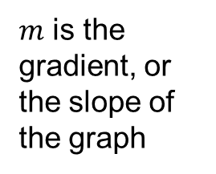
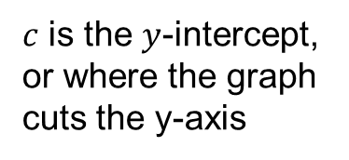
Remember:
$$y=mx+c$$
$m$ is the gradient, or the slope of the graph
$c$ is the $y$-intercept, or where the graph cuts the y-axis

Slide 7
Example
Calculate the equation of the perpendicular bisector of the line segment between $(5, 7)$ and $(−3, 3)$.
“Meets at a right angle”… What does this tell us about the gradients?
“Cut in half”… Which coordinate can we use in our calculation?

Slide 8
Example
Calculate the equation of the perpendicular bisector of the line segment between $(5, 7)$ and $(−3, 3)$.
Midpoint: $\left(\frac{5−3}{2}, \frac{7+3}{2}\right)=(1,5)$
Gradient: $\frac{3−7}{−3−5}=\frac{−4}{−8}=\frac{1}{2}$
Perpendicular gradient: $−1÷\frac{1}{2}=−2$
Equation: $y=mx+c$ Substitute midpoint and gradient
$5=−2×1+c$
$c=7$
$y=−2x+7$

Slide 9

Task
Calculate the equations of the perpendicular bisector of the following line segments:
a) $(0, 3)$ to $(4, 11)$
b) $(−4, 7)$ to $(8, 10)$
c) $(−3, −2)$ to $(3, −8)$
$$y=−\frac{1}{2}x+8$$
$$y=−4x+\frac{1}{2}$$
$$y=x−5$$

