Slide 1
Starter
Copy and complete the following:
6 + ___ = 10
3 + ___ = 10
___ + 5 = 10
10 + ___ = 10
___ + 1 = 10
4
7
5
0
9

Slide 2
Task
Answer the questions on the sheet based on this video.

Slide 4
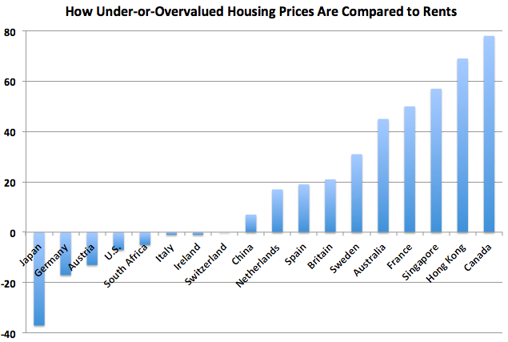
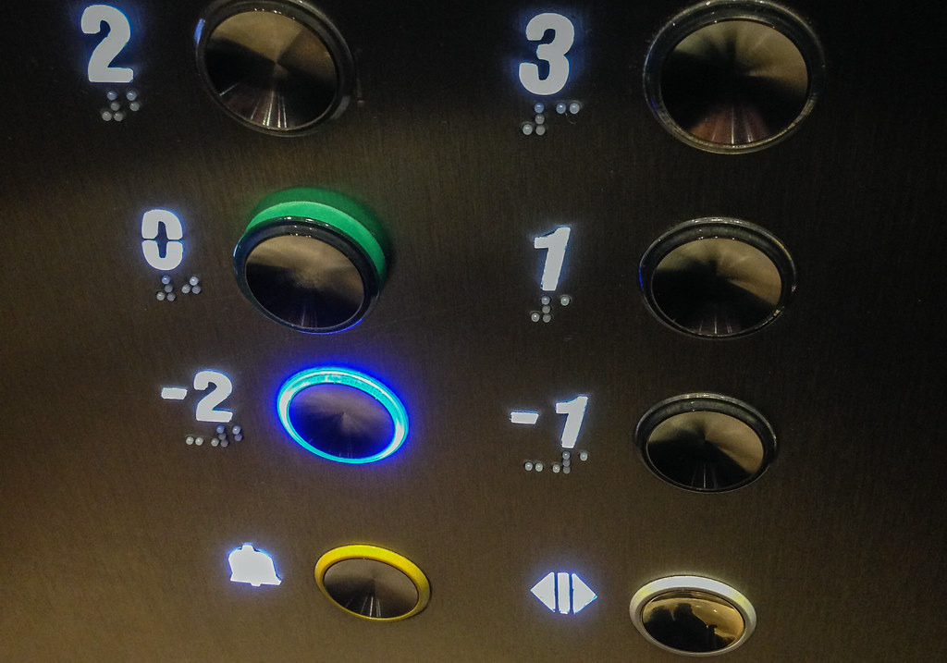
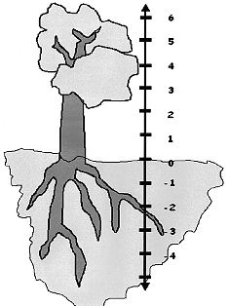
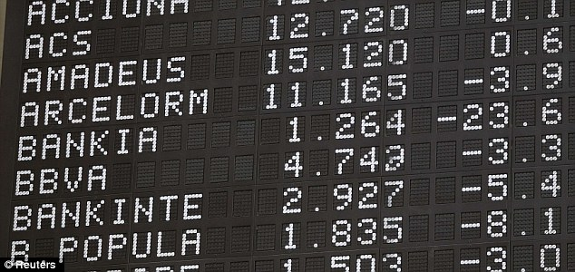
List the different places you could encounter negative numbers in real life.

Slide 5
Subtracting
Adding

Slide 6
Adding
5
1 + 4 =

Slide 7
Subtracting
-3
2 - 5 =

Slide 8
Subtracting
-1 - 2 =
-3

Slide 9
Adding
3
-4 + 7 =

Slide 10
Subtracting
-1 + - 3 =
-1 - 3 =
-4
Mixed means minus

Slide 11
Adding
-3 - - 6 =
-3 + 6 =
3
Double negative makes positive

Slide 13
Answers
1) -2
2) 5
3) -5
4) 5
5) 13
6) 3
7) -8
8) 9
9) -1
10) 3
11) 0, -1, -2
12) -4, -6, -8
13) 1, -4, -9
14) 0, 2, 4
15) -15, -12, -9
Extension
+ | -5 | -3 | -1 | 0 | 1 | 3
-4 | -9 | -7 | -5 | -4 | -3 | -1
-2 | -7 | -5 | -3 | -2 | -1 | 1
2 | -3 | -1 | 1 | 2 | 3 | 5

Slide 14
$$×$$ | -2 | -1 | 0 | 1 | 2 | 3
-2
-1
0
1
2
3
Use a calculator to complete this times tables grid involving directed numbers, then complete the sentences.

Slide 15
$$×$$ | -2 | -1 | 0 | 1 | 2 | 3
-2 | 4 | 2 | 0 | -2 | -4 | -6
-1 | 2 | 1 | 0 | -1 | -2 | -3
0 | 0 | 0 | 0 | 0 | 0 | 0
1 | -2 | -1 | 0 | 1 | 2 | 3
2 | -4 | -2 | 0 | 2 | 4 | 6
3 | -6 | -3 | 0 | 3 | 6 | 9
Use your completed times tables grid to help you with the following division questions.

Slide 16
9 ÷ 3
3
-3

Slide 17
9 ÷ 3
3
-3

Slide 18
-4 ÷ 2
2
-2

Slide 19
-4 ÷ 2
2
-2

Slide 20
-6 ÷ -2
3
-3

Slide 21
-6 ÷ -2
3
-3

Slide 22
2 ÷ -1
2
-2

Slide 23
2 ÷ -1
2
-2

Slide 24
4 ÷ -2
2
-2

Slide 25
4 ÷ -2
2
-2

Slide 26
-2 ÷ 2
1
-1

Slide 27
-2 ÷ 2
1
-1

Slide 28
Try these quick questions – you have 5 minutes!
= -12
= 14
= 81
= -36
= -12
= -4
= 10
= -20
= 209
= 90
= -6
= -77
= -132
= 24
= -8
= 9
1) 3 x – 4
2) -7 x -2
3) 9 x 9
4) 6 x -6
5) 4 x -1 x 3
6) -20 ÷ 5
7) -100 ÷ -10
8) -10 x 2
9) -11 x -19
10) - 450 ÷ - 5
11) 36 ÷ -6
12) -7 x 11
13) -12 x 11
14) -3 x -2 x 4
15) -2 x -2 x -2
16) (-6 x -3) ÷ 2

Slide 29
Pair Activity
Answer the questions above. Where the answer appears in the grid below, write the letter in the box beneath it. It will form another great maths joke!
By the way, you won’t need all the letters so make sure your answers are correct ☺
Answer: What did zero say to eight? Nice belt!

