Slide 1
Starter
What’s the same and what’s different?
√2 √81
9 √5

Slide 2
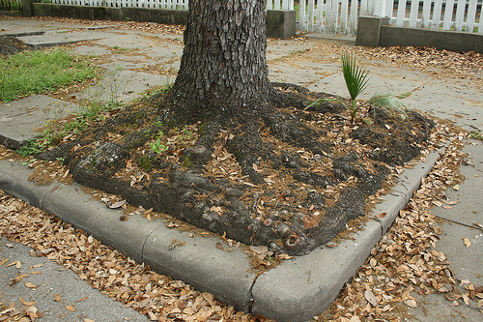
What is a surd?
A surd is a square root which cannot be reduced to a whole number.
Examples:
√2 is a surd.
√5 is a surd.
√81 looks like a surd, but isn't really...

Slide 3
√4 x √9 =
2 x 3
= 6
= √36
√2 x √8
= √16
= 4
General Rule:

Slide 4
2-minute challenge:
How many can you do?
Simplify answers where possible.
√3 x √12 =
√3 x √4 =
√2 x √5 =
√5 x √5 =
√6 x √9 =
√5 x √20 =
√3 x √27 =
√2 x √3 x √6 =

Slide 5
√3 x √12 = 6
√3 x √4 = √12
√2 x √5 = √10
√5 x √5 = 5
√6 x √9 = √54
√5 x √20 = 10
√3 x √27 = 9
√2 x √3 x √6 = 6
2-minute challenge:
Answers

Slide 6
√36 ÷ √9
= 2
= √4
= 6 ÷ 3
= 3
√54 ÷ √6
= √9
General Rule:

Slide 7
2-minute challenge:
How many can you do?
Simplify answers where possible.
√12 ÷ √3 =
√44 ÷ √4 =
√100 ÷ √4 =
√25 ÷ √5 =
√81 ÷ √9 =
√75 ÷ √25 =
√28 ÷ √7 =
(√2 x √9) ÷ √3 =

Slide 8
2-minute challenge:
Answers
√12 ÷ √3 = 2
√44 ÷ √4 = √11
√100 ÷ √4 = 5
√25 ÷ √5 = √5
√81 ÷ √9 = 3
√75 ÷ √25 = √3
√28 ÷ √7 = 2
(√2 x √9) ÷ √3 = √6

Slide 9
√9 + √16 = ?
√(9 + 16) = √25
√9 + √16 = 3 + 4
= 5
= 7
General Rule:
There isn't a rule for adding or subtracting!

Slide 10
Simplify √12
= √4
x √3
What is the largest square number that is a factor of 12?
= 2 x √3
= 2√3

Slide 11
Simplify √72
= √36
x √2
What is the largest square number that is a factor of 72?
= 6 x √2
= 6√2

Slide 12
Simplify √12 x √27
√12 = √4 x √3 = 2√3
√27 = √9 x √3 = 3√3
√12 x √27
= 2√3 x 3√3
= 2 x 3 x √3 x √3
= 6 x √9
= 18

Slide 13
Simplify √90
√10
= √9
= 3

Slide 14
(5 - √3)² = (5 - √3)(5 - √3)
= 25 - (√3 x 5) – (5 x √3) + (√3 x √3)
= 25 - 5√3 – 5√3 + √9
= 25 - 10√3 + 3
= 28 - 10√3

Slide 16
Answers
1. 3√2 2. 4√14 9. 33 + 11√3
3. 4√6 4. 2√15 10. 44
5. 3√6 11. 34 - 25√2
6. 12 12. 9
7. 8
8. 6

Slide 17
Plenary
The answer is
3√5
What was the question?

