Slide 1
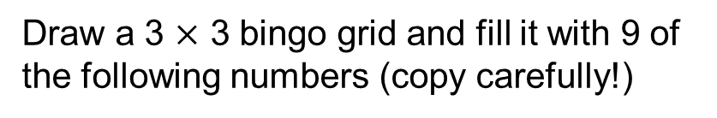
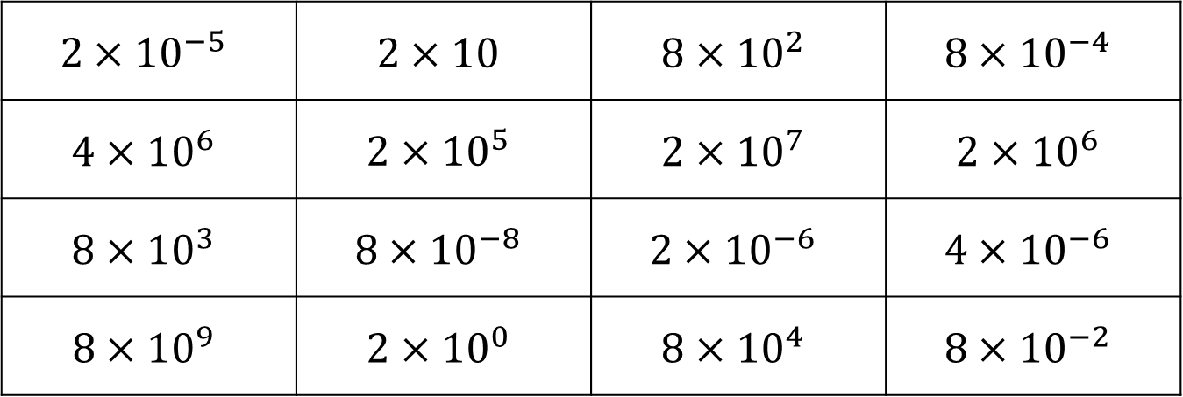
Draw a 3 $×$ 3 bingo grid and fill it with 9 of the following numbers (copy carefully!)
$$2×{10}^{−5}$$ | $$2×10$$ | $$8×{10}^{2}$$ | $$8×{10}^{−4}$$
$$4×{10}^{6}$$ | $$2×{10}^{5}$$ | $$2×{10}^{7}$$ | $$2×{10}^{6}$$
$$8×{10}^{3}$$ | $$8×{10}^{−8}$$ | $$2×{10}^{−6}$$ | $$4×{10}^{−6}$$
$$8×{10}^{9}$$ | $$2×{10}^{0}$$ | $$8×{10}^{4}$$ | $$8×{10}^{−2}$$

Slide 2
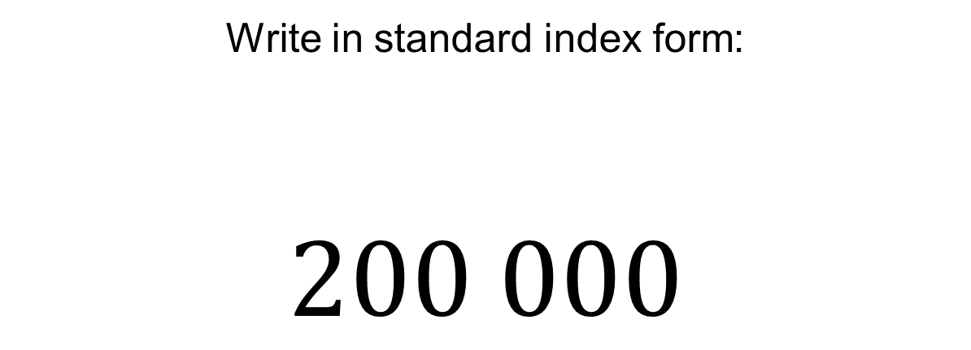
Write in standard index form:
$$200 000$$

Slide 3
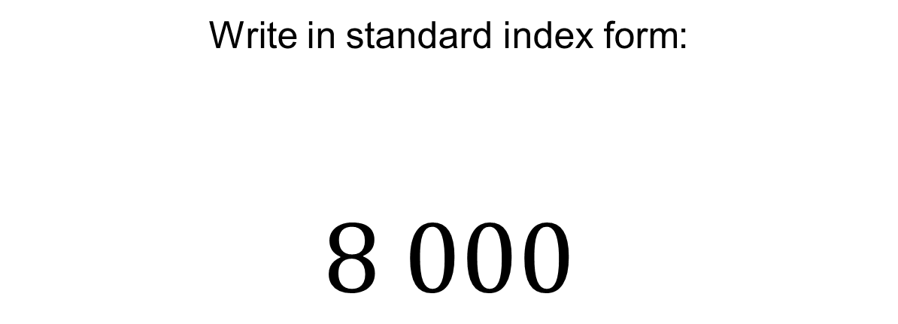
Write in standard index form:
$$8 000$$

Slide 4
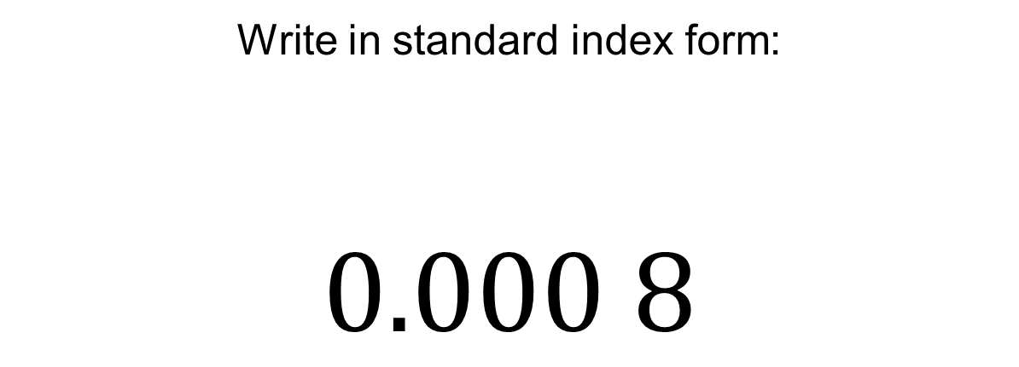
Write in standard index form:
$$0.000 8$$

Slide 5
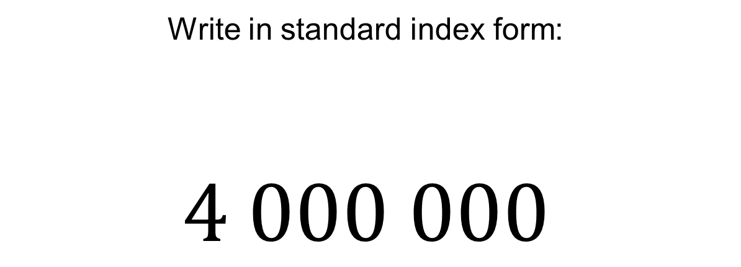
Write in standard index form:
$$4 000 000$$

Slide 6
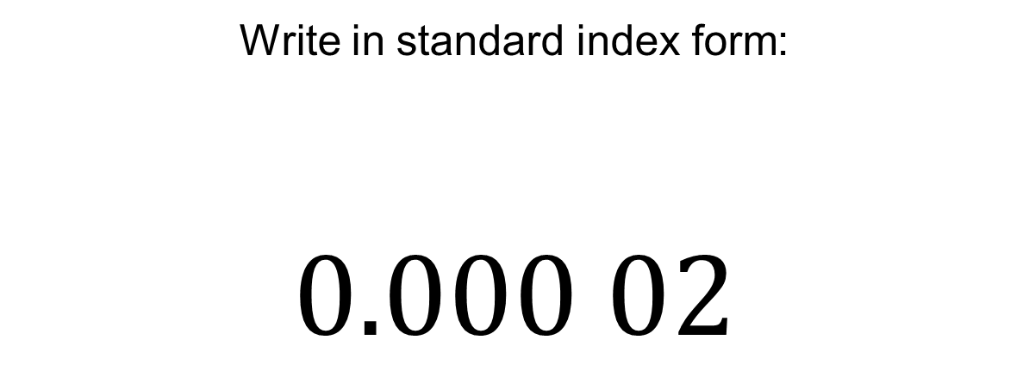
Write in standard index form:
$$0.000 02$$

Slide 7
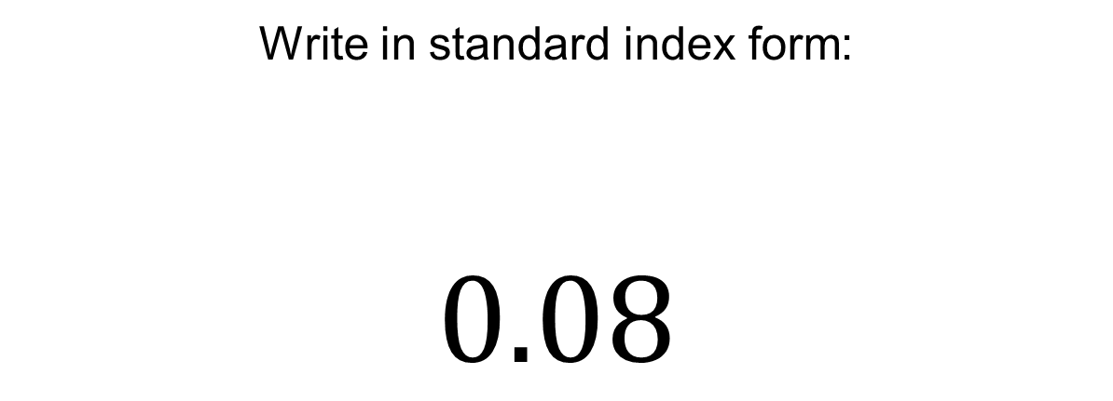
Write in standard index form:
$$0.08$$

Slide 8
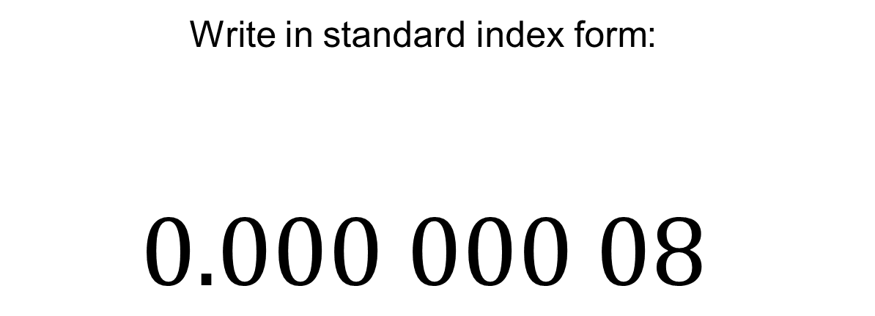
Write in standard index form:
$$0.000 000 08$$

Slide 9
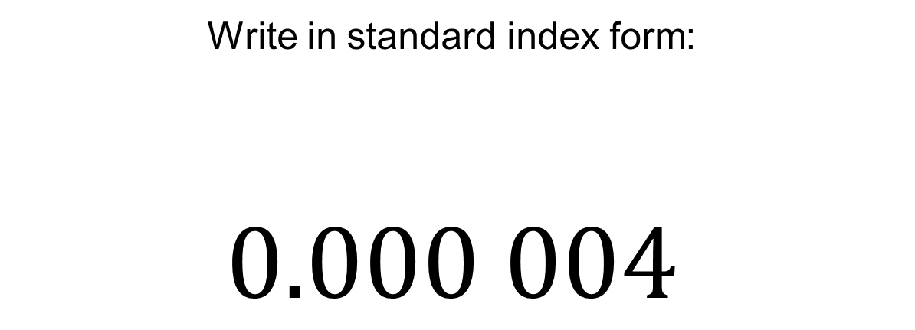
Write in standard index form:
$$0.000 004$$

Slide 10
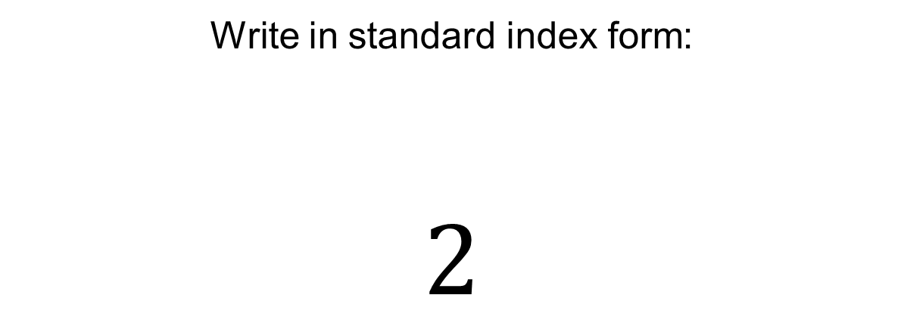
Write in standard index form:
$$2$$

Slide 11
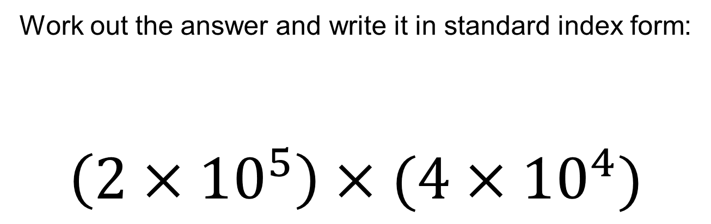
Work out the answer and write it in standard index form:
$$\left(2×{10}^{5}\right)×(4×{10}^{4})$$

Slide 12
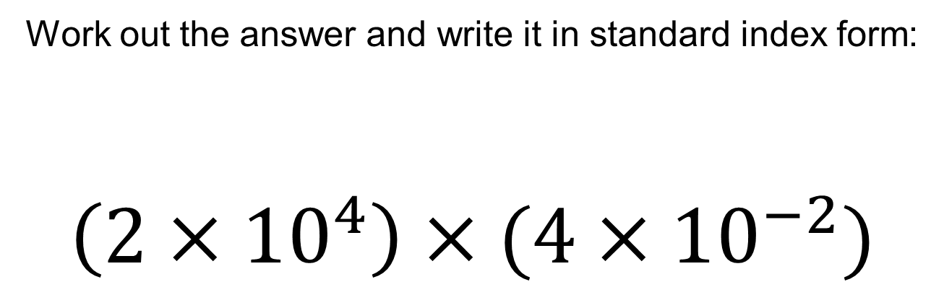
Work out the answer and write it in standard index form:
$$\left(2×{10}^{4}\right)×(4×{10}^{−2})$$

Slide 13
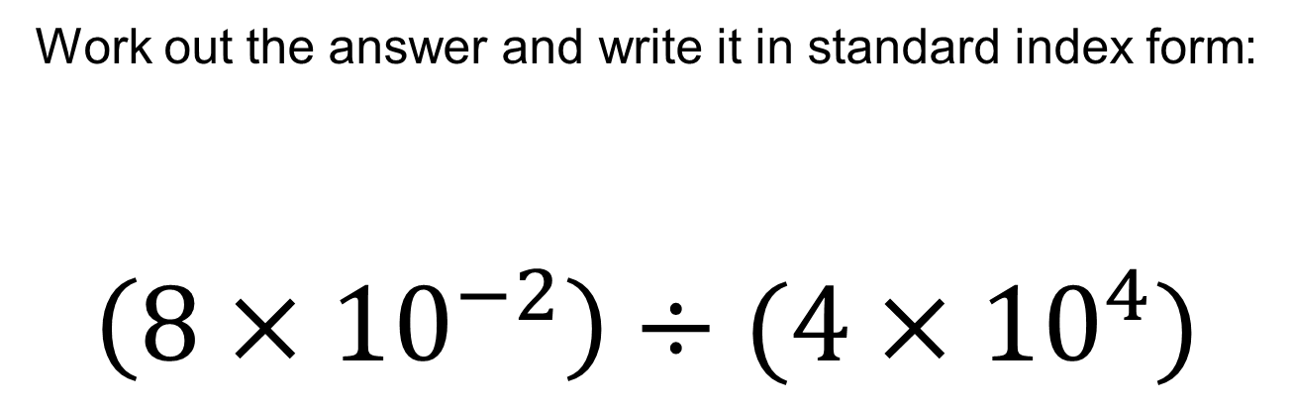
Work out the answer and write it in standard index form:
$$\left(8×{10}^{−2}\right)÷(4×{10}^{4})$$

Slide 14
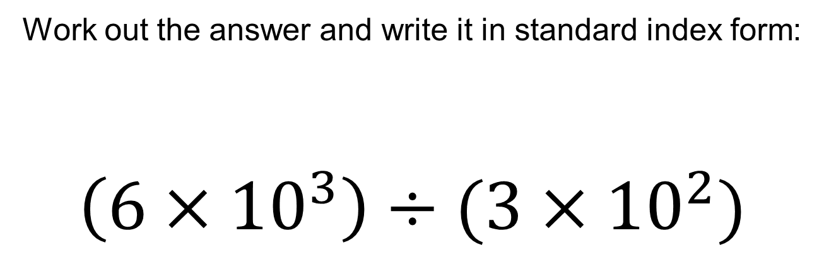
Work out the answer and write it in standard index form:
$$\left(6×{10}^{3}\right)÷(3×{10}^{2})$$

Slide 15
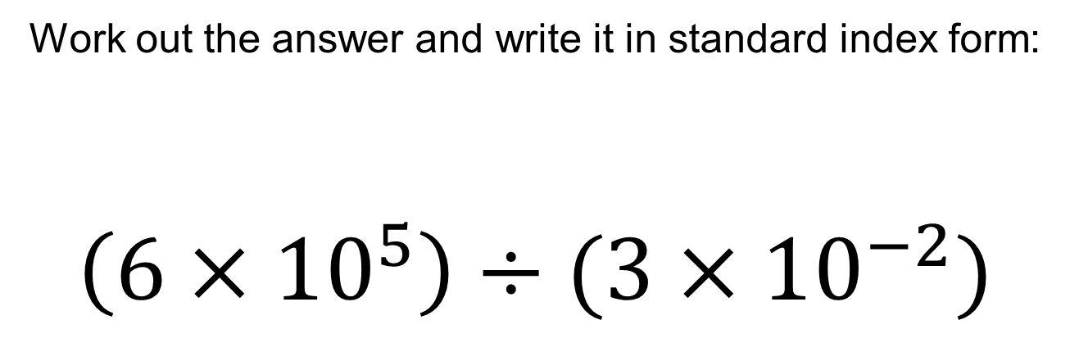
Work out the answer and write it in standard index form:
$$\left(6×{10}^{5}\right)÷(3×{10}^{−2})$$

Slide 16
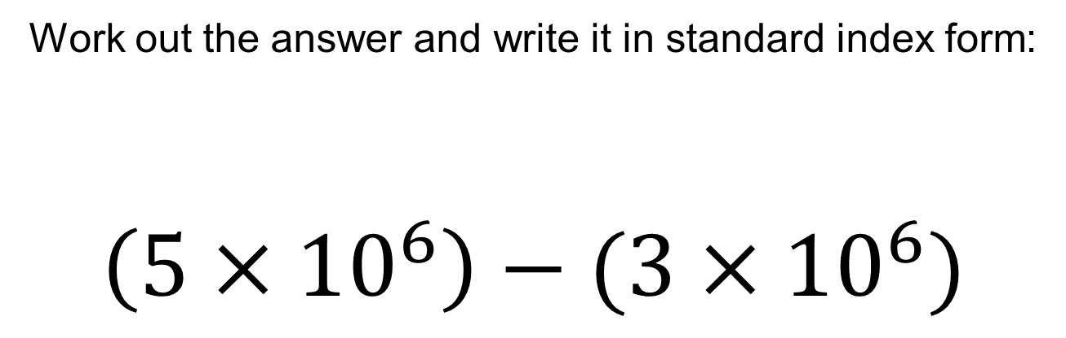
Work out the answer and write it in standard index form:
$$\left(5×{10}^{6}\right)−(3×{10}^{6})$$

Slide 17
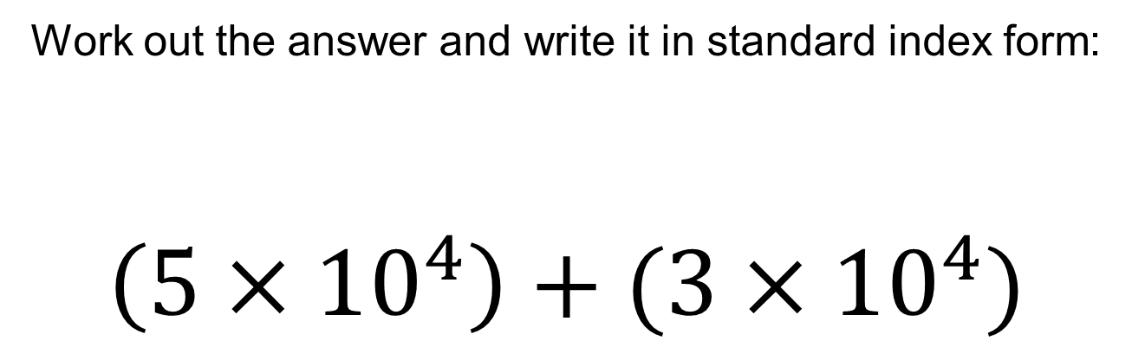
Work out the answer and write it in standard index form:
$$\left(5×{10}^{4}\right)+(3×{10}^{4})$$

