Slide 1
Starter – Coordinate Picture
For each instruction, join up the coordinates.
Do not join one instruction to the next.
1. (5, 1) → (7, 2) → (8, 4) → (8, 6) → (6, 8) → (4, 8) → (2, 6) → (2, 4) →
(3, 2) → (5, 1)
2. (1, 0) → (0, 2) → (0, 6) → (2, 9) → (4, 10) → (6, 10) → (8, 9) → (10, 6)
→ (10, 2) → (9, 0)
3. (6, 0) → (6, 1.5)
4. (4, 0) → (4, 1.5)
5. (4, 3) → (6, 3)
6. Big dots at (4, 5) and (6, 5)

Slide 2
We’ve looked at using a table of values to sketch graphs where their equations are in the form
$$y=mx+c$$
But what about graphs that are not in this format?
What about
$$2x+3y=6$$
We need to tactically pick coordinates that work!
$(0, ?)$ and $(?, 0)$

Slide 3
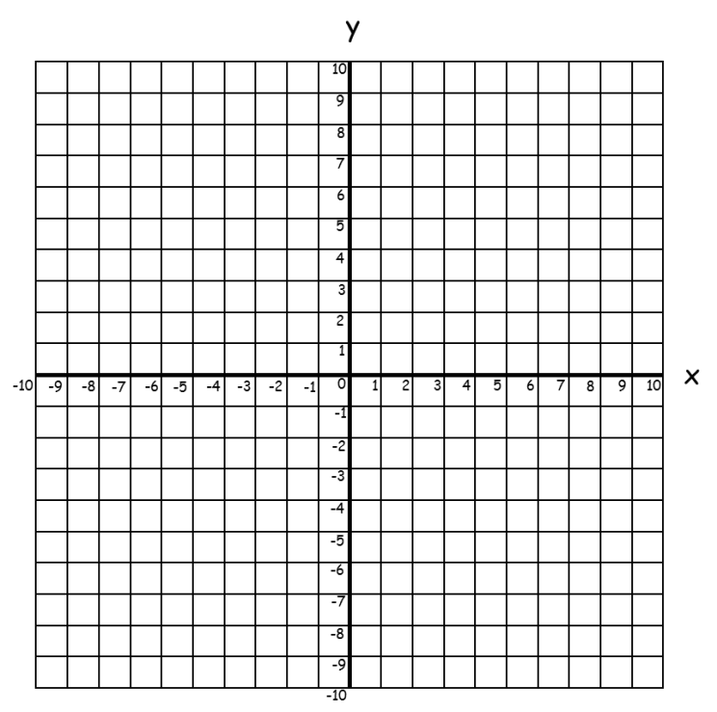
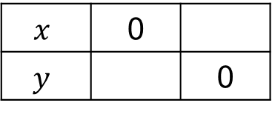
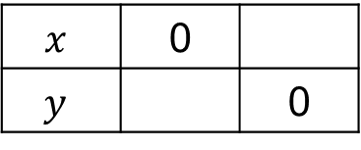
Example 1
Sketch the graph of
$$x+y=4$$
Example 2
Sketch the graph of
$$2x−3y=6$$
4
$$x$$ | 0
$$y$$ |  | 0
4
3
$$x$$ | 0
$$y$$ |  | 0
-2

Slide 4
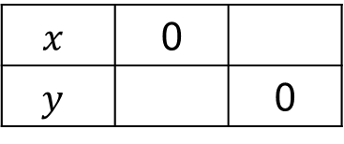
Example 3
Sketch the graph of
$$x−y=7$$
Example 4
Sketch the graph of
$$3x−4y−12=0$$
$3x−4y=12$
7
$$x$$ | 0
$$y$$ |  | 0
-7
4
$$x$$ | 0
$$y$$ |  | 0
-3

Slide 5
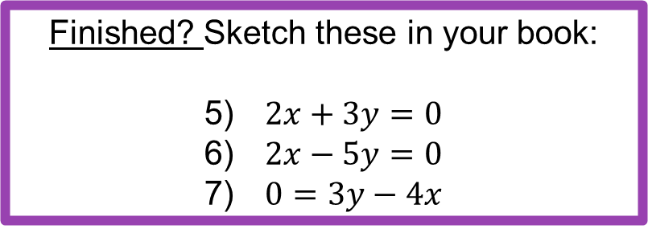
How confident do you feel with this topic?
Write red, amber or green in your book!
Complete the corresponding activity ☺
Finished? Sketch these in your book:
5) $2x+3y=0$
6) $2x−5y=0$
7) $0=3y−4x$

Slide 6
Teachers:
Use Geogebra to show solutions!
(or other graphing software)

Slide 7
Plenary
1 question about today’s topic
2 things you learnt today
3 things you knew already

