Slide 1

Starter
Convert the following into minutes:
1 hour and 30 minutes
1 hour 53 minutes
3 hours 6 minutes
Convert the following into hours:
105 minutes
30 minutes
57 minutes
26 minutes
90 mins
113 mins
186 mins
1.75 hrs or 1$\frac{3}{4}$ hrs
0.5 hrs or ½ hr
0.95 hrs
0.43 hrs

Slide 2
If the time is in hours and minutes, change it to hours and decimal parts of a hour like this:
2 hours 24 minutes = 2. __
24 minutes out of 60
= 24
60
= 24 ÷ 60
= 0.4
2 + 0.4
= 2.4 hours

Slide 3
Task
Change the following hours and minutes to hours written as decimals.
1 hour and 30 minutes
2 hours and 45 minutes
1 hour and 12 minutes
3 hours and 40 minutes
2 hours and 20 minutes
2 hours and 36 minutes
3 hours and 27 minutes
1 hour and 50 minutes
2 hours and 57 minutes
1 hour and 42 minutes
1 hour and 51 minutes
3 hours and 31 minutes
2 hours and 17 minutes
3 hours and 28 minutes
1 hour and 4 minutes
1.5 hours
2.75 hours
1.2 hours
3.67 hours
2.33 hours
2.6 hours
3.45 hours
1.83 hours
2.95 hours
1.7 hours
1.85 hours
3.52 hours
2.28 hours
3.47 hours
1.07 hours

Slide 4
What is compound measure?
Write down as many units of measure as you can.
Which do you think are compound ?
What is compound measure?

Slide 5
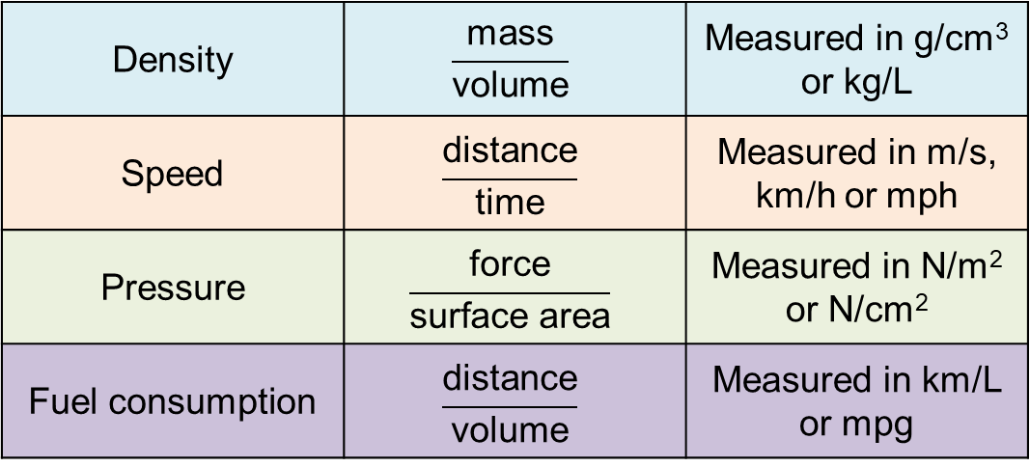
Commonly used compound measures include:
Density | $$\frac{\text{mass}}{\text{volume}}$$ | Measured in g/cm³ or kg/L
Speed | $$\frac{\text{distance}}{\text{time}}$$ | Measured in m/s, km/h or mph
Pressure | $$\frac{\text{force}}{\text{surface} \text{area}}$$ | Measured in N/m² or N/cm²
Fuel consumption | $$\frac{\text{distance}}{\text{volume}}$$ | Measured in km/L or mpg

Slide 6
Example
If a car is travelling at 60 mph. How far will it travel in :
1 hour?
2 hours?
5 hours?
10 hours?
Do we see a pattern? What about in:
(v) An hour and a half?
(vi) 57 minutes?

Slide 7
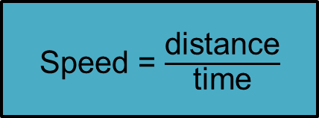
Example
A cyclist travels 45 miles in 3 hours. What is the cyclist’s speed?
Speed = $\frac{\text{distance}}{\text{time}}$
Speed = $\frac{\text{distance}}{\text{time}}$
= $\frac{\text{45}}{\text{3}}$
= 15
mph

Slide 8
Example
A car travels at 30 mph for 2 hours. How far has it travelled?
Speed = $\frac{\text{distance}}{\text{time}}$
30 = $\frac{\text{distance}}{\text{2}}$
60
Speed = $\frac{\text{distance}}{\text{time}}$
miles

Slide 9
Example
A plane covers a distance of 1200 miles at a speed of 300 mph. How long will it take to complete this journey?
Speed = $\frac{\text{distance}}{\text{time}}$
300 = $\frac{\text{1200}}{\text{time}}$
Time = $\frac{\text{1200}}{\text{300}}$
Speed = $\frac{\text{distance}}{\text{time}}$
= 4
hours

Slide 10
Show me and example of a suitable unit for the measurement of:
the speed of a boat,
an aeroplane,
the space shuttle,
a snail,
a Year 10 walking to my lesson
True/Never/Sometimes: A sprinter travelling 100m in 10 seconds is faster than a cyclist travelling 13 miles in 1 hour

Slide 12
Answers
1) 48 mph 5) 72.4 mph
2) 6 hours 40 minutes 6) 7 hours 36 minutes
3) 227.5 miles 7) 30 miles
4) 4.2 m/s 8) 4.4 m/sec

Slide 13
Plenary
Summarise in a text message (160 characters) what the key learning points are from today’s lesson.

