Slide 1
Starter What are the midpoints of the following pairs of numbers?
0 – 10
40 – 50
30 – 40
0 – 100
0 – 50
54 – 56
5 – 9
8 – 14
38 – 52
0 – 5

Slide 2
Answers
5
45
35
50
25
55
7
11
45
2.5

Slide 3

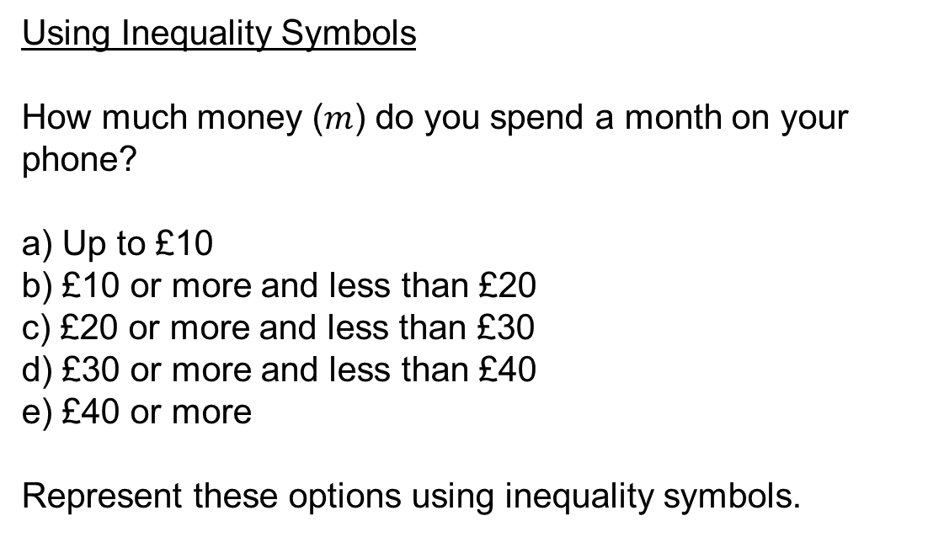
Using Inequality Symbols
How much money ($m$) do you spend a month on your phone?
a) Up to £10
b) £10 or more and less than £20
c) £20 or more and less than £30
d) £30 or more and less than £40
e) £40 or more
Represent these options using inequality symbols.
$0≤m<10$
$10≤m<20$
$20≤m<30$
$30≤m<40$
$m≥40$

Slide 4
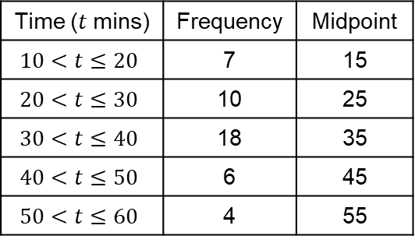
A frequency polygon can be drawn directly from the frequency table by using by finding the midpoint of each class interval.
Time Taken for Race
Time ($t$ mins) | Frequency | Midpoint
$$10<t≤20$$ | 7 | 15
$$20<t≤30$$ | 10 | 25
$$30<t≤40$$ | 18 | 35
$$40<t≤50$$ | 6 | 45
$$50<t≤60$$ | 4 | 55
20
Frequency
$$×$$
15
10
$$×$$
$$×$$
$$×$$
5
$$×$$
Remember a polygon is a shape with straight sides
0
0
10
20
30
40
50
60
Time in minutes

Slide 6
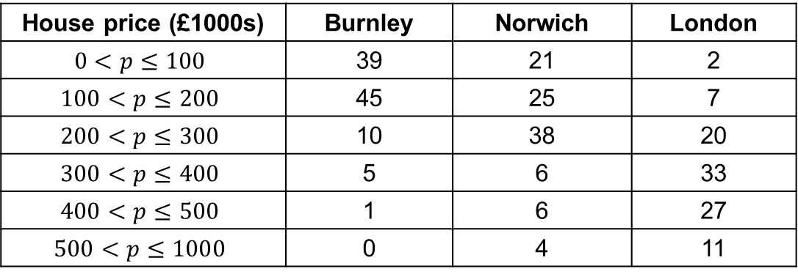
Group Task (3s)
The price of 100 houses in different parts of the country are shown in the table.
Draw frequency polygons to illustrate the data.
Compare your data
House price (£1000s) | Burnley | Norwich | London
$$0<p≤100$$ | 39 | 21 | 2
$$100<p≤200$$ | 45 | 25 | 7
$$200<p≤300$$ | 10 | 38 | 20
$$300<p≤400$$ | 5 | 6 | 33
$$400<p≤500$$ | 1 | 6 | 27
$$500<p≤1000$$ | 0 | 4 | 11

Slide 7
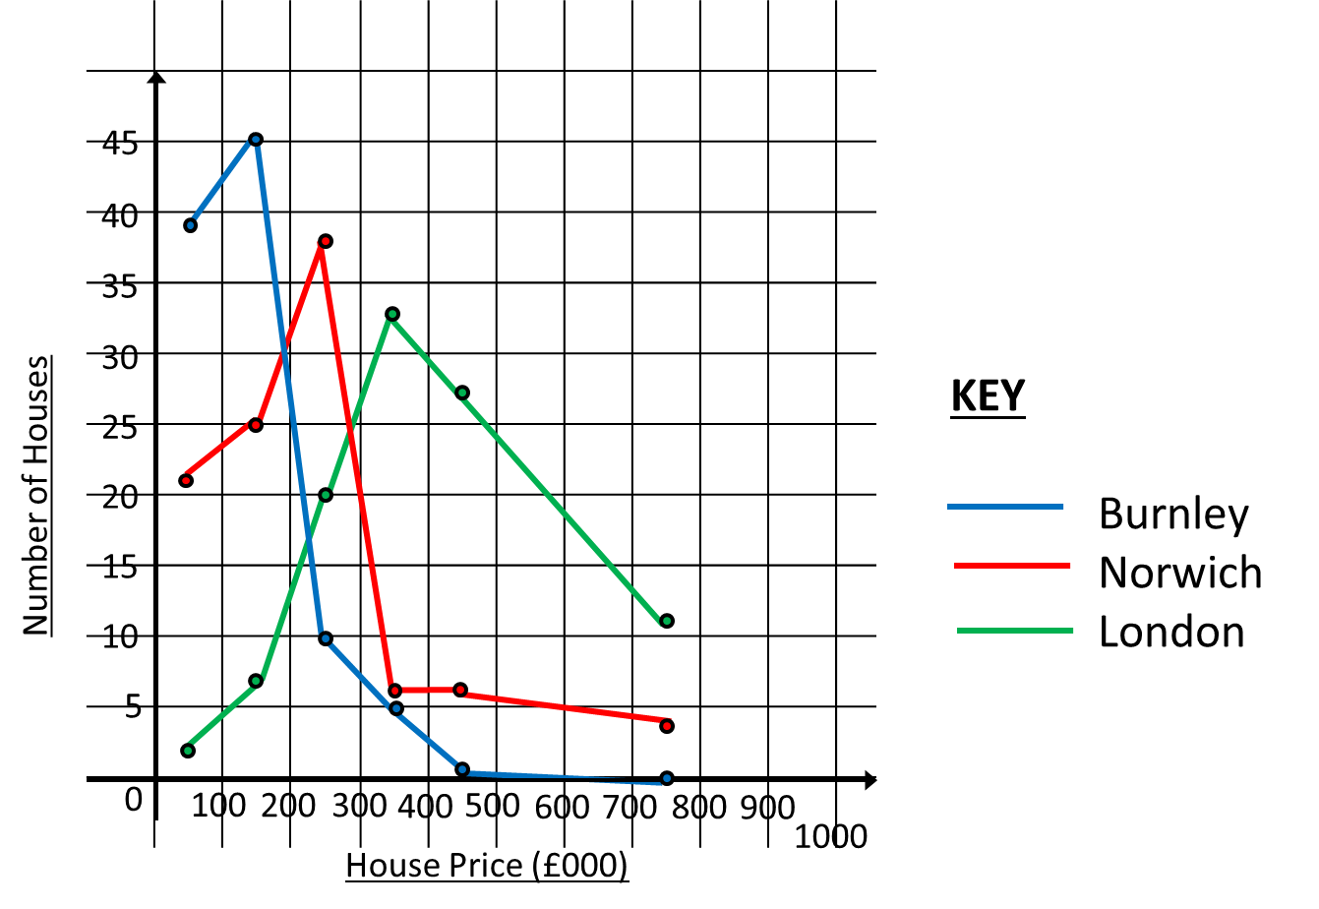
Group Task (3s)

