Slide 1
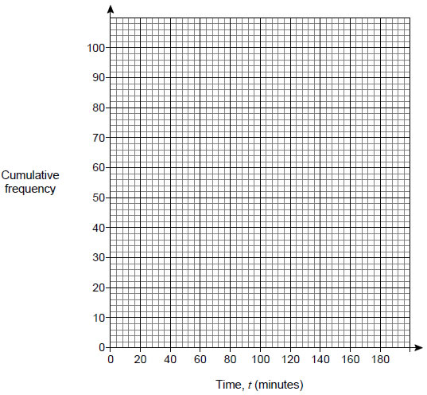
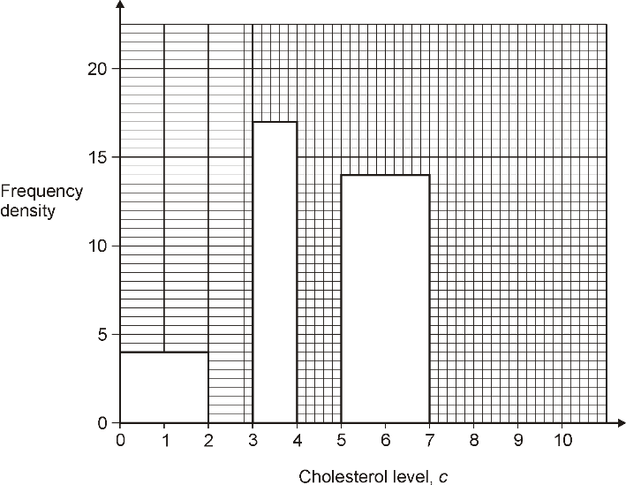
Data Handing Revision Mat
Scatter Graphs
The scatter graph shows some information about 8 cars.
What type of correlation does the scatter graph show?
A car has an engine size of 2.5 litres. Estimate the distance travelled on one litre.
Cumulative Frequency Graphs
The table shows the running times of some films.
Draw a cumulative frequency graph on the grid to represent the data.
Estimate the number of these films with a running time of less than 2 ½ hours.
The shortest film was 84 minutes long. The longest film was 179 minutes long. Use this information to draw a box plot below.
Histograms
The table and histogram show some information about the cholesterol level in the blood of 100 hospital patients.
Use the table to complete the histogram.
Use the histogram to complete the table.
Time, t (minutes) | Number of films
0 ≤ t < 80 | 0
80 ≤ t < 100 | 9
100 ≤ t < 120 | 35
120 ≤ t < 140 | 30
140 ≤ t < 160 | 18
160 ≤ t < 180 | 8
Cholesterol level, c | Frequency
0 < c ≤ 2 | 8
2 < c ≤ 3 | 13
3 < c ≤ 4
4 < c ≤ 5 | 19
5 < c ≤ 7
7 < c ≤ 10 | 15
Averages from Tables
Bob asked each of 40 friends how many minutes they took to get to work.
The table shows some information about his results.
Write down the modal class.
State the class in which the median lies.
Work out an estimate for the mean time taken.
Time taken (m minutes) | Frequency
0 < w ≤ 10 | 3
10 < w ≤ 20 | 8
20 < w ≤ 30 | 11
30 < w ≤ 40 | 9
40 < w ≤ 50 | 9
Capture/Recapture Method
A park ranger wants to estimate the number of fish in a lake. She catches 400 fish. She marks them with ink and puts them back in the lake. The next day she catches 60 fish. There are 3 marked with ink.
The ranger says, “There are about 8000 fish in the lake.” Show that she is correct.

