Slide 1
Starter
What’s the same and what’s different?
x² + 3x + 2 (x + 2)(x + 1)
(2x + 1)(x + 2) (x + 1)(x + 2)

Slide 2
Factorise and solve:
x² + 15x + 44 = 0
Product = 44, sum = 15
(x + 11)(x + 4) = 0
x = -11 or -4

Slide 3
Factorise and solve:
x² - 8x + 16 = 0
Product = 16, sum = -8
(x - 4)(x - 4) = 0
x = 4

Slide 5
Answers
Question | Factorise | Solve
x² + 8x + 12 | (x + 2)(x + 6) | x = -2 or -6
x² + 14x + 48 | (x + 6)(x + 8) | x = -6 or -8
x² + 15x + 56 | (x + 7)(x + 8) | x = -7 or -8
x² - 12x + 27 | (x – 3)(x – 9) | x = 3 or 9
x² - 3x + 2 | (x – 1)(x – 2) | x = 1 or 2
x² - x - 56 | (x – 8)(x + 7) | x = 8 or -7
x² + 4x - 21 | (x + 7)(x – 3) | x = -7 or 3
x² - 9x - 10 | (x – 10)(x + 1) | x = 10 or -1
x² - 36 | (x – 6)(x + 6) | x = 6 or -6

Slide 6
Factorise and solve:
2x² + 8x + 8 = 0
16
Product = 16, sum = 8
 | 2x²
 |  | 8
x
2
2x
4x
4
4x
(2x + 4)(x + 2) = 0
x = -2

Slide 7
Factorise and solve:
7x² - 19x - 6 = 0
-42
Product = -42, sum = -19
 | 7x²
 |  | -6
7x
2
x
2x
-3
-21x
(x - 3)(7x + 2) = 0
x = 3 or -2/7

Slide 9
Answers
Question | Factorise | Solve
4x² - 19x + 12 | (x - 4)(4x - 3) | x = 4 or 3/4
2x² + x - 6 | (2x - 3)(x + 2) | x = 3/2 or -2
4x² - 15x + 9 | (4x - 3)(x - 3) | x = 3 or 3/4
4x² + 7x + 3 | (x + 1)(4x + 3) | x = -3/4 or -1
6x² + 19x + 10 | (2x + 5)(3x + 2) | x = -5/2 or -2/3
2x² - x - 21 | (2x – 7)(x + 3) | x = 7/2 or -3
10x² - 11x + 3 | (2x - 1)(5x – 3) | x = 1/2 or 3/5
2x² - 10x - 28 | 2(x – 7)(x + 2) | x = 7 or -2

Slide 10
x² + 6x + 9
(x+6)²
(x+3)²
A
B
(x+9)²
(x+4)²
C
D

Slide 11
x² + 6x + 10
(x+6)² + 1
(x+3)² + 10
A
B
(x+3)² - 1
(x+3)² + 1
C
D

Slide 12
x² + 10x + 25
(x+5)² +20
(x+10)²
A
B
(x+5)² +10
(x+5)²
C
D

Slide 13
x² + 10x + 24
(x+5)² +1
(x+5)² -1
A
B
(x+5)² -2
(x+5)² +4
C
D

Slide 14
x² + 12x + 36
(x+6)²
(x+6)² + 4
A
B
(x+12)²
(x+6)² +2
C
D

Slide 15
x² + 12x + 46
(x+6)²+10
(x+6)²+16
A
B
(x+6)²-10
(x+6)²+36
C
D

Slide 16
x² + 20x + 80
(x+10)²+20
(x+10)²+10
A
B
(x+10)²-10
(x+10)²-20
C
D

Slide 17
x² + 14x + 56
(x+7)²+8
(x+8)²+6
A
B
(x+7)²+7
(x+7)²-7
C
D

Slide 18
Completing the Square
x² + 10x + 10 = 0
Half the coefficient of x
(x + 5)² – (5)² + 10 = 0
(x + 5)² – 25 + 10 = 0
Simplify
Minimum point
(-5, -15)
(x + 5)² – 15 = 0
(x + 5)² = 15
Solve
x + 5 = ± √15
x = - 5 ± √15
Make sure you have both + and – square root!

Slide 19
Completing the Square
x² - 8x + 5 = 0
Half the coefficient of x
(x - 4)² – (-4)² + 5 = 0
(x - 4)² – 16 + 5 = 0
Simplify
Minimum point
(4, -11)
(x - 4)² – 11 = 0
(x - 4)² = 11
Solve
x - 4 = ± √11
x = 4 ± √11
Make sure you have both + and – square root!

Slide 20
Completing the Square
x² - 14x - 9 = 0
Half the coefficient of x
(x - 7)² – (-7)² - 9 = 0
(x - 7)² – 49 - 9 = 0
Simplify
Minimum point
(7, -58)
(x - 7)² – 58 = 0
(x - 7)² = 58
Solve
x - 7 = ± √58
x = 7 ± √58
Make sure you have both + and – square root!

Slide 21
Minimum Points
(x + 5)² – 15 = 0 Minimum at (-5, -15)
(x - 4)² – 11 = 0 Minimum at (4, -11)
(x - 7)² – 58 = 0 Minimum at (7, -58)
(x - p)² + q = 0 Minimum at (p, q)

Slide 23
Answers
 | (a) | (b) | (c)
1 | (x + 4)² - 25 | x = 1 or -9 | (-4, -25)
2 | (x - 3)² - 19 | x = 3 ± √19 | (3, -19)
3 | (x + 5)² - 34 | x = -5 ± √34 | (-5, -34)
4 | (x + 3)² - 16 | x = 1 or -7 | (-3, -16)
5 | (x - 5)² - 22 | x = 5 ± √22 | (5, -22)
6 | (x – 7/2)² - 45/4 | x = 7/2 ± 3/2√5 | (3.5, -11.25)
7 | (x + 6)² - 41 | x = -6 ± √53 | (-6, -41)
8 | (x + 3/2)² + 7/4 | x = -3/2 ± ½√29 | (-1.5, 1.75)
9 | 4(x + 1)² - 16 | x = 1 or -3 | (-1, -16)
10 | 3(x + 1)² - 12 | x = 1 or -3 | (-1, -12)
11 | 5(x + 1)² - 21 | x = -1 ± √(29/5) | (-1, -21)
12 | 2(x + 3/2)² + ½ | x = -3/2 ± ½√23 | (-1.5, 0.5)

Slide 24
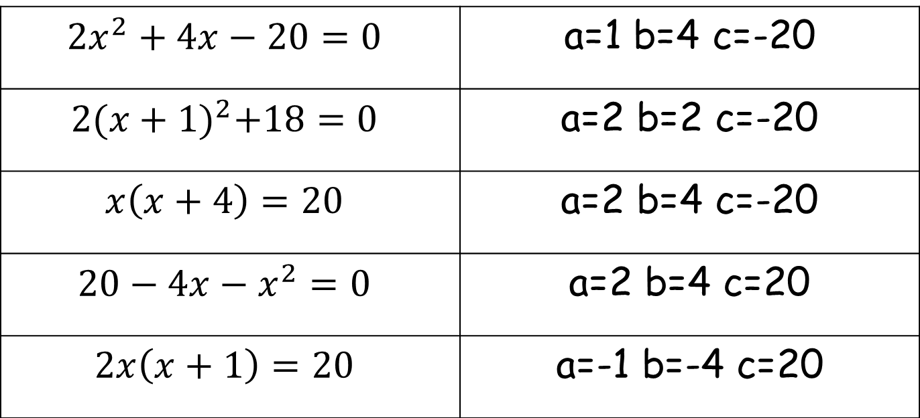
Match the equation to its values of a, b and c for $$ax^{2}+bx+c=0$$
$${2x}^{2}+4x−20=0$$ | a=1 b=4 c=-20
$$2{(x+1)}^{2}+18=0$$ | a=2 b=2 c=-20
$$x\left(x+4\right)=20$$ | a=2 b=4 c=-20
$$20−4x−x^{2}=0$$ | a=2 b=4 c=20
$$2x\left(x+1\right)=20$$ | a=-1 b=-4 c=20

Slide 25
Using the quadratic formula
Any quadratic equation of the form,
ax² + bx + c = 0
can be solved by substituting the values of a, b and c into the formula,
–b ± √b² – 4ac
x =
2a
This equation can be derived by completing the square on the general form of the quadratic equation.

Slide 26
Use the quadratic formula to solve x² – 7x + 8 = 0.
1x² – 7x + 8 = 0
–b ± √b² – 4ac
x =
2a
7 ± √(–7)² – (4 × 1 × 8)
SUBSTITUTE
x =
2 × 1
SIMPLIFY
7 ± √49 – 32
x =
2
7 + √17
7 – √17
SPLIT
x =
or
x =
2
2
SOLVE
x = 5.562
x = 1.438 (to 3 d.p.)

Slide 27
Use the quadratic formula to solve 2x² + 5x – 1 = 0.
2x² + 5x – 1 = 0
–b ± √b² – 4ac
x =
2a
–5 ± √5² – (4 × 2 × –1)
SUBSTITUTE
x =
2 × 2
SIMPLIFY
–5 ± √25 + 8
x =
4
–5 + √33
–5 – √33
SPLIT
x =
or
x =
4
4
SOLVE
x = 0.186
x = –2.686 (to 3 d.p.)

Slide 28
What were the original quadratic equations of the following:
–7 ± √49 - 16
9 ± √81 + 120
x =
x =
2
6
a = 1, b = 7, c = 4
a = 3, b = -9, c = -10
x² + 7x + 4 = 0
3x² - 9x – 10 =0

Slide 29
What’s wrong with the following answer?
4x² - 2x - 1 = 8
– - 2 ± √-2² – (4 × 4 × -1)
SUBSTITUTE
x =
2 × 4
SIMPLIFY
2 ± √4 + 16
x =
8
2 + √21
2 – √21
x =
or
x =
SPLIT
8
8
SOLVE
x = 0.823
x = -0.323 (to 3 d.p.)

Slide 31
Answers
x = -0.63 or -2.37
x = 1.5 or 0.3333…
x = 0.19 or -2.69
x = -0.27 or -3.73
x = 1 or 0
x = -0.5
x = 6.70 or 0.30
No solutions

Slide 32
Use the quadratic formula to solve 2x² + 5x – 1 = 0.
2x² + 5x – 1 = 0
–b ± √b² – 4ac
x =
2a
–5 ± √5² – (4 × 2 × –1)
SUBSTITUTE
x =
2 × 2
SIMPLIFY
–5 ± √25 + 8
x =
4
–5 + √33
–5 – √33
SPLIT
x =
or
x =
4
4
SOLVE
x = 0.186
x = –2.686 (to 3 d.p.)

Slide 33
For the quadratic function f(x) = ax² + bx + c, the expression b² - 4ac is called the discriminant.
The value of the discriminant shows how many solutions, or roots, f(x) has.
When the b² - 4ac > 0, there are two distinct roots.
When the b² - 4ac = 0, there is one repeated root.
When the b² - 4ac < 0, there are no roots.
Why is this the case?

Slide 34
We can demonstrate each of these possibilities using graphs.
If we plot the graph of y = ax² + bx + c the solutions to the equation ax² + bx + c = 0 are given by the points where the graph crosses the x-axis.
b² – 4ac > 0
b² – 4ac = 0
b² – 4ac < 0
y
y
y
x
x
x
Two solutions
One solution
No solutions

Slide 35
Find the values of k for which
f(x) = x² + kx + 9 has equal roots.
a = 1, b = k, c = 9
For equal roots, b² - 4ac = 0
k² - 4 x 1 x 9 = 0
k² - 36 = 0
(k + 6)(k – 6) = 0
So k = ±6

Slide 36
Find the range of values of k for which
x² + 4x + k = 0 has two distinct real solutions.
a = 1, b = 4, c = k
For equal roots, b² - 4ac > 0
4² - 4 x 1 x k > 0
16 – 4k > 0
16 > 4k
So k < 4

Slide 38
Answers
1. a) 52
b) -23
c) 37
d) 0
e) 41
2. a) Two real roots
b) No real roots
c) Two real roots
d) One repeated root
e) Two real roots
3. k < 9
4. t = 9/8
5. k > 4/3
6. s = 4
7. a) p = 6
b) x = -9
8. a) k² + 16
b) k² is positive therefore
k² + 16 is positive

