Slide 1
Starter
Find the lengths of the missing edges, giving your answers correct to 1 decimal place.
$$b$$
5 cm
6 cm
$$a$$
9 cm
4 cm
16 cm
$$d$$
1 cm
11 cm
1 cm
$$c$$

Slide 2
Answers
10.3 cm
$$b$$
5 cm
7.2 cm
6 cm
$$a$$
9 cm
4 cm
1.4 cm
16 cm
$$d$$
1 cm
11 cm
1 cm
$$c$$
11.6 cm

Slide 3
We can label the sides of a right-angled triangle in the following way:
Hypotenuse (H)
This is the longest side and is opposite the right-angle
Opposite Side (O)
This is the side opposite the angle in question
Adjacent Side (A)
This is the side adjacent (next to) the angle in question.

Slide 4
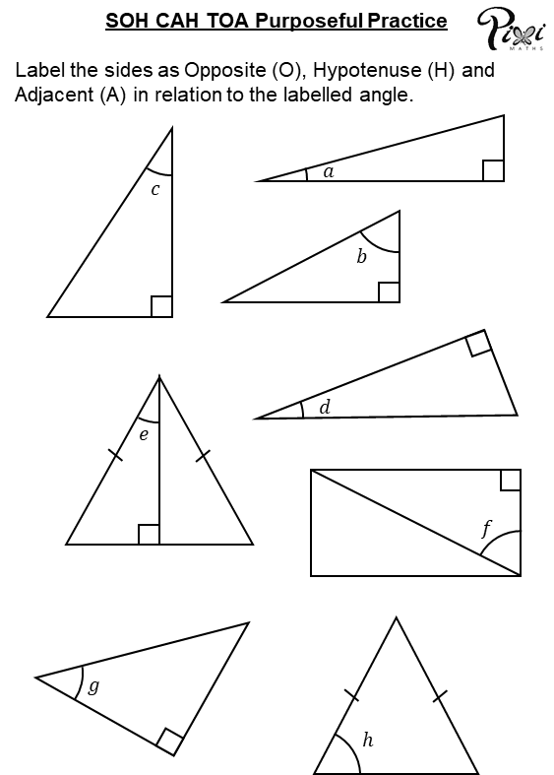
Purposeful Practice
Label the sides of the right-angled triangles on the sheet.

Slide 5
Purposeful Practice
Label the sides of the right-angled triangles.
$$c$$
A
H
O
H
A
O
$$a$$
$$d$$
A
H
O
O
H
$$b$$
A
H
A
$$f$$
O
$$e$$
H
H
A
H
O
$$h$$
$$g$$
O
A
A
O

Slide 6
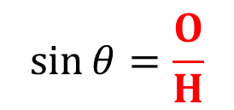
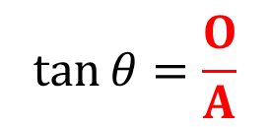
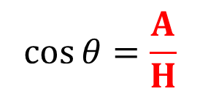
H
Trigonometric ratios can help us to find missing sides and angles in right-angled triangles.
O
$$θ$$
A
$$\sin{θ}=\frac{O}{H}$$
$$\cos{θ}=\frac{A}{H}$$
$$\tan{θ}=\frac{O}{A}$$

Slide 7
Example
Calculate $p$. Give your answer correct to 2 decimal places.
$\cos{θ}=\frac{A}{H}$
$\cos{46}=\frac{7}{p}$
$p×\cos{46}=7$
$p=\frac{7}{\cos{46}}$
$p=10.08$ cm
H
$p$ cm
$$×$$
O
$$46°$$
$7$ cm
A

Slide 8
Example
Calculate $Q$. Give your answer correct to 1 decimal place.
$\tan{θ}=\frac{O}{A}$
$\tan{Q}=\frac{4.3}{3.8}$
$Q=\tan^{−1}\left(\frac{4.3}{3.8}\right)$
$Q=48.5°$
$$×$$
$4.3$ m
H
O
$$Q°$$
$3.8$ m
A

Slide 9
Extension: Trigonometry pile-up

Slide 10
Answers
1. a = 12.03 cm
b = 61.44 cm
c = 41.80 cm
d = 115.19 cm
2. a = 69.5°
b = 33.5°
c = 69.4°
d = 54.4°
3. 2.25 m
4. 48.2º
5. 9.21 m
Extension: 12.073 cm (3dp)

Slide 11
Show me an example of:
A hypotenuse
An opposite side
An adjacent side
A problem that can be solved using trigonometry
True/Never/Sometimes: you can use trigonometry ratios to find the missing length/angle in triangles

Slide 12
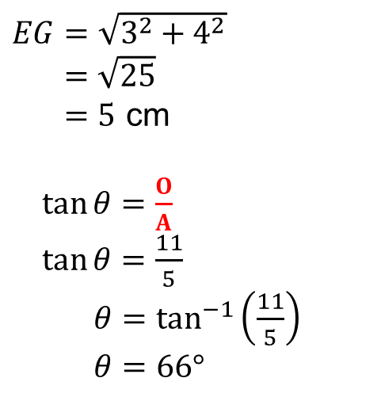
Example
The image below is of a cuboid. Calculate the size of the angle between $CE$ and $EFGH$. Give your answer correct to the nearest degree.
$$C$$
$$B$$
$$C$$
$$A$$
$$D$$
$EG=\sqrt{3^{2}+4^{2}}$
$=\sqrt{25}$
$=5$ cm
$\tan{θ}=\frac{O}{A}$
$\tan{θ}=\frac{11}{5}$
$θ=\tan^{−1}\left(\frac{11}{5}\right)$
$θ=66°$
11 cm
$$×$$
H
11 cm
O
$$F$$
$$G$$
$$θ$$
3 cm
$$E$$
$$H$$
$$E$$
? cm
$$G$$
4 cm
5 cm
A

Slide 13
The image below is of a cuboid. Calculate the size of the angle between CE and EFGH.
B
C
C
A
D
O
T
A
11cm
11cm
tan $θ$ = opp ÷ adj
Opp
tan$θ$ = 11 ÷ 5
F
G
$θ$ = tan⁻¹ (11 ÷ 5)
$$θ$$
3cm
$θ$ = 66°
E
H
E
G
4cm
5 cm
Adj

Slide 15
Answers
1. 10.2°
2. a. 9.11 cm
b. 19.2°

