Slide 1

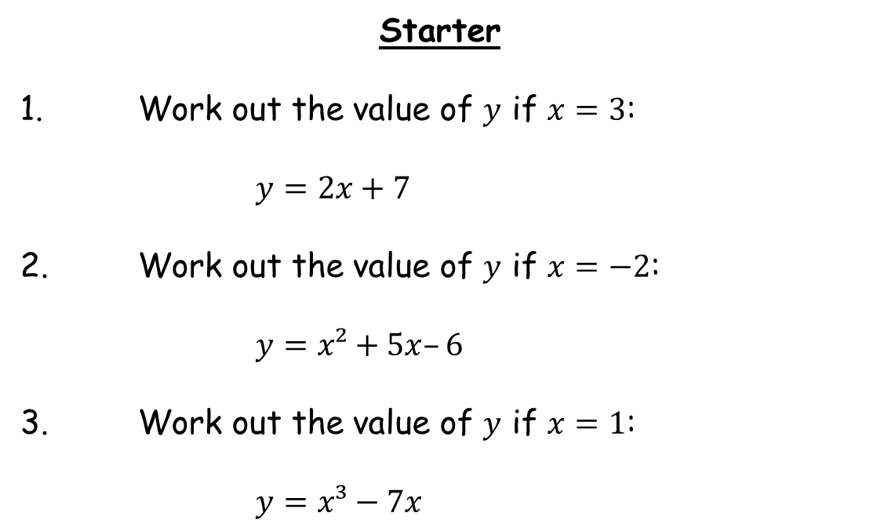
Starter
1. Work out the value of $y$ if $x=3$:
$y=2x+7$
2. Work out the value of $y$ if $x=−2$:
$y=x²+5x–6$
3. Work out the value of $y$ if $x=1$:
$y=x³−7x$
$6+7=13$
$4−10−6=−12$
$1−7=−6$

Slide 2
If we had a function machine that doubled every input, it might look something like this:
2
Double
4
7
14
$$x$$
$$2x$$
We could generalise by calling this “the function of $x$”.
But that’s a lot to write each time, so we’ll write $f(x)$ instead.

Slide 3
You will be familiar with function notation such as:
$y=5x+3$ or $y=x2+4x+6$
So, if $y = x2 + 2$, we can also write
$f(x) = x2 + 2$

Slide 4
The domain of the function is the set of possible inputs.
2
Double
4
Domain
Range
7
14
$$x$$
$$2x$$
The range of the function is the set of possible outputs.
What would this particular function look like if we were to plot it on a graph?
Where would the domain and range be on the graph?

Slide 5
Example
$f\left(x\right)=2x+6$
Domain Range
$$\left\{3, 5, 9\right\}$$
$$\left\{12, 16, 24\right\}$$
$$y$$
$$\left\{x≥0\right\}$$
$$\left\{y≥6\right\}$$
$$\left\{x∈\text{ℝ}\right\}$$
$$\left\{y∈\text{ℝ}\right\}$$
$$6$$
$$x$$

Slide 6
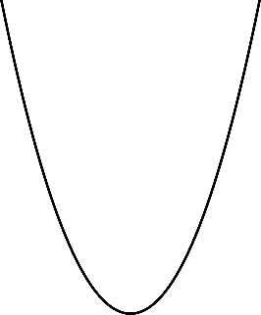
Example
$g\left(x\right)=x^{2}+4$
Domain Range
$$\left\{x∈\text{ℝ}\right\}$$
$$\left\{y≥4\right\}$$
$$y$$
$$4$$
$$x$$

Slide 7
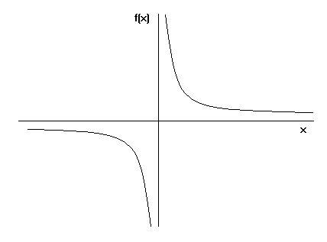
Example
$h\left(x\right)=\frac{1}{x}$
Domain Range
$$\left\{x≠0\right\}$$
$$\left\{y≠0\right\}$$
$$y$$
$$x$$

Slide 8
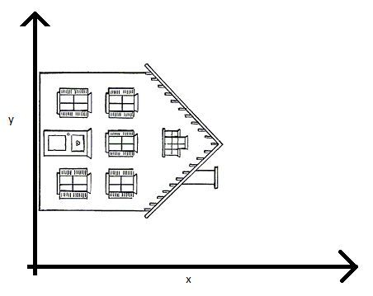
Home on the range!

Slide 9


Sketch the graphs if you think that will help you
Task
Find the range of the following functions.
a) $f\left(x\right)=x+4$ Domain: $\left\{1,2,3,4,5\right\}$
b) $f\left(x\right)=3x$ Domain: $\left\{−2,−1,0,1,2\right\}$
c) $f:x→2x+5$ Domain: $\left\{0,1,2,3,4,5\right\}$
d) $f\left(x\right)=6x+1$ Domain: $\left\{0,1,2,3\right\}$
e) $g\left(x\right)=20−3x$ Domain: $\left\{−1,0,1,2,3\right\}$
f) $f\left(x\right)=x^{2}$ Domain: $\left\{−2,−1,0,1,2\right\}$
g) $g\left(x\right)=\frac{6}{x}$ Domain: $\left\{1,2,3,4,5,6\right\}$
h) $f\left(t\right)=2t^{2}−3t$ Domain: $\left\{0,1,2,3,4\right\}$
i) $g:x→{(2x+1)}^{2}$ Domain: $\left\{−1,0,1,2\right\}$
j) $f\left(x\right)=\frac{30}{x+1}$ Domain: $\left\{0,2,4\right\}$
Range: $\left\{5,6,7,8,9\right\}$
Range: $\left\{−6,−3,0,3,6\right\}$
Range: $\left\{5,7,9,11,13,15\right\}$
Range: $\left\{1,7,13,19\right\}$
Range: $\left\{23,20,17,14,11\right\}$
Range: $\left\{0,1,4\right\}$
Range: $\left\{6,3,2,\frac{3}{2},\frac{6}{5},1\right\}$
Range: $\left\{−1,0,2,9,20\right\}$
Range: $\left\{0,1,9,25\right\}$
Range: $\left\{6,10,30\right\}$

Slide 10
If $f(x) = 3x + 7$, find:
This means that the value of $x$ is $1$. So substitute $x$ with $1$.
(a) $f(1)$
$= 3(1) + 7$
$= 3 + 7$
$$= 10$$
(b) $f(4)$
$= 3(4) + 7$
$= 12 + 7$
$= 19$
(c) $f(−2)$
$= 3(−2) + 7$
$= −6 + 7$
$= 1$

Slide 11
Let $f(x) = 4x2 – 3$, find:
This means that the value of $x$ is $3$. So substitute $x$ with $3$.
(a) $f(3)$
$= 4(3)2 – 3$
$= 4(9) − 3$
$= 36 − 3$
$= 33$
(b) $f(−5)$
$= 4(−5)2 – 3$
$= 4(25) − 3$
$= 100 − 3$
$= 97$

Slide 12


Let $f(x) = 7x – 8$. Find the value of:
$f(2)$
$f(8)$
$f(−8)$
$= 14 – 8 = 6$
$= 56 – 8 = 48$
$= −56 – 8 = −64$
Let $f(x) = 3x² + 2$. Find the value of:
$f(4)$
$f(−1)$
$f(−3)$
$= 3 x 16 + 2 = 50$
$= 3 x 1 + 2 = 5$
$= 3 x 9 + 2 = 29$
Let $g(x) = 3x² − 2x + 1$. Find the value of:
$g(3)$
$g(−2)$
$g(0)$
$= 3 x 9 – 6 + 1 = 22$
$= 3 x 4 + 4 + 1 = 17$
$= 3 x 0 + 0 + 1 = 1$

Slide 13
If $g(x) = 5x − 9$, then:
This means that the expression is equal to $21$. Now solve the equation ☺
(a) Solve $g(x) = 21$
$$5x – 9 = 21$$
$$5x = 30$$
$$x = 6$$
(b) Solve $g(x) = −64$
$$5x – 9 = −64$$
$$5x = −55$$
$$x = −11$$

Slide 14
If $f(x) = x2 – 3x$, then solve $f(x) = 4$.
$$x2 – 3x = 4$$
$$x2 – 3x – 4 = 0$$
$$(x − 4)(x + 1) = 0$$
$x = 4$or $x = −1$

Slide 15
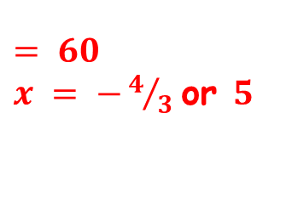
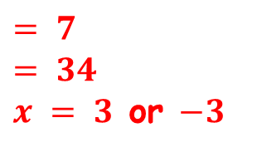

$x = 6$
$x = ¾$
Let $h(x) = 2x – 5$. Solve $h(x) = 7$
Let $g(x) = 4x − 3$. Solve $g(x) = 0$
$h(x) = x2 – 2$
Find $h(3)$
Find $h(−6)$
Solve $h(x) = 7$
$= 7$
$= 34$
$x = 3$ or $−3$
Let $f(x) = 3x2 – 11x$
Find $f(−3)$
Solve $f(x) = 20$
$= 60$
$x = −4/3$or $5$

Slide 16
If $h(x) = 2x + 7$, then write an expression for:
(a) $h(3x)$
$= 2(3x) + 7$
This means that the value of $x$ is $3x$. So substitute $x$ with $3x$.
$= 6x + 7$
(b) $3h(x)$
$= 3(2x + 7)$
This means we are multiplying $h(x)$ by $3$.
$= 6x + 21$
$= 4(2x + 7)$
(c) $4h(x)$
This means we are multiplying $h(x)$ by $4$.
$= 8x + 28$

Slide 17
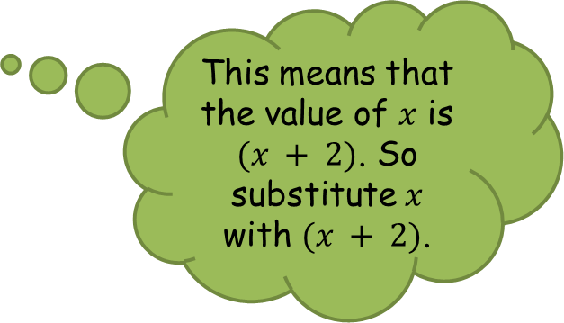
Let $f(x) = x2 + 7$, then write an expression for:
(a) $f(x) +2$
$= (x2 + 7) + 2$
This means we add $2$ to $f(x)$.
$= x2 + 9$
This means that the value of $x$ is $(x + 2)$. So substitute $x$ with $(x + 2)$.
(b) $f(x + 2)$
$= (x +2)2 + 7$
$= (x +2)(x +2) + 7$
$= x2 + 4x + 4 + 7$
$= x2 + 4x + 11$

Slide 18



Let $g(x) = 5x + 6$. Write an expression for:
$g(3x)$
$3g(x)$
$= 15x + 6$
$= 15x + 18$
$h(x) = x² − 6$. Write an expression for each of these:
$2h(x)$
$h(2x)$
$h(x) + 3$
$h(x + 3)$
$= 2x² − 12$
$= 4x² − 6$
$= x² − 3$
$= x² + 6x + 3$
$f(x) = 3x² − 2x$. Write an expression for each of these.
$f(x – 1)$
$f(x) – 1$
$f(−x)$
$−f(x)$
$= 3x² − 8x + 5$
$= 3x² − 2x − 1$
$= 3x² + 2x$
$= −3x² + 2x$

