Slide 1
Starter
Calculate the volumes of the cuboids and the missing lengths.
Reminder: volume of a cuboid = height × width × depth
5 mm
3 cm
4 m
125
30
___ mm³
___ cm³
16
___ m³
2 cm
5 mm
5 cm
5 mm
2 m
2 m
4
___ cm
4 mm
64 cm³
120 mm³
2 mm
2 cm
___ mm
8 cm
15

Slide 2
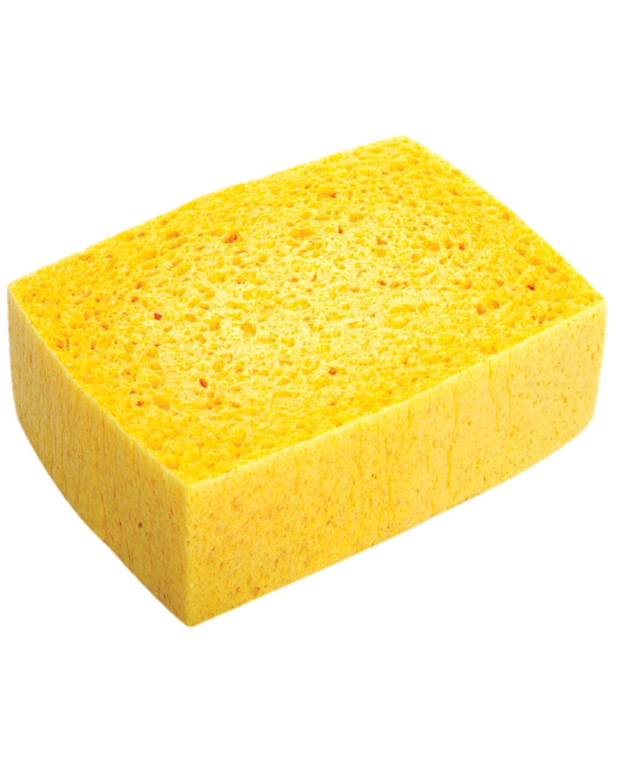
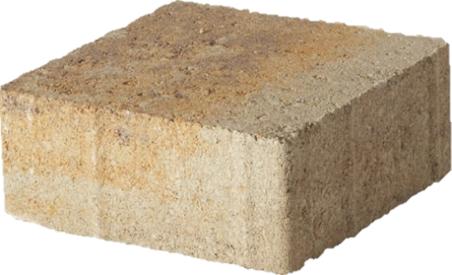
Think – Pair – Share
These two objects are the same volume. In water, the brick would sink and the sponge would float. Why?

Slide 3
Density is the amount of mass in a volume.
It tells us how tightly matter is packed together.
Common units
g/cm³ → how many grams for every cm³
kg/m³ → how many kg for every m³

Slide 4
Things to look out for:
Are the units consistent?
Do you need to calculate the volume before you start?
1 m
100 cm
1 m
100 cm
1 m
100 cm
1 m³ = 1 000 000 cm³

Slide 5
What is compound measure?
Write down as many units of measure as you can.
Which do you think are compound ?
What is compound measure?

Slide 6
Commonly used compound measures include:
Density | $$\frac{\text{mass}}{\text{volume}}$$ | Measured in g/cm³ or kg/L
Speed | $$\frac{\text{distance}}{\text{time}}$$ | Measured in m/s, km/h or mph
Pressure | $$\frac{\text{force}}{\text{surface} \text{area}}$$ | Measured in N/m² or N/cm²
Fuel consumption | $$\frac{\text{distance}}{\text{volume}}$$ | Measured in km/L or mpg

Slide 7
Example
A cuboid has dimensions of 9 cm × 3 cm × 12 cm
It has a mass of 194.4 g
Find the density of the cuboid.
Volume = 9 × 3 × 12
Density = $\frac{\text{mass}}{\text{volume}}$
Density = $\frac{\text{mass}}{\text{volume}}$
= 324
cm³
= $\frac{\text{194.4}}{\text{324}}$
= 0.6
g/cm³

Slide 8
Example
A cuboid has dimensions of
2 m × 50 cm × 160 cm.
It has a density of 0.8 kg/m³.
Find the mass of the cuboid.
Volume = 2 × 0.5 × 1.6
Density = $\frac{\text{mass}}{\text{volume}}$
Mass = density × volume
Density = $\frac{\text{mass}}{\text{volume}}$
= 1.6
m³
= 0.8 × 1.6
= 1.28
kg/m³

Slide 9
Example
A cylinder has a mass of 270 g.
It has a density of 3 g/cm³.
Find the volume of the cylinder.
Density = $\frac{\text{mass}}{\text{volume}}$
Volume = $\frac{\text{mass}}{\text{density}}$
Density = $\frac{\text{mass}}{\text{volume}}$
= $\frac{\text{270}}{\text{3}}$
= 90
cm³

Slide 10
Mass, Density and Volume
Use any of these numbers in your grid
(no repeats)
3000 | 0.75 | 0.8 | 120
156.8 | 2.72 | 10 | 3200
240 | 1.6 | 1.79 | 35
0.6 | 11.4 | 36 800 | 75

Slide 11
Find the density of a piece of wood weighing 6 g and having a volume of 8 cm.
6 ÷ 8 = 0.75 g/cm³

Slide 12
Calculate the volume of a liquid weighing 4 kg and having a density of 1.25 g/cm³.
4000 ÷ 1.25 = 3200 g

Slide 13
A 1 kg bag of sugar has a volume of about 625 cm³. What is the density of the sugar in grams per cubic centimeter?
1000 ÷ 625 = 1.6 g/cm³

Slide 14
Calculate the volume of a piece of wood that weighs 102 g and has a density of 0.85 g/cm³.
102 ÷ 0.85 = 120 cm³

Slide 15
Find the mass of a marble model, 56 cm³ in volume, if the density of marble is 2.8 g/cm³.
56 × 2.8 = 156.8 g

Slide 16
I bought a 50 kg bag of coal and estimated the total volume to be about 28 000 cm³. What is its density in g/cm³ to 2 d.p.?
50 000 ÷ 2 800 = 1.79 g/cm³

Slide 17
Find the density of the material of a pebble weighing 34 g, which has a volume of 12.5 cm³.
34 ÷ 12.5 = 2.72 g/cm³

Slide 18
Oil has a density of 800 kg/m³.
Convert this into g/cm³
800 ÷ 1 000 000 × 1000
= 0.8 g/cm³

Slide 19
A block of lead has a volume of 540 cm³ and a mass of 6.156 kg.
Find its density in g/cm³
6156 ÷ 540 = 11.4 g/cm³

Slide 20
A statue is made of metal of density 8 g/cm³. Find the mass of the statue if its volume is 30 cm³.
8 × 30 = 240 cm³

Slide 21
It is estimated that the statue of Queen Victoria in Endcliffe Park, Sheffield has a volume of about 4 m³. The density of the material used to make the statue is 9.2 g/cm³. What is its mass?
4 × 9200 = 36 800 g

Slide 22
The volume of a solid object is 5 cm³ and its mass is 50 g. Calculate the density of the material.
50 ÷ 5 = 10 g/cm³

Slide 23
Water of density 1000 kg/m³ fills a pool. The mass of the water is 35 tonnes.
(1 tonne = 1000 kg)
Calculate the volume of the pool.
35 000 ÷ 1000 = 35 m³

Slide 24
A cuboid of dimensions 4 cm by 5 cm by 3 cm is made of metal with density 10 g/cm³. Calculate the mass of the cuboid in kg.
4 × 5 × 3 = 60 cm³
60 × 10 = 600 g = 0.6 kg

Slide 25
A certain type of plastic has a density of 3 g/cm³.
Convert the density into kg/m³
3 × 1 000 000 ÷ 1000
= 3000 kg/m³

Slide 26
A cast-iron rod 2 m long has a cross-sectional area of 14 cm². The mass of the rod is 210 kg. Calculate the density of the rod in g/cm³
14 × 200 = 2800 cm³
210 000 ÷ 2800 = 75 g/cm³

Slide 28
Answers
1a) 9 g/cm³ b) 2.1 g/cm³
2a) 20 g b) 570 kg
3a) 4 cm³ b) 6 m³
4a) 70 cm³ b) 805 g
5a) 720 cm³ b) 0.55 g/cm³
6a) 2500 cm³ b) 2.5 L
7a) 1500 cm³ b) 4050 g or 4.05 kg
8a) 8482.3 mm³ or 8.5 cm³ b) 161.2 g

