Slide 1
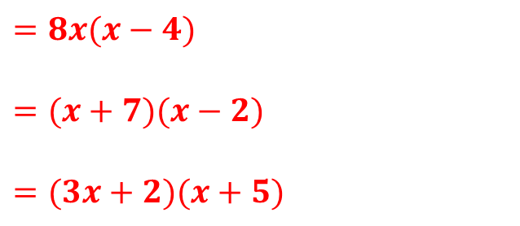
Starter
Factorise the following:
$8x²−32x$
$x²+5x−14$
$3x²+17x+10$
$=8x(x−4)$
$=(x+7)(x−2)$
$=(3x+2)(x+5)$

Slide 2
Think – Pair – Share
Simplify the following fractions:
$\frac{4}{8}$ $\frac{18}{24}$ $\frac{3xy}{6x^{2}}$
Why have you done what you have done?
Use the key words below to write down how you think you might simplify algebraic fractions.

Slide 3
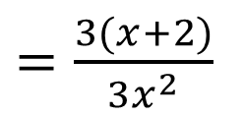



To simplify algebraic fractions:
factorise the numerator and/or denominator
cancel common factors
Examples
Simplify $\frac{3x+6}{3x^{2}}$
Simplify $\frac{4ab+8a}{12a}$
Why can’t we cancel this further?
$=\frac{3(x+2)}{3x^{2}}$
$=\frac{x+2}{x^{2}}$
$=\frac{4a(b+2)}{12a}$
$=\frac{b+2}{3}$
$$3$$

Slide 4
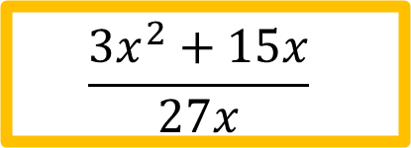
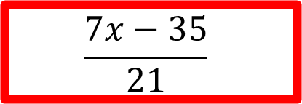
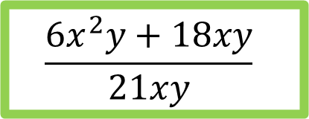
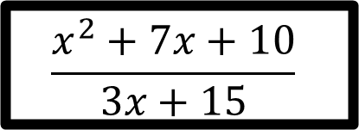
Checkpoint
$$\frac{7x−35}{21}$$
$$\frac{3x^{2}+15x}{27x}$$
$$\frac{x−5}{3}$$
$$\frac{x+5}{9}$$
$$\frac{6x^{2}y+18xy}{21xy}$$
$$\frac{x^{2}+7x+10}{3x+15}$$
$$\frac{2(x+3)}{7}$$
$$\frac{x+2}{3}$$

Slide 5




To simplify algebraic fractions:
factorise the numerator and/or denominator
cancel common factors
Examples
Simplify $\frac{4x−20}{x^{2}−13x+40}$
Simplify $\frac{x^{2}−16}{x^{2}−x−20}$
$=\frac{4(x−5)}{(x−8)(x−5)}$
$=\frac{4}{x−8}$
$=\frac{(x+4)(x−4)}{(x−5)(x+4)}$
$=\frac{x−4}{x−5}$

Slide 6
Task
$\frac{5x−25}{10x^{2}}$ $\frac{12x+30}{9x^{2}}$ $\frac{20x^{2}−40x}{15x^{2}}$
$\frac{8ab−16b}{24ab}$ $\frac{9cd^{2}−24d^{2}}{15d}$ $\frac{14efg^{2}+7ef^{2}}{21efg}$
$\frac{x^{2}+9x+20}{7x+28}$ $\frac{x^{2}−3x−88}{x^{2}−21x+110}$ $\frac{x^{2}−49}{x^{2}−5x−14}$
$\frac{2x^{2}+7x+3}{x^{2}−9}$ $\frac{5x^{2}−3x−14}{x^{2}−11x+18}$ $\frac{6x^{2}−13x−5}{10x^{2}−19x−15}$

Slide 7
Answers
$\frac{x−5}{2x^{2}}$ $\frac{4x+10}{3x^{2}}$ $\frac{4x−8}{3x}$
$\frac{a−2}{3a}$ $\frac{3cd−8d}{5}$ $\frac{2g^{2}+f}{3g}$
$\frac{x+5}{7}$ $\frac{x+8}{x−10}$ $\frac{x+7}{x+2}$
$\frac{2x+1}{x−3}$ $\frac{5x+7}{x−9}$ $\frac{3x+1}{5x+3}$

Slide 8



Multiplying Algebraic Fractions
To multiply algebraic fractions:
factorise the numerator and/or denominator
cancel common factors
multiply the numerators, multiply the denominators
Examples
$\frac{4a}{5}×\frac{15b}{16}$
$\frac{n+4}{n−3}×\frac{3n−9}{5n+20}$
$$3$$
$=a×\frac{3b}{4}$
$=\frac{3ab}{4}$
$$4$$
$=\frac{n+4}{n−3}×\frac{3(n−3)}{5(n+4)}$
$=\frac{3}{5}$

Slide 9
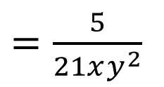



Dividing Algebraic Fractions
To divide algebraic fractions:
factorise the numerator and/or denominator
flip the second fraction and change $÷$ to $×$
cancel common factors
multiply the numerators, multiply the denominators
Examples
$\frac{11}{9x^{2}y}÷\frac{77y}{15x}$
$\frac{x^{2}−4}{x^{2}+4x−32}÷\frac{x^{2}−5x+6}{5x+40}$
$=\frac{11}{9x^{2}y}×\frac{15x}{77y}$
$=\frac{1}{3xy}×\frac{5}{7y}$
$=\frac{5}{21xy^{2}}$
$$5$$
$$3$$
$$7$$
$=\frac{(x+2)(x−2)}{(x+8)(x−4)}×\frac{5(x+8)}{(x−2)(x−3)}$
$=\frac{5(x+2)}{(x−4)(x−3)}$

Slide 11
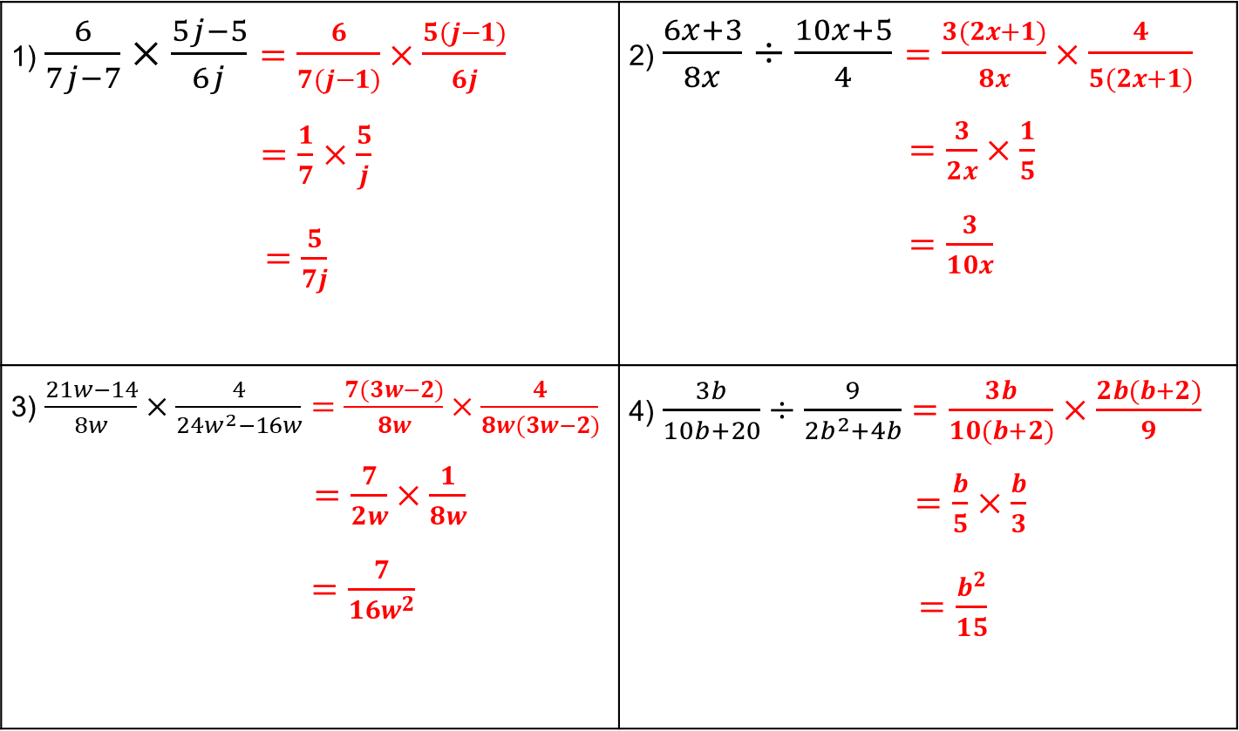
Answers
1) $\frac{6}{7j−7}×\frac{5j−5}{6j}=\frac{6}{7(j−1)}×\frac{5(j−1)}{6j}$ $=\frac{1}{7}×\frac{5}{j}$ $=\frac{5}{7j}$ | 2) $\frac{6x+3}{8x}÷\frac{10x+5}{4}=\frac{3(2x+1)}{8x}×\frac{4}{5(2x+1)}$ $=\frac{3}{2x}×\frac{1}{5}$ $=\frac{3}{10x}$
3) $\frac{21w−14}{8w}×\frac{4}{24w^{2}−16w}=\frac{7(3w−2)}{8w}×\frac{4}{8w(3w−2)}$ $=\frac{7}{2w}×\frac{1}{8w}$ $=\frac{7}{16w^{2}}$ | 4) $\frac{3b}{10b+20}÷\frac{9}{2b^{2}+4b}=\frac{3b}{10(b+2)}×\frac{2b(b+2)}{9}$ $=\frac{b}{5}×\frac{b}{3}$ $=\frac{b^{2}}{15}$

Slide 12
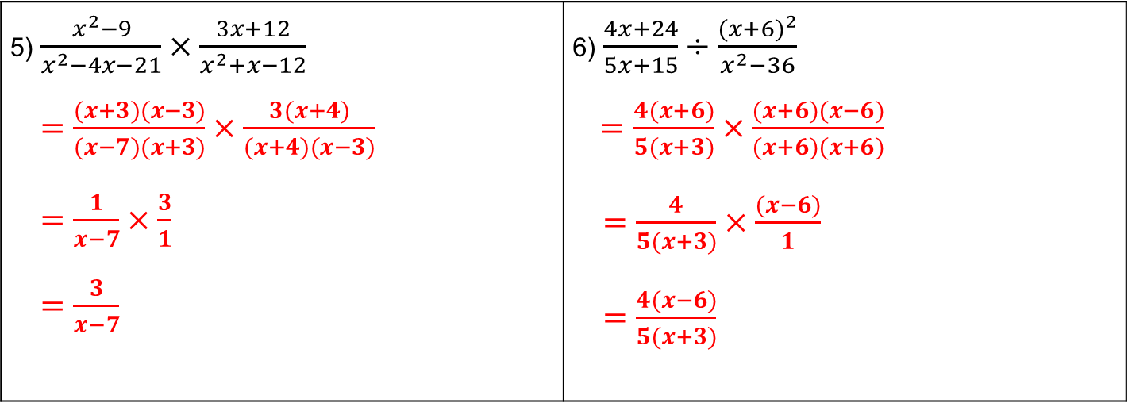
Answers
5) $\frac{x^{2}−9}{x^{2}−4x−21}×\frac{3x+12}{x^{2}+x−12}$ $=\frac{(x+3)(x−3)}{(x−7)(x+3)}×\frac{3(x+4)}{(x+4)(x−3)}$ $=\frac{1}{x−7}×\frac{3}{1}$ $=\frac{3}{x−7}$ | 6) $\frac{4x+24}{5x+15}÷\frac{{(x+6)}^{2}}{x^{2}−36}$ $=\frac{4(x+6)}{5(x+3)}×\frac{(x+6)(x−6)}{(x+6)(x+6)}$ $=\frac{4}{5(x+3)}×\frac{(x−6)}{1}$ $=\frac{4(x−6)}{5(x+3)}$

Slide 13
Answers
7) $\frac{a^{2}−a−6}{a^{2}+6a+5}×\frac{a^{2}+3a−10}{a^{2}+a−12}$ $=\frac{(a−3)(a+2)}{(a+5)(a+1)}×\frac{(a+5)(a−2)}{(a+4)(a−3)}$ $=\frac{a+2}{a+1}×\frac{a−2}{a+4}$ $=\frac{(a+2)(a−2)}{(a+1)(a+4)}$ | 8) $\frac{c^{2}+12c+32}{c^{2}−5c+4}÷\frac{c^{2}−3c−28}{c^{2}+c−2}$ $=\frac{(c+8)(c+4)}{(c−1)(c−4)}×\frac{(c+2)(c−1)}{(c−7)(c+4)}$ $=\frac{c+8}{c−4}×\frac{c+2}{c−7}$ $=\frac{(c+8)(c+2)}{(c−4)(c−7)}$

Slide 14


Adding and Subtracting Algebraic Fractions
To add or subtract algebraic fractions:
Find a common denominator
Find equivalent fractions with that denominator
Add or subtract the numerators and put the answer over the same denominator
Simplify if possible
Examples
$\frac{x+1}{4}+\frac{x−3}{7}$
$\frac{9}{x−2}−\frac{8}{x+4}$
$=\frac{7\left(x+1\right)}{28}+\frac{4(x−3)}{28}$
$=\frac{11x−5}{28}$
$=\frac{9\left(x+4\right)}{(x−2)(x+4)}−\frac{8\left(x−2\right)}{(x−2)(x+4)}$
$=\frac{x+52}{(x−2)(x+4)}$

Slide 16
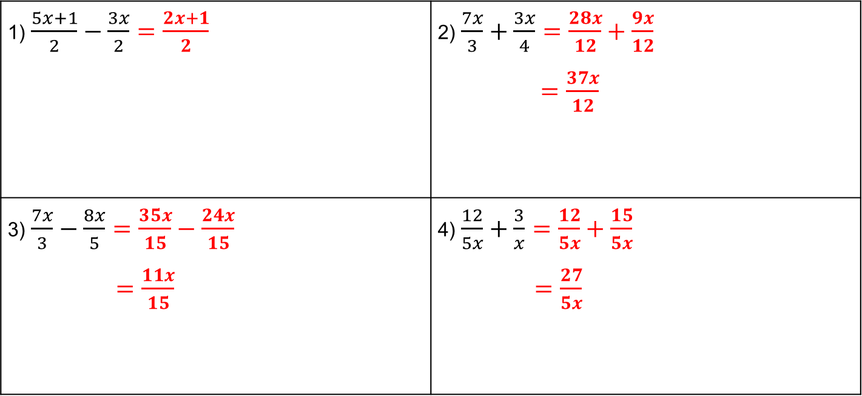
Answers
1) $\frac{5x+1}{2}−\frac{3x}{2}=\frac{2x+1}{2}$ | 2) $\frac{7x}{3}+\frac{3x}{4}=\frac{28x}{12}+\frac{9x}{12}$ $=\frac{37x}{12}$
3) $\frac{7x}{3}−\frac{8x}{5}=\frac{35x}{15}−\frac{24x}{15}$ $=\frac{11x}{15}$ | 4) $\frac{12}{5x}+\frac{3}{x}=\frac{12}{5x}+\frac{15}{5x}$ $=\frac{27}{5x}$

Slide 17
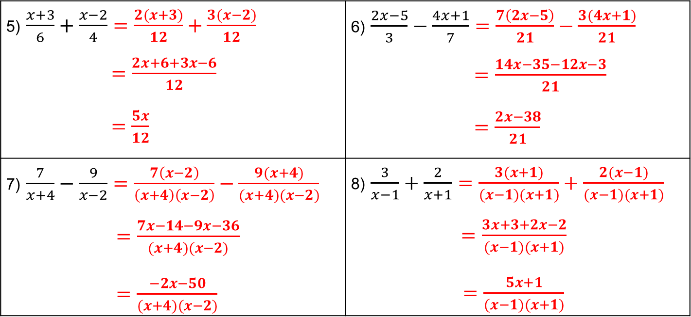
Answers
5) $\frac{x+3}{6}+\frac{x−2}{4}=\frac{2(x+3)}{12}+\frac{3(x−2)}{12}$ $=\frac{2x+6+3x−6}{12}$ $=\frac{5x}{12}$ | 6) $\frac{2x−5}{3}−\frac{4x+1}{7}=\frac{7\left(2x−5\right)}{21}−\frac{3(4x+1)}{21}$ $=\frac{14x−35−12x−3}{21}$ $=\frac{2x−38}{21}$
7) $\frac{7}{x+4}−\frac{9}{x−2}=\frac{7\left(x−2\right)}{\left(x+4\right)\left(x−2\right)}−\frac{9(x+4)}{(x+4)(x−2)}$ $=\frac{7x−14−9x−36}{(x+4)(x−2)}$ $=\frac{−2x−50}{(x+4)(x−2)}$ | 8) $\frac{3}{x−1}+\frac{2}{x+1}=\frac{3(x+1)}{(x−1)(x+1)}+\frac{2(x−1)}{(x−1)(x+1)}$ $=\frac{3x+3+2x−2}{(x−1)(x+1)}$ $=\frac{5x+1}{(x−1)(x+1)}$

