Slide 1
Starter
Use Pythagoras’ Theorem to calculate the missing lengths:
Give your answers correct to 2 decimal places where appropriate.
$b$ cm
14 m
8 m
13 cm
$a$ cm
6 cm
$c$ cm
8 cm
10 cm

Slide 2
Answers
11.49 cm
14 m
8 m
13 cm
10 cm
6 cm
12 cm
8 cm
10 cm

Slide 3
Example
Calculate the distance between (5, 7) and (9, 10)
If its tricky, draw a piccy!
10
(9, 10)
9
3
3
(5, 7)
5
7
4
4
3² + 4² = 9 + 16 = 25
$\sqrt{\text{25}}$ = 5 units

Slide 4
Example
Calculate the distance between (-2, 6) and (8, -1)
If its tricky, draw a piccy!
6
(-2, 6)
-2
7
7
10
-1
(8, -1)
8
10
7² + 10² = 49 + 100 = 149
$\sqrt{\text{149}}$ = 12.21 units

Slide 5
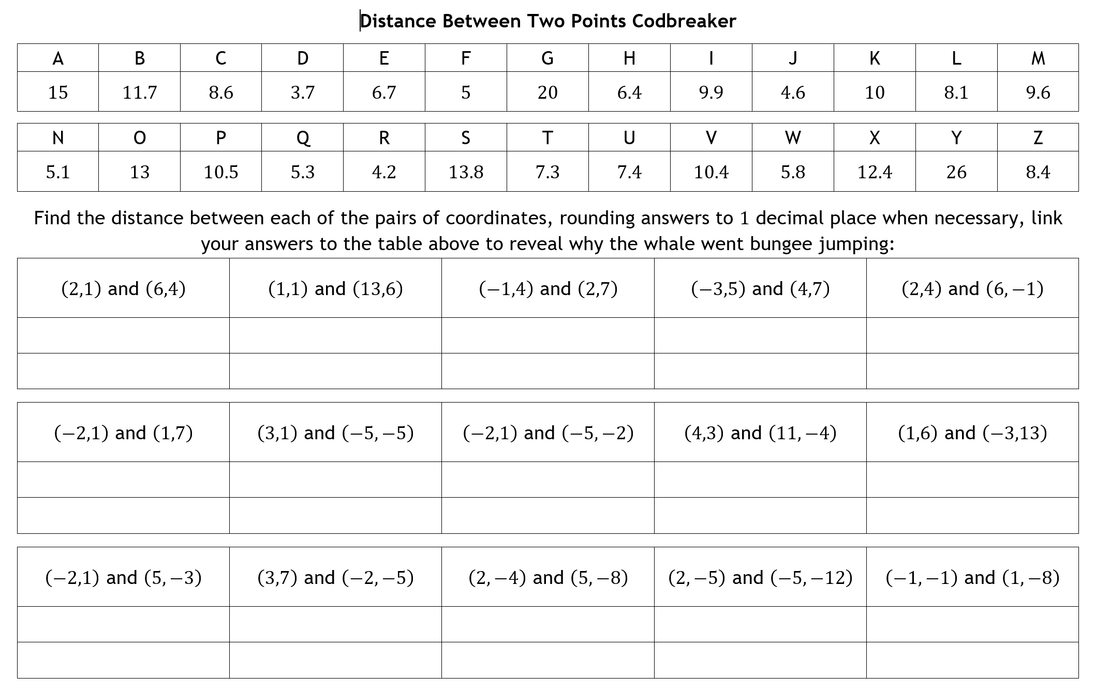
Pair Task
Work through the code breaker with your partner.
Don’t forget to sketch each triangle!
Notes:
Source: Alutwyche on TES

Slide 6
Pair Task
Work through the code breaker with your partner.
Don’t forget to sketch each triangle!
Solution: For the krill of it!
Notes:
Source: Alutwyche on TES

Slide 7
Find the distance between the following pairs of coordinates:
a) (2, 5) and (10, 8) b) (6, 4) and (0, 9)
c) (5, 9) and (12, 2) d) (3, 6) and (-2, -2)
e) (12, -5) and (0, 5)
1. The vertices of a quadrilateral DEFG are D(3, -2), E(0, -3), F(-2, 3) and G(4, 1).
a) Find the length of each side of the quadrilateral.
b) What type of quadrilateral is DEFG?
2. Show that the triangle formed by the points (-3, -2), (2, -7) and (-2, 5) is isosceles.
1. Calculate the area of the right angled triangle formed by the points A (1, 3),
B (2, 5) and C (5, 1).
2. A triangle has one vertex at (3, 3), a second at (5, 7) and the third is 6 units
vertically above the midpoint of the first two coordinates. Find the perimeter of the triangle.
Notes:
Source: JennaSanderson on TES

Slide 8
a) 8.54 units b) 7.81 units
c) 9.90 units d) 9.43 units
e) 15.62 units
1. a) DE = 3.16 units, EF = 6.32 units, FG = 6.32 units, DG = 3.16 units
b) Kite (two pairs of adjacent equal sides)
2. Side lengths of 7.07 units, 12.65 units and 7.07 units
Two equal sides therefore isosceles
1. 5 units²
2. 16.66 units
Notes:
Source: JennaSanderson on TES

Slide 9
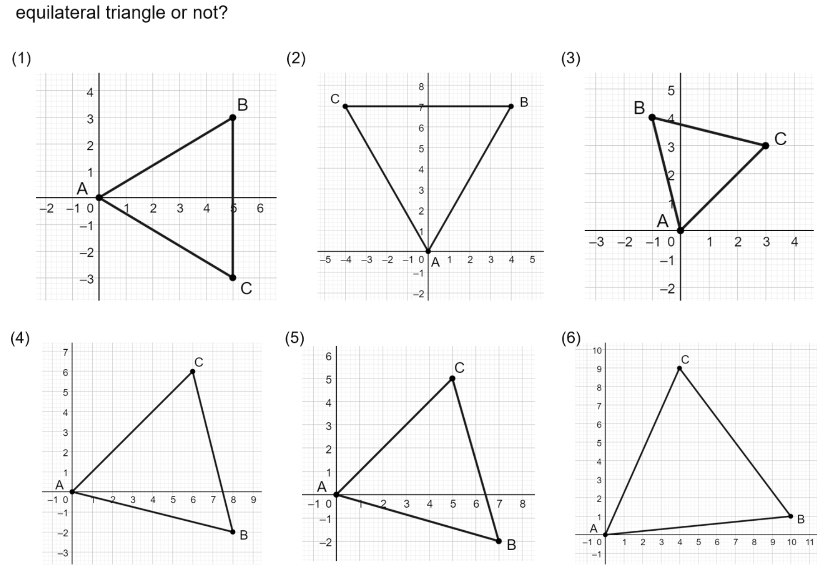
Notes:
Source: Don Steward’s Median website

Slide 10
No - isosceles
No - isosceles
No - isosceles
$$8$$
$$4.12$$
$$5.83$$
$$6$$
$$4.12$$
$$4.24$$
$$8.06$$
$$8.06$$
$$5.83$$
No - isosceles
No - isosceles
No - scalene
$$8.49$$
$$7.07$$
$$10$$
$$7.28$$
$$8.25$$
$$9.85$$
$$10.5$$
$$8.25$$
$$7.28$$
Notes:
Source: Don Steward’s Median website

Slide 11
Plenary
Complete the exit ticket, making sure you justify each emoji.
Notes:
Source: Don Steward’s Median website

